Slide 1
Lab: Clinical inference with language model: Activity
BEACON | Riaz Lab
Samarth Rawal
Umair Ayub
Syed Arsalan Ahmed Naqvi
Irbaz Bin Riaz

Slide 2
Agenda outline
Time | Speaker(s) | Session Title | Details / Links
3:00 – 3:15 PM Central | Arsalan | Introduction to Lab: Clinical Inference with LLMs | Overview of LLMs basics
3:15 – 3:40 PM Central | Sam | Prompt Engineering Primer | 10 min walkthrough of prompt engineering concepts 10–15 min interactive session with example prompts 🔗 Slides🔗 Interface
3:40 – 4:30 PM Central | Umair / Arsalan / Sam | Colab Lab: Clinical Inferences with LLMs | Hands-on lab using a pathology report case - Q&A and discussion 🔗 Colab Notebook🔗 Dataset

Slide 3
How LLMs are pre-trained
Imagine pretraining an LLM is like teaching a kid to understand and predict language.
Step 1: Reading lots of books/texts
Storybooks, Newspaper, Wikipedia
Step 2: Learning to guess the word
Step 4: Growing smarter
Using the books/texts the kid learns to predict the word(s)
The kid learns patterns based on millions of sentences/phrases
The cat sat on the ___
For example, they learn:
“The” is often followed by a noun.
“Cats” are more likely to sit on mats than bananas.
The cat sat on the mat
Step 3: Learning from mistakes
Based on the original books/texts, the kid corrects its mistakes
The cat sat on the bananas
The cat sat on the mat

Slide 4
Inference
Inference with large language models refers to the process of using these pre-trained models to generate predictions or outputs based on new input data.
Input
Output
LLM
Prompt
Input
Tokenization
Contextual processing
Output generation
Detokenization
Notes:
Model Input: You provide a prompt or input text to the LLM.
Tokenization: The input text is broken down into tokens (words, subwords, or characters).
Contextual Processing: The model processes these tokens through its layers, using the learned parameters from its training phase. It uses contextual information to understand the input.
Output Generation: Based on the input and its internal representations, the model generates an output, which could be a continuation of the text, an answer to a question, or any other relevant response.
Detokenization: The output tokens are converted back into human-readable text.

Slide 5
Prompt
A query with or without an input text provided to a language model to elicit a response or generate a specific output.
Characteristics of an effective prompt
Clear & specific
Sufficient context
Structured format
Iteratively refined
Decomposed
Notes:
Be Clear and Specific: Ambiguous prompts can lead to unclear or irrelevant responses.
Provide Sufficient Context: Include enough background information to help the model understand the context.
Use Proper Formatting: Depending on the desired output, structure the prompt in a way that guides the model (e.g., asking a direct question for a factual response).
Iterate and Refine: If the initial response is not satisfactory, refine the prompt and try again

Slide 6
Prompt development
Input
Query
What is the cancer status in this radiology report?
Prompt
What is the cancer status in this radiology report?
Increase in the overall metastasis in the form of increase in size and number of hepatic metastasis, increase in size of retroperitoneal lymphadenopathy, and sclerotic osseous metastasis. The large hepatic metastasis in the right hepatic lobe is seen. New small right lower lobe consolidation is likely aspiration pneumonia.
Impression from a radiology report
Increase in the overall metastasis in the form of increase in size and number of hepatic metastasis, increase in size of retroperitoneal lymphadenopathy, and sclerotic osseous metastasis. The large hepatic metastasis in the right hepatic lobe is seen. New small right lower lobe consolidation is likely aspiration pneumonia.

Slide 7
Prompt engineering
Prompt engineering is the process of designing and refining input queries (prompts) to elicit desired outputs from a language model
Iterative refinement
Input
Output
LLM

Slide 8
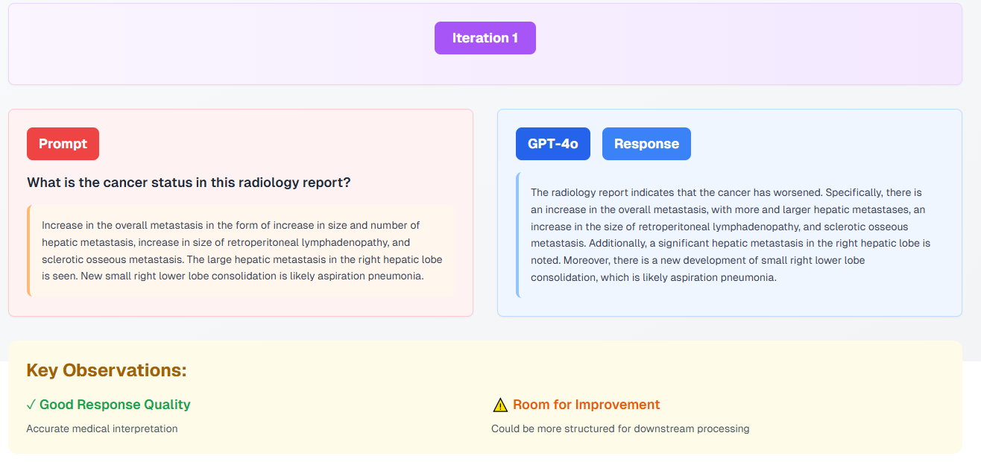

Slide 9
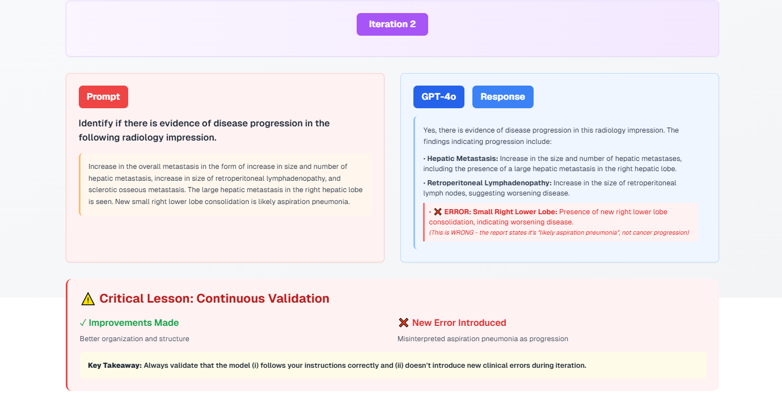

Slide 10
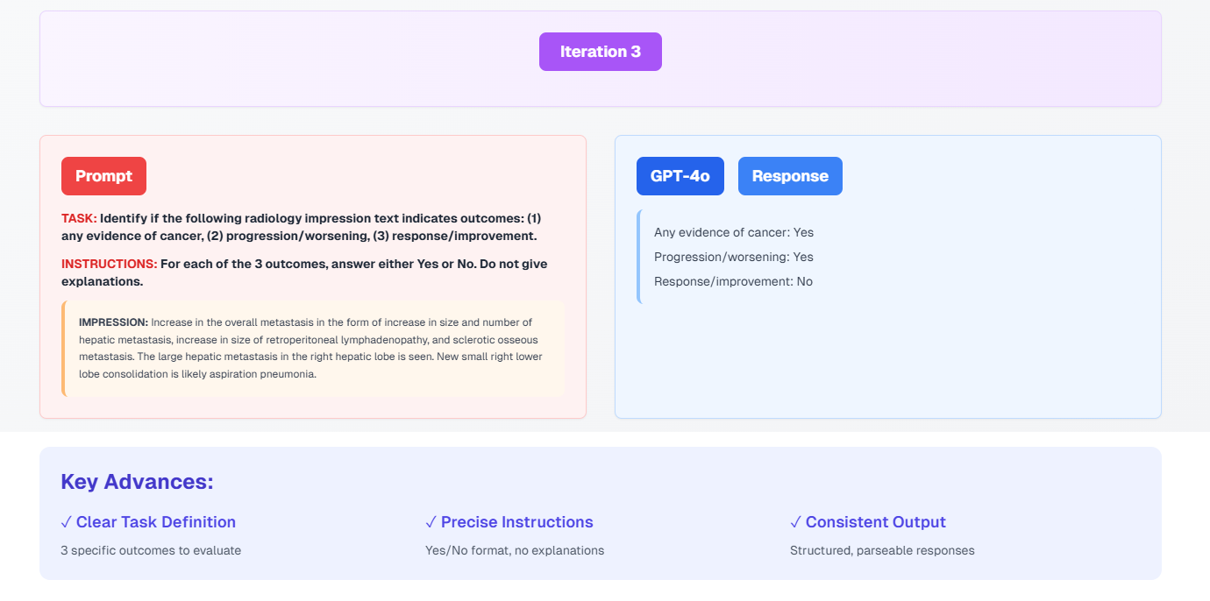

Slide 11
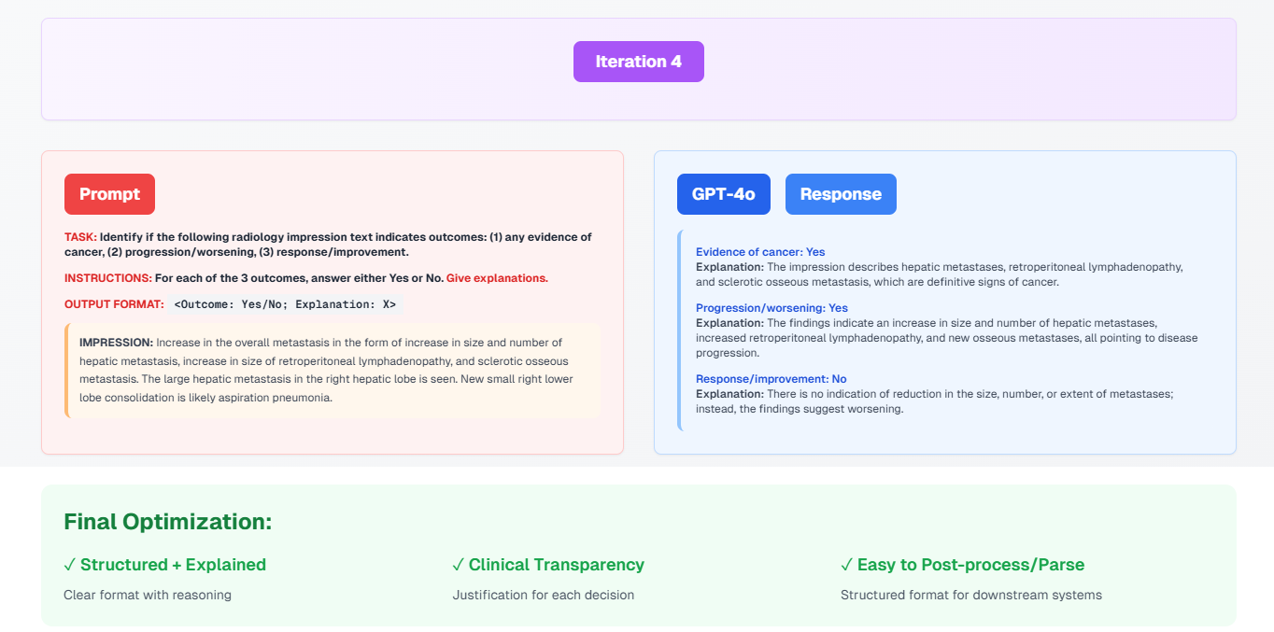

Slide 12
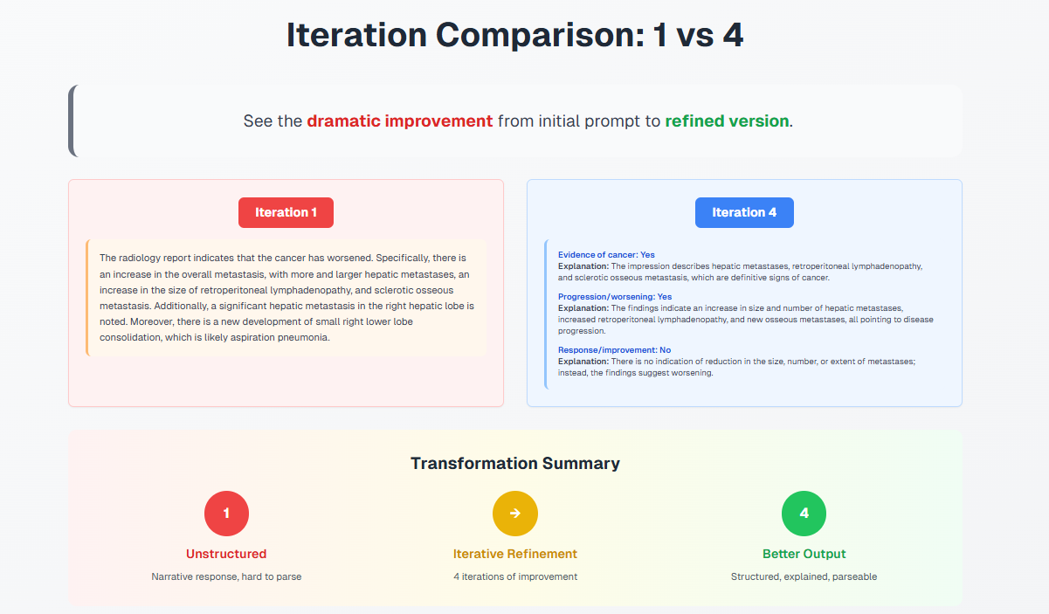

Slide 13
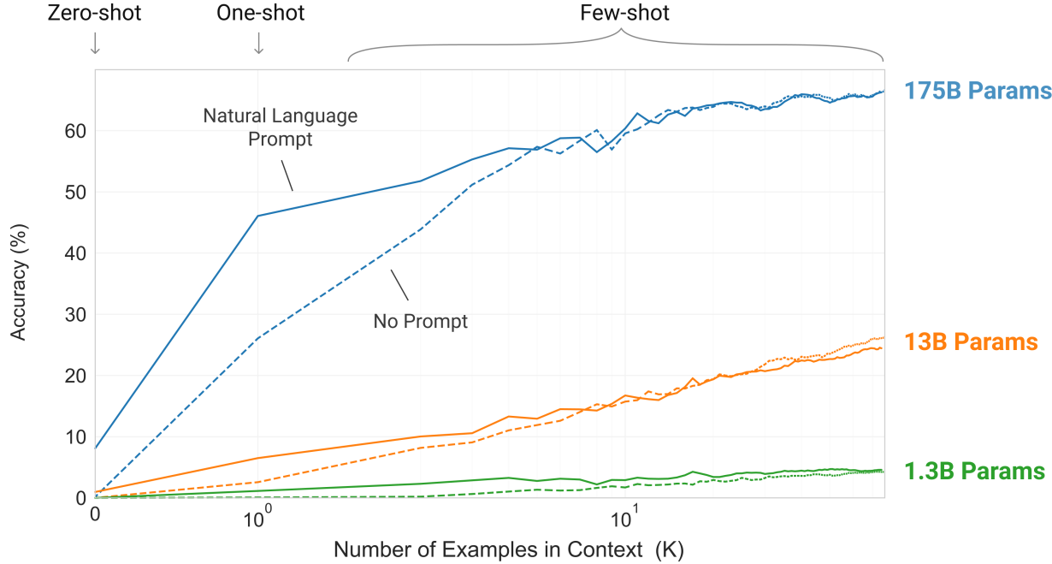
LLMs are few-shot learners
Zero-shot
The model predicts the answer given only a natural language description of the task. No gradient updates are performed.
Translate English to French:
cheese =>
One-shot
In addition to the task description, the model sees a single example of the task. No gradient updates are performed.
Translate English to French:
sea otter => loutre de mer
cheese =>
Few-shot
In addition to the task description, the model sees a few examples of the task. No gradient updates are performed.
Translate English to French:
sea otter => loutre de mer; peppermint => menthe poivrée; plush giraffe => girafe peluche
cheese =>
Modified from MIT 6.S191 (Google): Large Language Models by Peter Grabowski

Slide 14
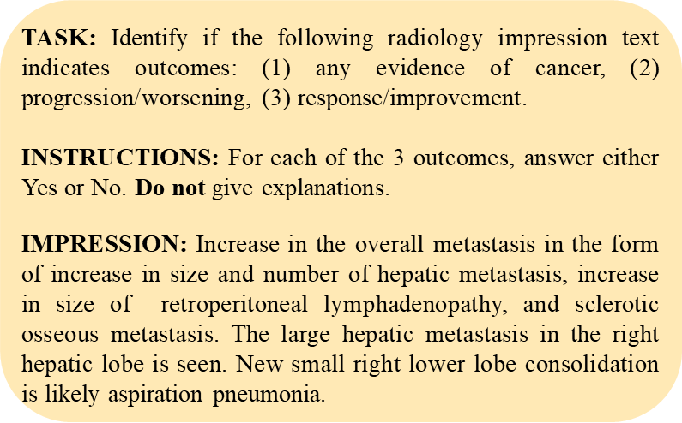
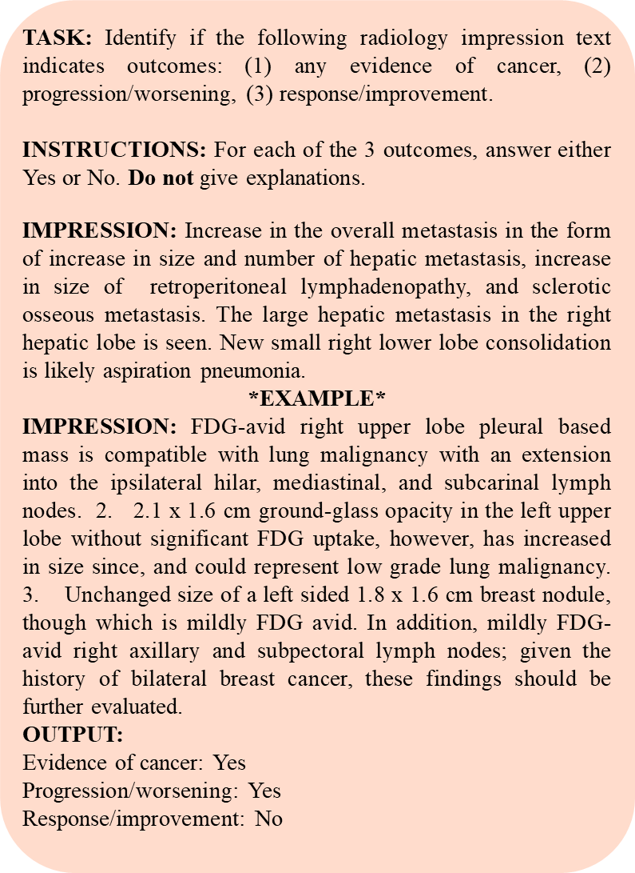
Zero-shot prompt
Few-shot prompt
Chain of thought
Self consistency
Not providing any specific examples in the prompt.
Providing specific examples in the prompt.
Input
Input
Step 1
Step n
Output
Output 1
Output 2
Output 3

Slide 15
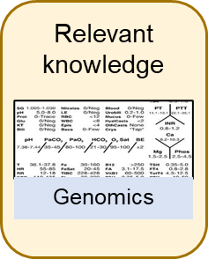
Retrieval augmented generation
Prompt
Hallucinated Response (without RAG)
Did my patient receive germline testing for prostate cancer?
Yes, your patient has ATM mutation and requires chemotherapy
LLM
Correct Response (with RAG)
Yes, your patient underwent germline testing. The results were positive for BRCA2 mutation.
Augmented prompt

