Slide 1
Variant interpretation – examples

Slide 2
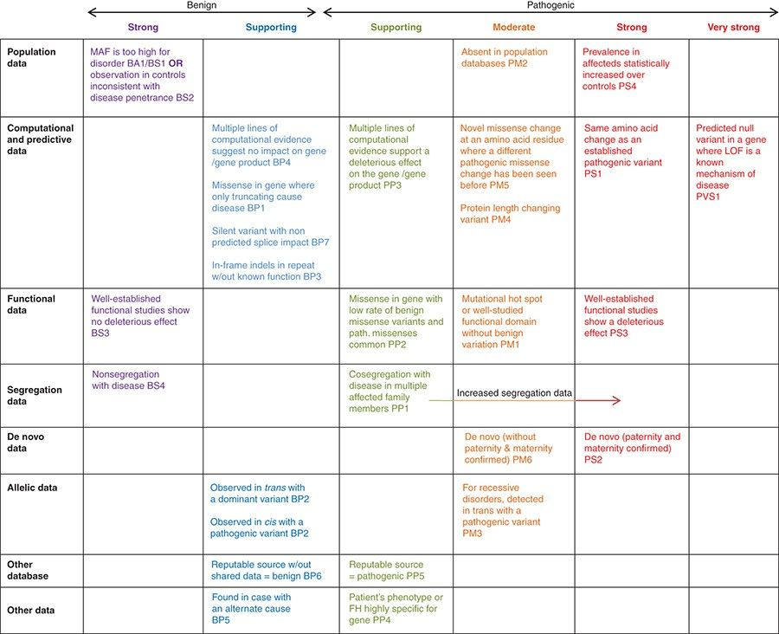
PMID: 25741868

Slide 3
Concept | Questions | ACMG Criteria’s | Resources
Minor Allele Frequency (MAF) | Is it common or rare? | PM2, BS1, BA1 | gnomAD
Mechanism of Disease | Haploinsufficient gene? Dosage sensitivity? | PVS1 | ClinGen Dosage Map, OMIM
Impact Predictions | Which type of variant? In-silico evidence? Constraint metrics? Gene/regional? Splicing impact? | PM4, PM5, PS1 PP3 PP2 BP7 | Protein nomenclature Gene/Exon Location Uniprot, Varsome gnomaAD Splicing predictors
Functional Knowledge | Previously characterized? Protein residue or region function? | PS3, BS3 PM1 | HGMD, pubmed, google Mastermind, clinvar
Clinical Knowledge (published, or case-specific) | 10. Previously reported cases? 11. Segregation? 12. Is phenotype specific? | PS4, BS2, PM3, BP2 PP1, PS2/PM6 PP4 | ClinVar, HGMD, pubmed Literature or proband OMIM, Literature or proband
PMID: 25741868

Slide 4
Variant #1
Concept
Patient Phenotype:
Pancytopenia
Variant Identified:
DDX41 c.773C>T p.(Pro258Leu)
Transcript: NM_016222.2
Inheritance:
De novo
Classification #1 | Classification #2
?
Notes:
3-11067958-A-G
PM2

Slide 5
Variant #1
Concept | PM2_suporting
Minor Allele Frequency (MAF) | Gnomad: 1 Alleles of 250208 0 homozygotes Clinvar: Likely pathogenic - Genetic Services Laboratory, University of Chicago (2022) PM2_supp
Patient Phenotype:
Pancytopenia
Variant Identified:
DDX41 c.773C>T p.(Pro258Leu)
Transcript: NM_016222.2
Inheritance:
De novo
Classification #1 | Classification #2
?
Notes:
3-11067958-A-G
PM2

Slide 6
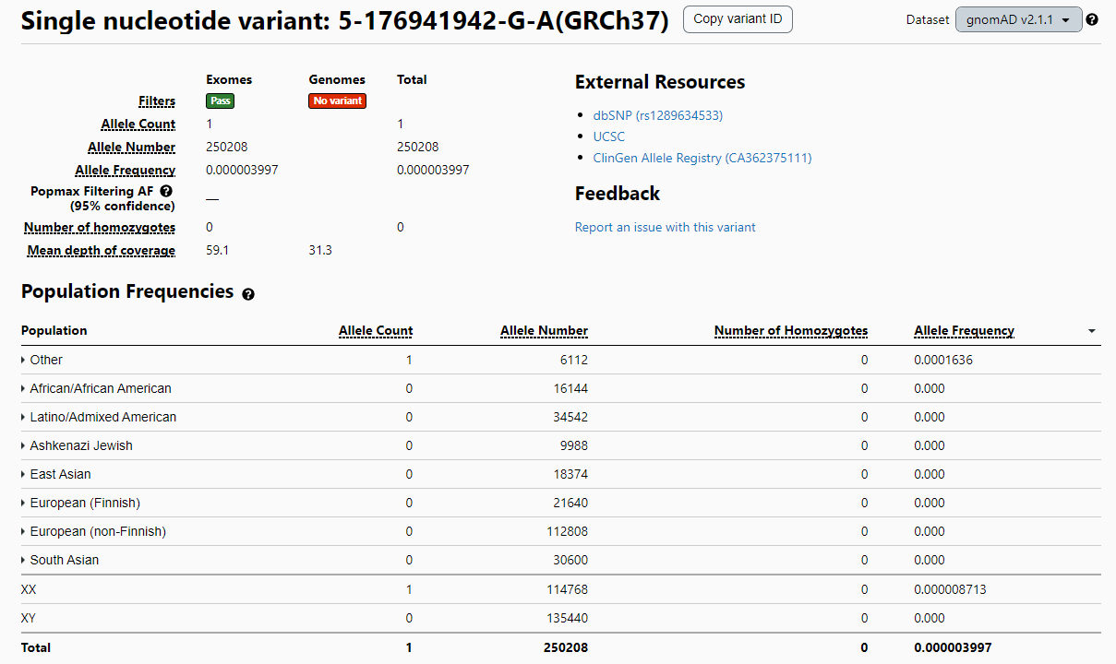
https://gnomad.broadinstitute.org/

Slide 7
Variant #1
Concept | PM2_suporting
Minor Allele Frequency (MAF) | Gnomad: 1 Alleles of 250208 0 homozygotes Clinvar: Likely pathogenic - Genetic Services Laboratory, University of Chicago (2022) PM2_supp
Mechanism of Disease | Clingen: Sufficient Evidence for Haploinsufficiency “The most commonly seen DDX41 variants are frameshifts, resulting in premature termination of the protein, suggesting loss of function or haploinsufficiency is the mechanism of tumorigenesis for this disorder (PMID:28637623, 26712909)”.
Patient Phenotype:
Pancytopenia
Variant Identified:
DDX41 c.773C>T p.(Pro258Leu)
Transcript: NM_016222.2
Inheritance:
De novo
Classification #1 | Classification #2
?
Notes:
3-11067958-A-G
PM2

Slide 8
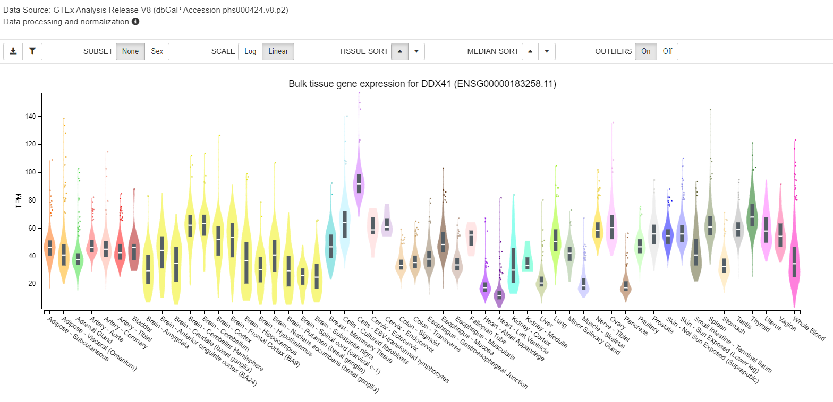
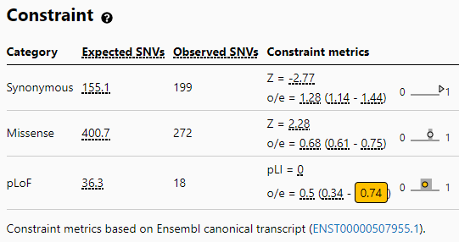
Variant of Uncertain Significance
GENE DDX41 HET c.773C>T p.(Pro258Leu) Transcript: NM_016222.2 De novo Disease: {Myeloproliferative/lymphoproliferative neoplasms, familial (multiple types), susceptibility to} (OMIM 616871) AD gnomAD: 1 Alleles of 250208 0 homozygotes/ HGMD: Yes ClinVAR:Likely pathogenic - Genetic Services Laboratory, University of Chicago (2022) In silico: Revel Deleterious (low) (0.64)/ Splice-Al: 0 /CADD 26.2 Location: Chr 5, Exon 8/17
https://gnomad.broadinstitute.org/
https://gtexportal.org/home/
Notes:
Mutation in human MIB1 cause LVNC (a) schematic of MIB1 domain structure. A valine to phenylalanine missense mutation,.

Slide 9
Variant #1
Concept | PM2_supporting+ PP3
Minor Allele Frequency (MAF) | Gnomad: 1 Alleles of 250208 0 homozygotes Clinvar: Likely pathogenic - Genetic Services Laboratory, University of Chicago (2022) PM2_supp
Mechanism of Disease | Clingen: Sufficient Evidence for Haploinsufficiency “The most commonly seen DDX41 variants are frameshifts, resulting in premature termination of the protein, suggesting loss of function or haploinsufficiency is the mechanism of tumorigenesis for this disorder (PMID:28637623, 26712909)”.
Impact Predictions | Multiple computational tools predict it to be deleterious (PP3) Revel Deleterious (low) (0.64)/ Splice-Al: 0 /CADD 26.2
Patient Phenotype:
Pancytopenia
Variant Identified:
DDX41 c.773C>T p.(Pro258Leu)
Transcript: NM_016222.2
Inheritance:
De novo
Classification #1 | Classification #2
?
Notes:
3-11067958-A-G
PM2

Slide 10
Variant #1
Concept | PM2_supporting+PP3+PM1
Minor Allele Frequency (MAF) | Gnomad: 1 Alleles of 250208 0 homozygotes Clinvar: Likely pathogenic - Genetic Services Laboratory, University of Chicago (2022) PM2_supp
Mechanism of Disease | Clingen: Sufficient Evidence for Haploinsufficiency “The most commonly seen DDX41 variants are frameshifts, resulting in premature termination of the protein, suggesting loss of function or haploinsufficiency is the mechanism of tumorigenesis for this disorder (PMID:28637623, 26712909)”.
Impact Predictions | Multiple computational tools predict it to be deleterious (PP3) Revel Deleterious (low) (0.64)/ Splice-Al: 0 /CADD 26.2 It is highly conserved among paralogs and orthologues and lies on the DEAD-box domain which is a region scored intolerant to variations by subRVIS (PM1)
Patient Phenotype:
Pancytopenia
Variant Identified:
DDX41 c.773C>T p.(Pro258Leu)
Transcript: NM_016222.2
Inheritance:
De novo
Classification #1 | Classification #2
?
Notes:
3-11067958-A-G
PM2

Slide 11
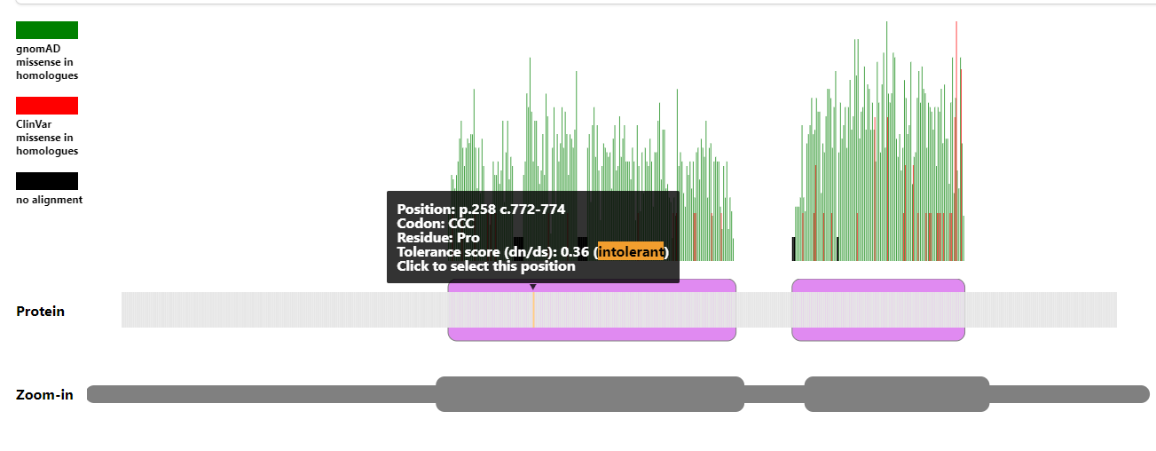
https://stuart.radboudumc.nl/metadome/dashboard
DEAD-box domain which is a region scored intolerant to variations
https://proteinpaint.stjude.org/

Slide 12
Variant #1
Concept | PM2_supporting+PP3+PM1+PS2_Moderate
Minor Allele Frequency (MAF) | Gnomad: 1 Alleles of 250208 0 homozygotes Clinvar: Likely pathogenic - Genetic Services Laboratory, University of Chicago (2022) PM2_supp
Mechanism of Disease | Clingen: Sufficient Evidence for Haploinsufficiency “The most commonly seen DDX41 variants are frameshifts, resulting in premature termination of the protein, suggesting loss of function or haploinsufficiency is the mechanism of tumorigenesis for this disorder (PMID:28637623, 26712909)”.
Impact Predictions | Multiple computational tools predict it to be deleterious (PP3) Revel Deleterious (low) (0.64)/ Splice-Al: 0 /CADD 26.2 It is highly conserved among paralogs and orthologues and lies on the DEAD-box domain which is a region scored intolerant to variations by subRVIS (PM1)
Functional Knowledge | Not available
Clinical Knowledge (published, or case-specific) | PS2_Moderate - De novo – phenotype consisting with the gene* (PS2_Moderate)**
Patient Phenotype:
Pancytopenia
Variant Identified:
DDX41 c.773C>T p.(Pro258Leu)
Transcript: NM_016222.2
Inheritance:
De novo
Classification #1 | Classification #2
?
Notes:
3-11067958-A-G
PM2

Slide 13
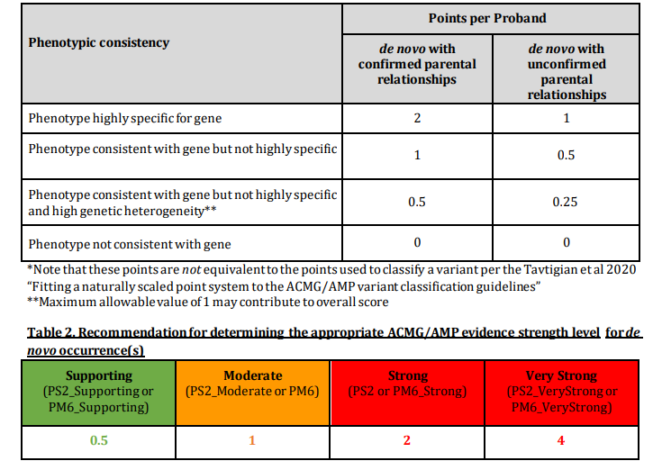
https://clinicalgenome.org/working-groups/sequence-variant-interpretation/

Slide 14
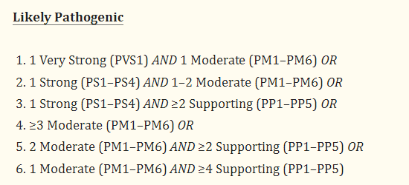
Variant #1
Concept | PM2_supporting+PP3+PM1+PS2_Moderate
Minor Allele Frequency (MAF) | Gnomad: 1 Alleles of 250208 0 homozygotes Clinvar: Likely pathogenic - Genetic Services Laboratory, University of Chicago (2022) PM2_supp
Mechanism of Disease | Clingen: Sufficient Evidence for Haploinsufficiency “The most commonly seen DDX41 variants are frameshifts, resulting in premature termination of the protein, suggesting loss of function or haploinsufficiency is the mechanism of tumorigenesis for this disorder (PMID:28637623, 26712909)”.
Impact Predictions | Multiple computational tools predict it to be deleterious (PP3) Revel Deleterious (low) (0.64)/ Splice-Al: 0 /CADD 26.2 It is highly conserved among paralogs and orthologues and lies on the DEAD-box domain which is a region scored intolerant to variations by subRVIS (PM1)
Functional Knowledge | Not available
Clinical Knowledge (published, or case-specific) | PS2_Moderate - De novo – phenotype consisting with the gene* (PS2_Moderate)
Patient Phenotype:
Pancytopenia
Variant Identified:
DDX41 c.773C>T p.(Pro258Leu)
Transcript: NM_016222.2
PMID: 25741868
Inheritance:
De novo
Classification #1 | Classification #2
Likely pathogenic (II)
Notes:
3-11067958-A-G
PM2

Slide 15
MYELOPROLIFERATIVE/LYMPHOPROLIFERATIVE NEOPLASMS, FAMILIAL (MULTIPLE TYPES), SUSCEPTIBILITY TO; MPLPF
INHERITANCE
- Autosomal dominant
RESPIRATORY
- Asthma (in rare mutation carriers unaffected by a hematologic malignancy)
SKELETAL
- Juvenile arthritis (in rare mutation carriers unaffected by a hematologic malignancy)
SKIN, NAILS, & HAIR
Skin
- Eczema (in rare mutation carriers unaffected by a hematologic malignancy)
HEMATOLOGY
- Myelodysplastic syndrome - Cytopenias - Refractory anemia - Bone marrow shows erythroid dysplasia
IMMUNOLOGY
- Sarcoidosis (in rare mutation carriers unaffected by hematologic malignancy) - Systemic lupus erythematosus (in rare mutation carriers unaffected by a hematologic malignancy) - Granulomatous disease (in rare mutation carriers unaffected by a hematologic malignancy) - Immune disorder (in rare mutations carriers unaffected by a hematologic malignancy)
NEOPLASIA
- Myelogeneous leukemia, acute - Myelogeneous leukemia, chronic - Lymphoma (1 family)
MISCELLANEOUS
- Adult onset - Incomplete penetrance - Favorable response to lenalidomide treatment
MOLECULAR BASIS
- Susceptibility conferred by mutation in the DEAD-box helicase 41 gene (DDX41, 608170.0001)
Additional laboratory tests showed a white blood cell count of 2,200/µL (NR: 3,500-10,500), hemoglobin of 11.9 g/dL (NR: 14-18), and platelet count of 2,000/µL (NR: 150,000-450,000). MCV was elevated at 105.2 fL (NR: 78.2-97.9 fL).

Slide 16
Second variant

Slide 17
Variant #2
Concept
Variant Identified:
RTEL1 c.101 A>G p.(Gln34Arg)
Transcript: NM_001283009.1
Inheritance:
Paternally inherited
Classification #1 | Classification #2
Notes:
3-11067958-A-G
PM2

Slide 18
Variant #2
Concept | PM2_Supporting
Minor Allele Frequency (MAF) | Gnomad: Not found Clinvar: Not found PM2_supp
Variant Identified:
RTEL1 c.101 A>G p.(Gln34Arg)
Transcript: NM_001283009.1
Inheritance:
Paternally inherited
Classification #1 | Classification #2
Notes:
3-11067958-A-G
PM2

Slide 19
Variant #2
Concept | PM2_Supporting
Minor Allele Frequency (MAF) | Gnomad: Not found Clinvar: Not found PM2_supp
Mechanism of Disease | Clingen: ClinGen has not yet published curations for RTEL1 (HGNC:15888). Many LOF variants described as P/LP**
Variant Identified:
RTEL1 c.101 A>G p.(Gln34Arg)
Transcript: NM_001283009.1
Inheritance:
Paternally inherited
Classification #1 | Classification #2
Notes:
3-11067958-A-G
PM2

Slide 20
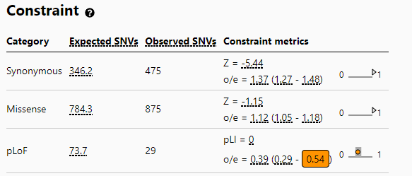
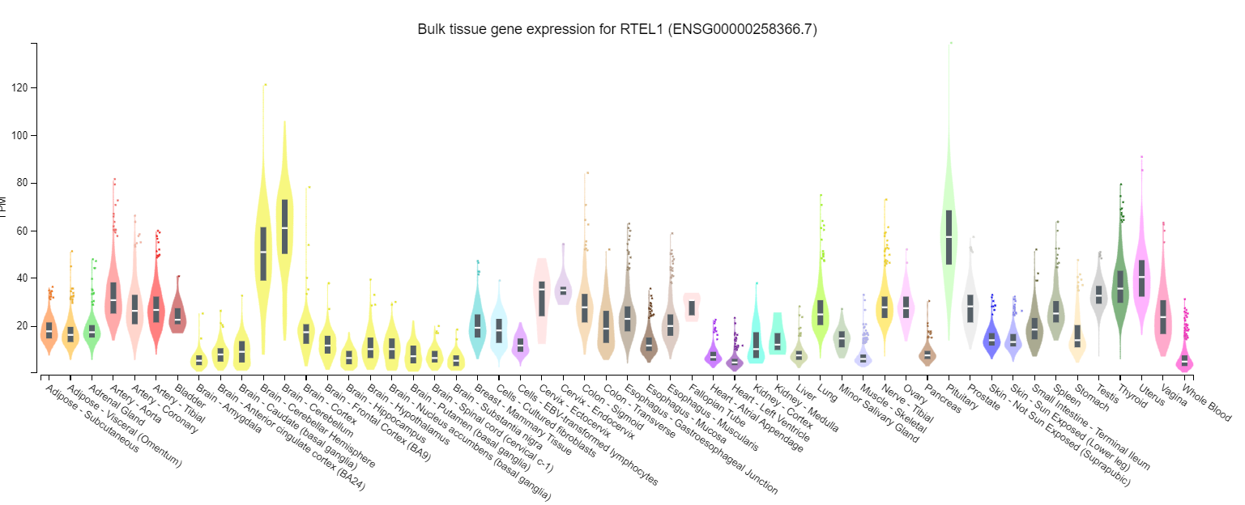
Variant of Uncertain Significance
GENE RTEL1 HET c.101 A>G p.(Gln34Arg) Transcript: NM_001283009.1 Paternal Disease: Dyskeratosis congenita, autosomal dominant 4 615190 AD, AR 3 Dyskeratosis congenita, autosomal recessive 5 615190 AD, AR 3 Pulmonary fibrosis and/or bone marrow failure, telomere-related, 3 616373 AD gnomAD: N/A HGMD: Not found ClinVAR: Not found In silico: Revel Benign (0.1)/ Splice-Al:Donor Loss (0.71) /CADD 33 Location: Chr 20, Exon 2/35
https://gnomad.broadinstitute.org/
https://gtexportal.org/home/
Notes:
Mutation in human MIB1 cause LVNC (a) schematic of MIB1 domain structure. A valine to phenylalanine missense mutation,.

Slide 21
https://proteinpaint.stjude.org/

Slide 22
Variant #2
Concept | PM2_Supporting
Minor Allele Frequency (MAF) | Gnomad: Not found Clinvar: Not found PM2_supp
Mechanism of Disease | Clingen: ClinGen has not yet published curations for RTEL1 (HGNC:15888). Many LOF variants described as P/LP**
Impact Predictions | Conflicting computational tools predictions ( PP3) Revel Benign (0.1)/ Splice-Al:Donor Loss (0.71) /CADD 33 Affects splicing (perhaps this could be an interesting step)?
Functional Knowledge
Clinical Knowledge (published, or case-specific)
Variant Identified:
RTEL1 c.101 A>G p.(Gln34Arg)
Transcript: NM_001283009.1
Inheritance:
Paternally inherited
Classification #1 | Classification #2
Notes:
3-11067958-A-G
PM2

Slide 23
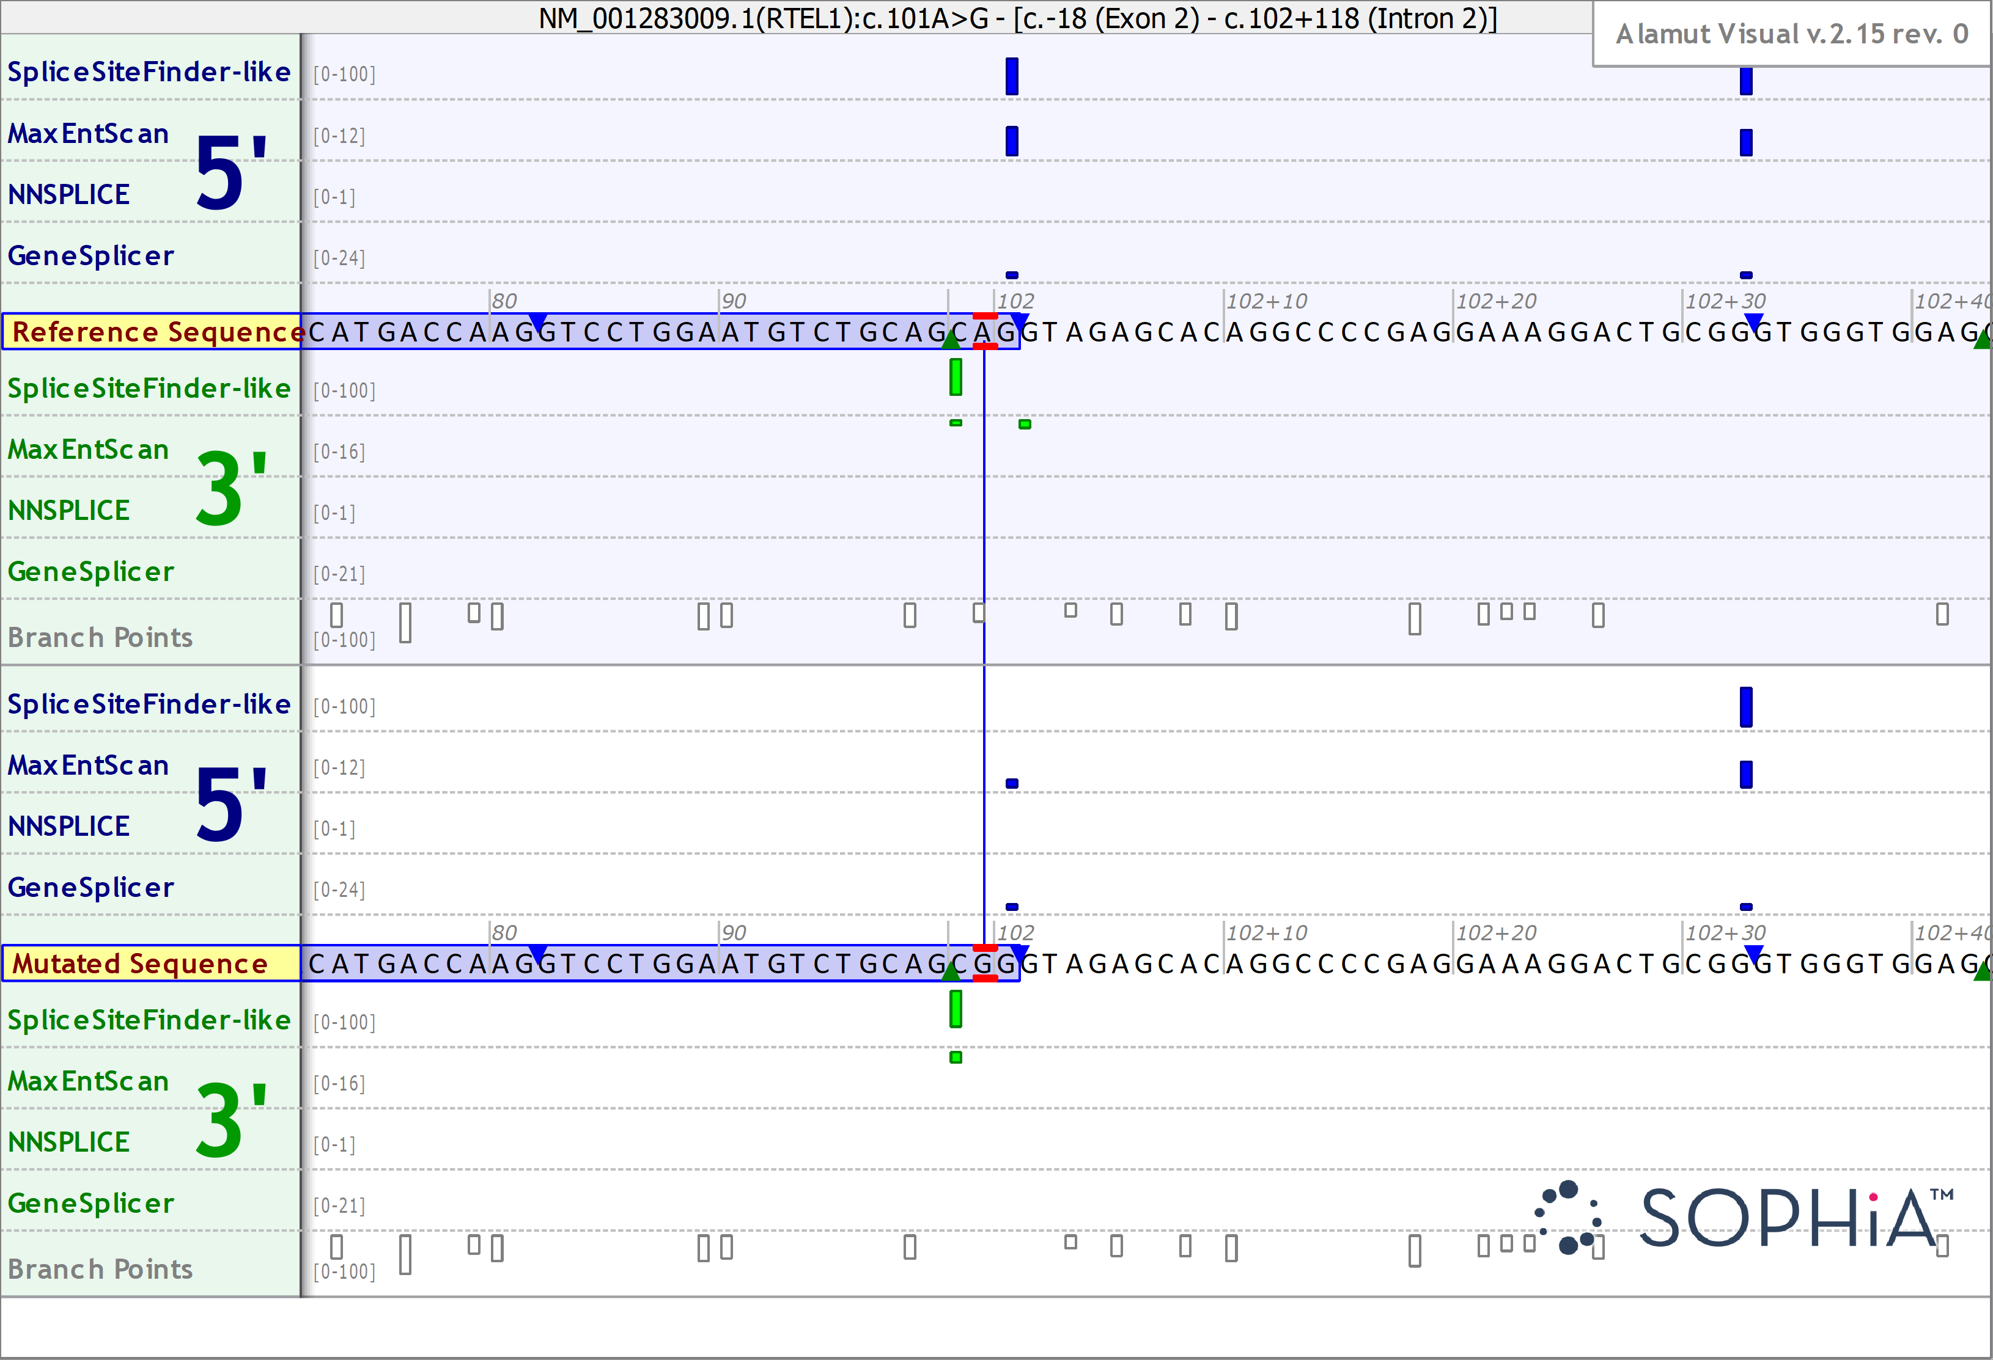
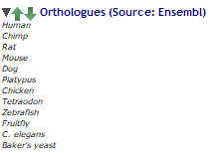

Slide 24
Variant #2
Concept | PM2_Supporting
Minor Allele Frequency (MAF) | Gnomad: Not found Clinvar: Not found PM2_supp
Mechanism of Disease | Clingen: ClinGen has not yet published curations for RTEL1 (HGNC:15888). Many LOF variants described as P/LP**
Impact Predictions | Conflicting computational tools predictions (PP3) Affects splicing (perhaps this could be an interesting step)?
Functional Knowledge | Not available
Clinical Knowledge (published, or case-specific) | Segregation (PP1)?**
Variant Identified:
RTEL1 c.101 A>G p.(Gln34Arg)
Transcript: NM_001283009.1
Inheritance:
Paternally inherited
Classification #1 | Classification #2
Notes:
3-11067958-A-G
PM2

Slide 25
I
1
2
II
1
2
3
III
??
1
2
3
4
5
IV
1

Slide 26
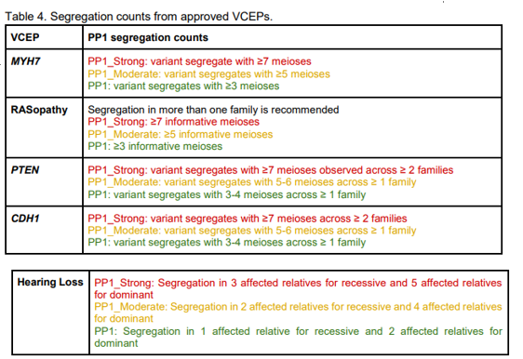
Other variants in linkage disequilibrium with the linked variant must be considered when applying PP1, and thorough phenotypic evaluation of affected non-segregating family members must be done for BS4 to rule out phenocopies.
Correct application of these criteria are hampered by issues of penetrance, expressivity, and age of onset of the disorder. Different conditions apply if diagnostic clarity or phenocopy are a concern.

Slide 27
I
1
2
Other variants in linkage disequilibrium with the linked variant must be considered when applying PP1, and thorough phenotypic evaluation of affected non-segregating family members must be done for BS4 to rule out phenocopies.
Correct application of these criteria are hampered by issues of penetrance, expressivity, and age of onset of the disorder. Different conditions apply if diagnostic clarity or phenocopy are a concern.
II
1
2
3
How old is the cousin?
What is the penetrance of this condition?
III
??
1
2
3
4
5
IV
1

Slide 28
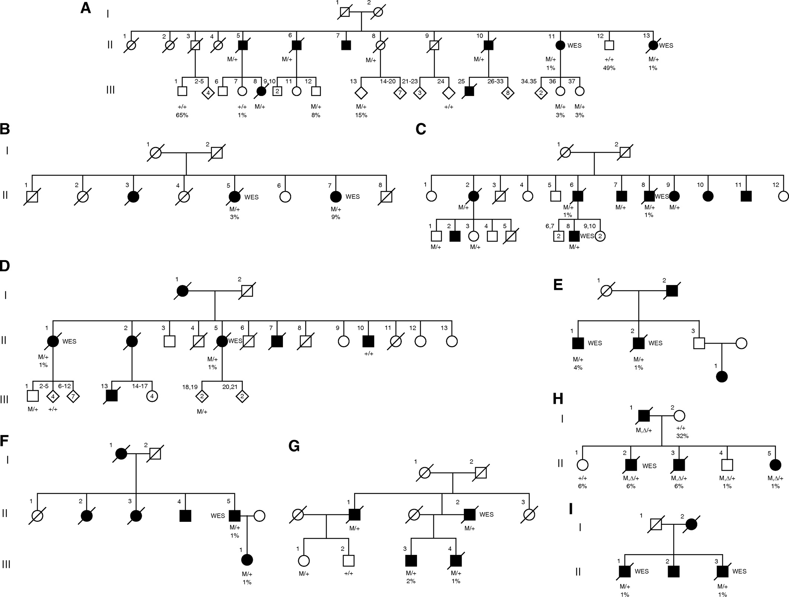
Example of families with variants in RTEL1
Pedigrees of familial interstitial pneumonia (FIP) families with RTEL1 rare variants. (A–I) Pedigrees of kindreds with heterozygous RTEL1 rare variants that segregate with FIP are depicted.
Heterozygous RTEL1 rare variant carriers are denoted as M/+; wild-type RTEL1 subjects are denoted as +/+.
Like other telomere-pathway RVs, the penetrance of RTEL1 RVs is not known but is likely to be incomplete and dependent on age.
Probands and unaffected carriers of these rare variants had short telomeres (,10% for age) in peripheral blood mononuclear cells and increased T-circle formation, suggesting impaired RTEL1 function.

Slide 29
Variant #2
Concept | PM2_Supporting
Minor Allele Frequency (MAF) | Gnomad: Not found Clinvar: Not found PM2_supp
Mechanism of Disease | Clingen: ClinGen has not yet published curations for RTEL1 (HGNC:15888). Many LOF variants described as P/LP**
Impact Predictions | Conflicting computational tools predictions (PP3) Affects splicing (perhaps this could be an interesting step)?
Functional Knowledge | Not available
Clinical Knowledge (published, or case-specific) | . Segregation ( PP1)
Variant Identified:
RTEL1 c.101 A>G p.(Gln34Arg)
Transcript: NM_001283009.1
Inheritance:
Paternally inherited
Classification #1 | Classification #2
VUS
Notes:
3-11067958-A-G
PM2

Slide 30
Variant #2
Concept | PM2_Supporting
Minor Allele Frequency (MAF) | Gnomad: Not found Clinvar: Not found PM2_supp
Mechanism of Disease | Clingen: ClinGen has not yet published curations for RTEL1 (HGNC:15888). Many LOF variants described as P/LP**
Impact Predictions | Conflicting computational tools predictions (PP3) Affects splicing (perhaps this could be an interesting step)?
Functional Knowledge | Is variant affect splicing- could we assess Gene Expression?
Clinical Knowledge (published, or case-specific) | . Could we further segregate this variant?
Interesting next steps?
Variant Identified:
RTEL1 c.101 A>G p.(Gln34Arg)
Transcript: NM_001283009.1
Inheritance:
Paternally inherited
Classification #1 | Classification #2
VUS
Notes:
3-11067958-A-G
PM2

Slide 31
In-class Variant Characterization – Interactive Session
April 29, 2022

Slide 32
Variant #3
As part of a genetic screen in an ostensibly healthy population you identify the following variant NM_000527.4(LDLR):c.1414G>T p.Asp472Tyr. You note there is a submission ID (183116) in ClinVar however, there is conflicting interpretations. Review the information in ClinVar and any additional resources to determine which ACMG criteria you believe should be applied and what your final assertion is. Please come to class prepared to discuss your interpretation.​

Slide 33
Variant #3
Concept | Criteria
Minor Allele Frequency (MAF) | PM2 – absent or rare in the population
Mechanism of Disease | PVS1 – Loss of protein function per other articles.
Impact Predictions | PP3 - Multiple computational tools predict it to be deleterious PM4 – Protein length change
Functional Knowledge | PS3 – well-established in vitro or in vivo functional study supports pathogenicity
Clinical Knowledge (published, or case-specific) | PS4 – Prevalence of variant in affected individuals is higher than in controls PP1 – Variant segregates with phenotype
Patient Phenotype:
Unknown
Variant Identified:
Chr19(GRCh37):g.11224266G>T LDLR(NM_000527.4):
c.1414G>T p.(Asp472Tyr)
Criteria | Classification
none | Benign <-> Pathogenic

Slide 34
Variant #3
Concept | Criteria
Minor Allele Frequency (MAF) | PM2 NA 15/282578 (1 homozygotes)
Mechanism of Disease | PVS1 – Loss of protein function per other articles.
Impact Predictions | PP3 - Multiple computational tools predict it to be deleterious PM4 – Protein length change
Functional Knowledge | PS3 – well-established in vitro or in vivo functional study supports pathogenicity
Clinical Knowledge (published, or case-specific) | PS4 – Prevalence of variant in affected individuals is higher than in controls PP1 – Variant segregates with phenotype
Patient Phenotype:
Unknown
Variant Identified:
Chr19(GRCh37):g.11224266G>T LDLR(NM_000527.4):
c.1414G>T p.(Asp472Tyr)
Criteria | Classification
none | Benign <-> Pathogenic

Slide 35
Variant #3
Concept | Criteria
Minor Allele Frequency (MAF) | PM2 NA 15/282578 (1 homozygotes)
Mechanism of Disease | PVS1 – Loss of protein function per other articles.
Impact Predictions | PP3 - Multiple computational tools predict it to be deleterious PM4 – Protein length change
Functional Knowledge | PS3 – well-established in vitro or in vivo functional study supports pathogenicity
Clinical Knowledge (published, or case-specific) | PS4 – Prevalence of variant in affected individuals is higher than in controls PP1 – Variant segregates with phenotype
Patient Phenotype:
Unknown
Variant Identified:
Chr19(GRCh37):g.11224266G>T LDLR(NM_000527.4):
c.1414G>T p.(Asp472Tyr)
Criteria | Classification
none | Benign <-> Pathogenic

Slide 36
Variant #3
Concept | Criteria
Minor Allele Frequency (MAF) | PM2 NA 15/282578 (1 homozygotes)
Mechanism of Disease | PVS1 NA Missense Variant
Impact Predictions | PP3 - Multiple computational tools predict it to be deleterious PM4 – Protein length change
Functional Knowledge | PS3 – well-established in vitro or in vivo functional study supports pathogenicity
Clinical Knowledge (published, or case-specific) | PS4 – Prevalence of variant in affected individuals is higher than in controls PP1 – Variant segregates with phenotype
Patient Phenotype:
Unknown
Variant Identified:
Chr19(GRCh37):g.11224266G>T LDLR(NM_000527.4):
c.1414G>T p.(Asp472Tyr)
Criteria | Classification
none | Benign <-> Pathogenic

Slide 37
Variant #3
Concept | Criteria
Minor Allele Frequency (MAF) | PM2 NA 15/282578 (1 homozygotes)
Mechanism of Disease | PVS1 NA Missense Variant
Impact Predictions | PP3 - Multiple computational tools predict it to be deleterious PM4 – Protein length change
Functional Knowledge | PS3 – well-established in vitro or in vivo functional study supports pathogenicity
Clinical Knowledge (published, or case-specific) | PS4 – Prevalence of variant in affected individuals is higher than in controls PP1 – Variant segregates with phenotype
Patient Phenotype:
Unknown
Variant Identified:
Chr19(GRCh37):g.11224266G>T LDLR(NM_000527.4):
c.1414G>T p.(Asp472Tyr)
Criteria | Classification
none | Benign <-> Pathogenic

Slide 38
Variant #3
Concept | Criteria
Minor Allele Frequency (MAF) | PM2 NA 15/282578 (1 homozygotes)
Mechanism of Disease | PVS1 NA Missense Variant
Impact Predictions | PP3 NA REVEL: 0.649, CADD: 23, MT: Neutral
Functional Knowledge | PS3 – well-established in vitro or in vivo functional study supports pathogenicity
Clinical Knowledge (published, or case-specific) | PS4 – Prevalence of variant in affected individuals is higher than in controls PP1 – Variant segregates with phenotype
Patient Phenotype:
Unknown
Variant Identified:
Chr19(GRCh37):g.11224266G>T LDLR(NM_000527.4):
c.1414G>T p.(Asp472Tyr)
Criteria | Classification
none | Benign <-> Pathogenic

Slide 39
Variant #3
Concept | Criteria
Minor Allele Frequency (MAF) | PM2 NA 15/282578 (1 homozygotes)
Mechanism of Disease | PVS1 NA Missense Variant
Impact Predictions | PP3 NA REVEL: 0.649, CADD: 23, MT: Neutral
Functional Knowledge | PS3 – well-established in vitro or in vivo functional study supports pathogenicity
Clinical Knowledge (published, or case-specific) | PS4 – Prevalence of variant in affected individuals is higher than in controls PP1 – Variant segregates with phenotype
Patient Phenotype:
Unknown
Variant Identified:
Chr19(GRCh37):g.11224266G>T LDLR(NM_000527.4):
c.1414G>T p.(Asp472Tyr)
Criteria | Classification
none | Benign <-> Pathogenic

Slide 40
Variant #3
Concept | Criteria
Minor Allele Frequency (MAF) | PM2 NA 15/282578 (1 homozygotes)
Mechanism of Disease | PVS1 NA Missense Variant
Impact Predictions | PP3 NA REVEL: 0.649, CADD: 23, MT: Neutral
Functional Knowledge | PS3_supporting The p.Asp472Tyr reduced was tested in an overexpression and complementation assays in transfected cells that indicated an impact on either LDLR biosynthesis or turnover (PMID: 25647241).
Clinical Knowledge (published, or case-specific) | PS4 – Prevalence of variant in affected individuals is higher than in controls PP1 – Variant segregates with phenotype
Patient Phenotype:
Unknown
Variant Identified:
Chr19(GRCh37):g.11224266G>T LDLR(NM_000527.4):
c.1414G>T p.(Asp472Tyr)
Criteria | Classification
PS3_supporting | Benign <-> Pathogenic

Slide 41
Variant #3
Concept | Criteria
Minor Allele Frequency (MAF) | PM2 NA 15/282578 (1 homozygotes)
Mechanism of Disease | PVS1 NA Missense Variant
Impact Predictions | PP3 NA REVEL: 0.649, CADD: 23, MT: Neutral
Functional Knowledge | PS3_supporting The p.Asp472Tyr reduced was tested in an overexpression and complementation assays in transfected cells that indicated an impact on either LDLR biosynthesis or turnover (PMID: 25647241).
Clinical Knowledge (published, or case-specific) | PS4 – Prevalence of variant in affected individuals is higher than in controls PP1 – Variant segregates with phenotype
Patient Phenotype:
Unknown
Variant Identified:
Chr19(GRCh37):g.11224266G>T LDLR(NM_000527.4):
c.1414G>T p.(Asp472Tyr)
Criteria | Classification
PS3_supporting | Benign <-> Pathogenic

Slide 42
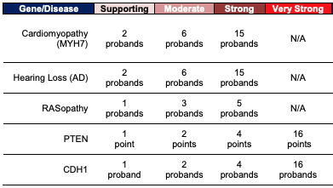
https://clinicalgenome.org/working-groups/sequence-variant-interpretation/

Slide 43
Variant #3
Concept | Criteria
Minor Allele Frequency (MAF) | PM2 NA 15/282578 (1 homozygotes)
Mechanism of Disease | PVS1 NA Missense Variant
Impact Predictions | PP3 NA REVEL: 0.649, CADD: 23, MT: Neutral
Functional Knowledge | PS3_supporting The p.Asp472Tyr reduced was tested in an overexpression and complementation assays in transfected cells that indicated an impact on either LDLR biosynthesis or turnover (PMID: 25647241).
Clinical Knowledge (published, or case-specific) | PS4_strong Variant detected in >15 unrelated, individuals affected with FH/MI (<50yo) PMID: 17196209, 21310417, 27542166, 28008010, 31980526, 25487149 PP1 Variant segregated with disease in 2 families (3 in family1 and 4 in family2) PMID: 27542166
Patient Phenotype:
Unknown
Variant Identified:
Chr19(GRCh37):g.11224266G>T LDLR(NM_000527.4):
c.1414G>T p.(Asp472Tyr)
Criteria | Classification
PS3_supporting, PS4_strong, PP1 | Benign <-> Pathogenic

Slide 44
Variant #3
Concept | Criteria
Minor Allele Frequency (MAF) | PM2 NA 15/282578 (1 homozygotes)
Mechanism of Disease | PVS1 NA Missense Variant
Impact Predictions | PP3 NA REVEL: 0.649, CADD: 23, MT: Neutral
Functional Knowledge | PS3_supporting The p.Asp472Tyr reduced was tested in an overexpression and complementation assays in transfected cells that indicated an impact on either LDLR biosynthesis or turnover (PMID: 25647241).
Clinical Knowledge (published, or case-specific) | PS4_strong Variant detected in >15 unrelated, individuals affected with FH/MI (<50yo) PMID: 17196209, 21310417, 27542166, 28008010, 31980526, 25487149 PP1 Variant segregated with disease in 2 families (3 in family1 and 4 in family2) PMID: 27542166
Patient Phenotype:
Unknown
Variant Identified:
Chr19(GRCh37):g.11224266G>T LDLR(NM_000527.4):
c.1414G>T p.(Asp472Tyr)
Criteria | Classification
PS3_supporting, PS4_strong, PP1 | Likely Pathogenic

