Slide 1
Reliable Extraction of Emergency Response Networks from Text Data and Benchmarking with National Emergency Response Guidelines
Jana Diesner, PhD
Associate Professor, UIUC

Slide 2
Research Objective
Premise: Emergency response is a complex, large-scale, socio-technical system, which we model as a dynamic network with actors, events, and resources.
Goal: Apply, advance, and evaluate methods from natural language processing (NLP) and social network analysis (SNA) to unstructured text data from different, commonly used sources of information about emergencies to identify and evaluate multi-modal networks involved in Humanitarian Assistance and Disaster Relief (HADR) efforts.
Contribution: Demonstrate the applicability and usefulness of methodologies from Human-Centered Data Science and Social Computing in HADR contexts.

Slide 3
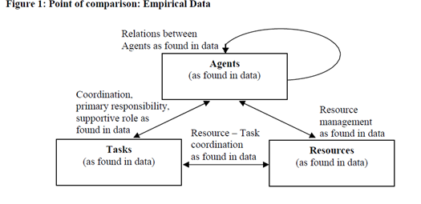
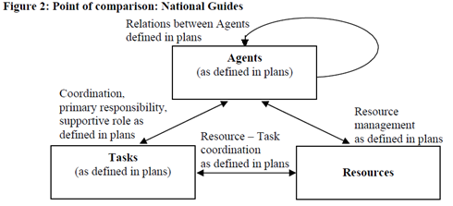
Research question 1

Slide 4
Research question 1
How can we extract reliable multi-mode networks from text data in a scalable way?
Use ground truth benchmark data to generate to detect nodes and edges based on statistical, lexical, semantic, and syntactic features of text data.
Compare to commonly used, off the shelf implementations.
Significance: Comprehensive assessment of network construction from texts, systematic identification of sensitivity of graphs to NLP methods, detection of best practices for constructing reliable networks from text data. Improves rigor and scalability of semantic computing across disciplines and application areas.

Slide 5
Research question 2
How can we label links the extracted semantic networks in a way that is meaningful for HADR and scalable?
Leverage text summarization technique(s) from our prior CIRI project.
Adaptation of previously developed methods for text-based link labeling
Explore sub-event detection techniques.
Significance: Results in a classification schema for links (interactions between agents) in HADR-related networks built from text data. Enables automated and meaningful link labeling, which supports further inference tasks.

Slide 6
Research question 3
How do the extracted interactions networks compare to prescribed networks? What can we learn from differences between extracted versus prescribed networks?
Ground truth/ normative networks: generated based on national emergency response guidelines, especially the National Response Framework (NRF) outlined by U.S. Department of Homeland Security.
Empirical response networks: extracted from text data.
Assessment: Compare normative to empirical networks to identify congruence, and opportunities (false positives) and needs (false negatives) for policy change.
Significance: Investigate real-world emergencies from an organizational behavior perspective to advance our understanding of organizational processes, flaws, and possible points of failure. Develops and applies a methodology for comparing policy based on incidence management plans to evidence for action, which may assist in assessing emergency management policy.

Slide 7
Summary
Establish ground truth – National response framework, other policies, guidelines, etc. i.e., “SOP for disaster response.”
Gather data from historical disaster response – “how it actually unfolded”
Compare the two
Identify areas where guidelines could be improved
Make recommendations

