Slide 1
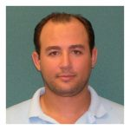
Hybrid Quantum-Classical Reinforcement Learning in Controlled Quantum Networks
George Siopsis
University of Tennessee
Barry Sanders
University of Calgary
Marouane Salhi
Computational Physicist
Qubit Engineering, Inc.
Radhakrishnan Balu
Computational Chemist
ARL
CIRI Symposium on Resilience of Critical Infrastructures
April 2019

Slide 2
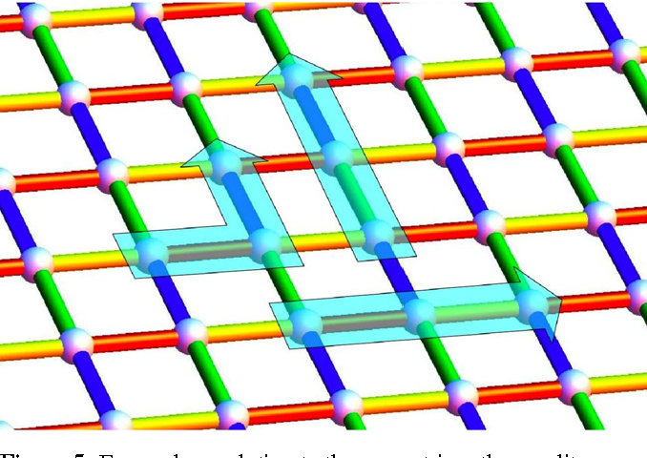
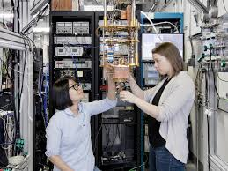
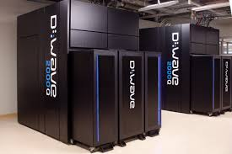
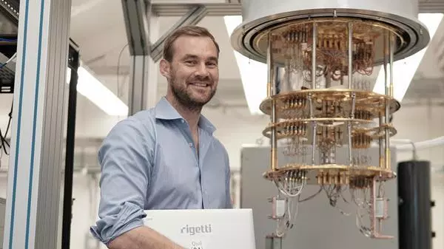
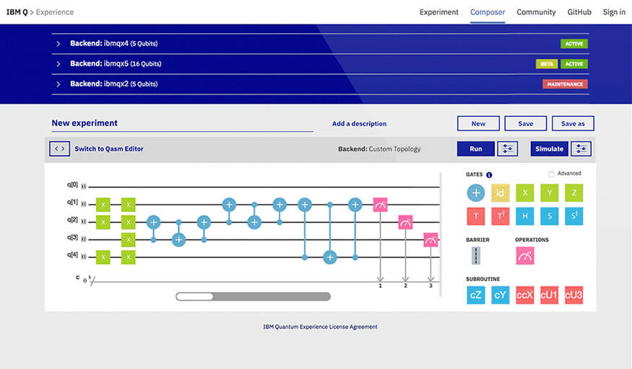
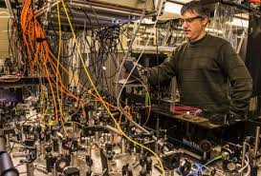
HYPOTHESIS
Quantum computing enhances machine learning, thereby enabling rapid, reliable optimization and decision-making for complex environments and large data sets.
QUANTUM MACHINE LEARNING
Machine learning is a transformative approach that enables machines to learn how to perform tasks through experience rather than being directly programmed. The overlap between machine learning and quantum technology is especially intriguing and paradigm shifting.
Photonic quantum computer
GOAL
Create software for operators at DHS components and agencies that stand to benefit from applications of quantum machine learning.

Slide 3
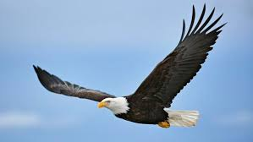
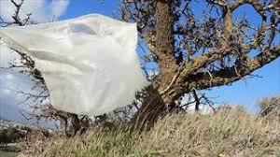
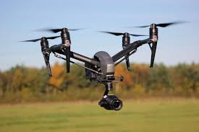
Drone Detection
PROBLEM
A bird or a plastic bag caught in the wind might be mistaken for a drone. To discriminate, use heat or acoustic signatures.
MACHINE LEARNING
Promising technology: visual detection (camera) + machine learning (DHS S&T with Sandia National Labs).
GOAL
Introduce quantum computing to build hybrid classical-quantum machine algorithms and use them to train neural networks to recognize patterns

Slide 4
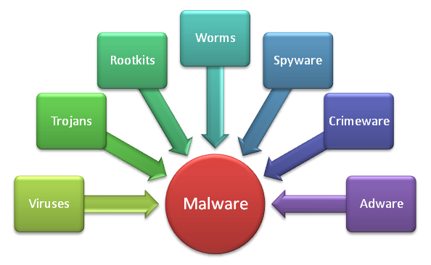
Cybersecurity: Malware Detection
PROBLEM
Coping with malware is getting more and more challenging, given their relentless growth in complexity and volume.
TECHNOLOGY
Machine learning is used in antimalware software. Analyzes files based on databases of both malicious and benign code.
GOAL
Develop new tools for malware analysis based on hybrid classical-quantum machine learning algorithms and compare their performance with existing code.

Slide 5
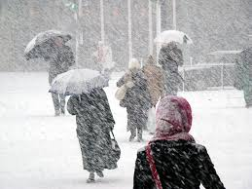
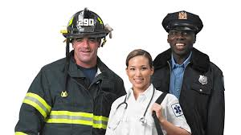
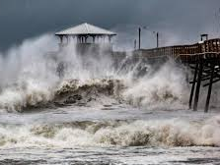
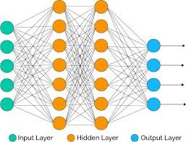
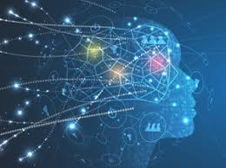
First Responders: Data Mining and Analysis
PROBLEM
First responders need to make strategic decisions quickly and efficiently during emergency events.
TECHNOLOGY
Data mining and analysis are machine learning algorithms (neural networks) that extract relevant knowledge from a massive database of information, in order to optimize models and identify dependent variables. These tools help first responders to handle dangerous situations (blizzard whiting out an entire town, hurricane, etc.).
GOAL
Develop hybrid classical-quantum neural networks to improve performance of software.

Slide 6
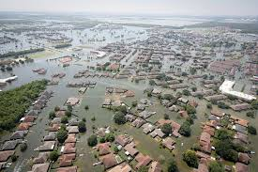
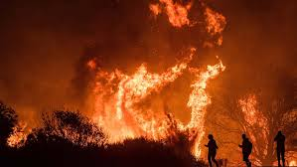
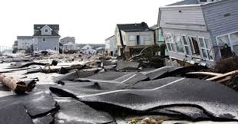
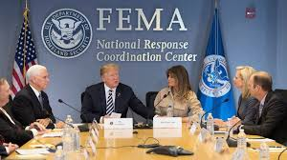
FEMA: Crisis Management
PROBLEM
FEMA Guidelines for emergency preparedness in crisis/disaster:
Perform needs analysis (receive requests, prioritize events, pass requests, track request status, report to Resource Manager), coordinate effective resource allocation.
RESILIENCE
“Develop holistic resilience solutions that marry natural phenomena sciences with machine learning to provide cities and companies with hyperlocal impact predictions.”
“Google is using AI to develop enhanced flood warnings in India”
-- Richard Serino
CROWDSOURCING
Operationalize crowdsourcing to enhance situational awareness, decision-making, and inform machine learning and artificial intelligence applications.
GOAL
Develop hybrid classical-quantum algorithms for the optimization of allocation of limited resources in crisis situations.

