Slide 1
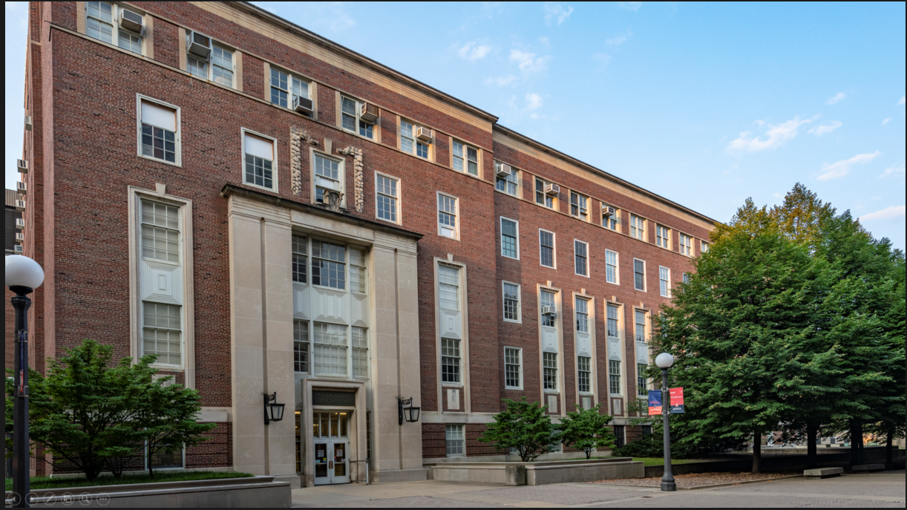
Chemical and Biomolecular Engineering

Slide 2
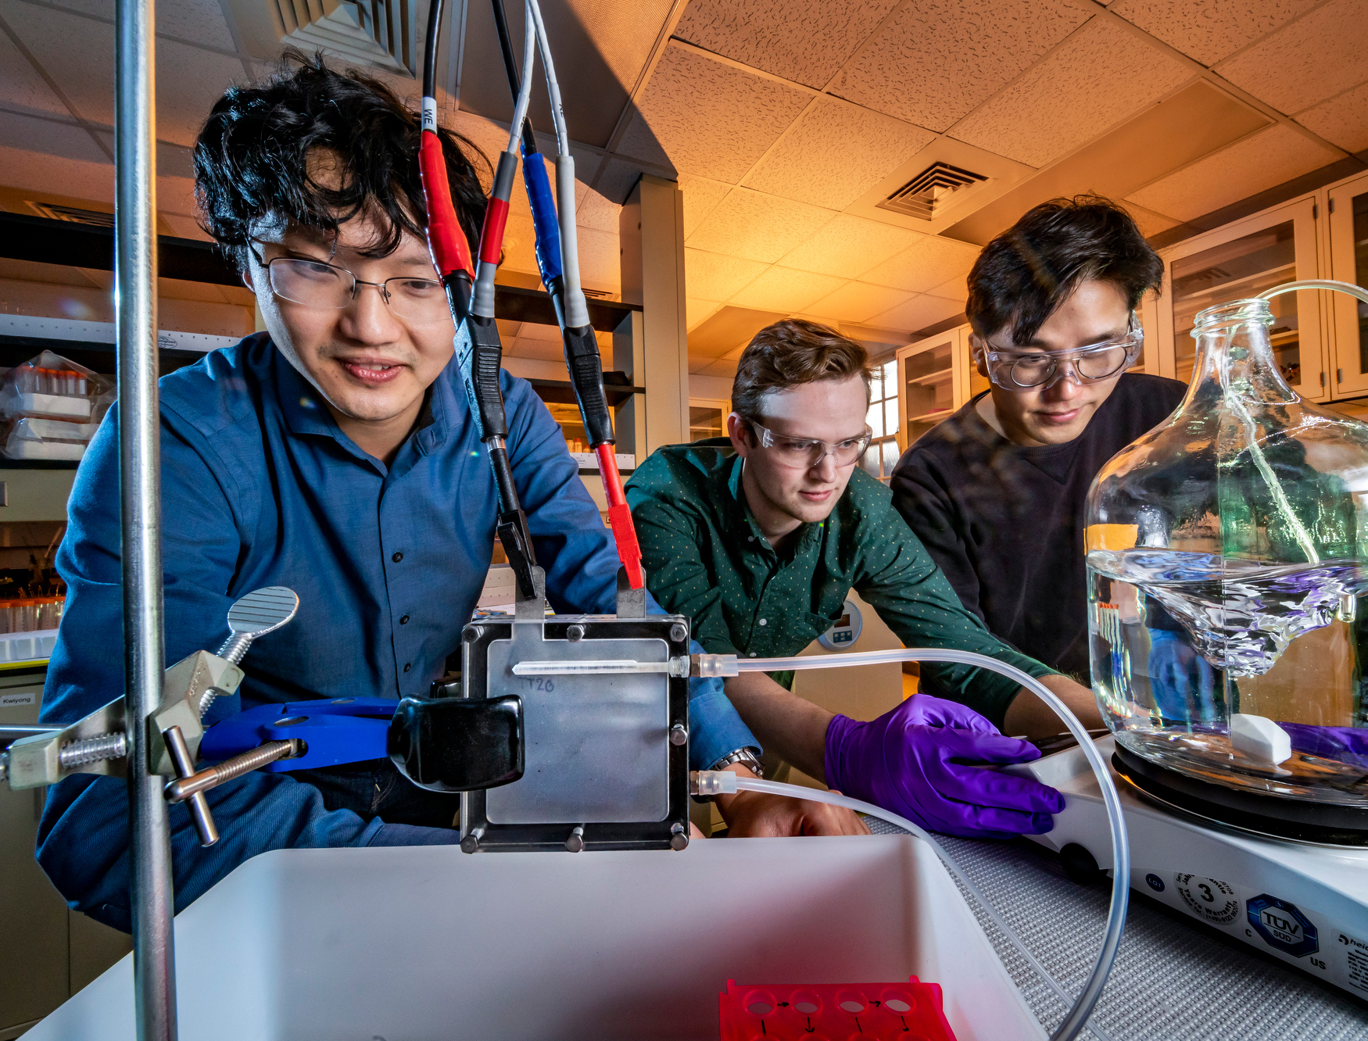
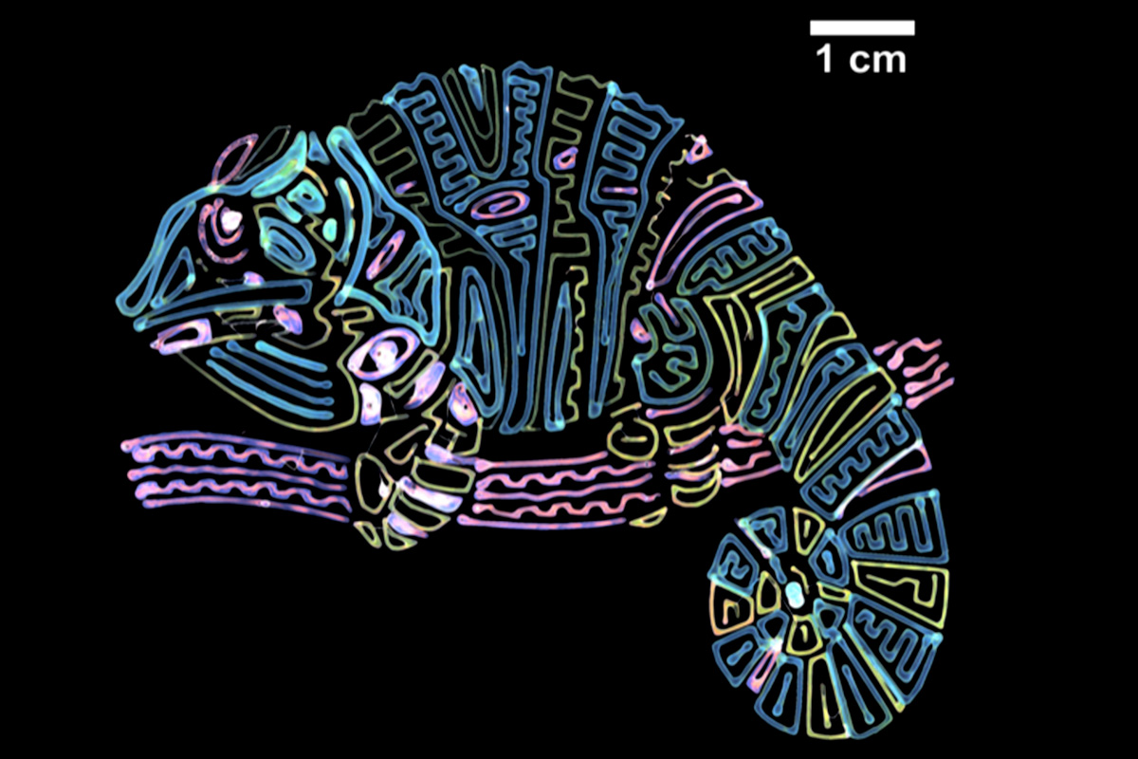
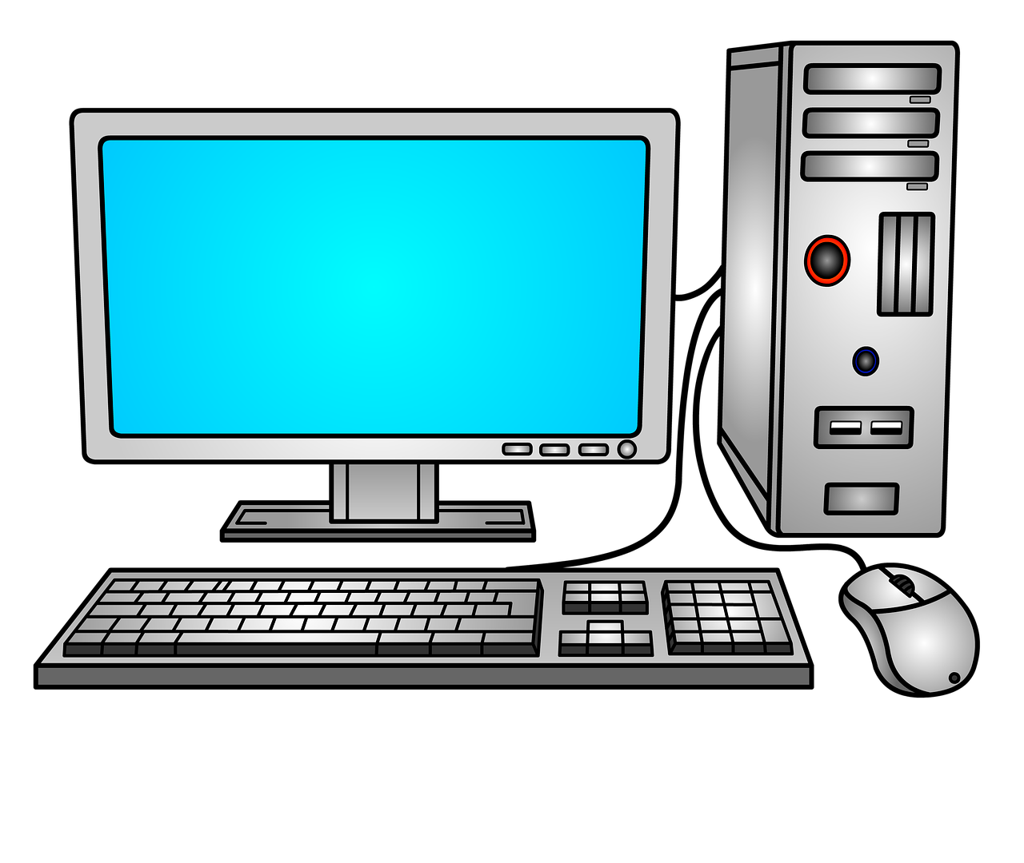
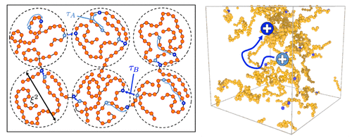
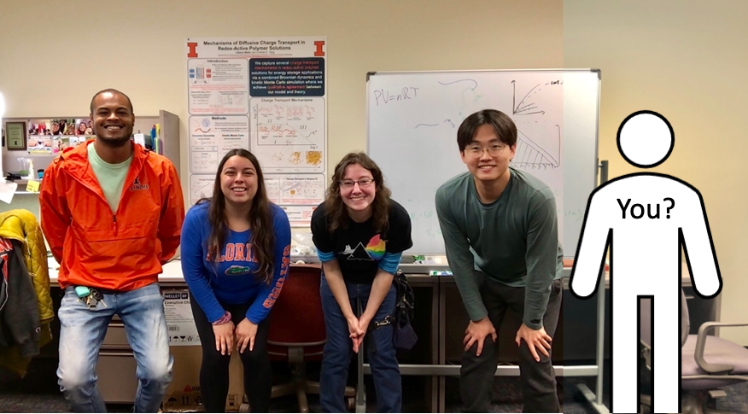
Do you remember who we are?
Chemical and Biomolecular Engineers
scientists that know a lot of about chemicals and solve fun and important problems!
We help people
We do science
We are creative
We use computers to solve problems
This could be you one day!

Slide 3
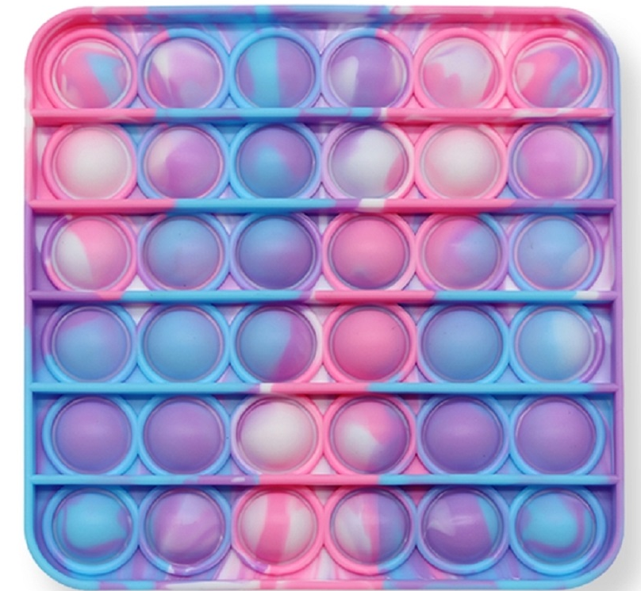
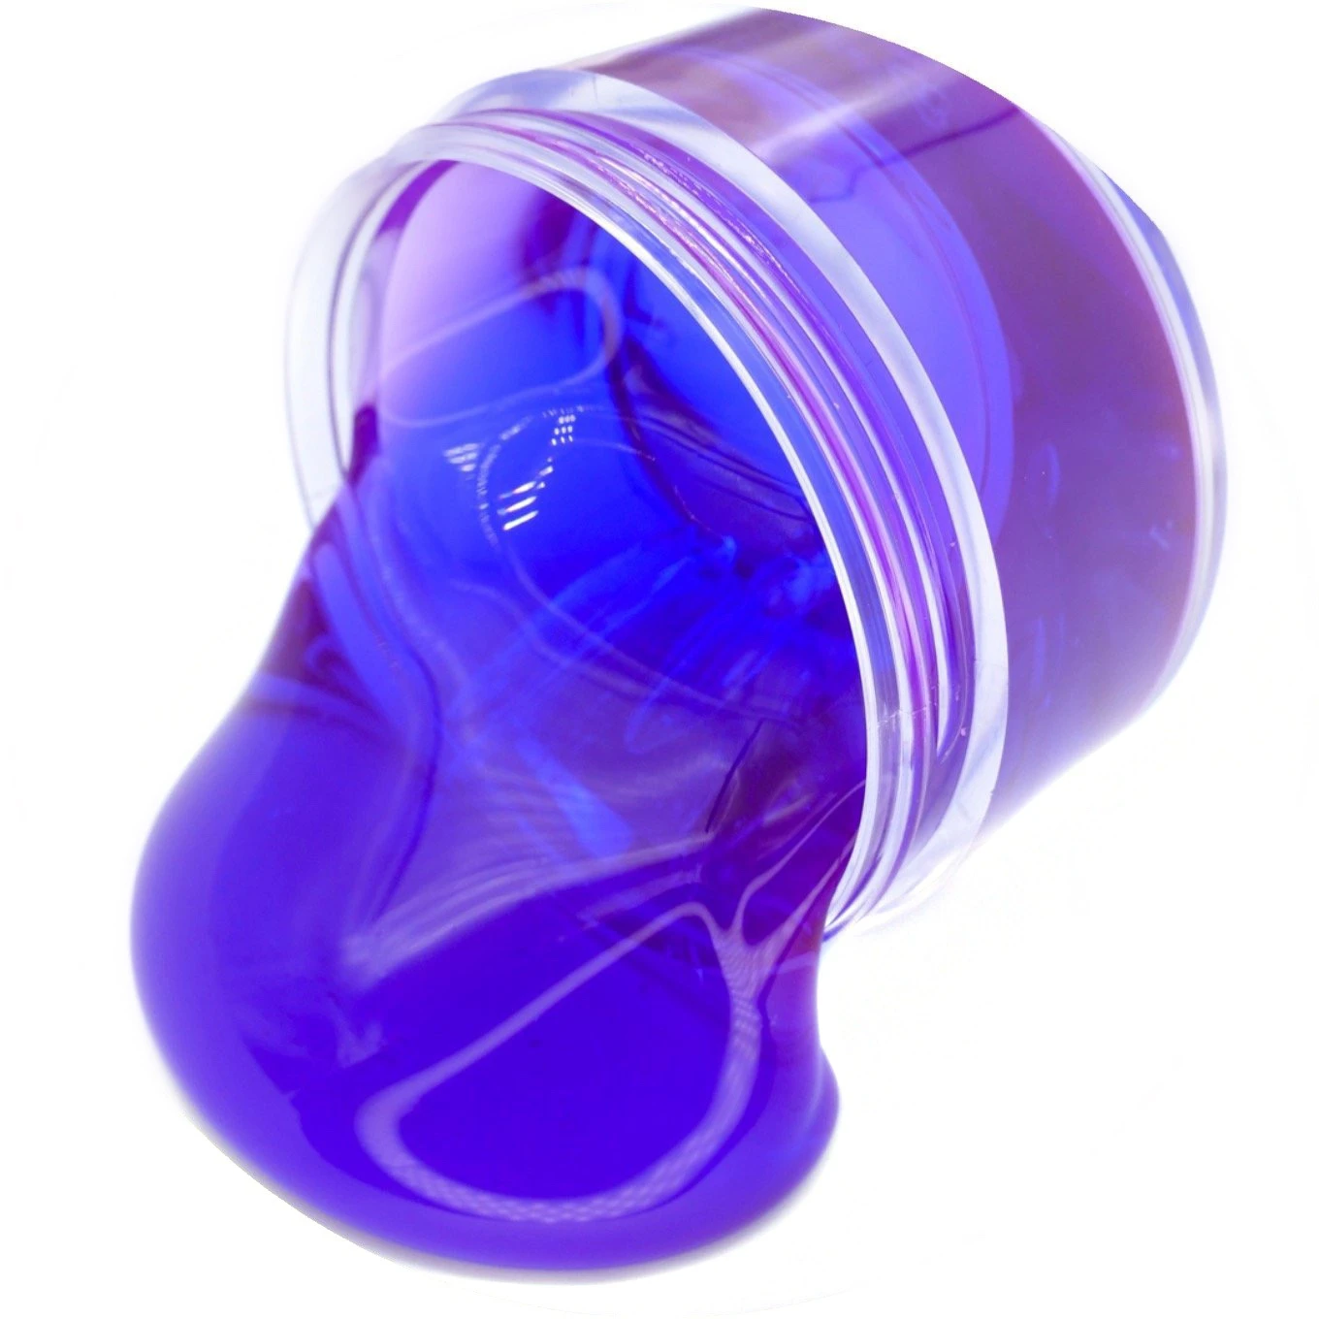
Let us recap what we learned last week
Polymers
Plastics are big molecules. We call them ___________?
Slime
Pop-It Toys
zoom in!
zoom in!
What do the polymer chains look like?
What about these chains?
What do we call the building blocks?
Long polymer chains
Not connected to one another
Feels liquid/slimy
Connected polymer chains
Feels solid/rubbery
Monomers

Slide 4
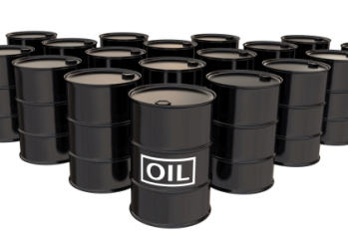
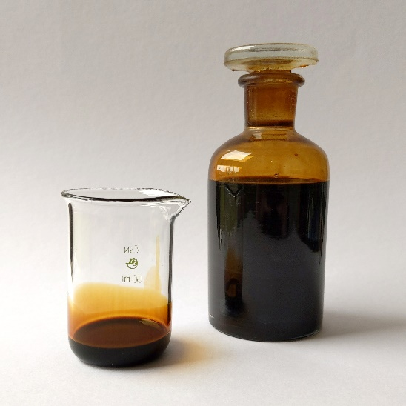
What is plastic made of?
What is the raw material for plastics?
What did we mine for last week?
Answer: The raw materials for plastics is crude oil or petroleum

Slide 5
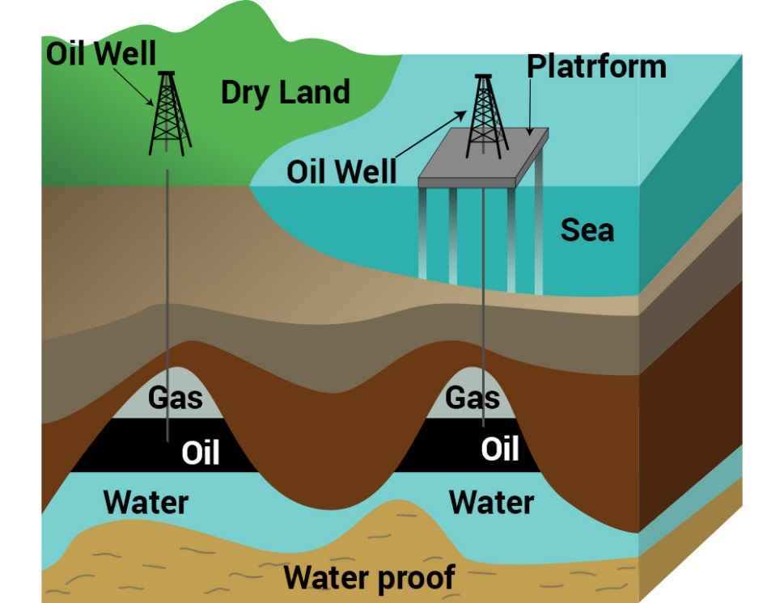
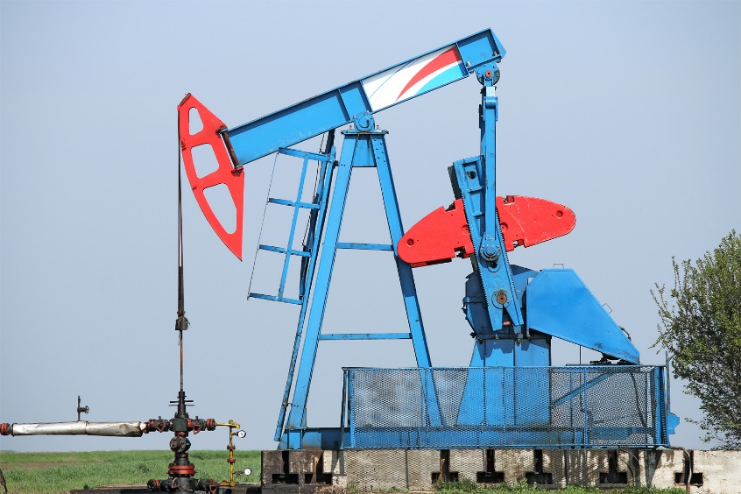
Where is oil found?
Do you remember where we find oil?
Their nickname is grasshopper
They bring oil to the surface!
In the ground and at the bottom of the ocean!

Slide 6
How was oil made?
It takes MILLIONS of years to make oil!
What can we do to make sure we don’t run out of oil?

Slide 7
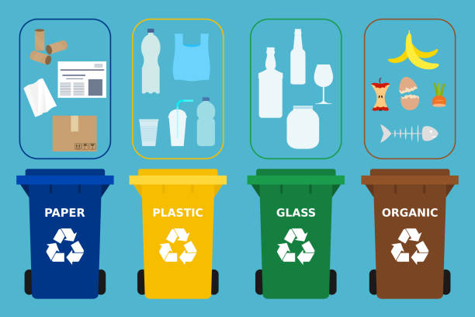
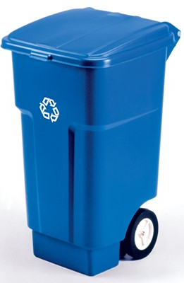
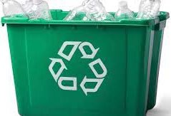
Recycling
What does it mean to recycle something?
What can we recycle?
ANSWER: Taking things ready to be thrown away and changing them into NEW materials.

Slide 8
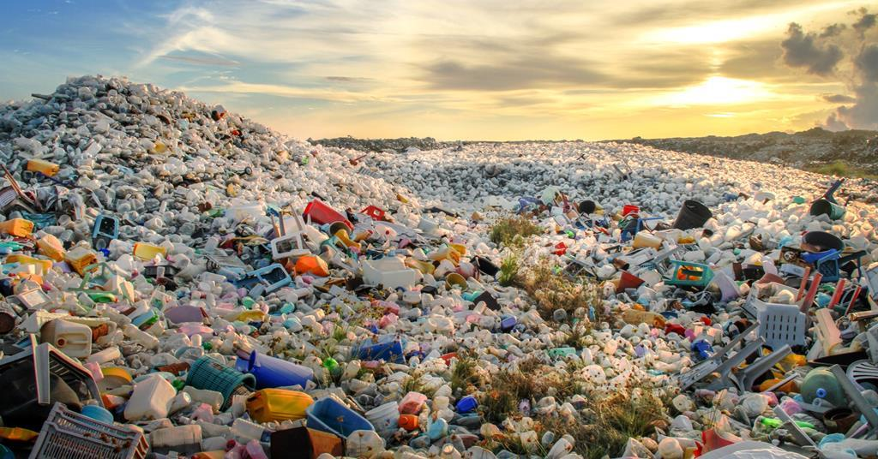
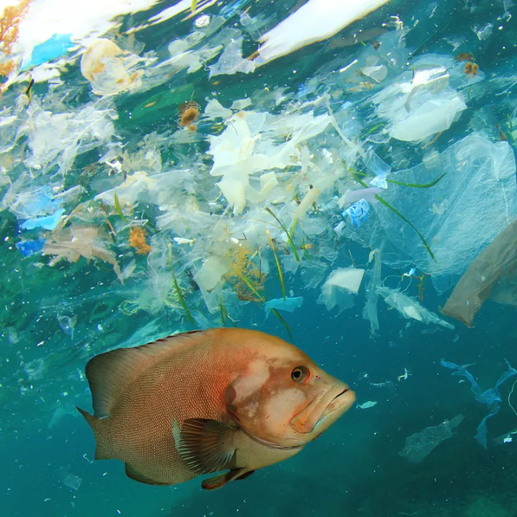
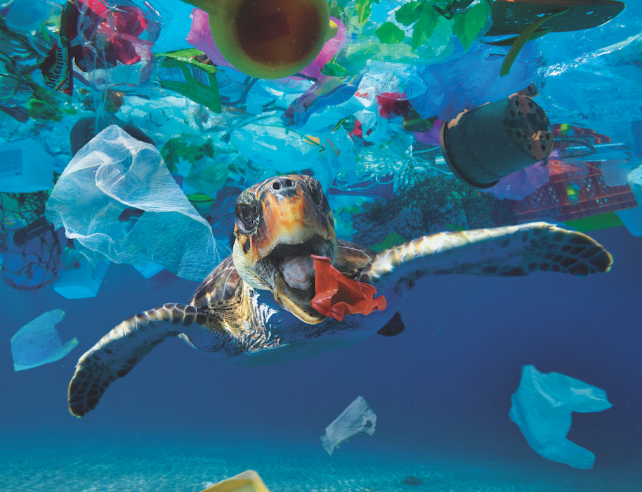
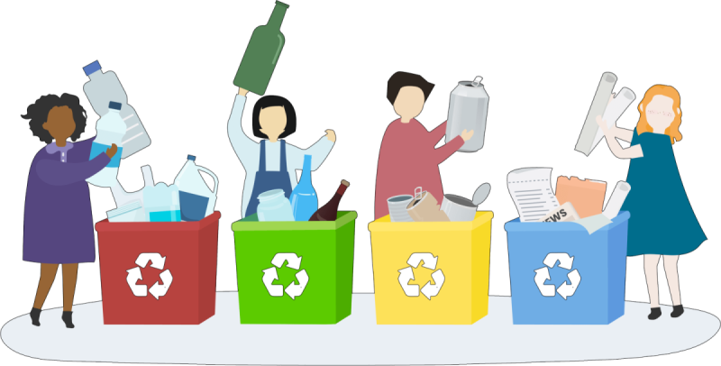
Why is recycling important?
We need to protect our environment!
It is all our jobs to recycle whenever we can!

Slide 9
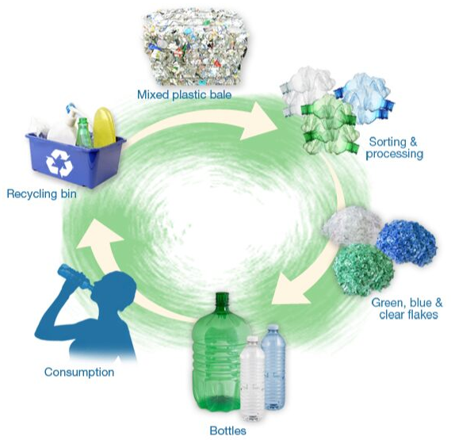
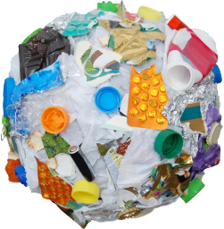
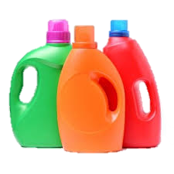
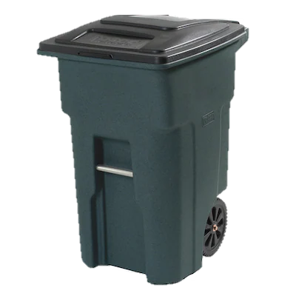
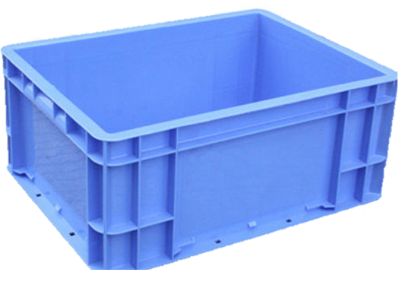
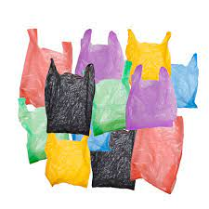
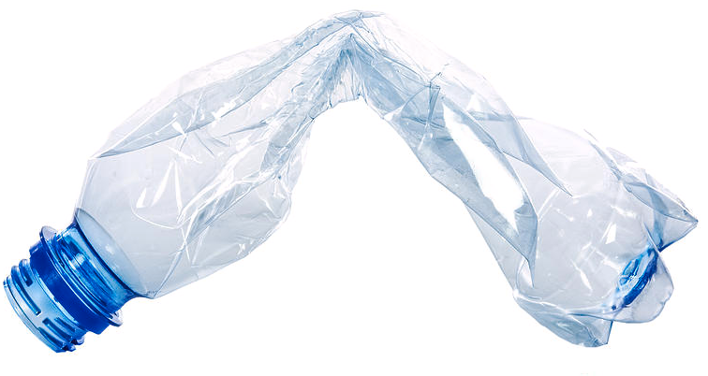
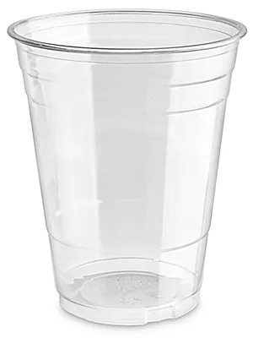
Let's learn the recycling process
Really hard plastic and you can’t see through
The most important part!
Mixed Plastic
Sorting Plastic
Recycling Bin
Holds its shape but is still crushable
See-through and thin plastic
Different plastic polymers
Use the bottles
Make new Bottles

Slide 10
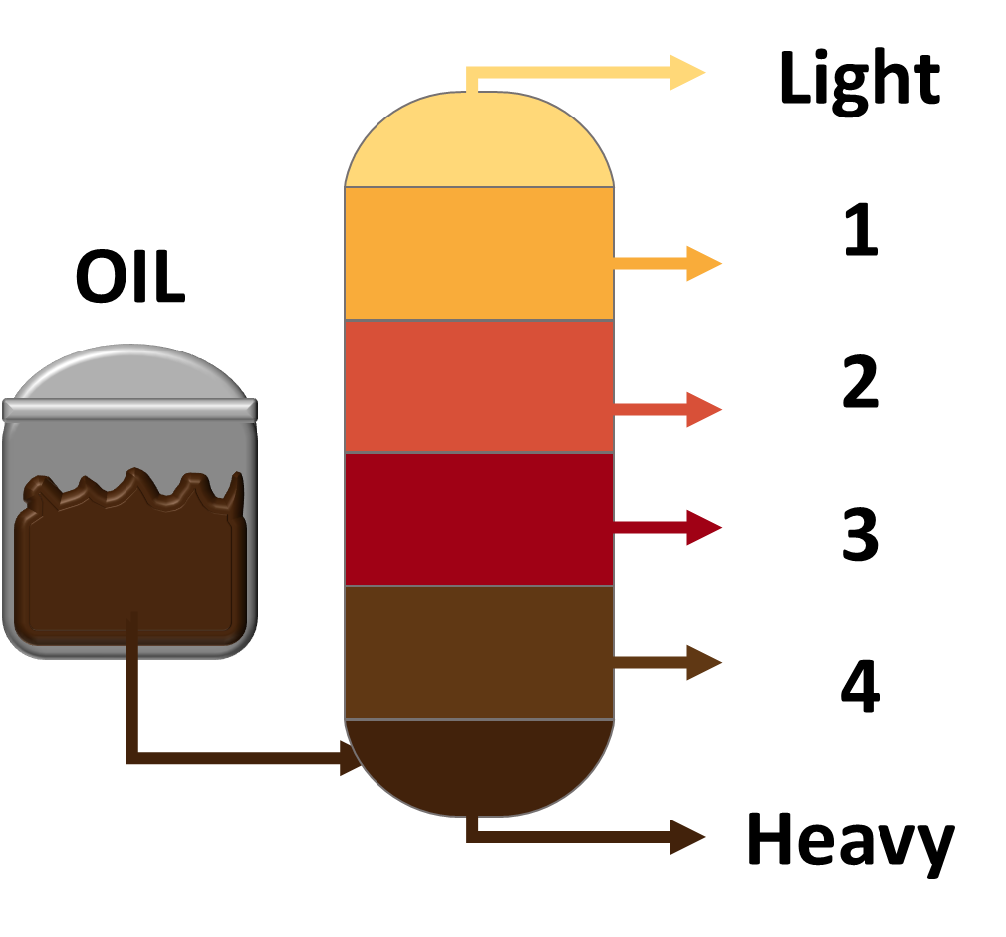
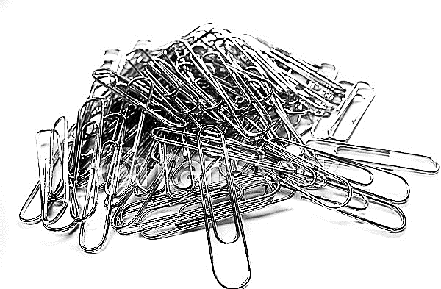
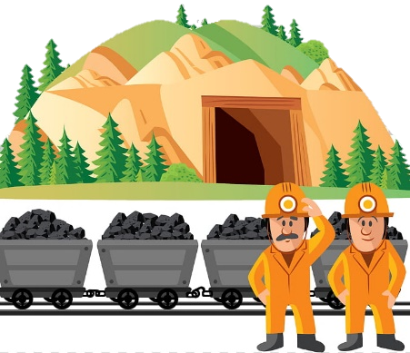
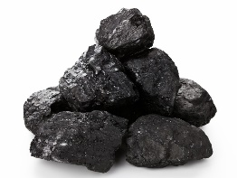
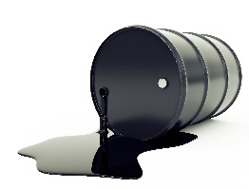
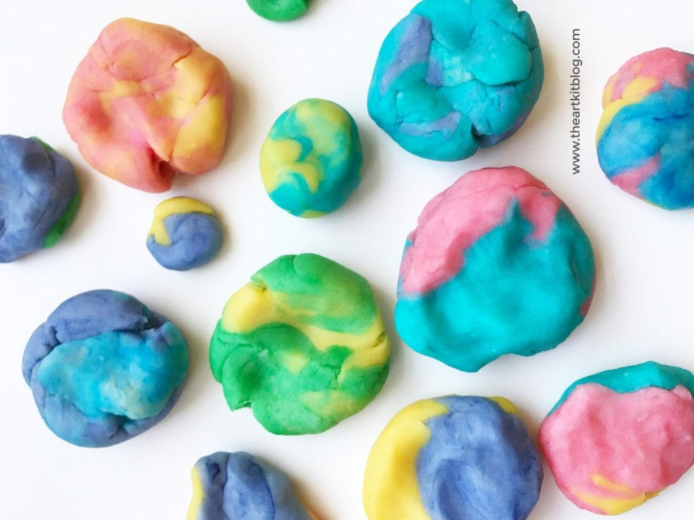
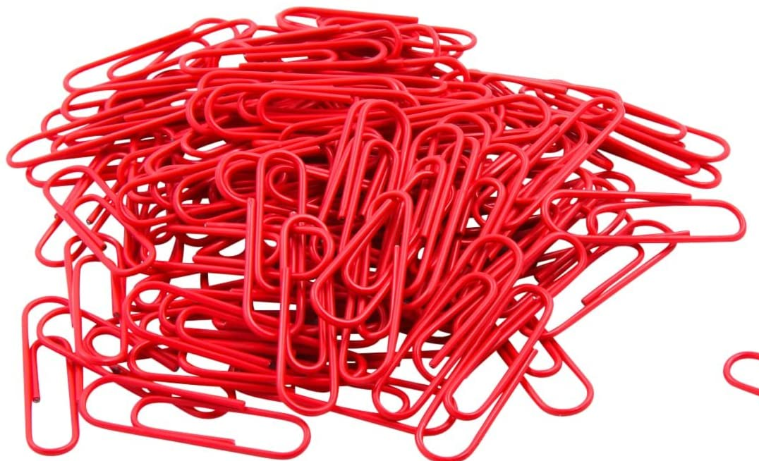
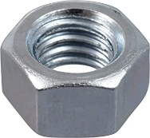
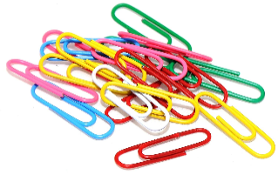
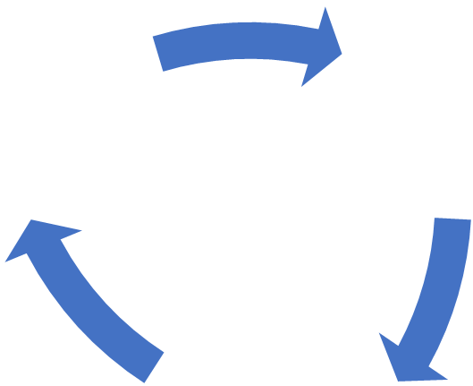
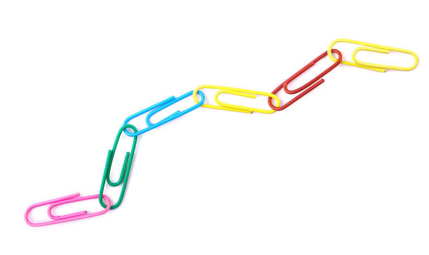
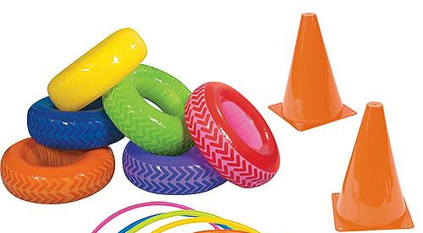
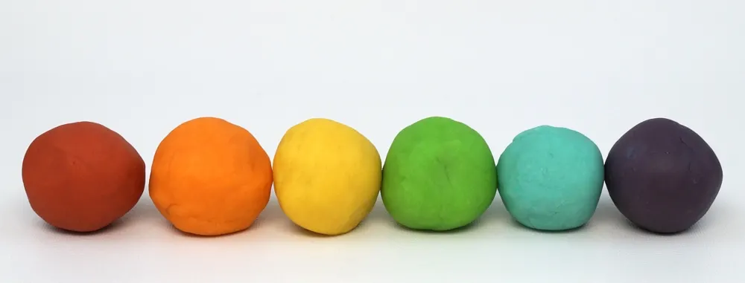
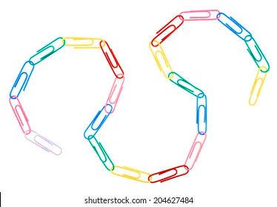
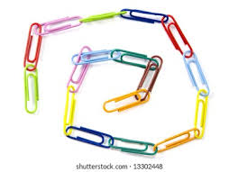
Recap: activity we did last week
Step 1: Mine your raw materials
Step 2: Separate your oil
NEW STEP: Recycle our plastic
COAL OIL
Step 3: Make your polymers
Step 4: Process into different shapes!

Slide 11
Supplemental Videos

Slide 12
Discussion Video: Practice recycling
Show after Activity #1
https://www.youtube.com/watch?v=eymigN8tMoY

Slide 13
Discussion Video: Practice recycling
Show during wrap-up if you have time.
https://www.youtube.com/watch?v=kY5Qz4TuV5Q

