Slide 1
LONG READ SEQUENCING
Lab exercise
Jag Balan and Jesse Walsh
Computational Genomics Course
6/25/2025

Slide 2
PREFACE and Learning objectives
Preface:
Long read sequencing we use in this exercise is from Oxford Nanopore Technology (ONT).
ONT yields long sequences, and this helps mapping in repetitive/low-complexity regions of genome.
ONT also simultaneously provides methylation information , which can be used to assess effects of the repeat expansion on DNA methylation.
Objectives:
Calculating N50s with a bash one-liner to assess read lengths.
Repeat motif analysis in FMR1 gene promoter region to assess
Presence of pathogenic CGG repeat expansion in a Fragile-X positive case
Absence of pathogenic CGG repeat expansion in a normal
Differential methylation analysis between a positive Fragile-X case and a normal.

Slide 3
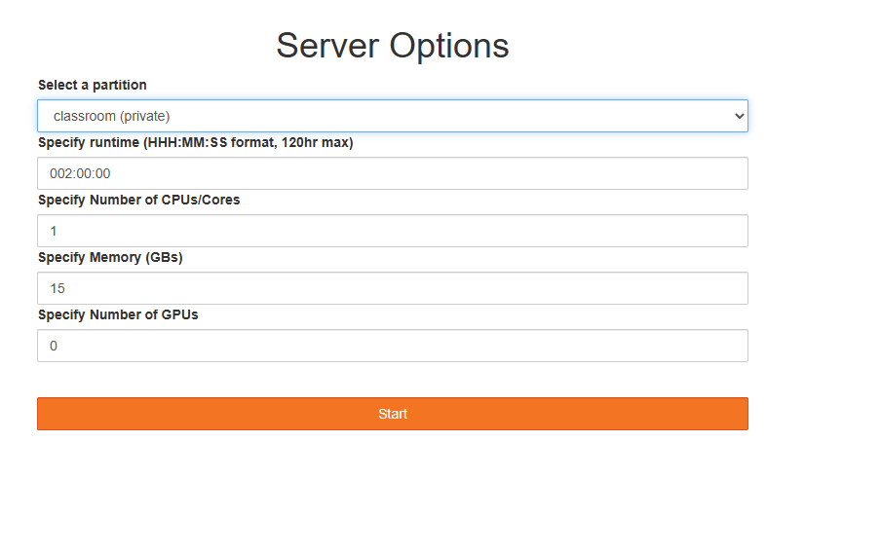
Environment and set up
Sign in with your credentials in https://biocluster.igb.illinois.edu/
Choose the server options:

Slide 4
Directory and environment for exercise
Select Mayo/2025-IGB-gcc-8.2.0 in the modules pane
Click on blue hexagon
Look for Mayo/2025-IGB-gcc-8.2.0
Hover over the Mayo module and Load button will appear
Click on Load , this will load required dependencies for the lecture
Now open the jupyter notebook in home directory (Double-click):
/home/a-m/<userid>/06-Long-Read-Sequencing/longread.ipynb

Slide 5
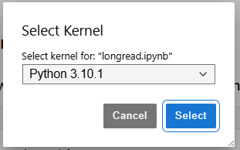
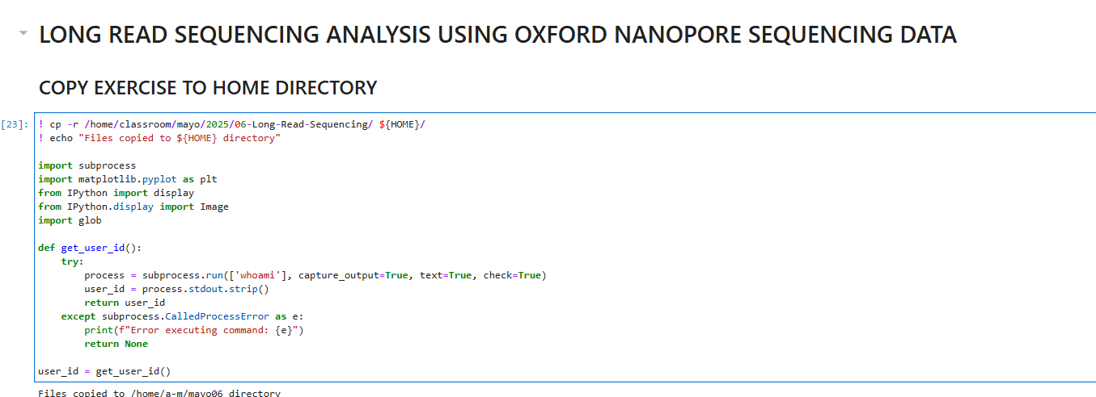
Methylation – seaborn error
Follow instructions in the Jupyter notebook and run the cells
In the methylation analysis (Part 3) if you see an error, click on Python on top right corner of screen for kernel selection (Red lasso marked in screenshot below)
In the dialog box select the Python version and click on Select. After this , kernel restarts, so please run the first cell of the Jupyter hub to make sure all modules load.

Slide 6
Take-home lessons
ONT sequencing provides long reads
We learnt how to calculate read length metric N50
Long read sequencing enables mapping and genotyping in regions that are challenging for short reads
We demonstrated capability of calling long repeat expansions from ONT sequencing, the lengths of repeats are much longer than read lengths from short read technologies (>400 repeats of CGG observed in each allele).
Clinical diagnostics involve ordering more than one assay to assess repeat expansion and methylation, separately. Here we use one sequencing run of ONT and it provides us ability to
Assess repeat in conjunction with methylation
Additionally, feel free to experiment with the tools and scripts by creating your own copy of the scripts.

Slide 7
QUESTIONS & ANSWERS

Slide 8
THANK YOU

