Slide 1
Security and Privacy of AR/VR: Contemplating attacks, threat models and the way forward
Nael Abu-Ghazaleh (naelag@ucr.edu)
Department of Computer Science & Engineering
University of California, Riverside
ILLIXR Open Consortium
10/26/2022
Jiasi Chen
Carter Slocum
Yicheng Zhang

Slide 2
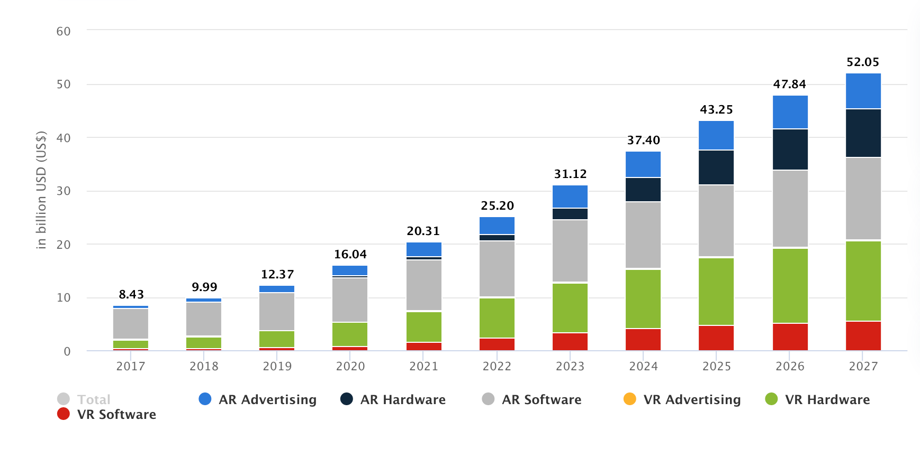
AR/VR – the next frontier in computing and living
Desktops->Laptops->Mobile computing->ubiquitous computing->AR/VR?
Close to tipping point
Dall-e generated art

Slide 3
Privacy and security threats to AR/VR
Privacy threats
As we do more in AR/VR, these activities can be tracked and exposed
AR vs. VR
Security threats
Denial of service/digital vandalism
Cyber criminals follow the money
Digital assets, credentials, …
What are the new technical challenges?
Integration of physical and digital worlds
New application spaces, new threat models
Evolving systems, applications, standards…
Dall-e generated

Slide 4
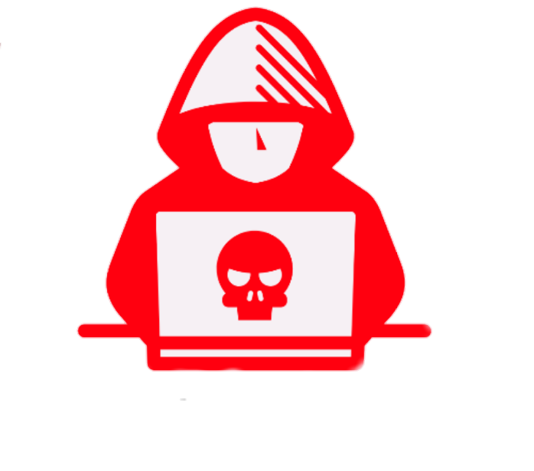
Background of our research
Side channel attacks across apps
App 1
App 2
App 3
AR/VR SDKs
Spatial mapping, anchors, headset tracking, ...
Sensors:

Slide 5
Threat model 1:
Side channel attacks across apps
Manuscripts under revision at USENIX Security’23

Slide 6
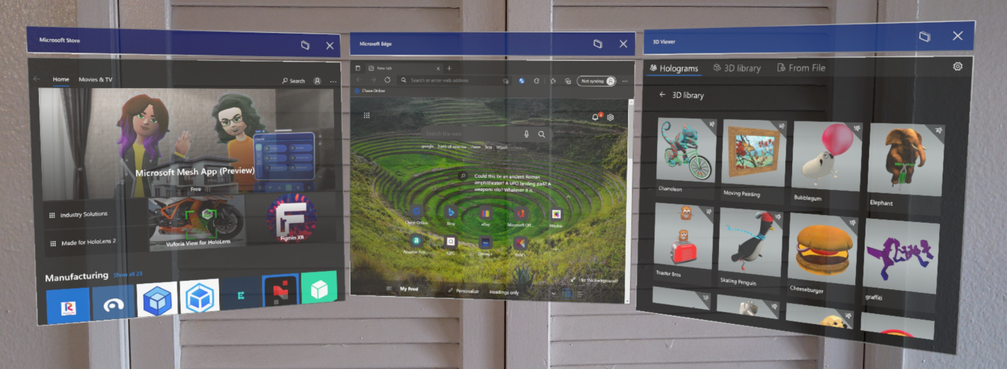
Scenario: Multiple applications running simultaneously
Many AR/VR devices support multiple apps simultaneously augmenting environment
Ex: Microsoft Hololens 2, Meta Quest 2, and Magic Leap One
Permissions management on AR/VR systems allows access to common lower-level SDKs
Even though apps can be visually isolated
Visually isolated apps
Shared access to SDKs

Slide 7
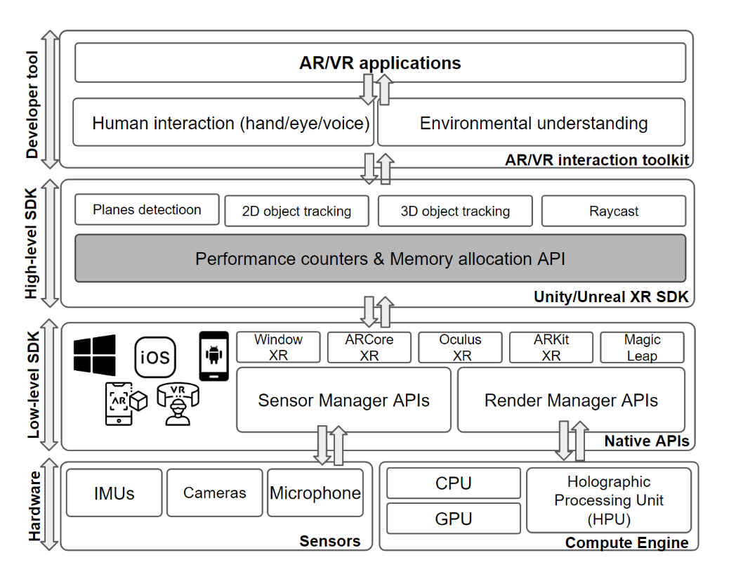
Overview of a typical XR system
Performance counters
accessible to user
applications

Slide 8
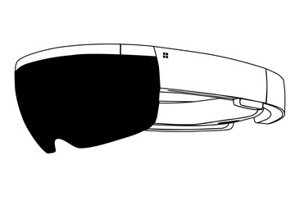
Threat model: Software side-channel
A malicious application runs in the background with normal permissions
Probe Unity/Unreal APIs to leak side-channel information
Memory allocation API: Memory usage/limit/peak, etc.
Rendering performance counters: CPU/GPU frame rate, etc.
Device tracking API: headset acceleration, gyroscope, etc.
Normally provided to developers to optimize app performance
Victim
Spy
App
Spy
Memory allocation API,
Performance counters,
Device tracking API
Side-channel leakage

Slide 9
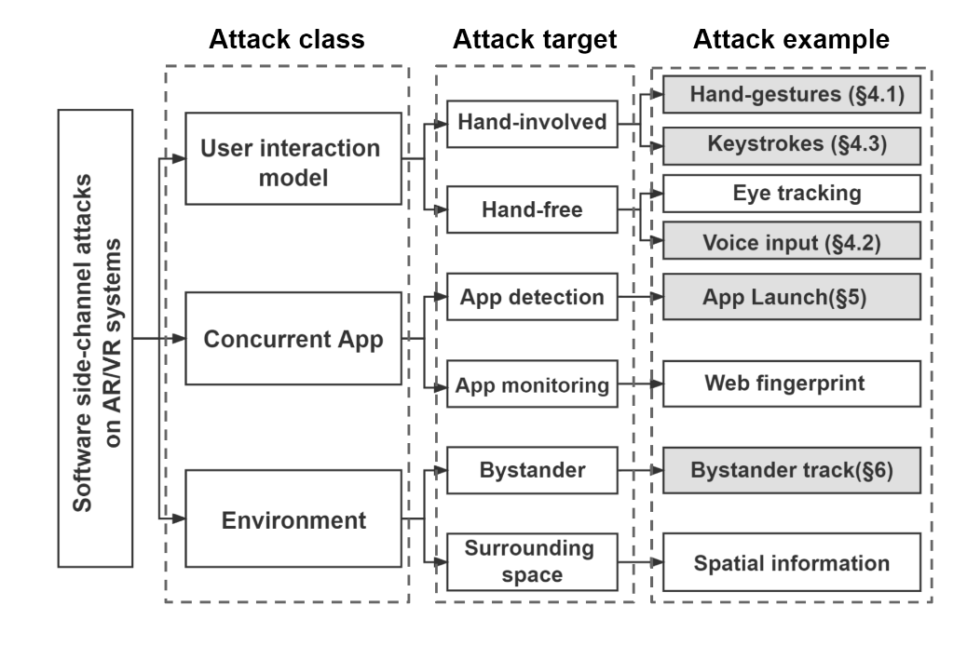
Side channel -- Attack Taxonomy

Slide 10
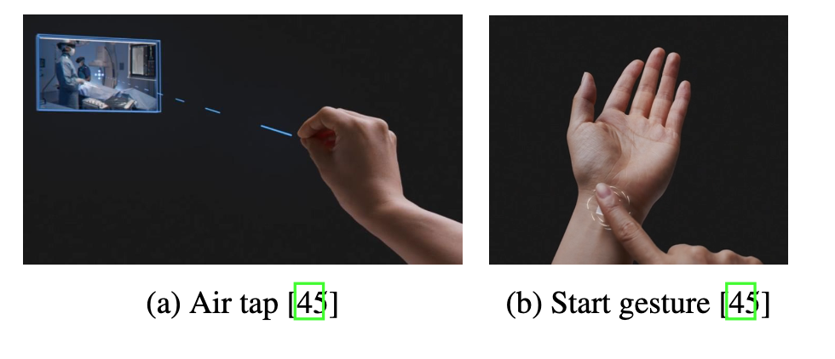
User Interaction Attack—Hand Gestures
Recall: malicious program in background samples performance counters
Performance counters have unique time series signatures
Example: Different patterns from user hand gestures

Slide 11
Concurrent Application attack: App Fingerprinting
Scenario: spy running in background and samples performance counters
Goal is to detect launch of an application
Different applications have different signatures

Slide 12
Environment Inference attack – Bystander ranging
Yes! Performance counters have unique time series signatures
Example: detect bystanders in view of the AR device:

Slide 13
A few more details

Slide 14
Top 10 features for classifying hand gestures

Slide 15
More complete inference pipeline
Hand gesture inference
Ran user studies and collected data from volunteers
Used time series ML tools to identify 10 most salient features/performance counters
Trained and tested various machine learning models
Machine learning method | Hololens 2 | Quest 2
K nearest neighbors | 47.0 | 57.1
Decision trees | 89.7 | 88.0
Random forest | 79.3 | 90.8
Light gradient boosting machine | 92.3 | 90.7

Slide 16
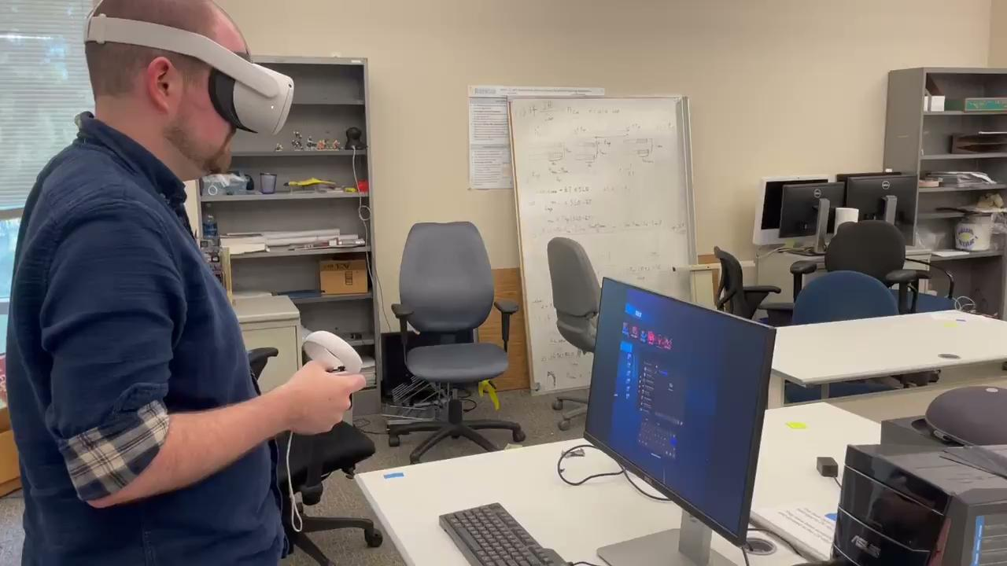
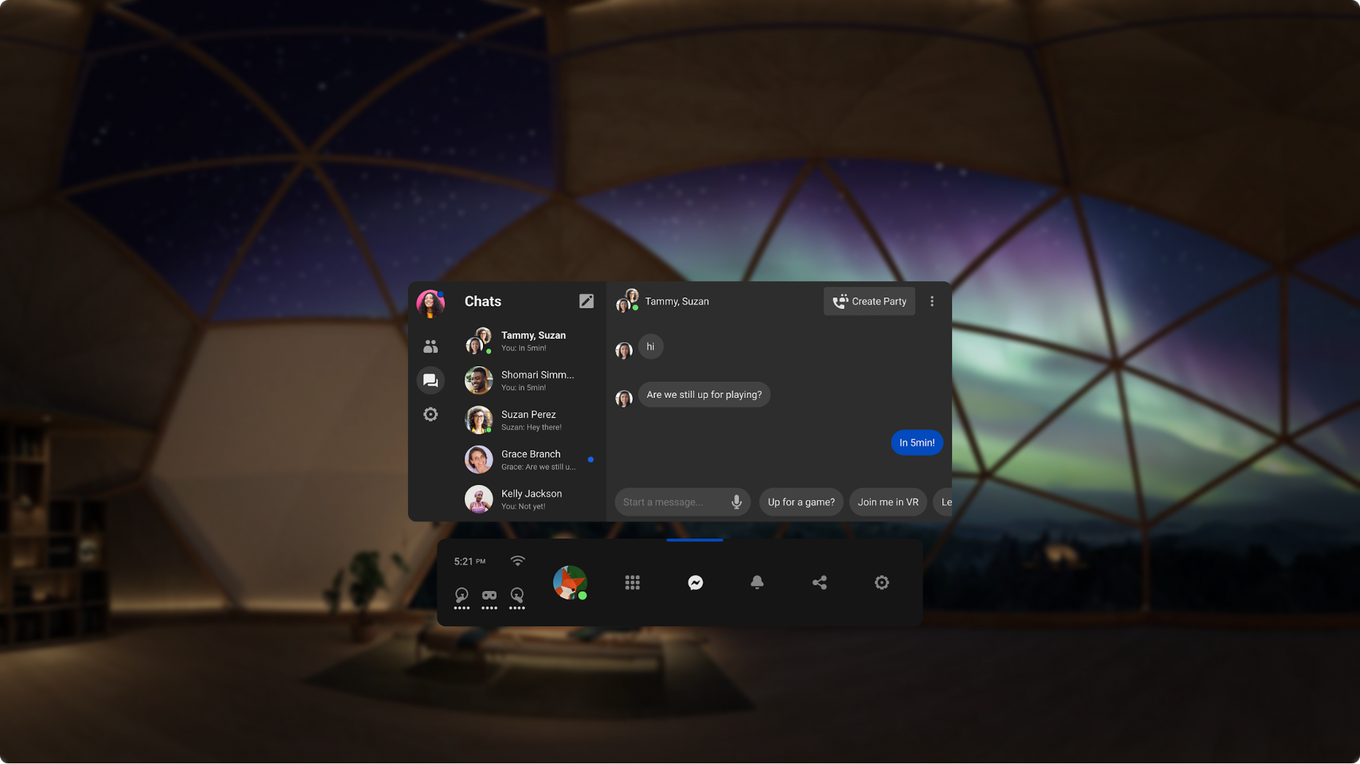
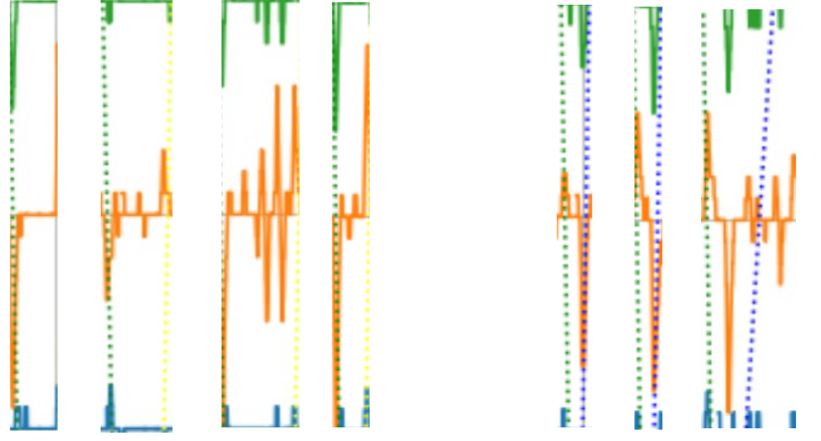
Can tracking APIs/sensors reveal typing in another app?
Yes! Head pose has unique time series signatures for different characters
Malicious background app
“apple”
“apple”
“apple”
“apple”
“map”
“map”
“map”
Headset angular velocity
Foreground app
Background app infers what is typed: “apple” or “map”
time

Slide 17
Attack workflow

Slide 18
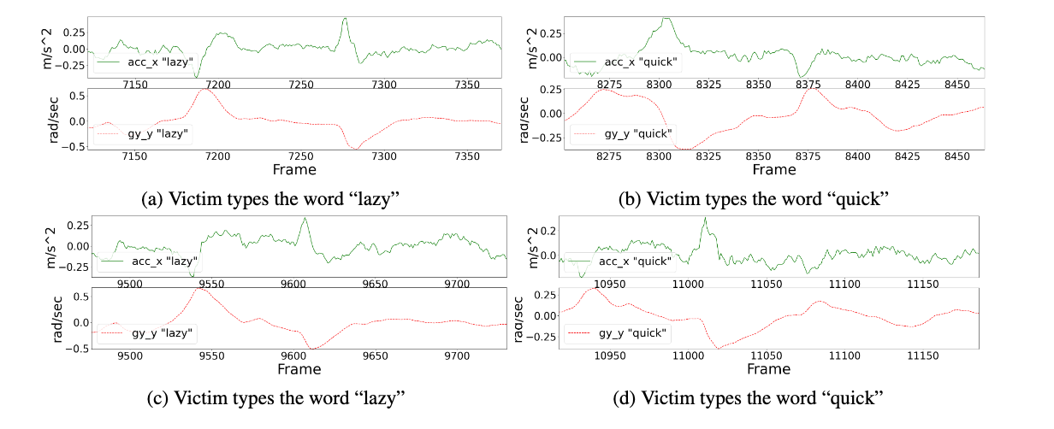
More examples

Slide 19
Performance/ 20 words corpus
Typed words inference
Machine learning method | Top-1 accuracy | Top-5 accuracy
Random | 0.05 | 0.25
ROCKET | 0.18 | 0.66
CNN | 0.75 | 0.99
(experiments on Quest 2)

Slide 20
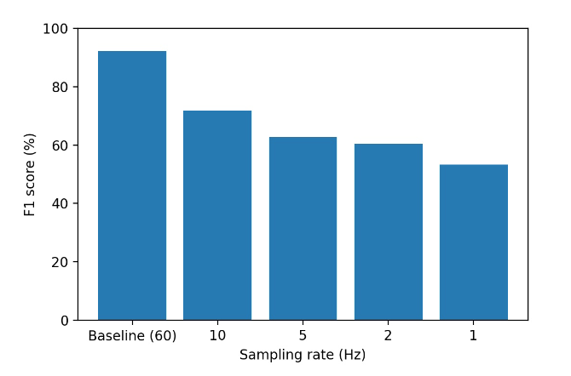
Potential mitigations
Reduce sampling precision
Limited success
Phenomena is mechanical
Millisecond-scale
Affects legitimate uses
Permission based?
Application share reality
Legitimate need for information
New models needed
What to share and when
Informed tradeoffs between functionality and security

Slide 21
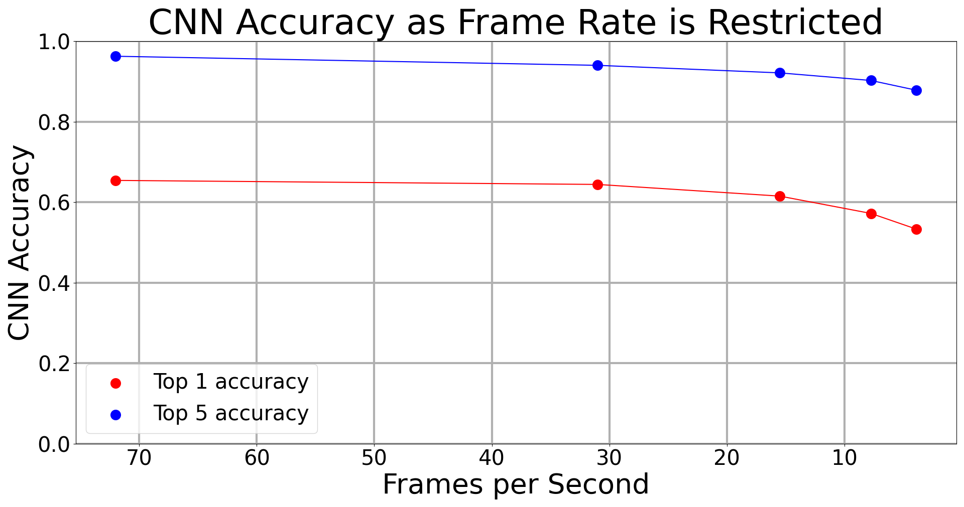
Potential Mitigations
Reduce available sampling rate of performance counters
Block access to performance counters completely → user suffers
User permissions → Informed consent difficult
…??
→ Sampling rate reduction ineffective!

