Slide 1
Large Reasoning Language Models in Clinical Applications
Ben Zhou
Assistant Professor, Arizona State University
https://arc-asu.github.io/

Slide 2
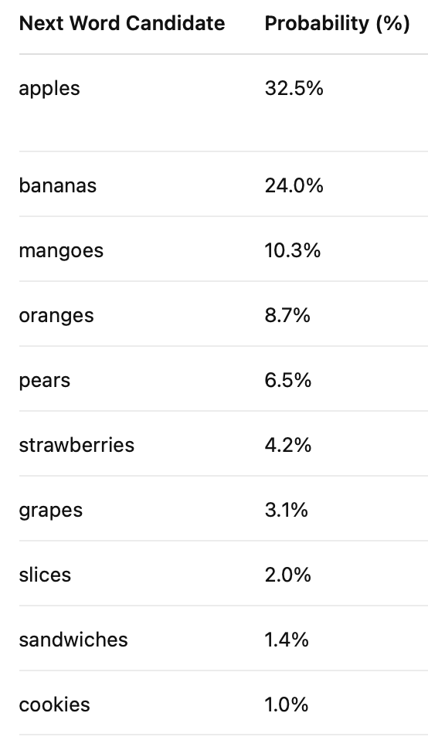
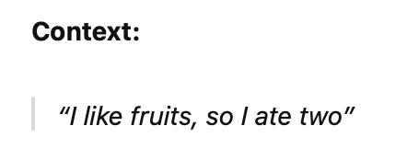
Language Models
Language Models (LMs) are models that attempt to predict word distributions given a context.
A good next-word prediction model encompasses logic and reason.

Slide 3
Large Language Models
Modern LLMs differ from smaller transformer-based LMs in several ways.
1. Larger models
LLMs usually have 7B to ~500+B number of parameters
Larger parameters enable better memorization and general capabilities

Slide 4
Large Language Models
Modern LLMs differ from smaller transformer-based LMs in several ways.
2. More training data
BERT used 0.8B tokens for training, while modern LLMs may use 15,000B tokens for training

Slide 5
Large Language Models
3. More sophisticated training methods
Pre-training: the process of establishing next-word distributions from raw text
Supervised fine-tuning (SFT): the process of providing task-specific data (with given expected outputs), such as instruction following, or QA

Slide 6
Large Language Models
3. More sophisticated training methods
Pre-training: the process of establishing next-word distributions from raw text
Supervised fine-tuning (SFT): the process of providing task-specific data (with given expected outputs), such as instruction following, or QA

Slide 7
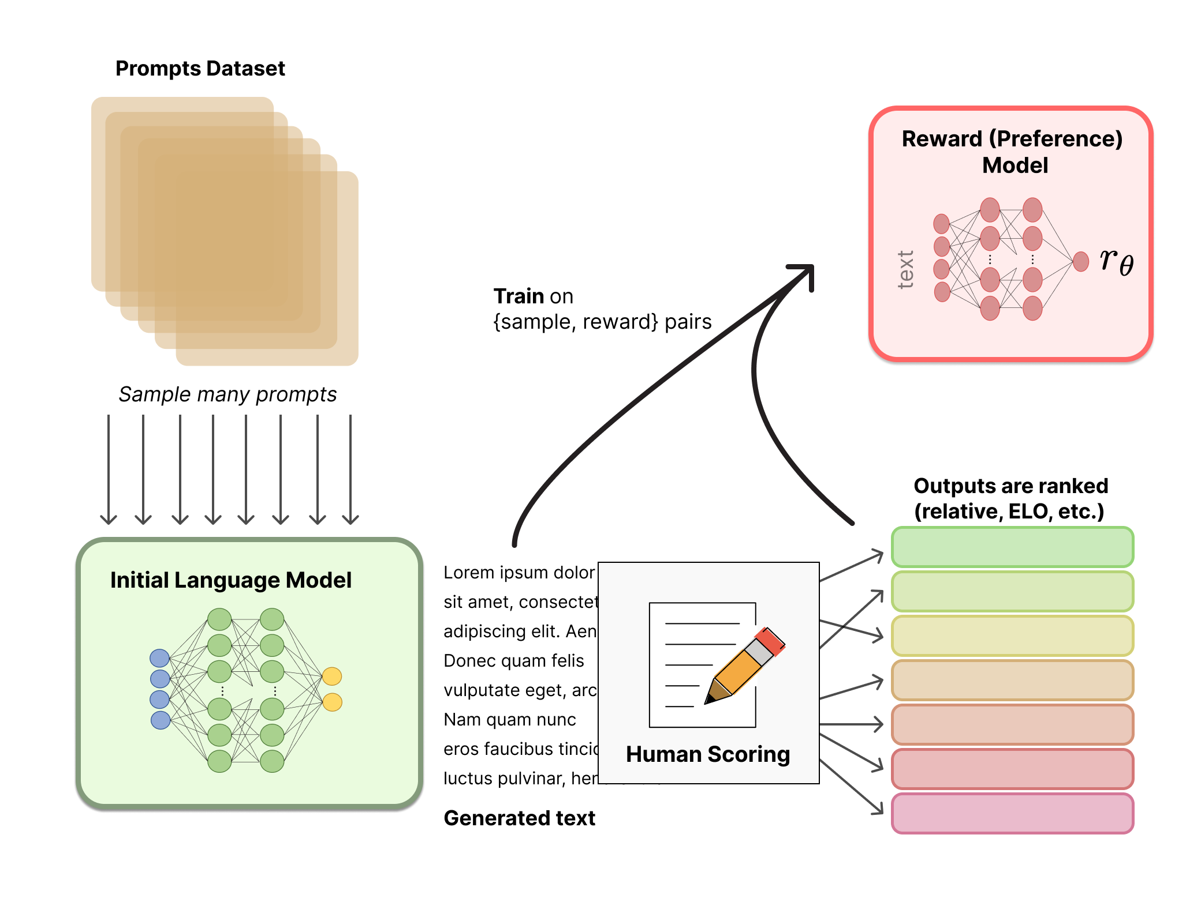
Large Language Models
3. More sophisticated training methods
Pre-training: the process of establishing next-word distributions from raw text
Supervised fine-tuning (SFT): the process of providing task-specific data (with given expected outputs), such as instruction following, or QA
RLHF / Alignment: the process of aligning model behaviors with human preferences
Credit: Huggingface

Slide 8
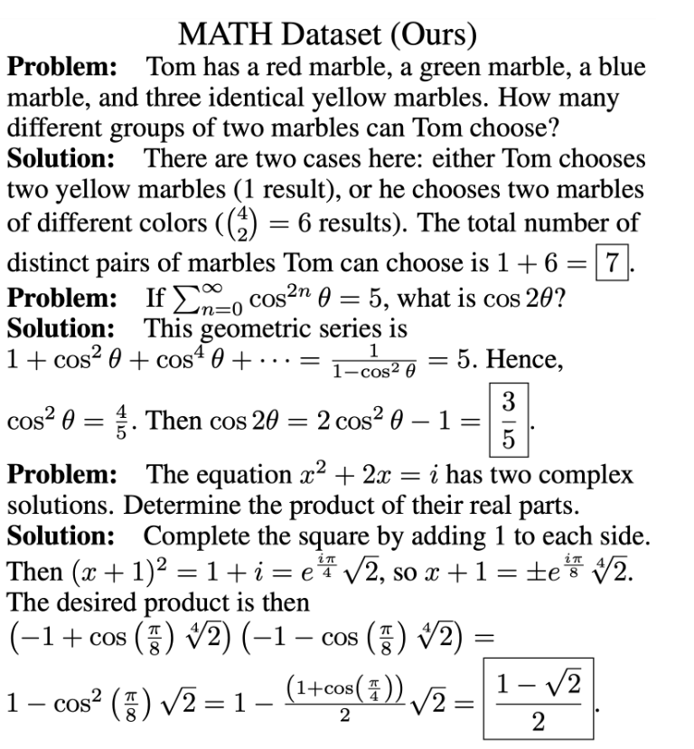
LLM Performance Progression
Model performances on MATH

Slide 9
More recently: “Reasoning” LLMs
Model performances on MATH

Slide 10
More recently: “Reasoning” LLMs
Source: OpenAI

Slide 11
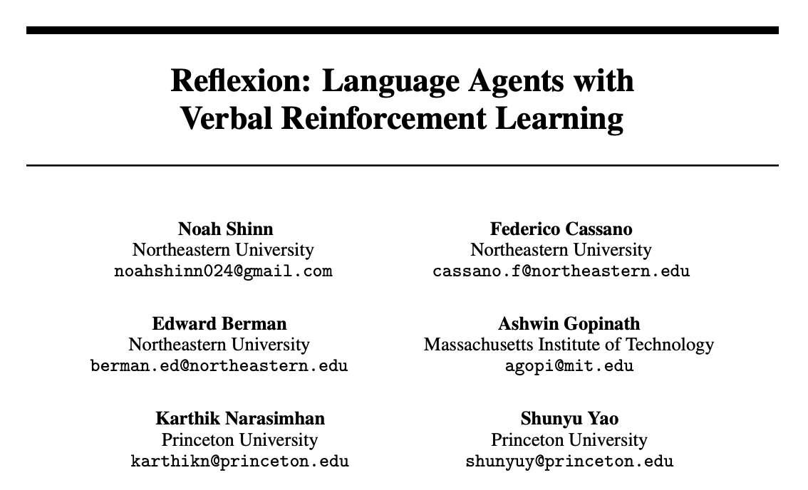
Foreshadowing Reasoning/Thinking Models
LLMs benefit from “thinking more” through self-generated/guided reflections and more elaborated rationales.

Slide 12
Reinforced Finetuning (RFT)
A scalable method to make models learn to self-reflect/elaborate
Brought into popularity/feasibility by:

Slide 13
SFT v.RFT
Supervised Fine-tuning (SFT)
Question
Human-annotated Solution
A car can run 100 miles on a full tank. How far can it run with half a tank?
100 / 2 = 50, the answer is 50 miles.
Model-generated Elaborated Solutions
Since the car only has half a tank, it can only travel … the answer is \box{50}
correct answer, correct format: reward: 1.0
The car can still travel the same distance … the answer is \box{100}
incorrect answer, correct format: reward: 0.5
Reinforcement learning algorithms: reward-based optimization. GRPO/PPO
The car is a Toyota RAV4 based on the description.
incorrect answer, incorrect format: reward: 0.0

Slide 14
Intuitive Comparisons between SFT/RFT
SFT can only provide “correct/positive” supervision, while RFT provides feedback on “incorrect/negative supervision.
Human-annotated Solution
Self-generated Negative Solution
100 / 2 = 50, the answer is 50 miles.
The car can still travel the same distance … the answer is \box{100}

Slide 15
Intuitive Comparisons between SFT/RFT
SFT enforces models to generate texts or answers in a “human style”, while RFT allows models to explore their own distribution.
RFT allows for more fine-grained updates that are more critical to LLM’s parameters.

Slide 16
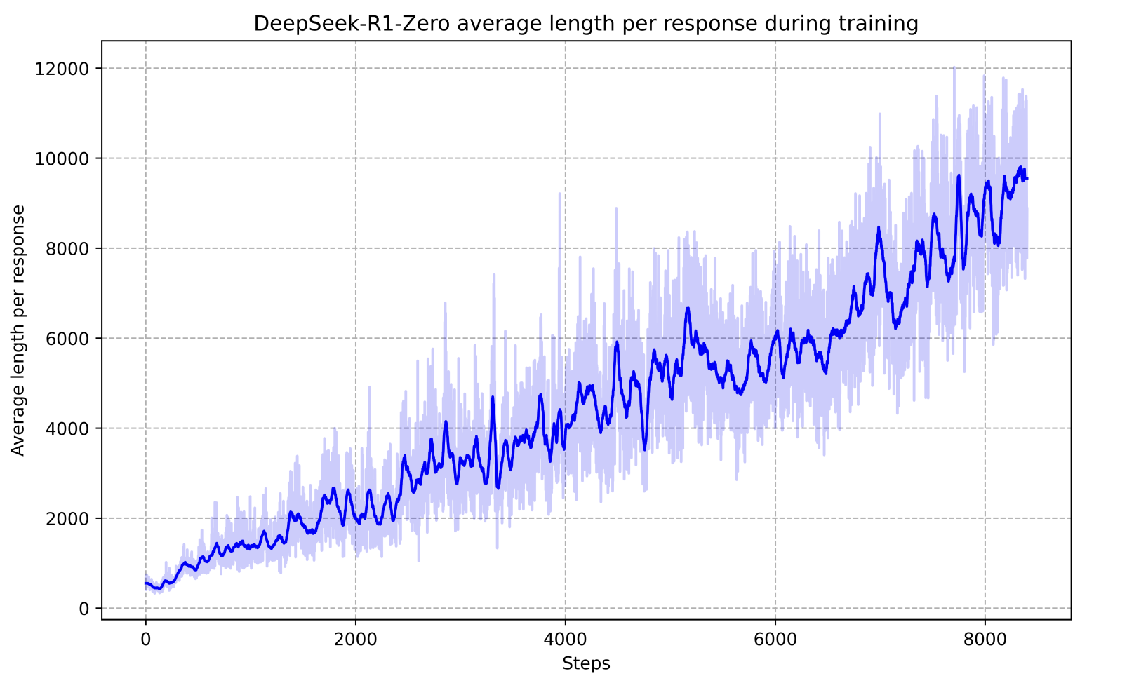
Thinking Model Behaviors
The elaborate and think longer before outputting the final answer

Slide 17
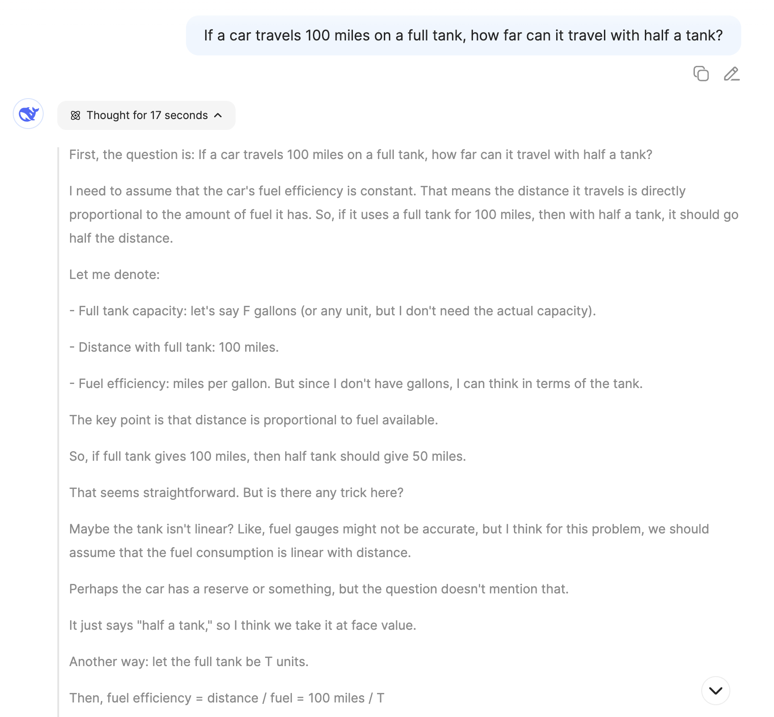
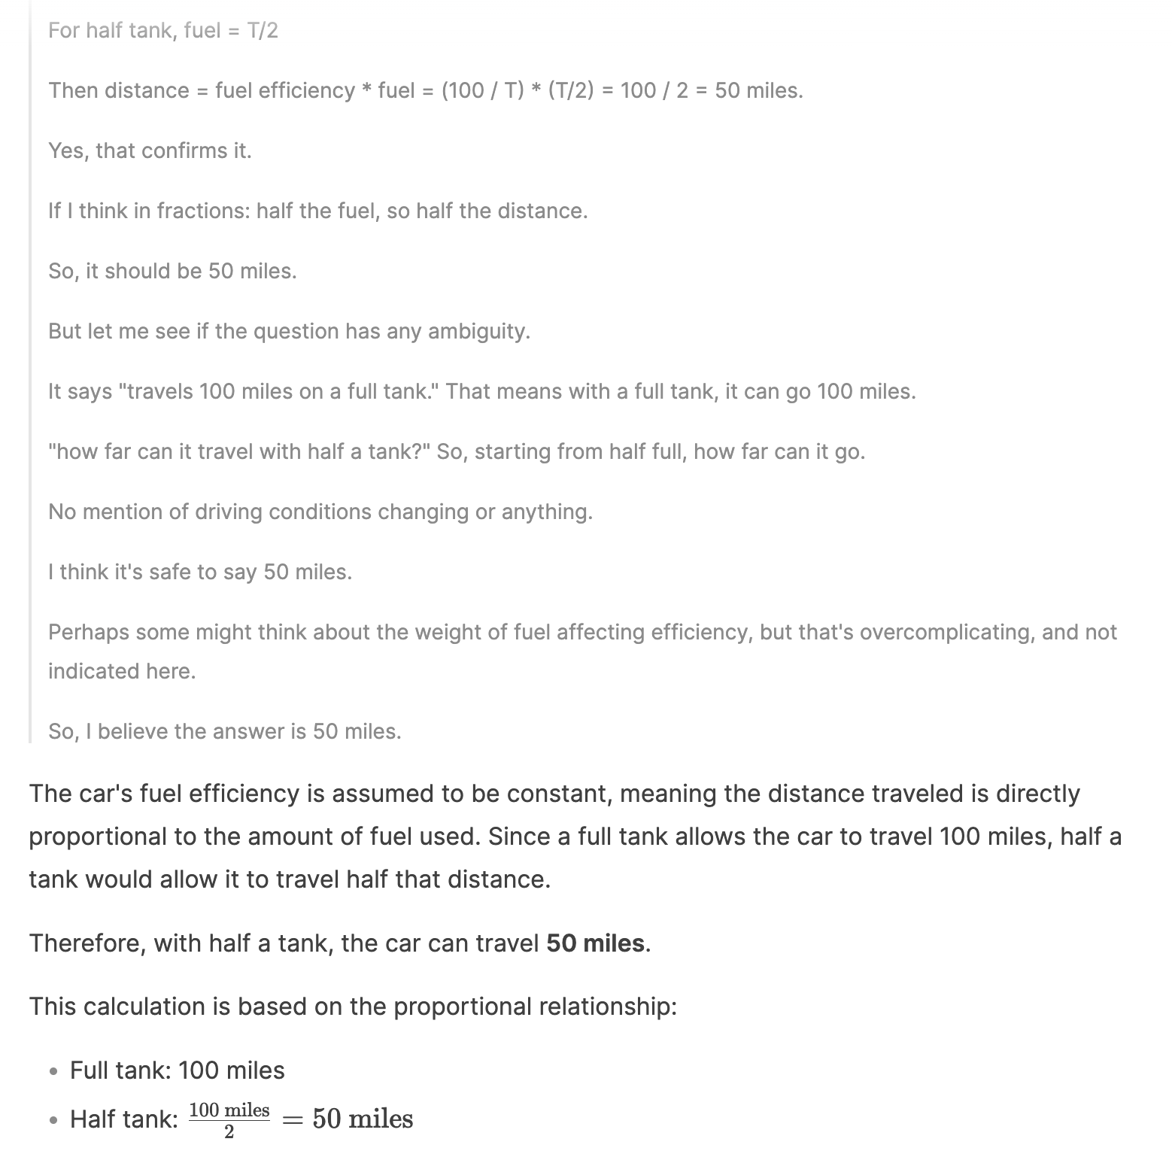
Thinking Model Behaviors

Slide 18
Thinking Exists in Smaller Models, too
Several reasoning/thinking models are 7-32B, enabling fast deployment and further training.

Slide 19
LLMs and Thinking LLMs
LLMs have progressed rapidly since 2018 to late 2024 with larger models, newer training techniques, and better data handling.
Since late 2024, a new training strategy called reinforced fine-tuning (RFT) has enabled models to self-explore longer inference-time outputs and generate more comprehensive and complex reasoning. These models are referred to as “thinking models.”
Many of these thinking models are open-sourced and small enough, so they can be hosted in-house for data-sensitive settings, such as clinical applications.

Slide 20
LLMs and Thinking LLMs
Where and when do we need thinking LLMs in clinical settings?

Slide 21
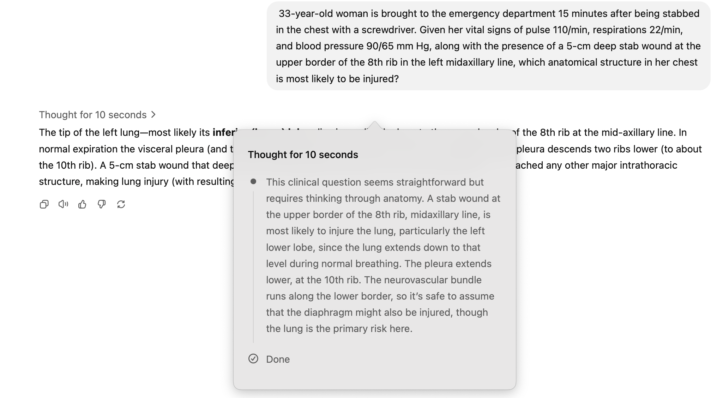
Direct Benefits with Minimum Efforts
Thinking LLMs have demonstrated superior performance on tasks that require long-form reasoning, arithmetic, and comprehensiveness.

Slide 22
Agentic Tool-use and Search
Tools: functions that can be called at LLM inference time.
Agents: Models that learned to use tools to iteratively interact with the world.
Browser Control
Device Control
Google Search
EHR Search
Home Automation
OR Automation
…
…

Slide 23
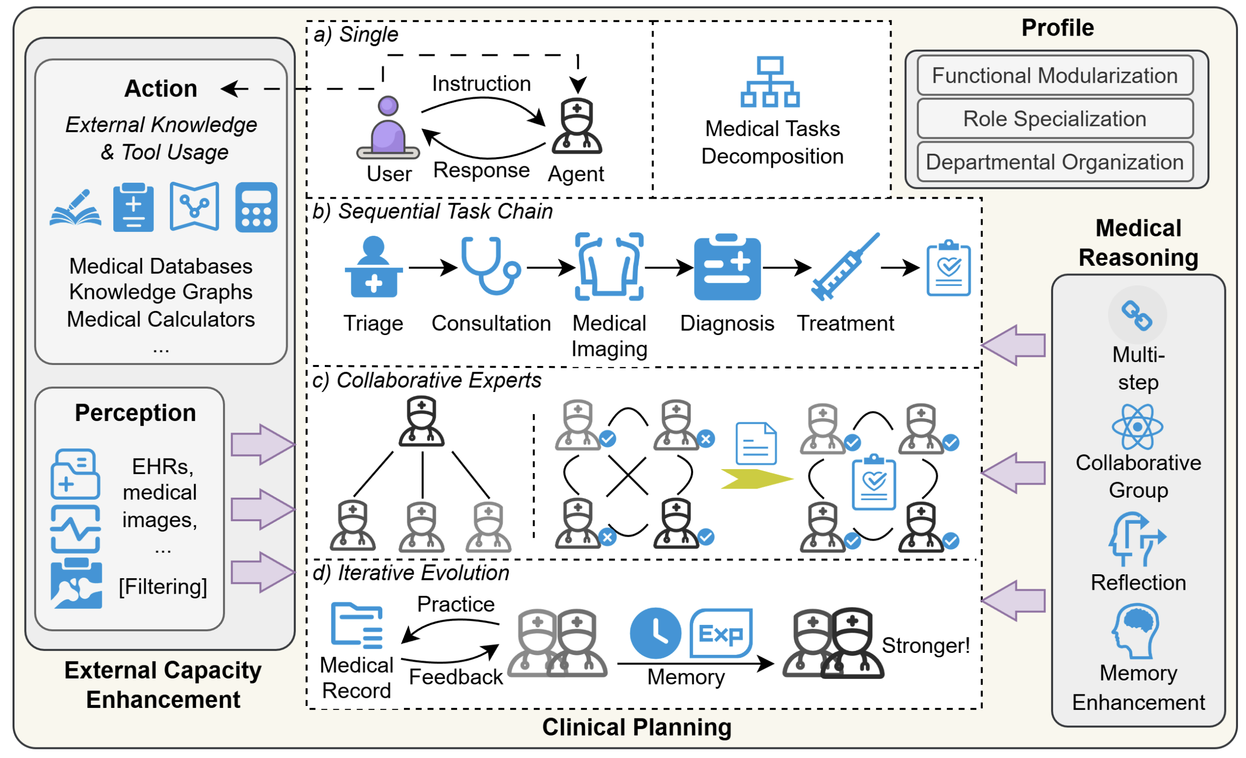
Agentic Tool-use and Search
Source: Wang et al. A Survey of LLM-based Agents in Medicine: How far are we from Baymax?

Slide 24
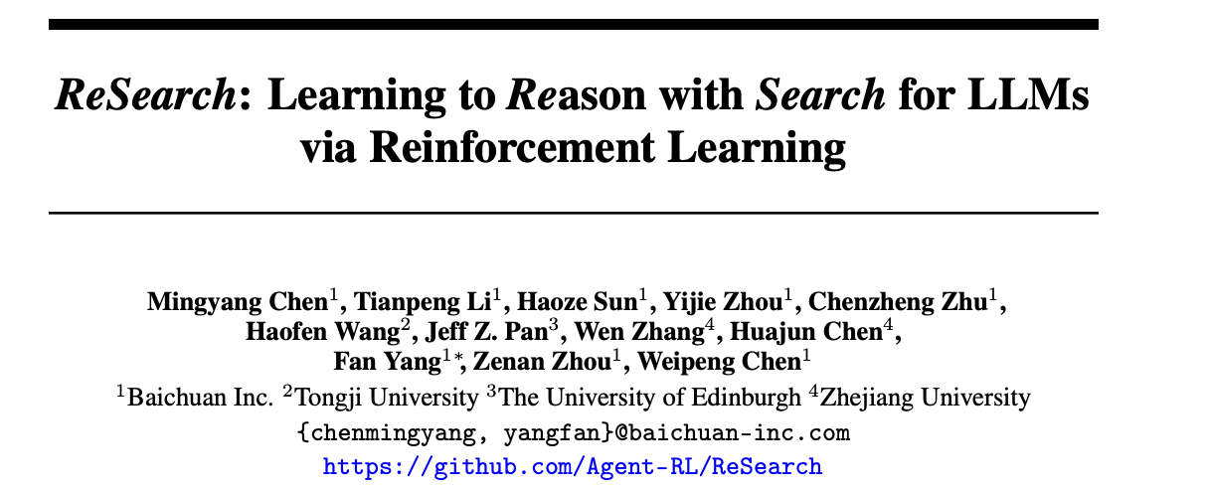
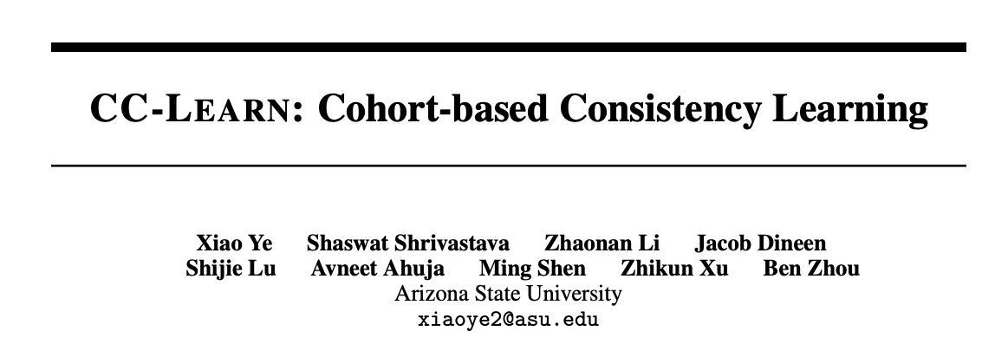
Improved Tool-use LLM Agents with RFT

Slide 25
Improved Tool-use LLM Agents with RFT
The general technical intuition is simple. Remember the RFT example:
Question
A car can run 100 miles on a full tank. How far can it run with half a tank?
Model-generated Elaborated Solutions
Since the car only has half a tank, it can only travel … the answer is \box{50}
correct answer, correct format: reward: 1.0
The car can still travel the same distance … the answer is \box{100}
incorrect answer, correct format: reward: 0.5
The car is a Toyota RAV4 based on the description.
incorrect answer, incorrect format: reward: 0.0

Slide 26
Improved Tool-use LLM Agents with RFT
Now we change it to settings that require some use of tools
General idea: models will likely get the right answer with the right tools, and will learn to use the right tools through RFT.
Question
What should I wear tomorrow?
Model-generated Elaborated Solutions
The date today is acquire_date(), tomorrow is … the weather is get_weather()…
correct answer, correct format: reward: 1.0
The weather is get_weather()
incorrect answer, correct format: reward: 0.5

Slide 27
Fine-grained Thinking Steering
Thinking models can separate “think” and “answer”
As a result, we can “steer” the model’s reasoning by directly manipulating this thinking part.
Question
A car can run 100 miles on a full tank. How far can it run with half a tank?
<think> We need to calculate … </think> <answer> the car can travel 50 miles with a half tank </answer>

Slide 28
Why do we need fine-grained steering?
In clinical settings, we need more fine-grained controls.
Example 1: Proper probabilistic estimation
LLMs suffer from computing conditional probabilities, which are needed in a lot of medical applications, such as diagnosis aid.
Symbolic Probabilistic Models
Task
Initial Reasoning
A patient has …. What is a likely diagnosis?
<think> We need to calculate the conditional probability … </think> <answer>…</answer>
Steered Reasoning
<think> To compute the probability, we consider…</think> <answer>…</answer>

Slide 29
Why do we need fine-grained steering?
In clinical settings, we need more fine-grained controls.
Example 2: Emotional Response
In patient-facing chatbots, we need the model to tailor to patients’ subtle emotional changes and needs.
Emotion Analysis
Patient Question
Initial Reasoning
What is the treatment next?
<think>We consider the patients condition … </think> <answer>…</answer>
Steered Reasoning
<think>…in addition to the condition, we consider the patients’ emotion, which …</think> <answer>…</answer>

Slide 30
Fine-grained Thinking Steering

Slide 31
Thank you!
Compared LLM v. smaller LMs
Compared Thinking LLMs v. LLMs
Key difference: reinforced fine-tuning
Discussed how thinking LLMs can be useful in clinical settings.

