Slide 1
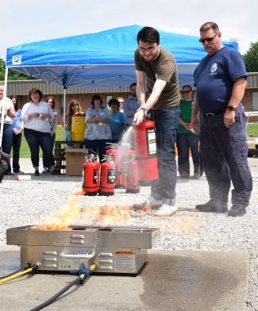
Minute for Safety -
Fire Extinguishers
Prepare
Learn to use one before there is a fire.
Familiarize yourself with the location of the extinguishers
Using a Fire Extinguisher
Use a fire extinguisher only if you have been trained to do so.
If you have any doubts, exit immediately and pull a fire alarm & call 911.
Report the fire first. Call 911 before attempting to use an extinguisher
Keep your back to the exit and P.A.S.S.
Pull the pin
Aim low, at the base
Squeeze the lever
Sweep side to side
Additional resources:
Emergency Response Guide – Fire (p.10)
Fire Safety – F&S Code Compliance & Fire Safety
Fire Extinguisher Training – Division of Research Safety
ISE / OFFICE OF SAFETY
GRAINGER ENGINEERING
Notes:
Immediately report accident/incident to supervisor
Promptly seek medical care as needed
Thoroughly complete and sign the First Report of Injury/Illness

