Slide 1
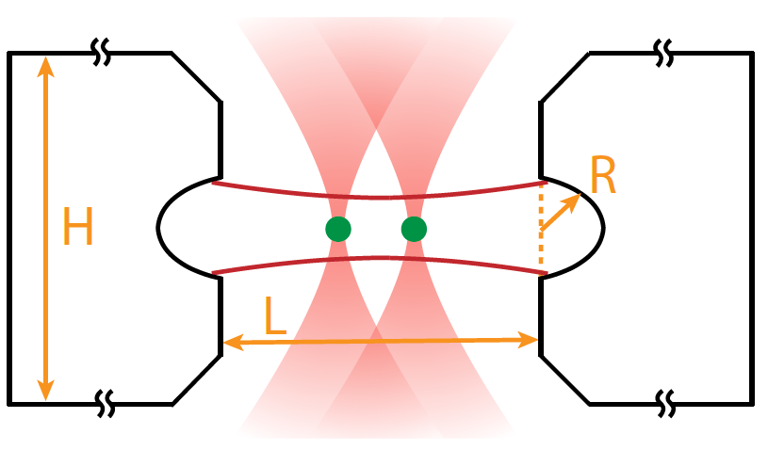
Jacob Covey Assistant Professor, Physics
https://physics.illinois.edu/people/directory/profile/jcovey
Coveylab.com
jcovey@illinois.edu
Updated November27 2020
Research Interests
Arrays of neutral atoms for quantum information science
Distributed quantum computing
Quantum error correction and fault-tolerance
Optical atomic clocks
Multiplexed telecom-band communication
Current Projects
Alkaline earth atoms in optical tweezer arrays
Atom array optical atomic clocks
Remote entanglement generation
In situ quantum error detection
Many-body entangled states on nuclear or optical qubits via Rydberg interactions
Simulation of quantum repeaters based on atoms in optical cavities
Interest areas for collaboration/future work
Quantum computing, communication, and sensing with cold atoms; devices for simplifying and miniaturizing cold atom systems
Keywords: Quantum entanglement, atomic physics, quantum optics, Rydberg states, optical atomic clocks, quantum error correction

