Slide 1
EMP Risk Assessment & Mitigation Prioritization
Glen Salo
Jose Schutt-Aine
Andreas Cangellaris
Xu Chen

Slide 2
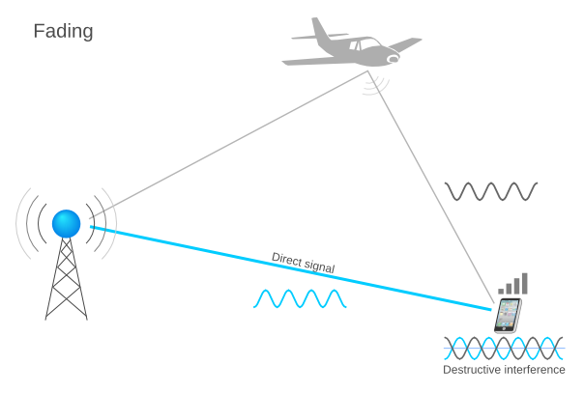
EMP – Electromagnetic Pulse “An Extreme Electromagnetic Incident”
EMP: A nuclear detonated 40 km or more above the surface of Earth
GMD (A geomagnetic disturbance): A temporary disturbance of Earth’s magnetic field resulting from interactions with solar eruptions
HPM (High Power Microwave): A non-nuclear directed energy weapon
Electromagnetic Interference
https://wiki.yatebts.com
Content is available under Creative Commons Attribution-ShareAlike 4.0

Slide 3
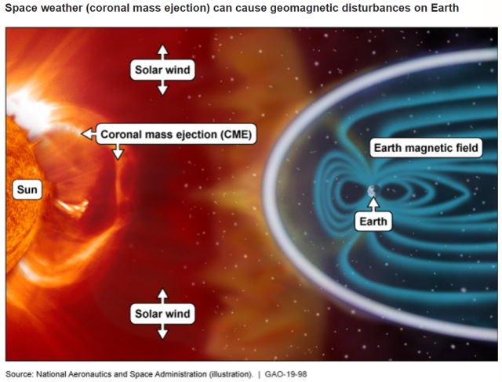
“[EMP] can affect large geographic areas, disrupting elements critical to the Nation’s security and economic prosperity…”
Executive Order on Coordinating National Resilience to Electromagnetic Pulses

Slide 4
EMP – A “Hard Problem” Different from naturally occurring hazards
“Low probability/high consequence scenario that challenge[s] effective policymaking…”
“Assessments of the risks … are intrinsically difficult to produce due to the rarity – or complete absence – of actual events…”
Significant technical and operational uncertainties (threat & effect) lead to policy challenges
Significantly different from other large-scale hazards – effects occur within milliseconds or seconds

Slide 5
EMP Risk – Recognized to be of Contemporary Relevance
Executive Order on Coordinating National Resilience to Electromagnetic Pulses
“…potential to disrupt, degrade, and damage technology and critical infrastructure…”
Signed 17 days ago!

Slide 6
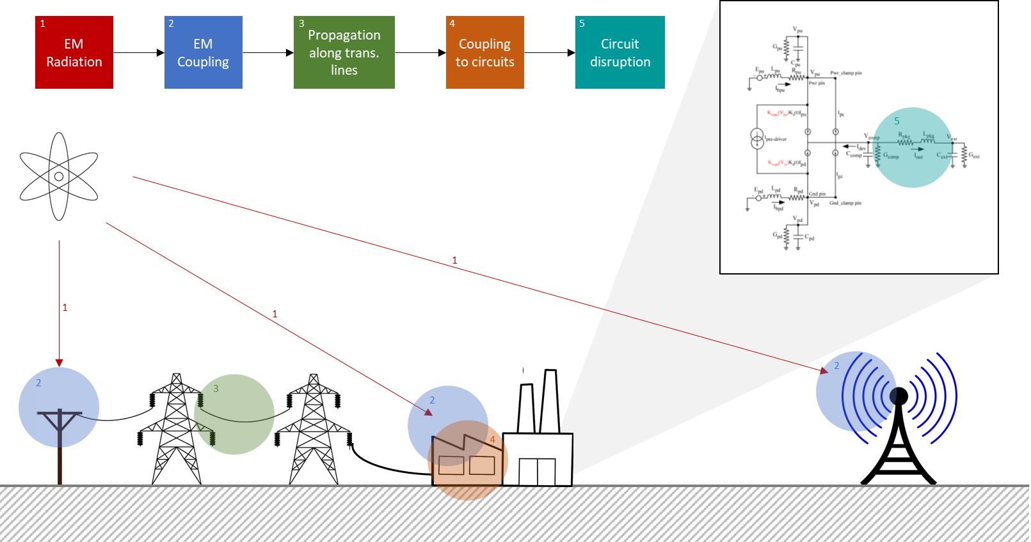
Our Objectives
Goal: Determine circuit-level impact
Develop an EMP risk assessment capability
Conduct assessments on critical infrastructures

Slide 7
A Few of the Challenges
Numerous Uncertainties
Source characteristics
Physical layout
Electronic components
Operational status
Computational requirements
E.g., Spatial resolutions ranging from mm to hundreds of km
Statistical variations
Limited testing options
Traditional brute force or statistical approaches are not practical

Slide 8
Our Approach
Embrace uncertainty
Subdivide the problem into manageable subsystems
Employ existing EM/circuit analysis simulation software
Integrate advancements in statistical analysis
Stochastic collocation
Stochastic LIM
Random coupling model
Work with established industry leaders to commercialize our product – ANSYS, Inc.
Collocation Nodes
$$f(\vec{x})$$
Interpolation
Statistics
EM Simulation
Source Extraction
Circuit Simulation

Slide 9
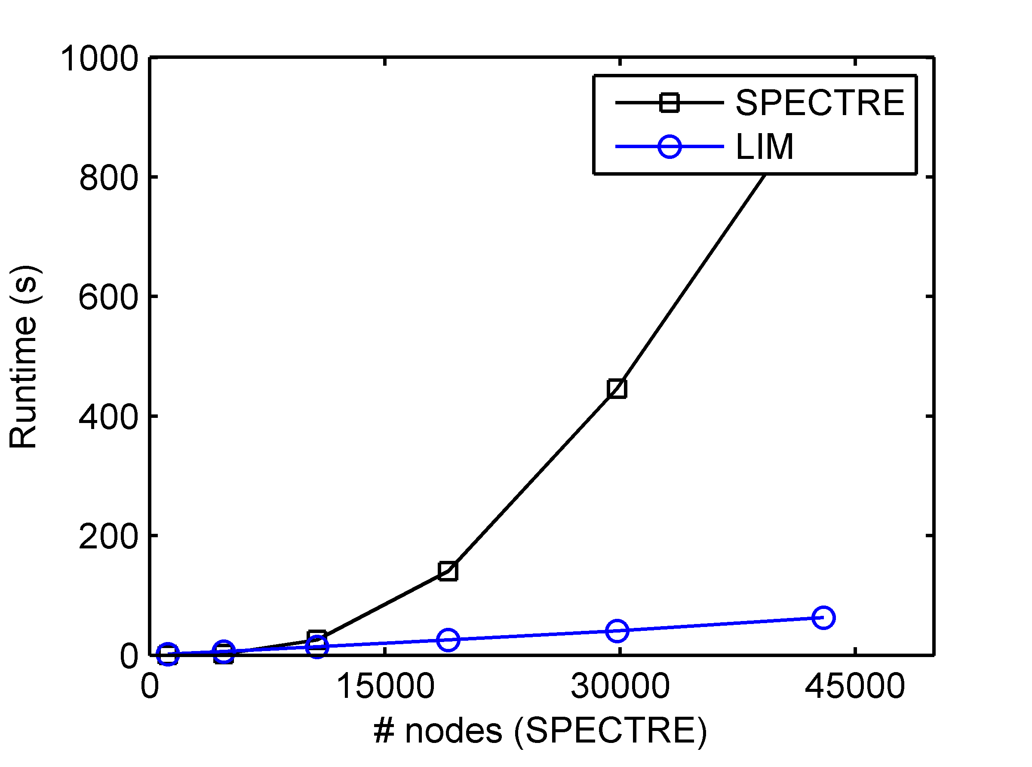
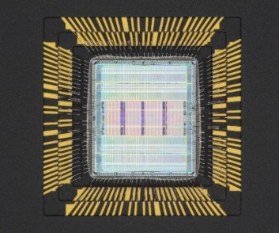
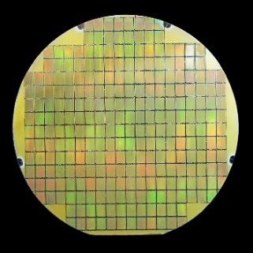
Latency Insertion Method (LIM)
PCB
How to handle circuit simulation in multilevel high-complexity environment?
TL, sensors
Linear+Nonlinear
Scaling with λ
LIM exhibits linear numerical complexity!
Outperforms conventional SPICE-like simulators.
* Intel 3.16 GHz processor, 32 GB RAM.
Circuit Size | # nodes (SPECTRE) | SPECTRE (s) | LIM (s)
20 × 20 | 1160 | 0.15 | 1.53
40 × 40 | 4720 | 2.14 | 6.25
60 × 60 | 10680 | 25.73 | 14.23
80 × 80 | 19040 | 140.59 | 25.71
100 × 100 | 29800 | 445.77 | 40.64
120 × 120 | 42960 | 945.00 | 62.89
PACKAGE
Interconnects
Linear
Multilayer
Scaling with λ
IC
Transistors
Nonlinear
Subnanometer
Scaling with tech

Slide 10
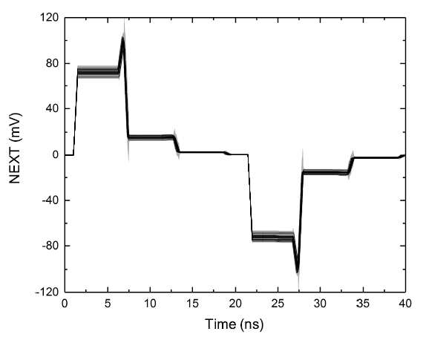
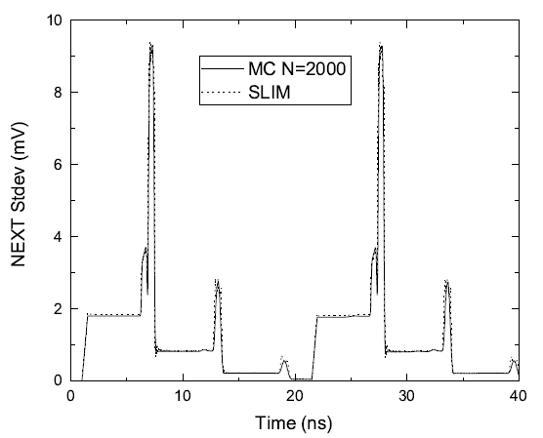
Stochastic LIM
Solve circuits problems where R,L,C etc are random variables
Uses LIM along with Stochastic Galerkin method to solve for Polynomial Chaos expansion coefficients of voltages and currents
Obtains probability distribution of transient voltages and currents with a single simulation of expanded state space system
Example | Method | EM Extraction | Transient Simulation | Post-Processing | Total | Speed-up
Coupled-line | SLIM | 402 | 107 | 10 | 519 | 48.025
 | MC | 3990 | 14000 | 6935 | 24925
Fiber-weave | SLIM | 49 | 41 | 10 | 100 | 292.02
 | MC | 5011 | 14000 | 10191 | 29202

Slide 11
Random Coupling Model
EMP
[1]-[4]
An efficient method to determine the EMP-induced fields inside large structures
Key features:
Exploits geometric/material complexity of the interior to quantify the coupling through a wave chaos-based stochastic model
Potential to improve calculation efficiency by 2 orders of magnitude compared to brute-force deterministic field solvers
[1] X. Zheng, T. M. Antonsen, and E. Ott, Electromagnetics, vol. 26, pp. 3-35, 2006.
[2] X. Zheng, T. M. Antonsen, and E. Ott, Electromagnetics, vol. 26, pp. 37-55, 2006.
[3] M. L. Mehta, Random Matrices, 3rd ed., New York: Academic, 2004.
[4] J. G. Gill et al, IEEE Trans. Electromagn. Compat., vol. 58, no. 5, Oct. 2016.

Slide 12
Year 1 Tasks
Develop an EMP model for an electric grid substation
Conduct an EMP assessment using our existing EMI capabilities
Proof-of-concept integration of Stochastic LIM

Slide 13
Thank You!

