Slide 1
Basic Single Cell Lab
Jenny Drnevich, PhD
Assistant Director, HPCBio
Roy J. Carver Biotechnology Center
June 25, 2025
Lab assistants:

Slide 2
Learning objectives
Examine 10x Genomics's web_summary.html report from the output of Cell Ranger
Walk through the steps of a standard Seurat analysis
Read explanations of why each step done
Run codes to do each step
Explore how to interact with a Seurat object
Try both manual and computational cell type calling
Get links for examples of more complex single cell and spatial analyses

Slide 3
Web_summary.html file
This public one is from cellranger multi not cellranger count but all the same information is in there:
Cells tab on left:
Any warnings at top?
Cell metrics:
# called - If >> targeted, high background. If << targeted, poor-quality cells
mean reads - If >> targeted, few good cells. If << targeted,
median genes - variable between tissue/cell types but ideally > 1000
total genes - summed over all genes; 20K+ for mammalian cells.
median UMIs - compare with mean reads (PCR dups) and median genes (shows ~UMIs per gene)
% mapped reads in cells - if >> 90% can indicate ambient background RNA
t-SNE
On left shaded by UMI counts and show strong correlation due to no normalization
right shows first clusters
10k Mouse E18 Combined Cortex, Hippocampus and Subventricular Zone Cells, Chromium GEM-X Single Cell 3' Gene Expression Dataset by Cell Ranger 8.0.0, 10x Genomics, Inc, (2024, Apr 15). Used with permission of 10x Genomics, Inc.
Notes:
When making your single cell libraries, there will be a targeted number of cells, maximum 10K for v3 chemistry and maximum of 20K for v3 GEM-X chemistry. Ask whoever made the libraries how many were targeted. If the number called by cellranger is >> more than targeted (e.g., expected 10k but called 18k), there may have been high ambient background RNA leading to many empty GEMs called as cells. if the number called is << targeted (only 2K called but 10K expected) likely the library has many poor-quality cells with few transcripts for sequencing. The number of called cells is inversely correlated with the mean reads per cell.
Based on the number of targeted cells, the sequencing center will also try to target a particular number of reads per cell to estimate the amount of sequencing needed. Usually 50K reads per cell is the target, but ask whoever sequenced the cells how many were targeted. If the mean reads per cell is >> targeted, likely were few high quality cells that made good libraries so they were preferentially sequenced (and # called cells will be very low). If the mean reads << targeted, likely had many more cells called because of ambient RNA (and also % mapped reads in cells likely to be low)
The median genes detected means how many genes had at least 1 UMI. This can vary greatly between cell types and tissue types, but usually > 1000 is good. New GEM-X chemistry can detect more.
The total genes detected is across all cells and usually is much larger than the median per gene because of dropouts in individual cells. Often >20,000 for mammalian samples
The median UMIs is after collapsing down reads to unique UMIs. Comparing with the mean reads indicates the level of PCR duplication. Also comparing with median genes per cell can estimate the number of UMIs per gene on average. In this example, 13505/4213 = 3.2 UMIs per gene.
% mapped reads in cells can indicate how many of the valid reads ended up in called cells. If low, can indicate widespread ambient RNA in background.

Slide 4
Web_summary.html file
This public one is from cellranger multi not cellranger count but all the same information is in there:
Library tab on left:
Cell Statistics (same as Cells tab)
Sequencing and Mapping metrics: click on ? for explanations
Metrics Per Physical Library
Sequencing saturation - "The fraction of reads originating from an already-observed UMI." Indicates whether more sequencing would result in substantially more reads.
Plots
GEX Barcode Rank Plot - should see sharp "cliff"
Sequencing Saturation & Median Gene per Cell - show downsampled values to observe curve and extrapolate what extra sequencing would gain.
10k Mouse E18 Combined Cortex, Hippocampus and Subventricular Zone Cells, Chromium GEM-X Single Cell 3' Gene Expression Dataset by Cell Ranger 8.0.0, 10x Genomics, Inc, (2024, Apr 15). Used with permission of 10x Genomics, Inc.
Notes:
When making your single cell libraries, there will be a targeted number of cells, maximum 10K for v3 chemistry and maximum of 20K for v3 GEM-X chemistry. Ask whoever made the libraries how many were targeted. If the number called by cellranger is >> more than targeted (e.g., expected 10k but called 18k), there may have been high ambient background RNA leading to many empty GEMs called as cells. if the number called is << targeted (only 2K called but 10K expected) likely the library has many poor-quality cells with few transcripts for sequencing. The number of called cells is inversely correlated with the mean reads per cell.
Based on the number of targeted cells, the sequencing center will also try to target a particular number of reads per cell to estimate the amount of sequencing needed. Usually 50K reads per cell is the target, but ask whoever sequenced the cells how many were targeted. If the mean reads per cell is >> targeted, likely were few high quality cells that made good libraries so they were preferentially sequenced (and # called cells will be very low). If the mean reads << targeted, likely had many more cells called because of ambient RNA (and also % mapped reads in cells likely to be low)
The median genes detected means how many genes had at least 1 UMI. This can vary greatly between cell types and tissue types, but usually > 1000 is good. New GEM-X chemistry can detect more.
The total genes detected is across all cells and usually is much larger than the median per gene because of dropouts in individual cells. Often >20,000 for mammalian samples
The median UMIs is after collapsing down reads to unique UMIs. Comparing with the mean reads indicates the level of PCR duplication. Also comparing with median genes per cell can estimate the number of UMIs per gene on average. In this example, 13505/4213 = 3.2 UMIs per gene.
% mapped reads in cells can indicate how many of the valid reads ended up in called cells. If low, can indicate widespread ambient RNA in background.

Slide 5
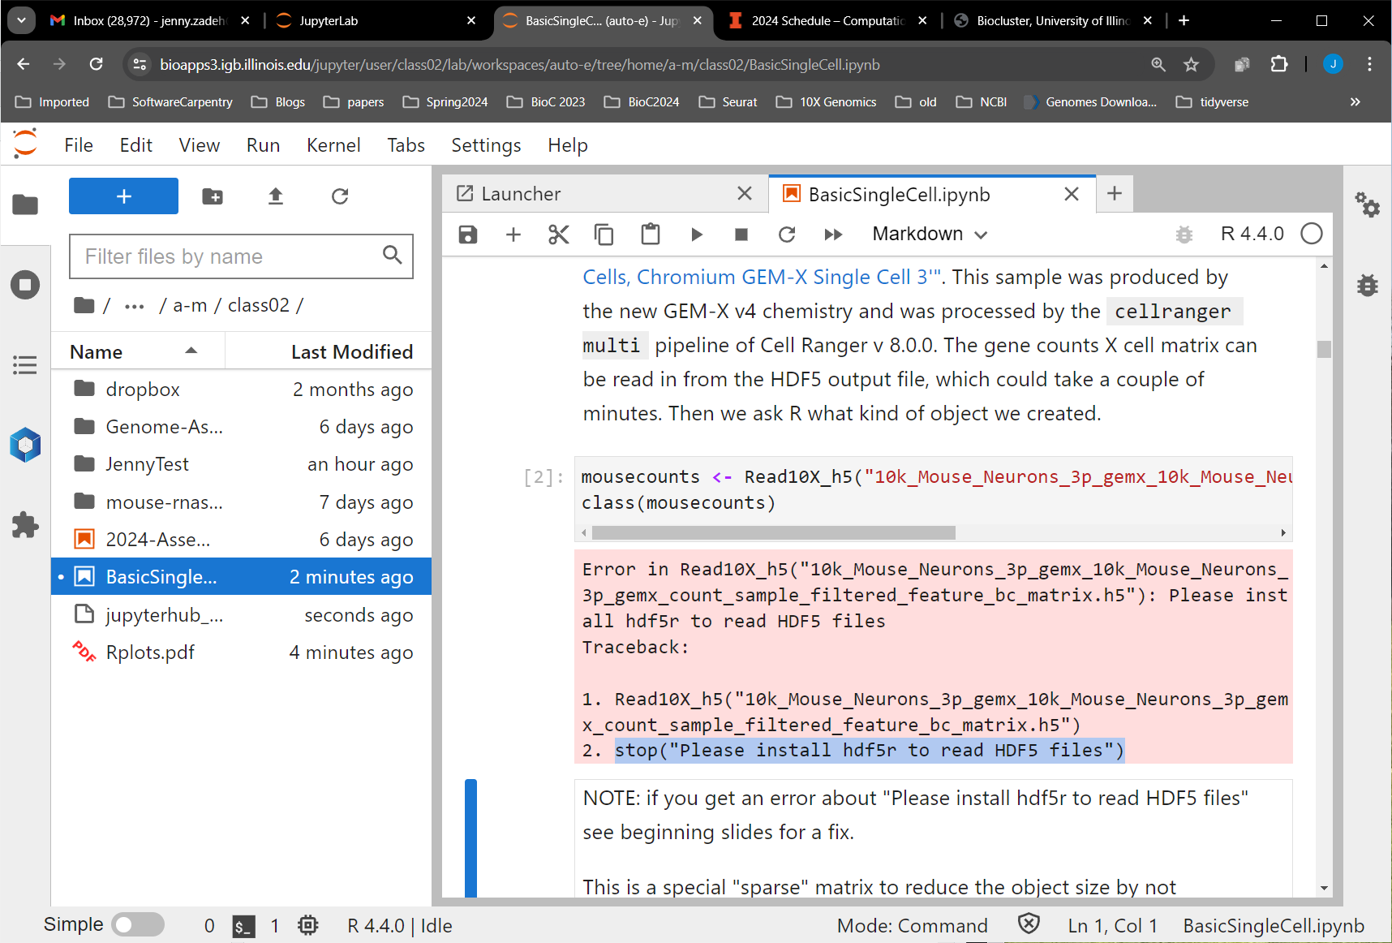
stop("Please install hdf5r to read HDF5 files")
If you get this error in the second code box then you did not load the Mayo module before opening the .ipynb.
To fix, follow next slides

Slide 6
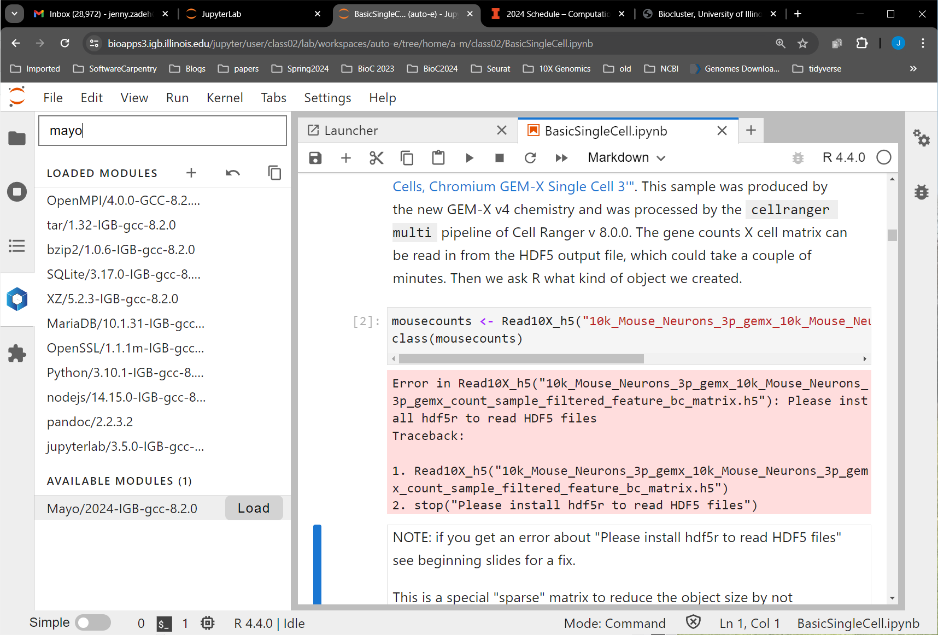
Load Mayo module
Click on blue hexagon
Search for Mayo at top
Click on "Load" by Mayo module at bottom.
2
1
3

Slide 7
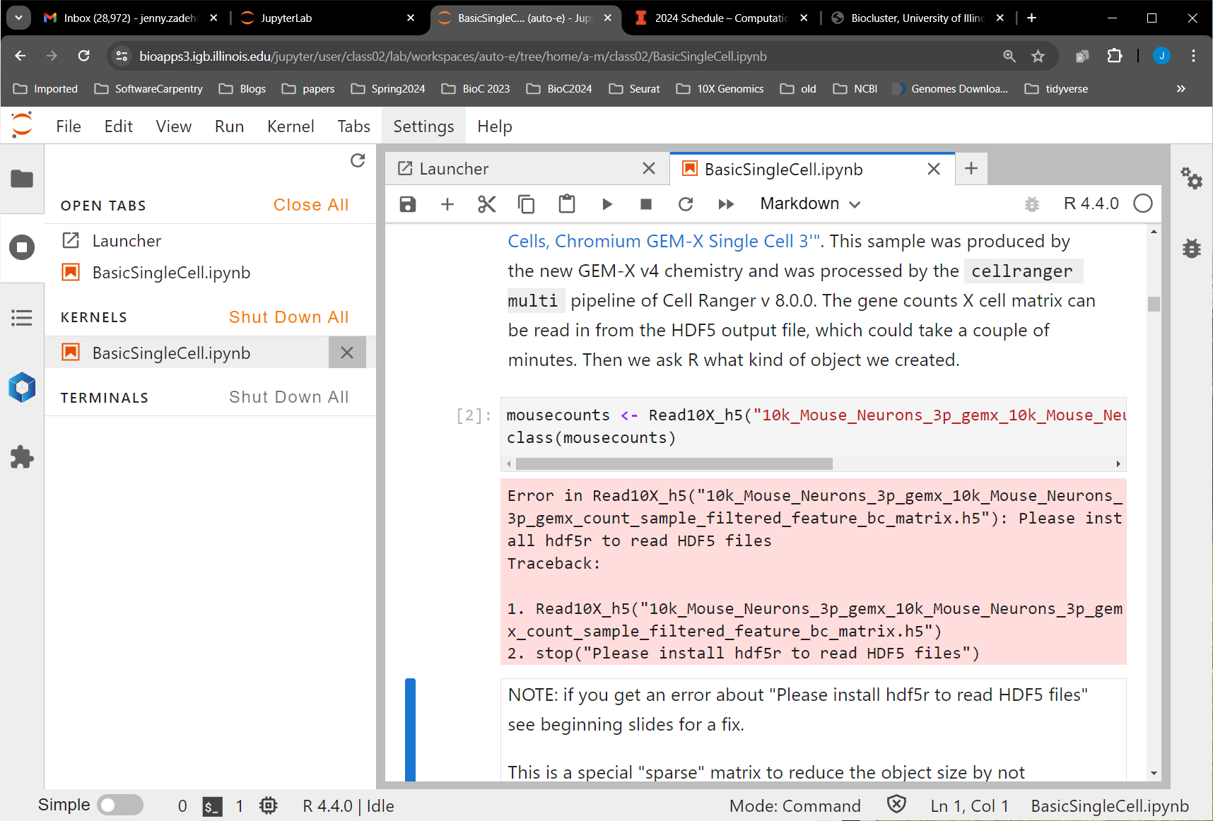
Stop Kernel
Click on gray circle with white square on left
Under KERNELS click on the X by BasicSingleCell.ipynb
1
2

Slide 8
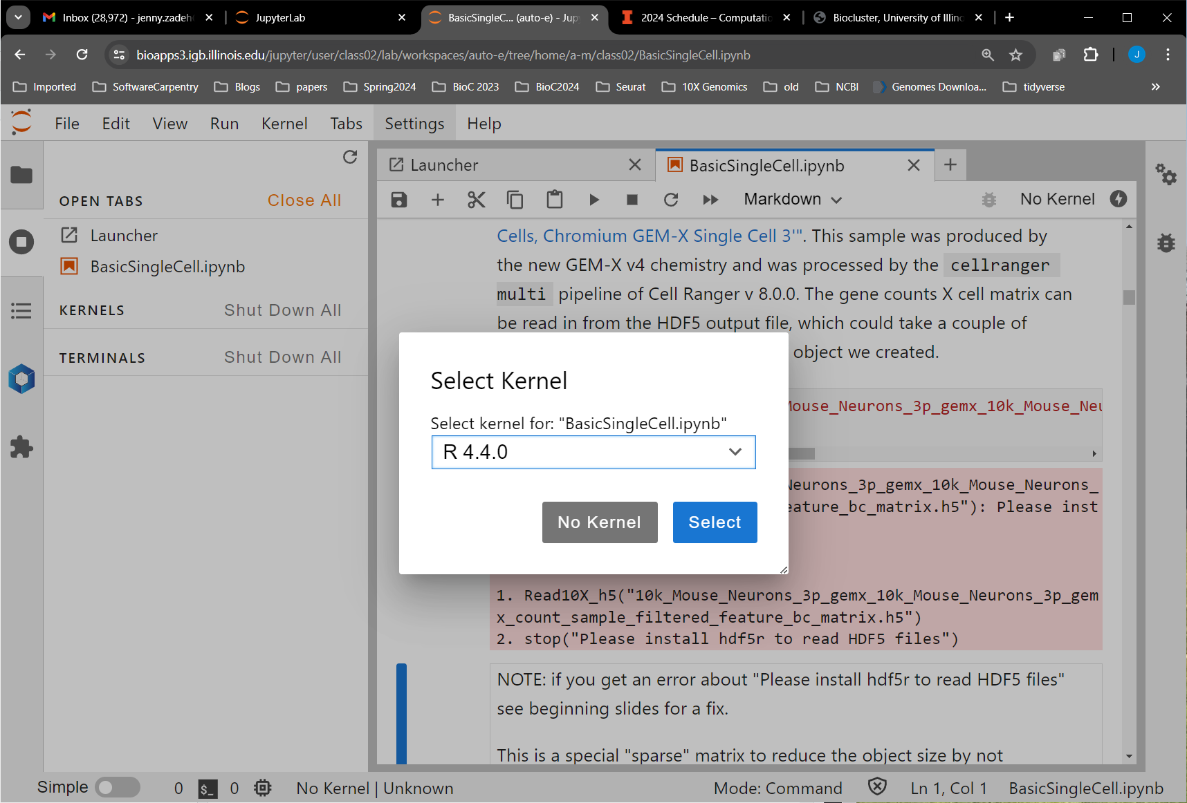
Re-start Kernel
Click on the "No Kernel" in the top right of the .ipynb to get the pop-up
Pick R 4.4.0 from the drop down menu
Click on "Select"
1
2
3

Slide 9
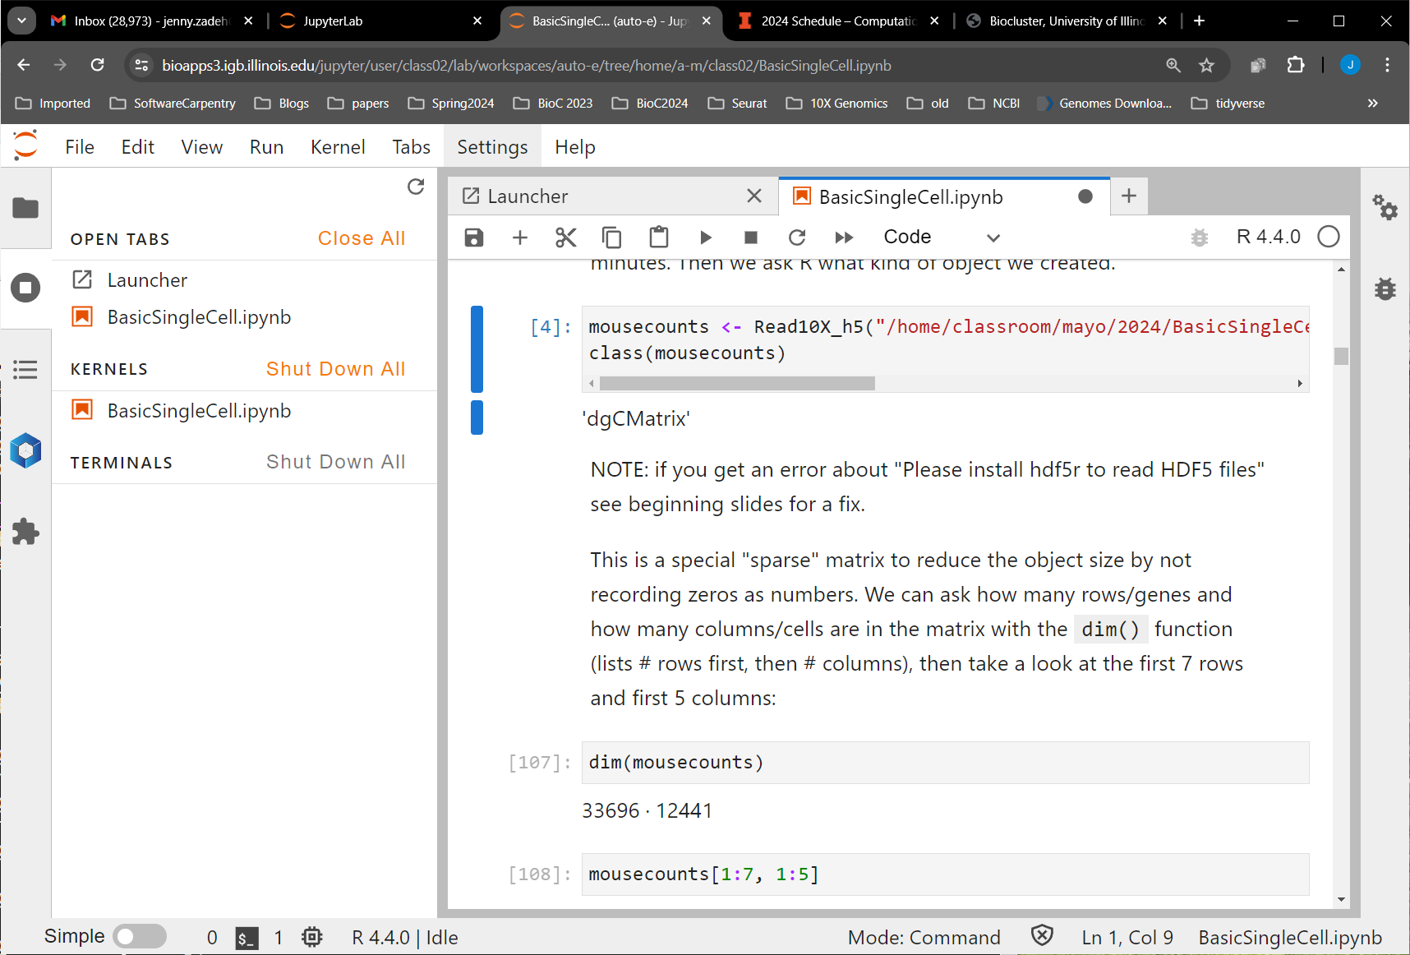
Re-run the code boxes
You need to re-run the first code box to load the packages from the library, then you can successfully run the second code box
Success!

