Slide 1
Aerospace Graduate Student Advisory Committee
Gyu Sub, Henry, Aanchal, Noel, & Vedant

Slide 2
What is a GSAC?
An advisory committee that represents the graduate student community
Why does it exist?
To promote fulfilling graduate careers and lifestyles in the AE department
What are things we do?
Host professional and social events, raise concerns and queries, survey student suggestions to improve the grad experience
What we stand for?
Fostering community amongst AE grad students, with the department, and beyond

Slide 3
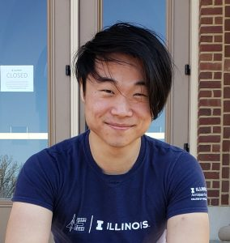
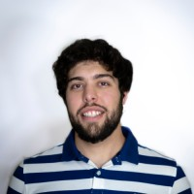
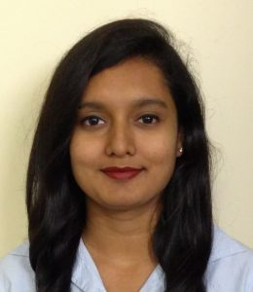
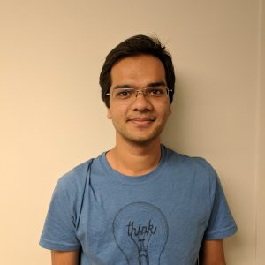
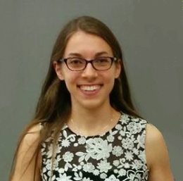
Current Members
Gyu Sub Lee | Chair
Henry Varona| Assistant Chair
Aanchal Gupta | Representative
Vedant | Representative
Noel Brindise | Representative

Slide 4
Structure
Department of Aerospace Engineering
AeroGSAC
Outreach & Advocacy
Social Exposure
Professional Exposure
GSAC Community Collaboration
EGSAC

Slide 5
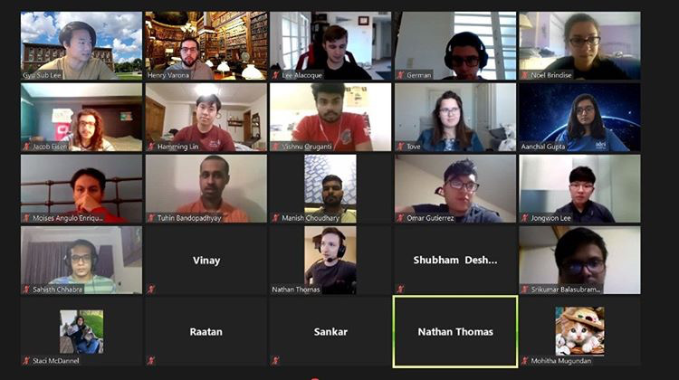
How We’ve Adapted
Host fun and interactive social events on Zoom/in accordance with social distancing protocols
Inter/intra-department
Began a dialogue between current and incoming students
Hosted a Zoom introductory meet & greet
Continued discussion on What’s App chat
Set up social media accounts to provide updates and feature events and members
Look forward to Grad student Discord!

Slide 6
COVID Testing
Twice a week
Test sites = big white tents on campus
Next to Engineering Hall
Test results take up to 48 hours to process
Check results and personal status using Safer Illinois app
Test in advance to avoid loss of campus access!

Slide 7
Beyond
What’s there to do around C-U?
RSOs (safe sports and clubs)
Favorite takeout restaurants
Bike around campus
Visit nearby parks
Check out Urbana’s farmers’ Market at the Square
Hang out with fellow grad students & AeroGSAC on Zoom

Slide 8
Beyond
How do I find a research advisor?
Use department websites to find research areas that interest you
Look up professors who work in these areas
Read their recent publications and contact their current graduate students
Most papers will have a mention of ‘future work’ that could be a starting point for a conversation
Meet with professors to discuss possible research topics
The most important thing is to take the initiative!
Notes:
Any questions regarding funding should be directed to Staci

Slide 9
Beyond
Some good classes to take?
AE 498/ 598 Special Topics classes can be really fun
Don’t be afraid to take classes outside your comfort zone!
If you are a Non-Thesis student, take classes from different departments!
AE 597 Independent Studies are great way to get exposed to a research environment if you are Non-Thesis student
If you haven’t already, use the course explorer: https://courses.illinois.edu/

Slide 10
Helpful Resources
Resources and Services provided by the Graduate College: https://emails.illinois.edu/newsletter/1712983543.html
Doctoral Research Support Program (DRSP) – a one-year initiative set up to help doctoral students prepare for and manage academic related work: https://doctoralstudents.web.illinois.edu/
Surplus Warehouse – Stock of redistributed equipment to support research needs: https://www.obfs.uillinois.edu/bfpp/section-12-property-accounting/loan-equipment-faculty-staff-student-employees
Illinois COVID-19 – Guidelines, information, and FAQ’s about the university’s efforts and policies aimed at a safer academic year: https://covid19.illinois.edu/

Slide 11
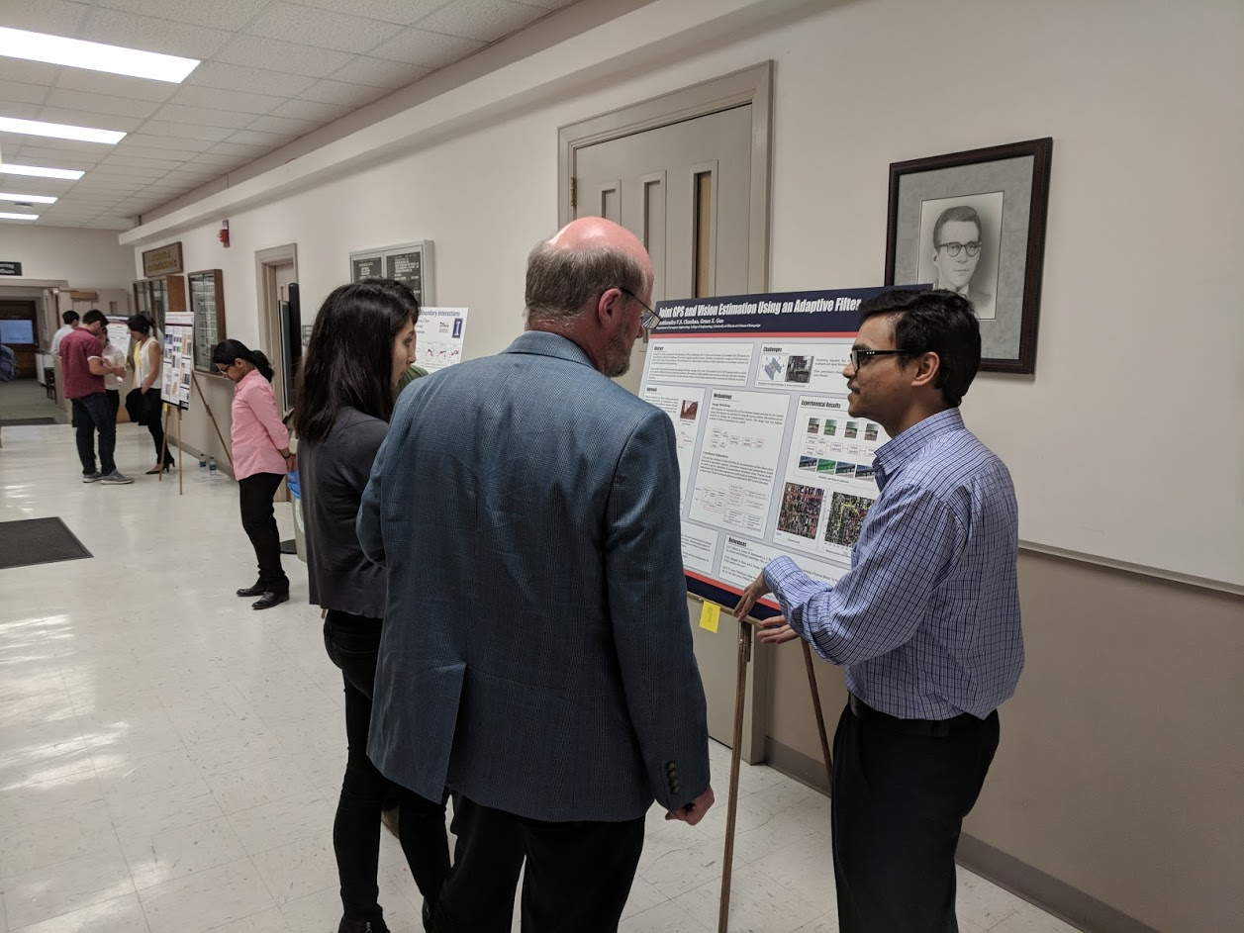
Events and Programs to Look Forward to
Invited speakers from national labs or industry
Grad research poster fair
Student presentation lunch seminar
Initiatives and workshops based on educating about and celebrating diversity and inclusivity in our community

Slide 12
UPCOMING Social Events
NEXT WEEK – Team trivia/questionnaire!
Saturday, August 29th 4:00-5:00 PM – Virtual grad meet & greet/social hour on Zoom
AE grad student highlights – on Instagram!

Slide 13
is recruiting!
Please email us if you are interested in joining us!
If you’d like more information, contact:
ae-gsac@mx.uillinois.edu
Please visit our webpage at: http://gsac.ae.illinois.edu/

Slide 14
Beyond
Questions?

