Slide 1
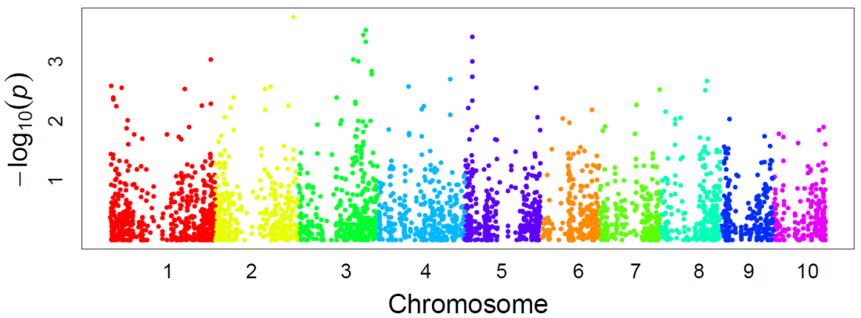
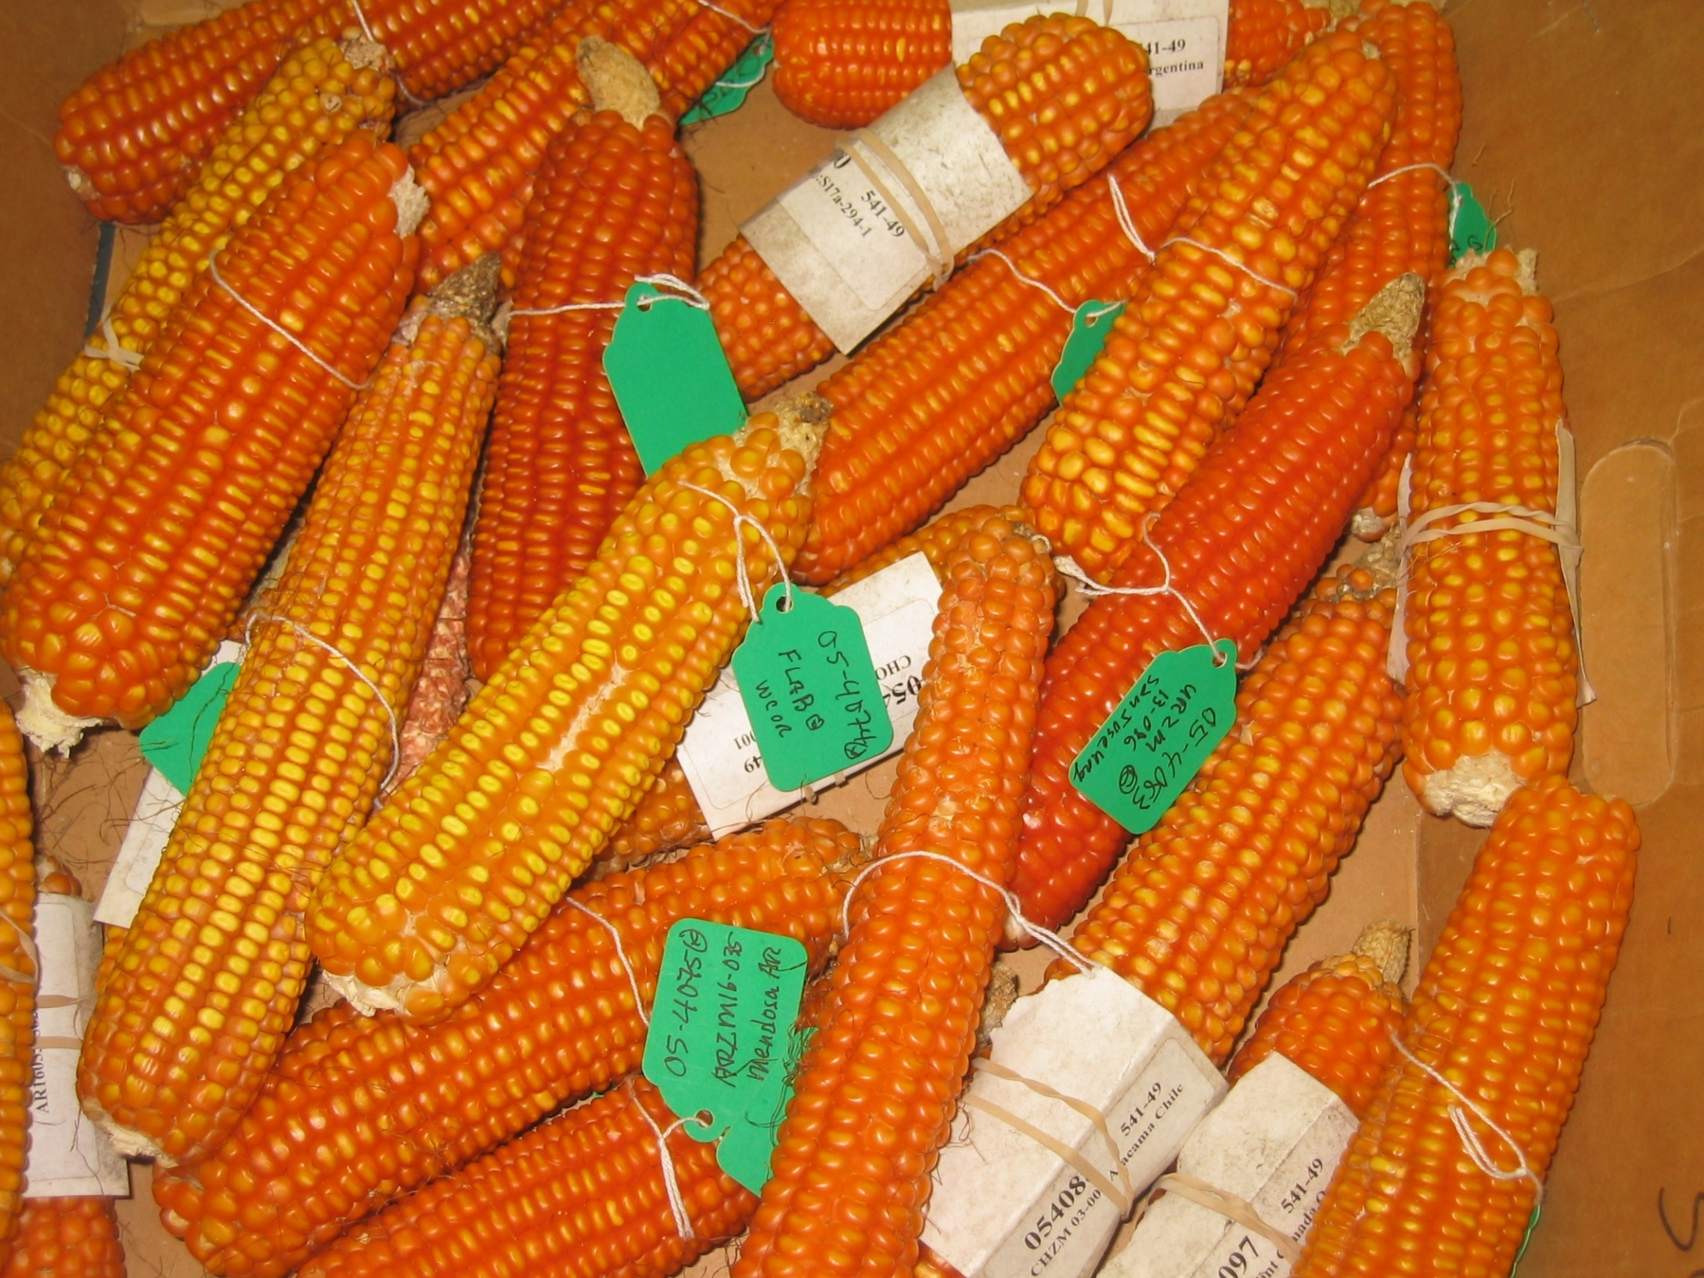
Polymorphisms and Association Tests
Alexander E. Lipka
Associate Professor of Biometry
Department of Crop Sciences
UIUC
Notes:
Go thorough all font sizes and make sure they are consistent; same thing for blue box

Slide 2
This is what we will learn
How association tests fit into data analysis
Basics: Simple linear regression
Basics: Fixed and random effects
Genome-wide association studies:
Introduction
Best practices
Genomic selection:
Introduction
Best practices
Examples of GWAS
Examples of GS
Notes:
http://boort.com.au/gallery/drone-checking-corn-crop/
https://www.pioneer.com/us/products/soybeans.html
https://tincture.io/tagged/dna-sequencing

Slide 3
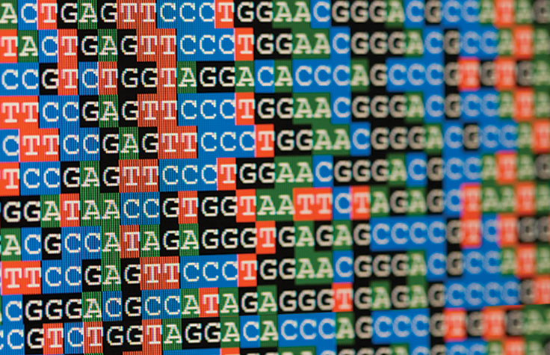
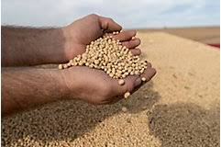
Role of the statistical genetics in polymorphism and association tests
G-to-P analyses
Genotypic data
Phenotypic data
Accurate G-to-P models help ensure that investments in high-throughput technologies lead to meaningful results in the field
Advanced statistical approaches that connect genotype to the phenotype
https://tincture.io/tagged/dna-sequencing
http://boort.com.au/gallery/drone-checking-corn-crop/
https://www.pioneer.com/us/products/soybeans.html
Slide courtesy of Dr. Matthew D. Murphy
Notes:
http://boort.com.au/gallery/drone-checking-corn-crop/
https://www.pioneer.com/us/products/soybeans.html
https://tincture.io/tagged/dna-sequencing

Slide 4
What can we do with statistical genetics?
Associate genotypes to phenotypes
Basic statistical model: Y-variables are one or more traits; X-variables are one or more genomic markers
Models that accurately model the intricate relationship between genotype and phenotype
More accurate genomic selection models
Ramifications of this research
Dissection of genetic sources of agronomically important traits in crops
Flexible statistical models that can analyze wider range of traits
Reduction in length of breeding cycles

Slide 5
G-to-P models are based on simple linear regression (SLR)
Slope
Parameter
Random Error Term
$$Y_{i}=β_{0}+β_{1}x_{i}+ε_{i}$$
Intercept
Parameter
Y-value of i^{th} observation
X-value of i^{th} observation
Models linear relationship between quantitative X and Y variables
Parameters $β_{0}$ and $β_{1}$ are unknown constants
Data sets of n (X, Y) observations used to estimate parameters

Slide 6
Assumptions of the error terms
$ε_{i}$~ NID (0,$σ_{e}^{2}$)
Normal
Independent
Equal Variance
What can be done if assumptions are violated?
Transform the trait (e.g., Box-Cox procedure)
Implement a bootstrapping (or similar) procedure
This framework can be used for X-variables that are categorical

Slide 7
Factorial Experiment
Factor A - Density
1
2
3
1
Quantify main effect of
Factor B
Factor B- Fertilizer
Quantify two-way interaction effect of Factors A and B
3x3 = 9 possible combinations of A and B
Measure Y = yield on all
N= 27 plants
Quantify main effect of
Factor A
Randomly assign N = 27 plants to each combination of A and B
2
3

Slide 8
2-way ANOVA model with fixed effects
$$Y_{ijk}=μ+α_{i}+β_{j}+{\left(αβ\right)}_{ij}+ε_{ijk}$$
${ Y}_{ijk}$ : $Y$-value of $k^{th}$ replicate receiving $j^{th}$ level of Factor B and $i^{th}$ level of Factor A
$μ$: Grand mean
$α_{i}$: Fixed main effect of $i^{th}$ level of Factor A
$β_{j}$: Fixed main effect of $j^{th}$ level of Factor B
${(αβ)}_{ij}$: Two-way interaction effect between receiving $j^{th}$ level of Factor B and $i^{th}$ level of Factor A
$ε_{ijk}$: Error term of $k^{th}$ replicate receiving $j^{th}$ level of Factor B and $i^{th}$ level of Factor A ~ NID(0, $σ_{e}^{2}$)
Inferences of fixed effects apply only to the factor levels used in your experiment

Slide 9
2-way ANOVA model with random effects
$$Y_{ijk}=μ+α_{i}+β_{j}+{\left(αβ\right)}_{ij}+ε_{ijk}$$
${ Y}_{ijk}$ : $Y$-value of $k^{th}$ replicate receiving $j^{th}$ level of Factor B and $i^{th}$ level of Factor A
$μ$: Grand mean
$α_{i}$: Random main effect of $i^{th}$ level of Factor A
~NID(0, $σ_{A}^{2}$)
$β_{j}$: Random main effect of $j^{th}$ level of Factor B
~NID(0, $σ_{B}^{2}$)
${(αβ)}_{ij}$: Random two-way interaction effect between receiving $j^{th}$ level of Factor B and $i^{th}$ level of Factor A
~NID(0, $σ_{AB}^{2}$)
$ε_{ijk}$: Error term of $k^{th}$ replicate receiving $j^{th}$ level of Factor B and $i^{th}$ level of Factor A ~ NID(0, $σ_{e}^{2}$)
Inferences of random effects apply to an entire population of factor levels

Slide 10
Mixed model
$$Y_{ijk}=μ+α_{i}+β_{j}+{\left(αβ\right)}_{ij}+ε_{ijk}$$
${ Y}_{ijk}$ : $Y$-value of $k^{th}$ replicate receiving $j^{th}$ level of Factor B and $i^{th}$ level of Factor A
$μ$: Grand mean
$α_{i}$: Fixed main effect of $i^{th}$ level of Factor A
$β_{j}$: Random main effect of $j^{th}$ level of Factor B
~NID(0, $σ_{B}^{2}$)
${(αβ)}_{ij}$: Random two-way interaction effect between receiving $j^{th}$ level of Factor B and $i^{th}$ level of Factor A
~NID(0, $σ_{AB}^{2}$)
$ε_{ijk}$: Error term of $k^{th}$ replicate receiving $j^{th}$ level of Factor B and $i^{th}$ level of Factor A ~ NID(0, $σ_{e}^{2}$)
Mixed models are flexible and can be adapted for many different quantitative genetics analyses

Slide 11
Genome-wide association study (GWAS)
Association with Vitamin E Levels in Maize Grain
Peak SNP is within ZmVTE4
Markers exhibiting peak associations with traits are potential targets for marker-assisted selection (MAS)
Lipka et al. (2013)
Identify genomic regions associated with a phenotype
Fit a statistical model at each SNP in genome
Use fitted models to test H₀: No association with SNP and phenotype

Slide 12
Genetic diversity can lead to false positives in a GWAS
Genetic Diversity of 2,815 Maize Inbreds
Principal Coordinate 2
Solution: GWAS models include fixed and random effects to account for false positives
Romay et al. (2013)
Principal Coordinate 1
Two sources for false positives:
Population Structure
Familial Relatedness

Slide 13
Unified mixed linear model (MLM)
Random effects: account for familial relatedness
Grand Mean
Marker effect
$$Y_{i}=μ+Σ_{j=1}^{p}β_{j}PC_{ji}+αx_{i}+Line_{i}+ε_{i}$$
Variance component estimation is computationally intensive
Computational approaches are available to reduce this computational burden
Random error
term
Phenotype of i^{th} individual
Fixed effects: account for population structure
Observed SNP alleles of i^{th} individual
(Line₁,…, Line_{n}) ~ MVN(0, )
K = kinship matrix
ε_{i} ~ i.i.d. N(0, )
Measures relatedness between individuals
Yu et al. (2006)

Slide 14
Approach 1: Compressed mixed linear model
$$Y_{i}=μ+Σ_{j=1}^{p}β_{j}PC_{ji}+αx_{i}+Line_{i}+ε_{i}$$
$$Y_{i}=μ+Σ_{j=1}^{p}β_{j}PC_{ji}+αx_{i}+Group_{i}+ε_{i}$$
Perform hierarchical clustering on lines using kinship matrix
Reduces computational time because it works with a smaller kinship matrix
(Line₁,…, Line_{n}) ~ MVN(0, )
K = kinship matrix
ε_{i} ~ i.i.d. N(0, )
(Group₁,…, Group_{k}) ~ MVN(0, )
K_{C} = group (“compressed”) kinship matrix
ε_{i} ~ i.i.d. N(0, )
Zhang et al. (2010)

Slide 15
Approach 2: Population parameters previously determined (P3D)
$$Y_{i}=μ+Σ_{j=1}^{p}β_{j}PC_{ji}+αx_{i}+Group_{i}+ε_{i}$$
Reduces computational time because intensive variance component estimation is conducted only once
Approximation: tends to underestimate most significant associations
Estimates variance components prior to running GWAS
GWAS is run using variance component estimates
(Group₁,…, Group_{k}) ~ MVN(0, )
K_{C} = group (“compressed”) kinship matrix
ε_{i} ~ i.i.d. N(0, )
Zhang et al. (2010)

Slide 16
Approach 3: GEMMA
$$Y_{i}=μ+Σ_{j=1}^{p}β_{j}PC_{ji}+αx_{i}+Line_{i}+ε_{i}$$
Same reduction in computational time as P3D
Exact: enables statistically optimal estimation of marker-trait associations
Behind the scenes: Replace computationally intensive calculations with simpler calculations
Statistically optimal variance estimates obtained at each marker
(Line₁,…, Line_{n}) ~ MVN(0, )
K = kinship matrix
ε_{i} ~ i.i.d. N(0, )
Zhou and Stephens (2012)

Slide 17
Genomic selection (GS)
Various frequentist and Bayesian models are commonly used
Most produce approximately the same prediction accuracies
Heffner et al. (2009)
Predict phenotypic values using markers distributed throughout the genome
Enables selection without phenotyping individuals
Developed to speed up breeding cycles

Slide 18
Basic GS statistical model
Trait is the response variable (Y_{i})
All markers are the explanatory variables (x_{1i},…, x_{pi})
Number of markers (p) typically exceeds sample size (n): n<<p
$$Y_{i}=β_{0}+β_{1}x_{1i}+…+β_{p}x_{pi}+ε_{i}$$

Slide 19
Issues with n << p
Problem:
Unique estimates of marker effects do not exist
Solution 1(Non-Bayesian):
Add a penalty that restricts values of the marker effects (e.g., ridge regression, LASSO)
Solution 2 (Bayesian):
Assign a “prior distribution” on the marker effects (e.g., Bayes A, Bayes B, …)

Slide 20
Ridge regression best linear unbiased prediction (RR-BLUP) for genomic selection
Observed SNP alleles of k^{th} marker at i^{th} individual
Random marker effect
~N(0, $σ_{G}^{2}$)
Phenotype of i^{th} individual
All predicted marker values are equally penalized so that they are shrunk to zero
$Y_{i}=β_{0}+\sum_{k=1}^{p}{x_{ik}β_{k}+ε_{i}}$
Error term ~N($0,σ_{E}^{2})$
Intercept
$Best linear unbiased predictors \left(BLUPs\right) of the β_{k}^{′}s$
$are subjected to the ridge regression penalty:$
$$J\left(β\right)=\sum_{k=1}^{p}{β_{k}^{2}}$$
Meuwissen et al., Genetics (2001);
Whittaker et al., Genetics Research (2000)
Notes:
The R function returns the variance components, the maximized log-likelihood (LL), the ML estimate for β, and BLUP solution for u.

Slide 21
Cross-validation
Use fitted model to predict trait values
Repeat so that each fold gets a chance to be the test set
Prediction accuracy: average correlation between observed and predicted traits across folds
Fit GS model
Source: blogs.sas.com
Partition data into k folds
Fit GS model in (k-1) folds
Plug markers from k^{th} fold into model
Calculate correlation between observed and predicted trait values

Slide 22
Differences between GS and GWAS
The overall objectives differ:
Main objective of GWAS is to find genomic regions associated with a trait
Main objective of GS is to determine how well marker sets predict trait breeding values
The statistical models differ:
Typical GWAS models in plants test one marker at a time
Typical GS models include all markers in the model at once

Slide 23
Differences between GS and marker-assisted selection (MAS)
GS:
Uses genome-wide marker sets for predictions
Can account for both major- and minor-effect QTL
Ideal for predicting complex traits
MAS:
Focuses on marker(s) linked to genes of major effect
Accounts for only major-effect QTL
Adequate for predicting simple and oligogenic traits

Slide 24
How to choose the best model for GWAS
It is critical to account for population structure and familial relatedness in a typical GWAS:
Unified mixed linear model is the best option
Recent developments in unified mixed linear model:
Multi-trait unified linear mixed model
Multi-locus mixed model
Other models:
Accounting for non-additive effects
Accounting for variance heterogeneity
Multi-locus, multi-trait models
Suggested strategy:
Use unified mixed linear model
If/when quantifying interesting GWAS result needs further refinement, use more sophisticated models

Slide 25
Examples of GWAS in crops
Rincker et al. (2016): Targets for brown stem rot resistance in soybean
Owens/Lipka et al. (2014): Targets for boosting provitamin A and other carotenoid levels in maize grain
Fernandes and Lipka (2020) and Fernandes et al (2021): Simulations to test performance of multi-trait GWAS models
Let’s take a break!

Slide 26
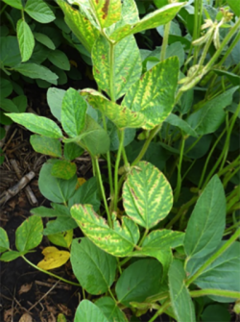
Example: Rincker et al. (2016)
Brown stem rot (BSR) and soybean:
Caused by the fungus C. gregata
Soybean yield loss of up to 38% has been reported in the United States
BSR resistance has been mapped in only 12 sources, only two of which have been used to develop BSR-resistant cultivars
Three genes associated with BSR resistance, Rbs1-3, have been identified in previous studies
Critical need to obtain a more precise location of these loci
Result in more efficient MAS for BSR resistance
Source: cornandsoybeandigest.com/

Slide 27
Separate GWAS performed on four association panels
N-1989 panel:
Binary phenotype: logistic regression + stepwise model selection
Other panels:
Quantitative phenotype: Unified MLM + multi-locus mixed model
Rincker et al. (2016)

Slide 28
Unified MLM GWAS identifies signals near Rbs1-Rbs3
Multi-locus mixed model identified two peak SNPs from this region in the final model
GWAS was reran using these two peak SNPs as covariates
Rincker et al. (2016)

Slide 29
Multi locus mixed model (MLMM) quantifies associations of multiple markers
Random effects: account for familial relatedness
Grand Mean
Additive effect of k^{th} marker
“Final” model selected by MLMM consisted of exactly 2 SNPs, both in Rbs1-Rbs3 region
$$Y_{i}=μ+Σ_{j=1}^{k}β_{j}PC_{ji}+Σ_{k∈I}α_{k}x_{ki}+Line_{i}+ε_{i}$$
Phenotype of i^{th} individual
Random error
term
Fixed effects: account for population structure
Observed SNP alleles of k^{th} marker for i^{th} individual
(Line₁,…, Line_{n}) ~ MVN(0, )
K = kinship matrix
I = subset of markers selected from stepwise regression
ε_{i} ~ i.i.d. N(0, )
Measures relatedness between individuals
Segura et al. (2012)

Slide 30
Peak SNPs from MLMM reduces explains most of Rbs1-Rbs3 signal
Similar findings were obtained in the other association panels
Rincker et al. (2016)
Notes:
These results are from the B-2000 Panel

Slide 31
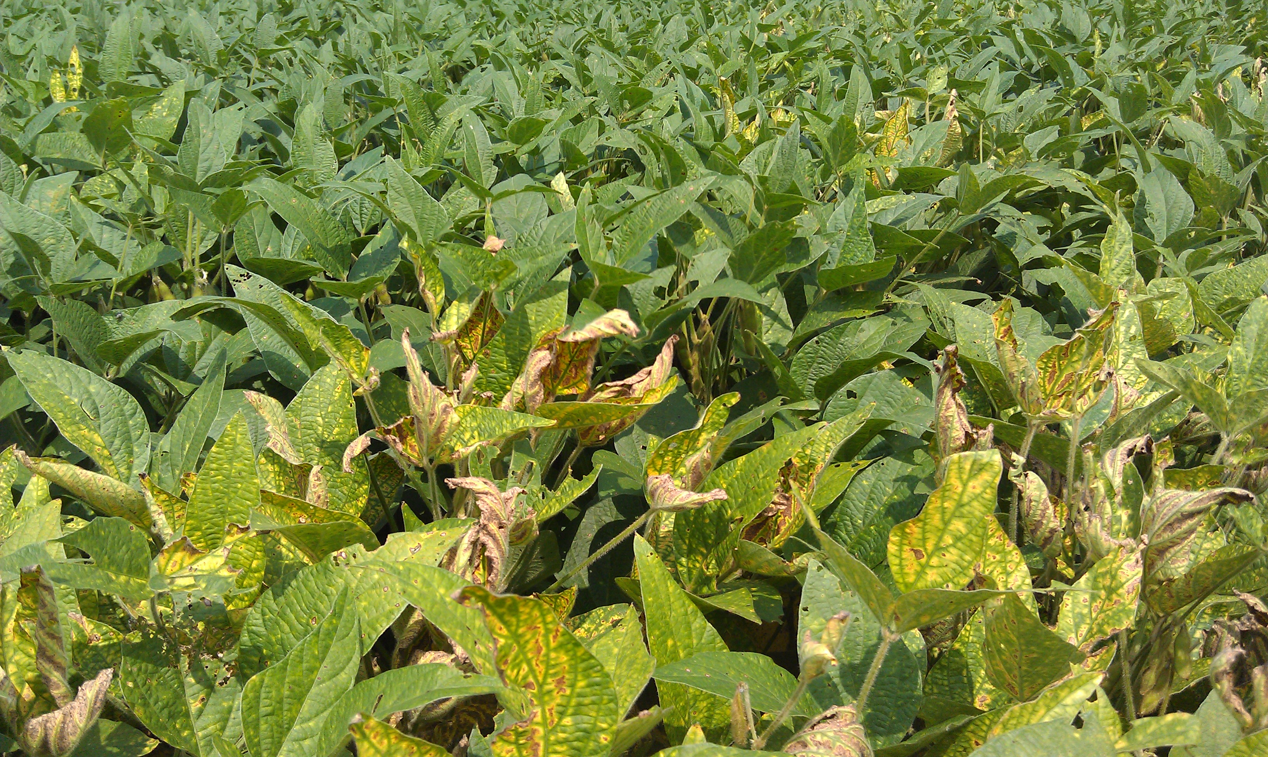
Breeding Ramifications
Source: blogs.ext.vt.edu
Previous Rbs1-Rbs3 signals been refined to a 0.3 Mb region on Chromosome 16
Should facilitate both MAS-based approaches and gene cloning efforts
Demonstrates the utility of GWAS in soybean
Rincker et al. (2016)

Slide 32
Biofortification
Identify target genes associated with nutrients in crops
Increase nutritional value of local crop varieties by selecting on these target genes
Results in increased availability of essential nutrients
Source: www. aboutharvest.com

Slide 33
Targeting vitamin A deficiency through biofortification
Vitamin A deficiency (VAD):
Affects 17-30% of children under 5
250-500,000 children become
blind every year
Infant morbidity and mortality
Source: en.wikipedia.org
Maize is a primary food source in many vitamin A deficient regions
Biofortification: breed locally-adapted maize lines for increased provitamin A levels in grain

Slide 34
Work in maize provitamin A biofortification prior to Owens/Lipka et al. (2014)
Candidate gene studies identified loci in maize (Harjes et al., 2008; Vallabheneni et al., 2010; Yan et al. 2010)
Developed high provitamin A maize (CIMMYT, HarvestPlus) and high carotenoid lines (Burt et al., 2011) through selection on target alleles
Owens/Lipka et al (2014):
1.) Conduct a GWAS to identify new candidate genes
2.) Determine a minimal marker set to accurately predict carotenoid levels
Major QTL identified near candidate genes (Chandler/Lipka et al., 2013)
Pleiotropy identified among metabolite QTL (Kandianis et al., 2013)
Source: Chandler/Lipka et al., 2013
Notes:
Cut out the text in the second bullet point
Phrase the text so that it is within carotenoids and tocochromanols

Slide 35
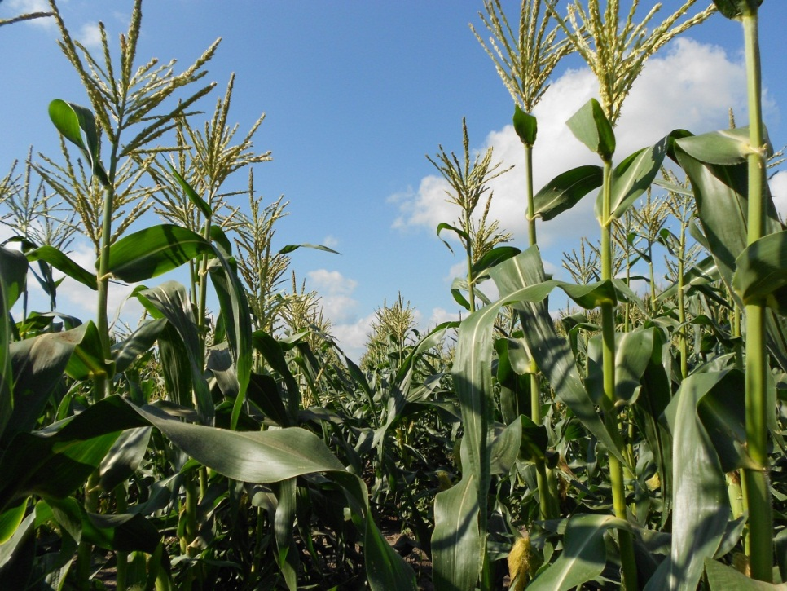
Data analyzed in Owens/Lipka et al. (2014)
Maize lines with white kernels do not produce measureable carotenoids
We only analyzed a subset of 201 lines that range from light yellow to dark orange kernel color
Source: Brenda Owens
281-member Goodman diversity panel
Grown at Purdue University in 2009 and 2010 field seasons
Compound levels quantified in grain:
Carotenoids for 252 lines

Slide 36
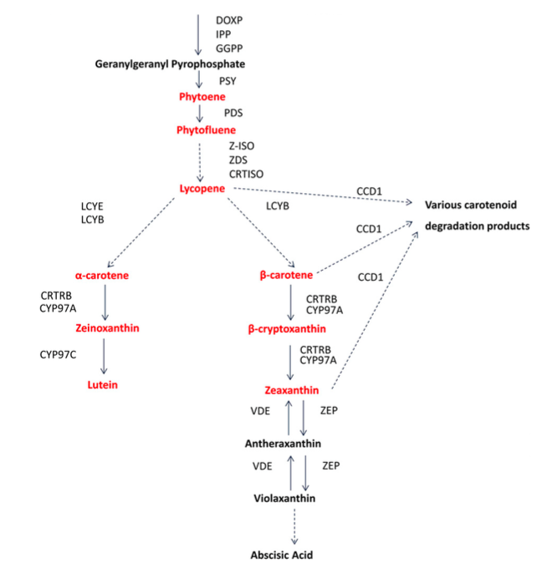
GWAS found significant marker-trait associations near carotenoid pathway genes
= Significant at the
genome-wide level
Adjusting for multiple testing at the genome-wide level was conservative
We also conducted a pathway-level analysis, where only markers near 58 a priori genes were considered
Carotenoid biosynthetic pathway
Owens/Lipka et al. (2014)
Notes:
(7,408 SNPs + 7 indels) 37 genes related to carotenoid biosynthesis and degradation
21 genes related to prenyl group synthesis
284,180 SNPs + 7 indels used for GWAS
CYP97A is encoded by lut5

Slide 37
GWAS found significant marker-trait associations near carotenoid pathway genes
Dxs2
= Significant at the
genome-wide level
This work identified potential targets for marker-assisted selection (MAS)
Are selecting for these target loci sufficient for improving provitamin A content in maize grain?
Carotenoid biosynthetic pathway
= Significant at the
pathway level
Owens/Lipka et al. (2014)
Notes:
CYP97A is lut5
(7,408 SNPs + 7 indels) 37 genes related to carotenoid biosynthesis and degradation
21 genes related to prenyl group synthesis
284,180 SNPs + 7 indels used for GWAS
We did NOT find any statistically significant associations in the vicinity of CCD1
lut5 encodes CYP97A

Slide 38
Prof. Samuel Fernandes
Multivariate quantitative genetics approaches have great potential
Identification of pleiotropic loci
Improve prediction accuracy
Simulating correlated traits will help assess their utility
We know genetic architectures of simulated traits
We directly assess true and false positive identification rates
CRAN/R package: simplePHENOTYPES: simulate univariate and multivariate traits based on user-inputted marker data
Fernandes and Lipka., BMC Bioinformatics (2020)
Notes:
DO THIS RIGHT NOW: GO TO THE GITHUB PAGE AND GET THE NUMBER OF DOWNLOADS ETC

Slide 39
How well can GWAS models differentiate between pleiotropy and linkage?
Trait 1
Trait 2
One pleiotropic locus
We are now at a stage where we should deploy multivariate GWAS models more readily
Causal Locus
Genomic position
Trait 1
Trait 2
Two loci in linkage
Causal Locus 1
Causal Locus 2
Genomic position
Fernandes et al., Frontiers in Genetics (2021)
Notes:
Fix the animation

Slide 40
Unified mixed linear model can become multivariate
Random effects: account for familial relatedness
Grand Mean
Marker effect
$$Y_{i}=μ+Σ_{j=1}^{p}β_{j}PC_{ji}+αx_{i}+Line_{i}+ε_{i}$$
Univariate GWAS: Y-variable consists of one trait
Multivariate GWAS: Y-variable consists of two or more traits
Random error
term
Phenotype of i^{th} individual
Fixed effects: account for population structure
Observed SNP alleles of i^{th} individual
(Line₁,…, Line_{n}) ~ MVN(0, )
K = kinship matrix
ε_{i} ~ i.i.d. N(0, )
Measures relatedness between individuals
Yu et al. (2006)

Slide 41
Examples of GS in crops
Lipka et al. (2014): Basic GS example in switchgrass
Olatoye et al. (2020): More advanced GS example in Miscanthus

Slide 42
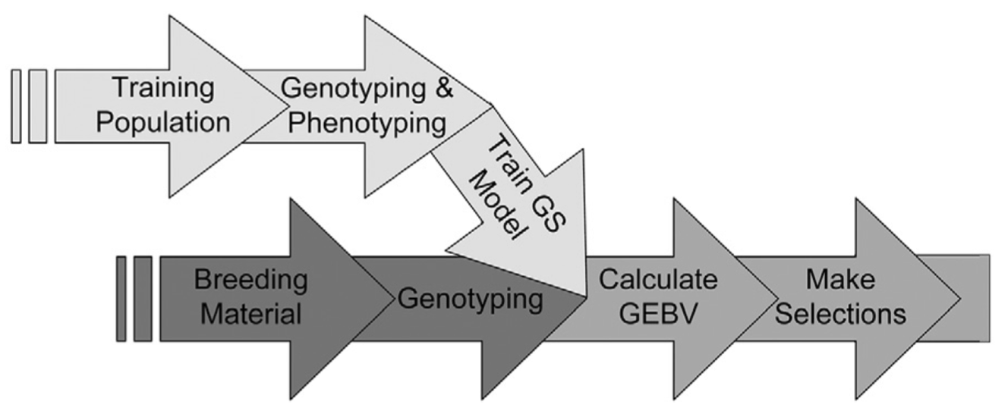
Genomic selection (GS) could speed up switchgrass breeding cycle
Heffner et al. (2009)
GS on simple-to-measure traits approximating biomass yield could revolutionize switchgrass breeding efforts
We evaluated the potential of GS using the latest genotypic and phenotypic resources
Lipka et al. (2014)

Slide 43
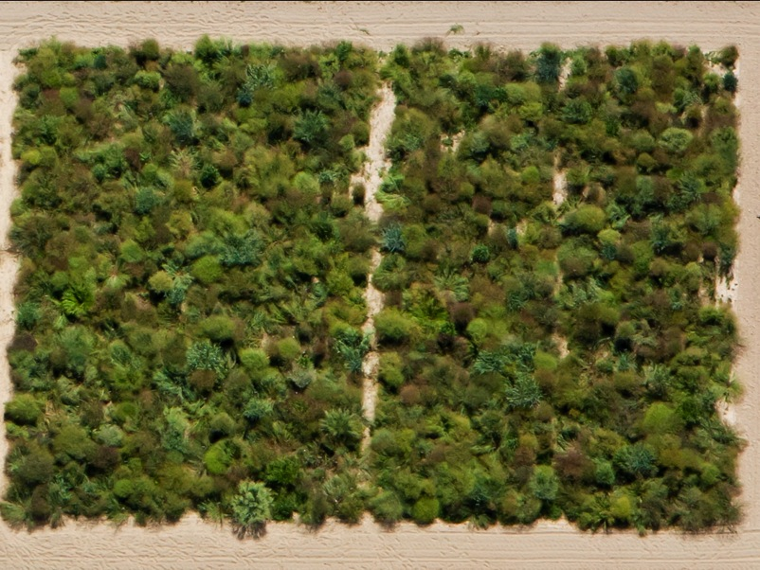
Switchgrass Association Panel
515 members
Grown in Ithaca, NY in 2009-2011
Tetraploids and octoploids included
Predominantly northern-adaptaed upland germplasm
Photo taken 17 August 2010; Caldwell Field
Cornell University, Ithaca NY
Lipka et al. (2014)

Slide 44
Genotypic and Phenotypic Data
7 morphological traits
13 biomass quality traits (Vogel et al., Bioenergy Resources, 2011)
16,669 SNPs using genotyping-by-sequencing (GBS) techniques
SNPs were anchored to the Panicum virgatum v1.1 reference genome
Used to impute missing SNP values
Lipka et al. (2014)

Slide 45
GS study
Three popular GS models:
RR-BLUP
Elastic net
LASSO
RR-BLUP should perform best for complex traits
LASSO should perform best for simple traits
10-fold cross validation to evaluate performance
Lipka et al. (2014)

Slide 46
Main finding: GS appears to work
Three GS models produced similar prediction accuracies
High prediction accuracies obtained for most traits
Standability had the highest (0.52)
Morphological traits generally had higher prediction accuracies than the biomass quality traits
Lipka et al. (2014)

Slide 47
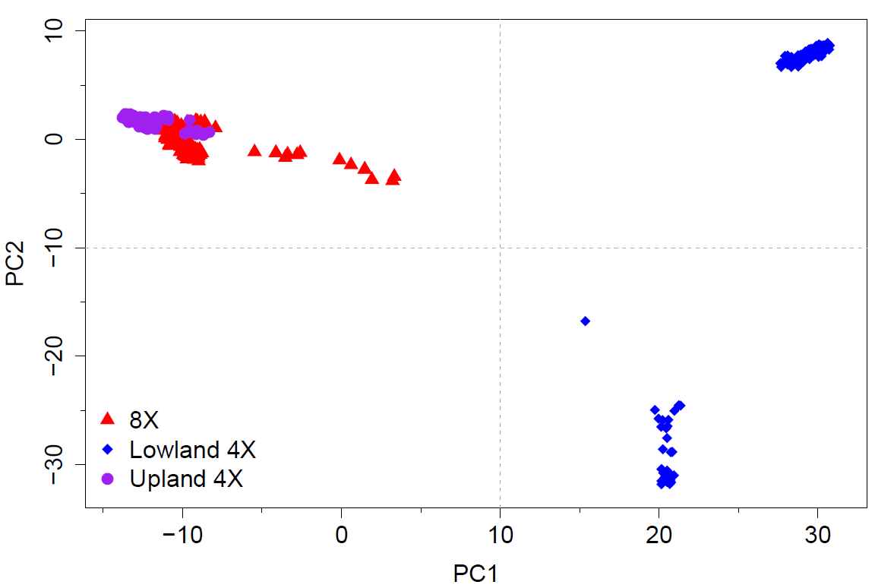
Do we need to “account” for population structure in GS?
First two principal components (PCs) of 16,669 SNPs
We used first two PCs to factor out SNP effects from population structure
No longer agree that we need to factor out population structure from GS models
Lipka et al. (2014)

Slide 48
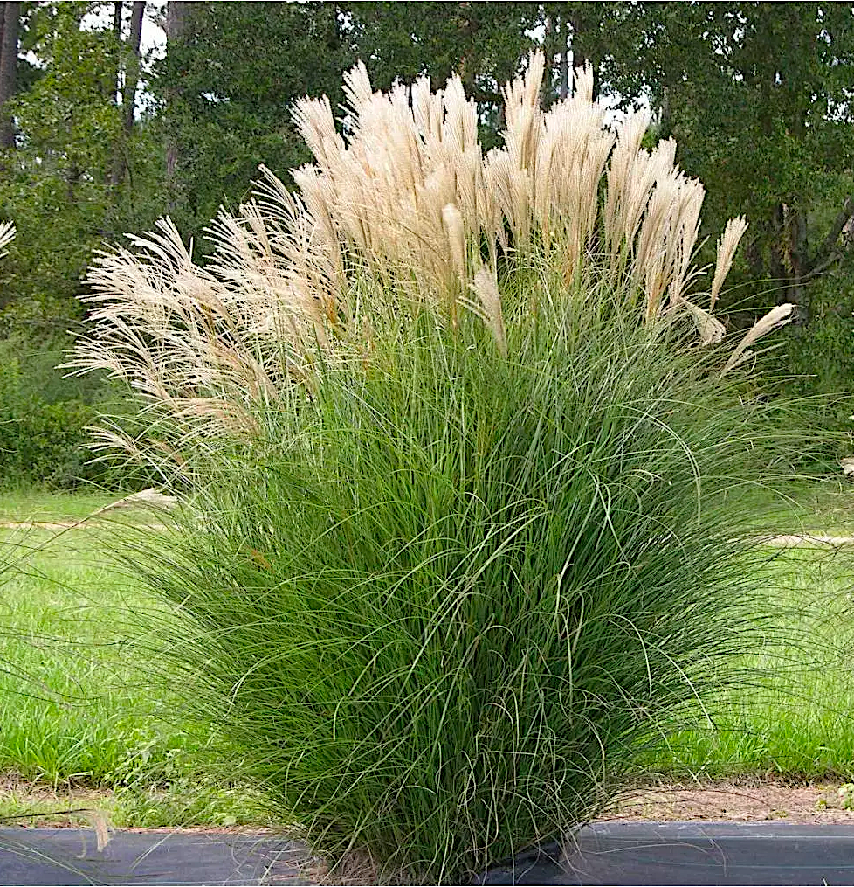
Miscanthus is a sustainable source of lignocellulosic ethanol biofuel production
Species 1: M. sinensis
Species 2: M. sacchariflorus
One clone of an interspecific cross of
Species 1 × Species 2 (M × g)
used for biofuel purposes in North America and Europe
Miscanthus sp.: Perennial grass from eastern Asia

Slide 49
Both species have substantial subpopulation structure
Purpose of GS is to quantify total genetic merit, whether it is:
From genes underlying a trait
Other genetic differences arising from subpopulation structure
Clark et al. 2018
Subpopulations in Species 1:
Clark et al. 2014
Subpopulations in Species 2:
Notes:
Call these “neighbor joining trees”.

Slide 50
Contribution of pop structure to prediction accuracy?
Panel 1: Msi panel
Panel 2: Msa panel
Dr. Marcus Olatoye
If pop structure is important, then prediction accuracy of PCs model should be close to GS model
Fit a standard GS model
Fit PCs model accounting for for pop structure
Fit a standard GS model
Fit PCs model accounting for for pop structure
Compare prediction accuracies
Compare prediction accuracies
Olatoye et al., G3 (2020)

Slide 51
Population structure accounts for substantial portion of GS prediction accuracy
c
c
My current opinion: do not “factor out” population structure in GS models
Results from model accounting for pop structure
Results from GS model
Olatoye et al., G3 (2020)
Notes:
These results are for Msi.

Slide 52
What did we just learn, and why is it important?
What we learned:
The basics of association tests
GWAS
GS
GWAS and GS are the two most widely used applications association tests
Notes:
http://boort.com.au/gallery/drone-checking-corn-crop/
https://www.pioneer.com/us/products/soybeans.html
https://tincture.io/tagged/dna-sequencing

