Slide 2
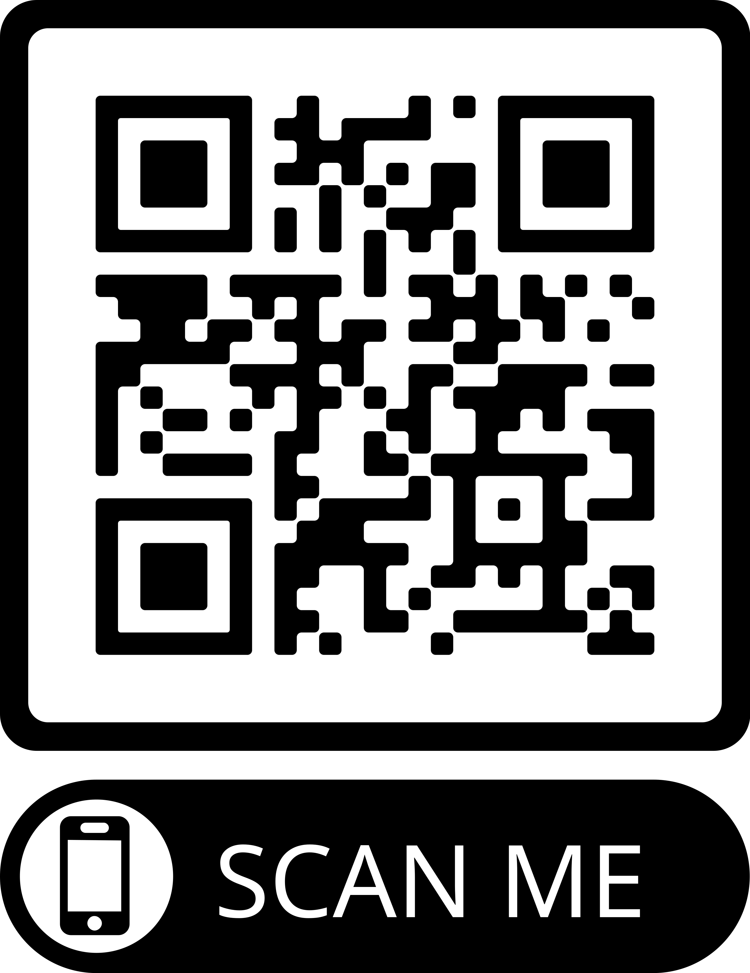
Graduate Student Orientation to Engineering IT Shared Services
EngrIT
https://go.grainger.Illinois.edu/GradITOrientation
Fall 2022

Slide 3
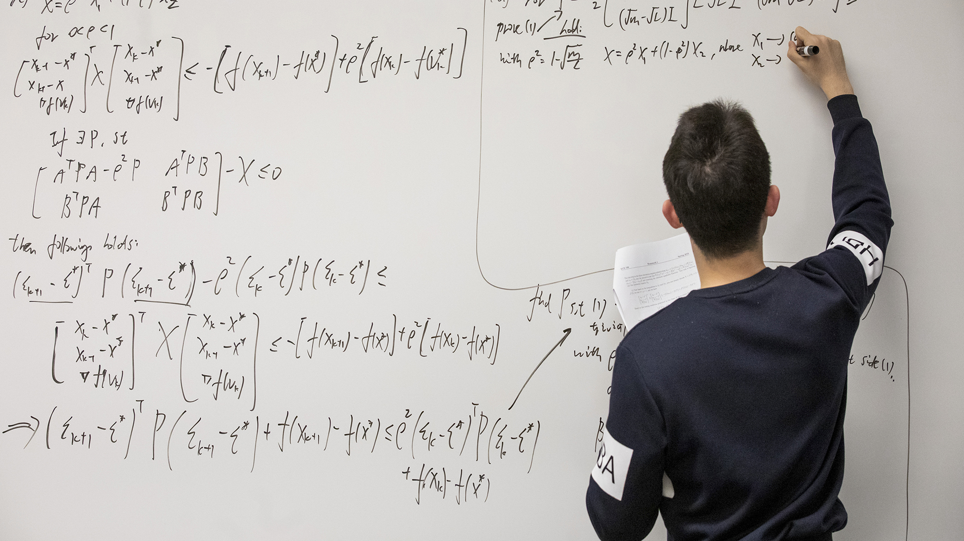
Teaching this semester?
https://answers.uillinois.edu/illinois.engineering/97001
Short check-list of things to do to make sure your class is successful with its information technology needs.
Designate course staff in online tools
Recommended teaching resources and tools
Lab reservations and scheduling
Software needs for your course
Course website hosting
Lecture recording options
Engineering IT Shared Services
GRAINGER ENGINEERING
Notes:
Speaking of TAs, if you are teaching this semester you might want to review the instructor checklist to make sure your course is prepared with its IT needs. The check list is a good pointer to resources for courses, like software requests, web hosting, lecture recording options, and more.

Slide 4
Will you be involved in research?
Stay tuned for information about Engineering IT (EngrIT) Research Services Office Hours
Time to get questions answered
Get hints on getting your IT needs met when starting up a research project
Learn about new resources
engrit.illinois.edu/welcome
Engineering IT Shared Services
GRAINGER ENGINEERING
Notes:
If you have research ahead of you, know that we have Research Services available within Engineering IT.
You’ll see an invitation to EngrIT Research Services office hours in the coming weeks in the weekly Grad Newsletter. Stay tuned.

Slide 5
Engineering IT Shared Services
GRAINGER ENGINEERING
Notes:
Why would you contact Engineering IT's Help Desk? We can help you troubleshoot problems, connect to the network and printers, and access the large number of resources available to university people. Whether you need help in your role as a student, or a researcher, or a teacher, we can support you.

Slide 6
Engineering IT Shared Services
GRAINGER ENGINEERING
Notes:
For support and the most up to date listing of hours and services, please see our website it.engineering.illinois.edu
You can also get remote help by emailing engrit-help@illinois.edu or calling 217-333-1313
Thank you! I hope you have a great semester – please let us know how we can help.

Slide 7
Engineering IT Shared Services
GRAINGER ENGINEERING

Slide 8
Engineering IT Shared Services (EngrIT)
engrit-help@illinois.edu
engrit.Illinois.edu
217-333-1313
Help Desk Locations & Hours
2302 Siebel Center for Computer Science
1005 Mechanical Engineering Laboratory (MEL)
264 Coordinated Science Laboratory (CSL)
264 Materials Research Laboratory (MRL)
Mondays thru Fridays, 9 a.m. to 12 p.m., and 1 p.m. to 5 p.m.
Engineering IT Shared Services
GRAINGER ENGINEERING

