Slide 1
This presentation can be found at
http://go.physics.illinois.edu/newgrads

Slide 2
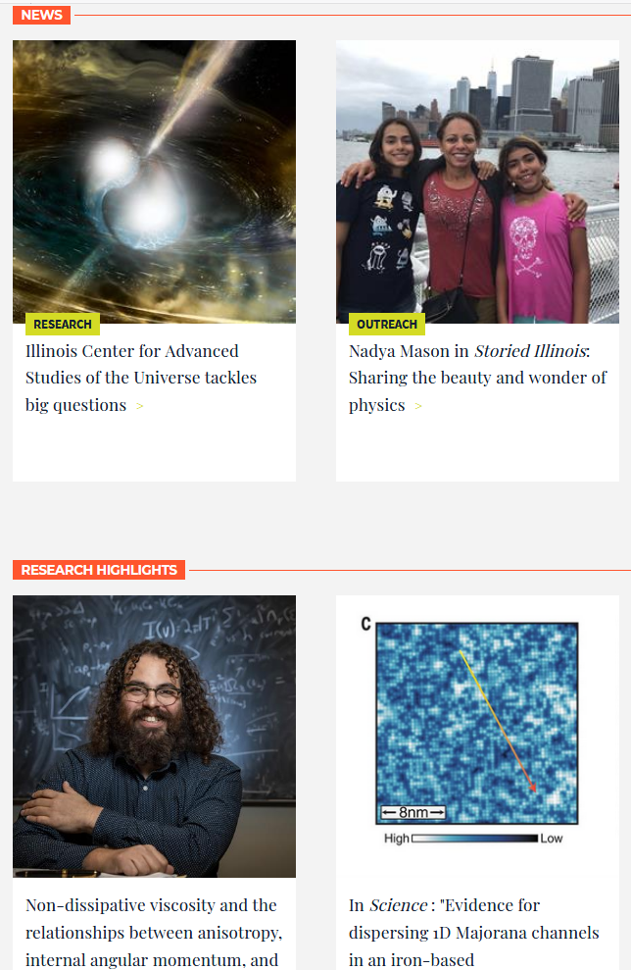
https://physics.illinois.edu/

Slide 3
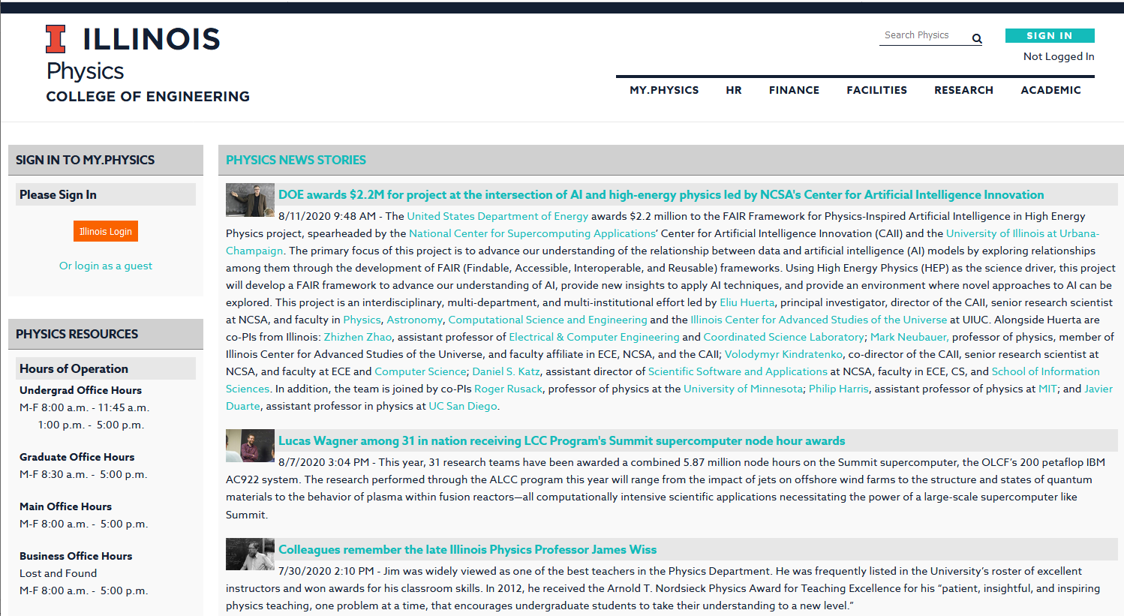
https://my.physics.illinois.edu/

Slide 4
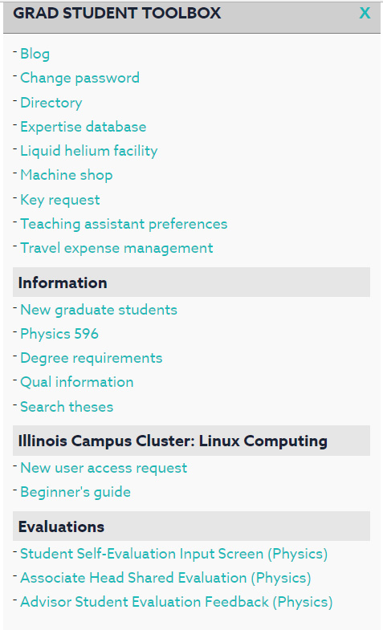

Slide 5
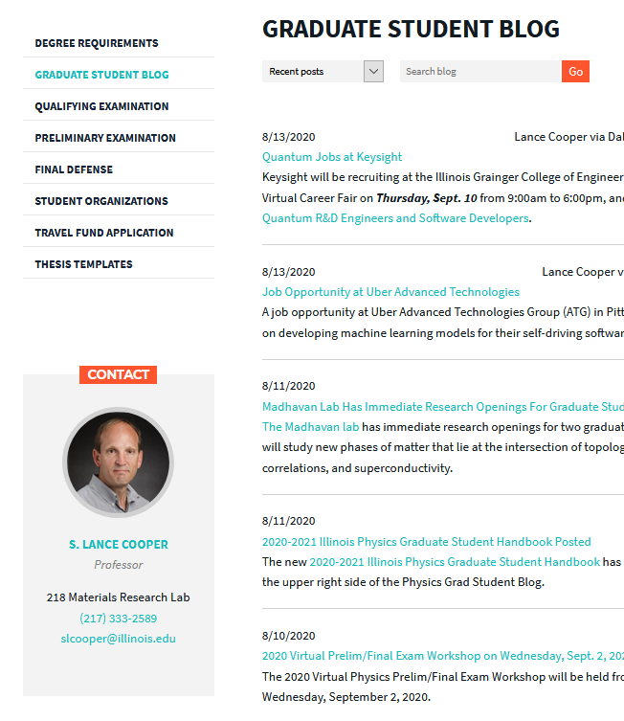
http://physics.illinois.edu/academics/graduates/blog/
https://blogtrottr.com/

Slide 6
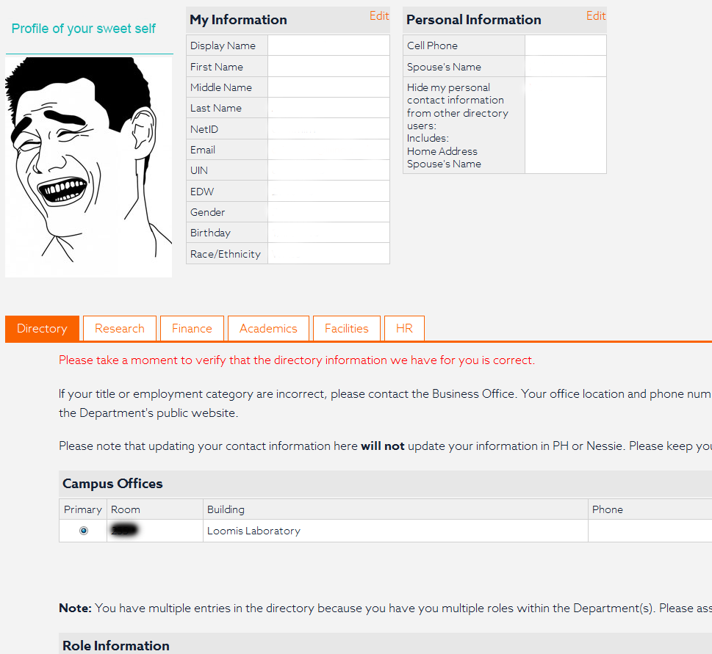
Directory
https://my.physics.Illinois.edu/myinfo/

Slide 7
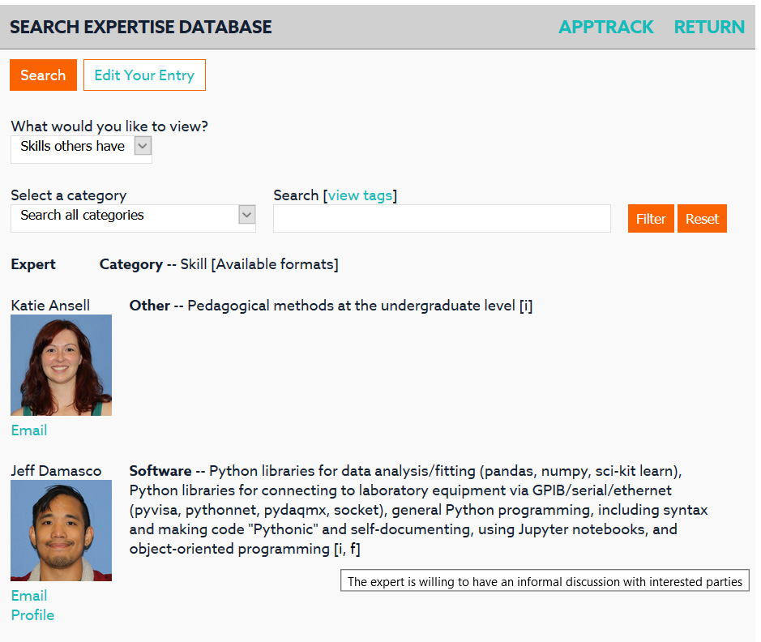

Slide 8
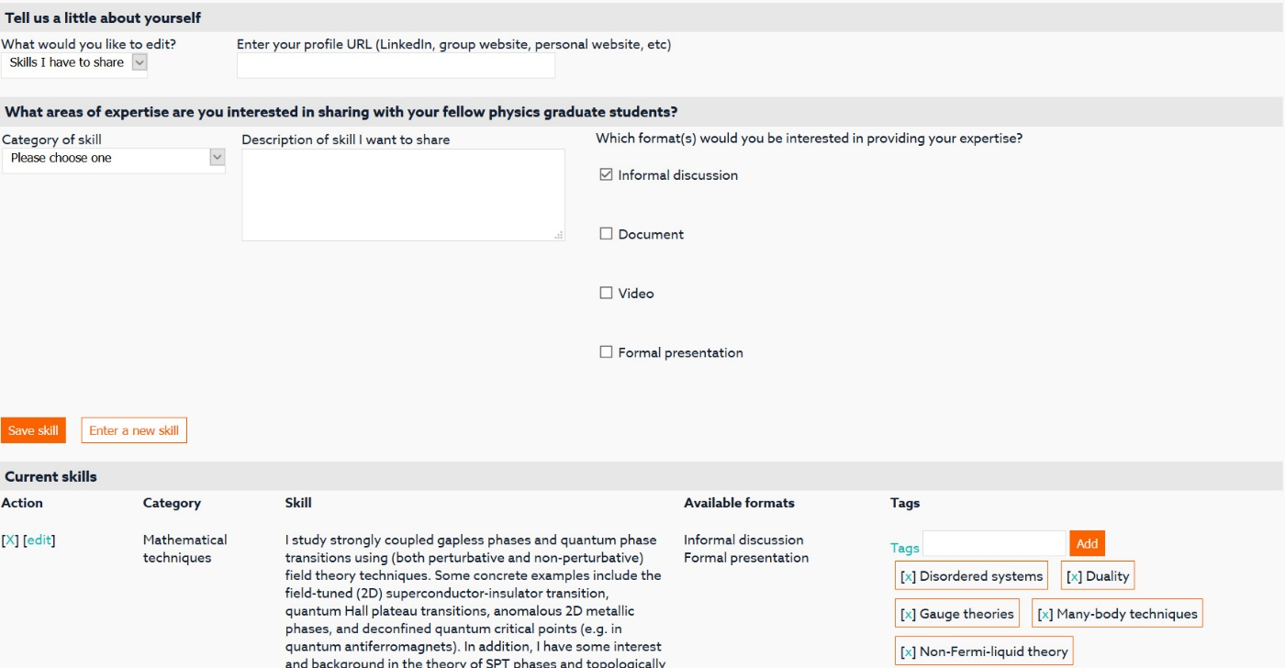

Slide 9
CFOP preauthorization is required for liquid helium, gaseous helium, liquid nitrogen and the machine shop.
Your advisor or the Physics Business Office can preauthorize students. preauth@physics.illinois.edu
Please plan at least 24 hours in advance when ordering liquid helium.
There’s a fee for bringing back dewars warm.
Illinois Physics
Liquid Helium Facility &
Machine Shop

Slide 10
Illinois Physics
Liquid Helium Facility
171 Loomis
217-333-1918
liquid-helium@physics.illinois.edu
Illinois Physics
Liquid Helium Facility
http://physics.illinois.edu/research/facilities/liquid-helium-facility.html

Slide 11
144 MRL
217-300-6338
machineshop@physics.illinois.edu
Illinois Physics
Machine Shop
http://physics.illinois.edu/research/facilities/machine-shop.html

Slide 12
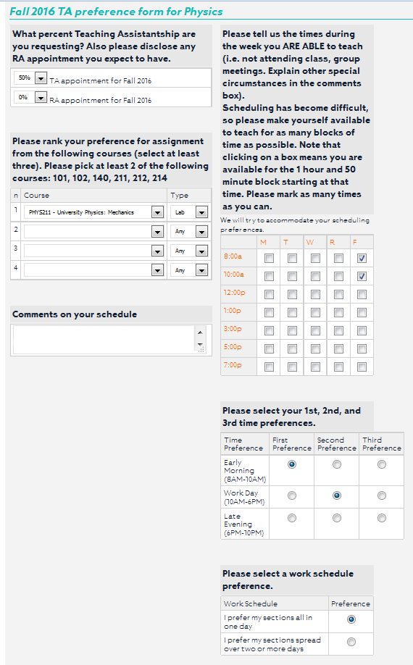

Slide 14
New user for Illinois Campus Cluster
Physics queue: 4 nodes, 192GB(40 core per node), no GPUs
Available to anyone affiliated with Physics
Secondary queue available too
RCaaS queue: pay-as-you-go
Physics Project Space available
- only meant for storage of data no longer than 6 months
ENG-RESEARCH queue: GPUs available
https://campuscluster.illinois.edu/
https://my.physics.illinois.edu/iccp/

Slide 15
Once an academic year (usually in summer), evaluations will be completed.
Head of Graduate Programs completes evaluation, which then emails you.
Your advisor will also be notified. If they complete the online evaluation, you will receive an email when it’s complete.
You will have an opportunity to either agree or disagree with either evaluation.
When you complete your self evaluation, your advisor will be sent a notification email.
Be sure to click the Save Evaluation button at the bottom of the screen to save your changes!
When you’re ready to mark your self evaluation as complete, click the
Complete & Submit Evaluation button.
Physics Evaluations

Slide 16
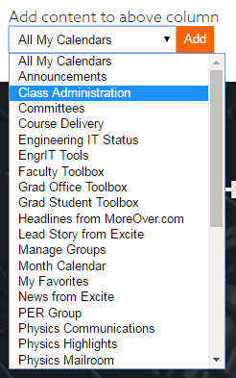
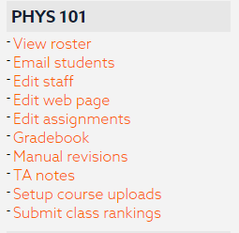
New TAs will want to add the
Class Administration module
from one of the dropdowns
at the bottom of your screen.
Not seeing your assigned course?
Contact the Undergraduate Office at
undergrad@physics.illinois.edu

Slide 17
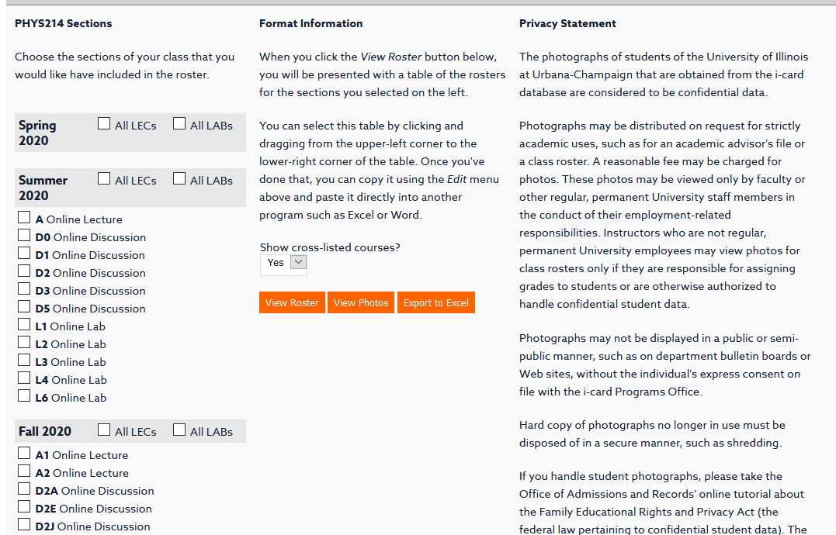

Slide 18
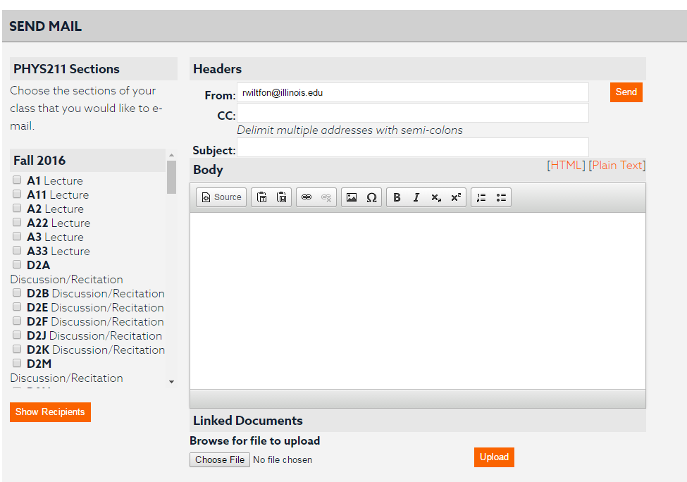

Slide 19
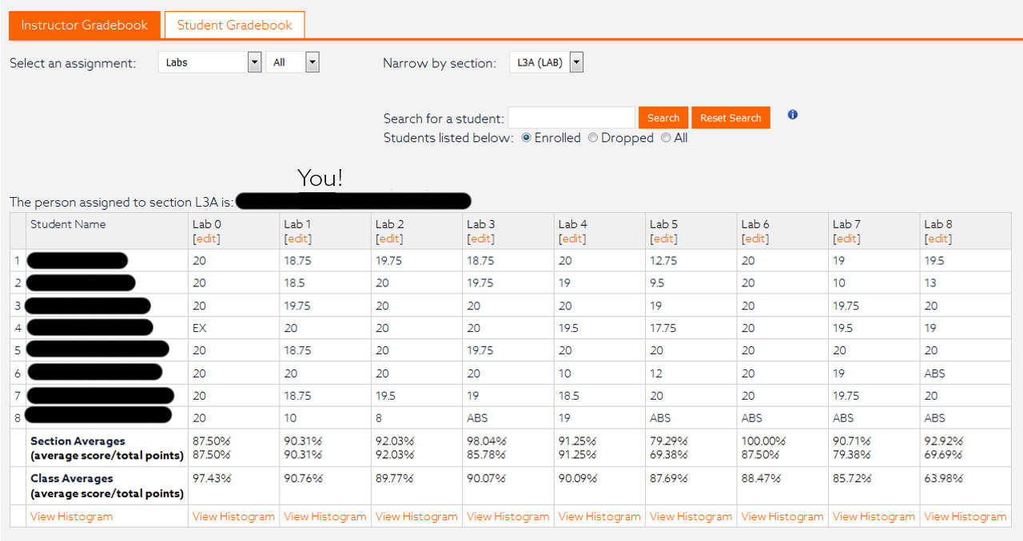

Slide 20
When a student in one of your sections submits an excuse for one of their assignments, the Undergraduate Office vets it first. If they approve it, then you will receive an email.
Please review the date, documentation and either Approve or Deny the request.
If you need to deny a request for an excuse, be sure to enter why in the [Deny notes] section. What you enter here, will be sent to the student.
Please deal with these ASAP to ensure the gradebook is up-to-date.
Course Excuses

Slide 21
Engineering IT
264 MRL
217-333-1313
engrit-help@illinois.edu

Slide 22
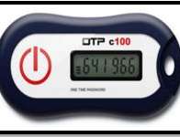
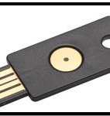
2-Factor Authentication
OTP C100
All graduate students are automatically enrolled.
4 options to use as your second device:
Your phone (text/call)
Your phone (DUO app)
https://verify.uillinois.edu/
https://guide.duo.com/manage-devices
Yubikey token ($35) or OTP C100 token ($10)
https://answers.uillinois.edu/illinois/internal/page.php?id=72159
Yubikey

Slide 23
This presentation can be found at
http://go.physics.illinois.edu/newgrads

