Slide 1
Clinical Variant interpretation lab
Joe Farris, Ph.D.
Introduction to Computational Genomics
June 24th, 2025

Slide 2
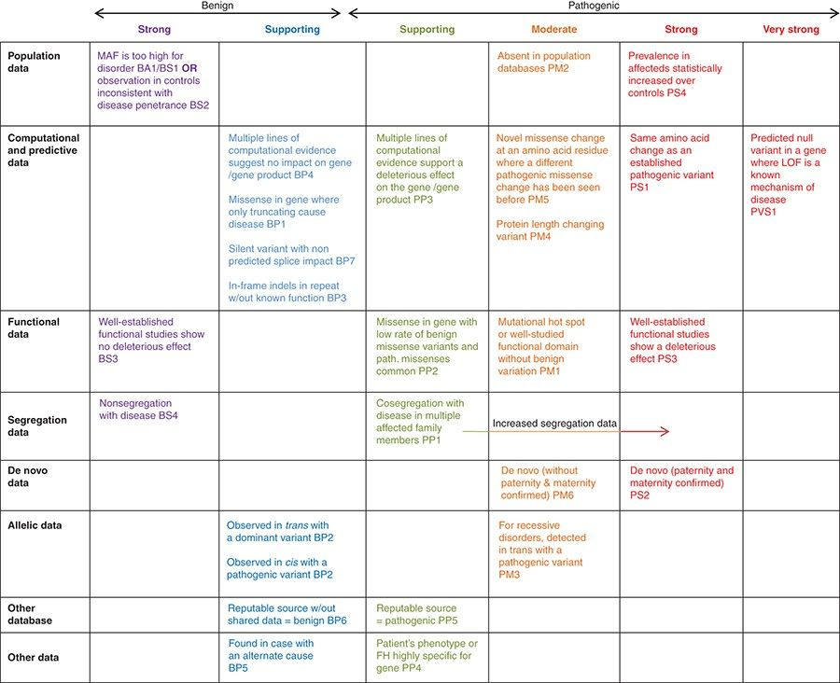
ACMG Criteria

Slide 3
Case 1: Guided Walkthrough
I will walk you through the variant classification with active discussion from the class

Slide 4
Case #1
Patient phenotype:
Abnormality of male external genitalia, high palate, retrognathia, low-set ears, patent ductus arteriosus, hypoglycemia, abnormal pattern of respiration, ascending tubular aorta aneurysm, abnormality of the external nose, abnormal digit morphology, fetal choroid plexus cysts, short fetal femur length, heart murmur, abnormal atrioventricular valve physiology
Variant identified via trio genome:
CCDC22:c.1634A>G, Lys545Arg
Inheritance: maternal (X-linked gene). Follow-up sequencing found the variant was not inherited from the mother’s parents.
Criteria being considered | Strength being applied | Evidence | Points
PM2 | supporting | Absent from gnomAD | +1
PP3 | supporting | SpliceAI > 0.2 | +1
PS2 | moderate | De novo in carrier mother in a gene consistent | +2

Slide 5
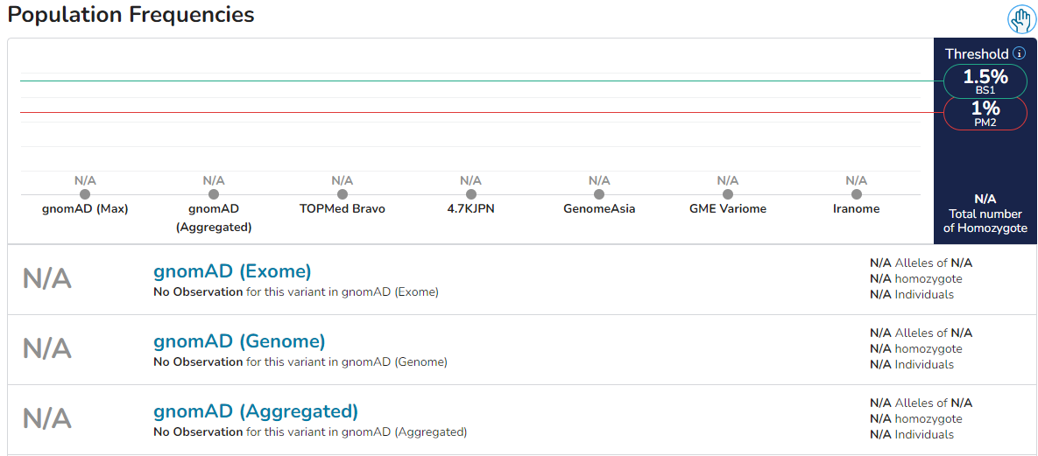
PM2

Slide 6
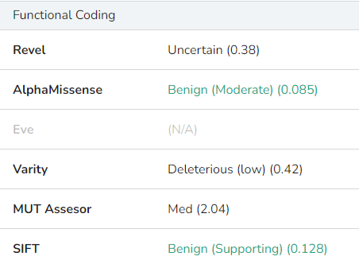
PP3

Slide 7
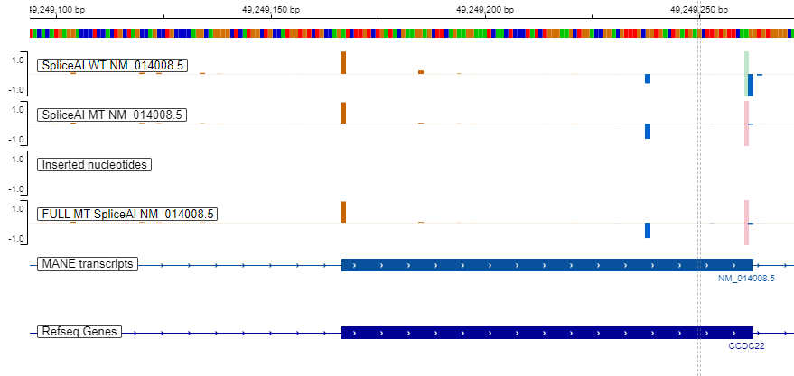
PP3

Slide 8
PP3

Slide 9
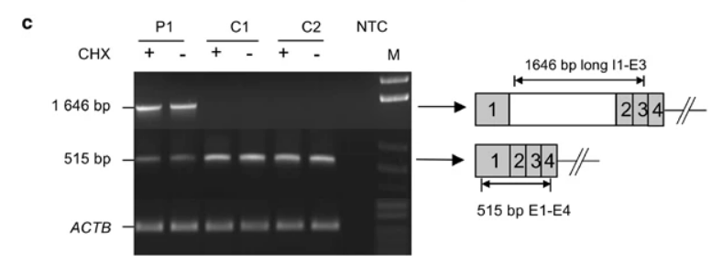
PP3
The second reported missense variant has been functionally proven to cause retention of intron 1.

Slide 10
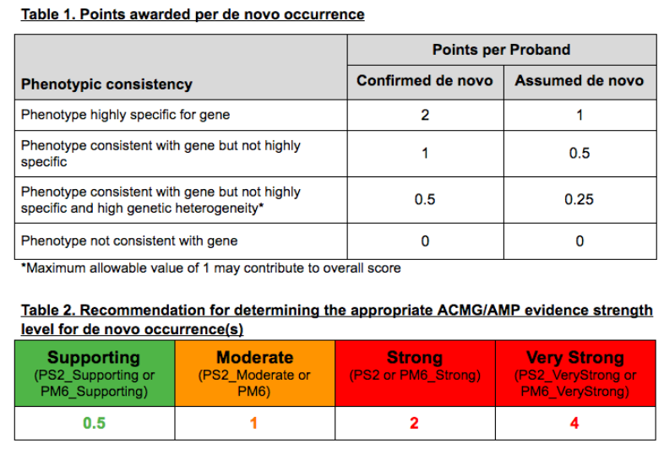
PS2

Slide 11
PS2
Ritscher-Schinzel syndrome 2
INHERITANCE
- X-linked recessive
GROWTH
Other
- Growth delay, postnatal
HEAD & NECK
Head
- Large head circumference
Face
- Broad forehead - Short philtrum
Eyes
- Upslanting palpebral fissures - Hypertelorism
Mouth
- Protruding tongue - Abnormal dentition (in some patients)
Neck
- Broad neck
CARDIOVASCULAR
Heart
- Ventricular septal defect - Atrial septal defect
Vascular
- Patent ductus arteriosus
GENITOURINARY
External Genitalia (Male)
- Cryptorchidism
SKELETAL
Skull
- Large anterior fontanelles
Spine
- Scoliosis
Hands
- Distal digital anomalies - Syndactyly - Camptodactyly - Clinodactyly - Hypoplastic distal phalanges
Feet
- Overriding toes - Broad halluces
SKIN, NAILS, & HAIR
Hair
- Low posterior hairline - Aplasia cutis (in some patients)
MUSCLE, SOFT TISSUES
- Hypotonia
NEUROLOGIC
Central Nervous System
- Delayed psychomotor development - Poor speech - Dandy-Walker malformation - Cerebellar hypoplasia
MISCELLANEOUS
- Variable features - Two unrelated families have been reported (last curated November 2015)

Slide 12
Case 2: Group Walkthrough #1
In breakout groups, walk through your variants and apply criteria you think are appropriate based on publically available databases.

Slide 13
Case #2
Patient phenotype:
Retinitis pigmentosa
Variant identified via trio exome:
RPGR:c.905G>A, Cys302Tyr
Transcript: NM_001034853.2
Inheritance: Unknown, but variant is on the X-chromosome
Criteria being considered | Strength being applied | Evidence | Points
PM2 | supporting | Absent from gnomAD | +1
PP3 | moderate | REVEL = 0.92 | +2
PS4 | moderate | 3 unrelated families | +2
PS3 | supporting | Functional evidence that the protein-protein interaction | +1

Slide 14
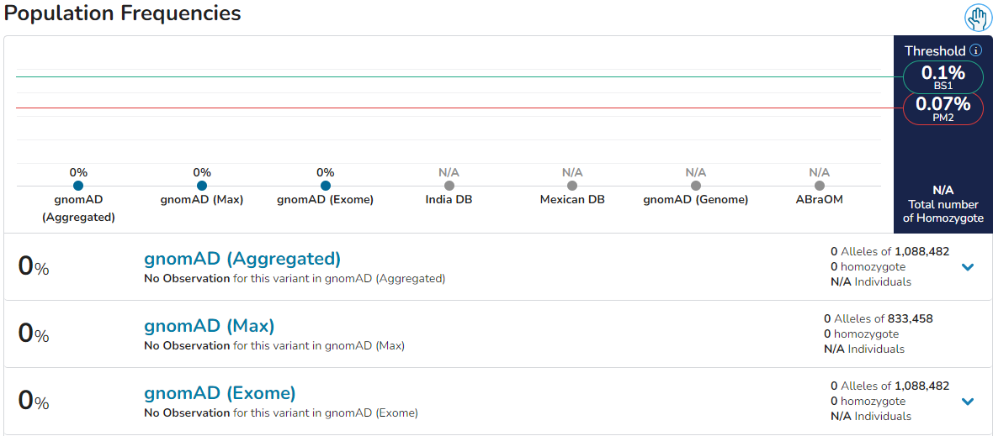
PM2

Slide 15
PS4
The variant was observed in three males with retinitis pigmentosa in one family. (PMID: 10937588)
The variant was observed in a 56 y/o male with retinitis pigmentosa in a Chinese cohort. Age of onset was 3 y/o. (PMID: 32100970)
The variant was observed in at least one family member from a large retinal degeneration cohort (PMID: 32037395) (They applied PP1 indicating multiple family members were observed).

Slide 16
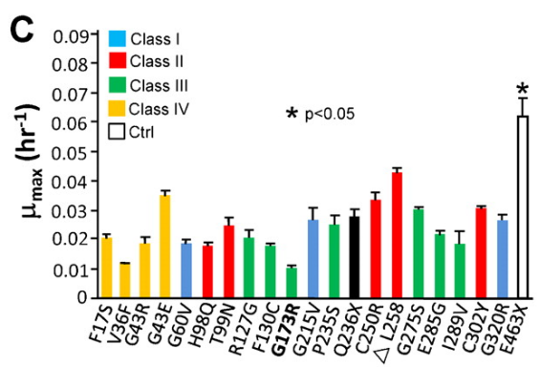
PS3
Cys302Tyr was shown to reduce the interaction between RPGR and RPGRIP1α by yeast hybridization assay (PMID: 23213406)

Slide 17
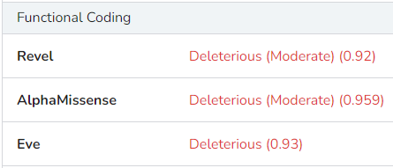
PP3

Slide 18
Case 3: Group Walkthrough #2
In breakout groups, walk through your variants and apply criteria you think are appropriate based on publically available databases.

Slide 19
Variant #3
I
Patient phenotype:
Pulmonary fibrosis, shorted telomeres
Variant identified via trio genome:
RTEL1:c.101A>G, Q34R
Inheritance: Paternal
Family history: 1 affected brother, 1 unaffected sister. Father and paternal uncle are affected.
1
2
II
1
2
3
III
1
2
3
4
5
IV

Slide 20
Variant #3
Criteria being considered | Strength being applied | Evidence | Points
PM2 | supporting | 2 carriers in gnomAD | +1
PP3 | supporting | SpliceAI > 0.2 | +1
PP1 | moderate | Segregates with disease in the family | +2
PP4 | supporting | Shortened telomeres | +1
Patient phenotype:
Pulmonary fibrosis, shorted telomeres
Variant identified via trio genome:
RTEL1:c.101A>G, Q34R
Inheritance: Paternal
Family history: 1 affected brother, 1 unaffected sister. Father and paternal uncle are affected.

Slide 21
PP1
I
1
2
II
1
2
3
(1/2)³ x (1/2) = 1/16
III
1
2
3
4
5
IV

Slide 22
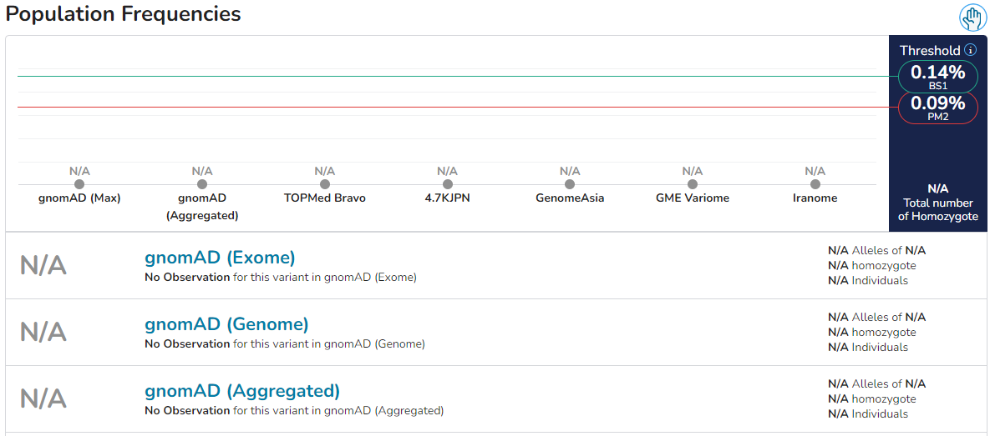
PM2

Slide 23
PP3
By REVEL score, you would apply BP4_moderate

Slide 24
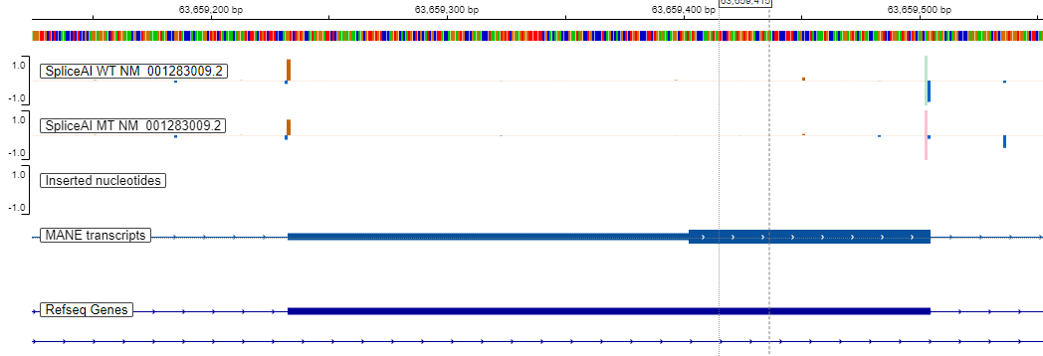
PP3

Slide 25
PP4
INHERITANCE
- Autosomal dominant
RESPIRATORY
Lung
- Pulmonary fibrosis - Dyspnea - Hepatopulmonary syndrome (in some patients) - Dilated pulmonary vasculature with shunting
ABDOMEN
Liver
- Hepatopulmonary syndrome (in some patients) - Portal hypertension - Nodular regenerative hyperplasia seen on liver biopsy
Spleen
- Splenomegaly
SKELETAL
Hands
- Digital clubbing
MUSCLE, SOFT TISSUES
- Ascites
LABORATORY ABNORMALITIES
- Decreased telomere length in lymphocytes - Elevated liver enzymes
MISCELLANEOUS
- Adult onset - Variable manifestations - Incomplete penetrance

Slide 26
Case 4: Group Walkthrough #3
In breakout groups, walk through your variants and apply criteria you think are appropriate based on publically available databases.

Slide 27
Case #4
Criteria being considered | Strength being applied | Evidence | Points
Variant 1 R402*
PVS1 | Very strong | LOF is established | +8
PM2 | Supporting | Rare in gnomAD | +1
Variant 2 R223C
PM3 | Strong | 2 probands (ours included) where in trans with LP variant | +4
PP3 | Supporting | SpliceAI | +1
PM2 | Supporting | Rare in gnomAD | +1
Patient phenotype:
Developmental regression, ataxia, seizures, cerebellar atrophy, nystagmus, Dandy-Walker malformation
Variant identified via trio genome:
In trans variants:
PMPCA:c.1204C>T, R402*
PMPCA:c.667C>T, R223C

Slide 28
Variant 1: PVS1

Slide 29
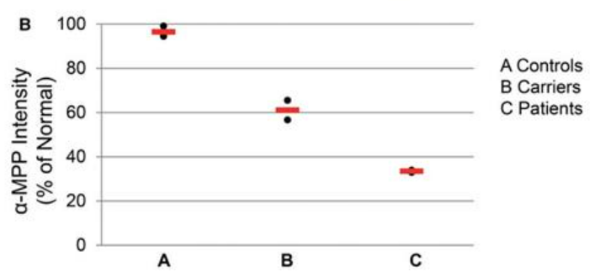
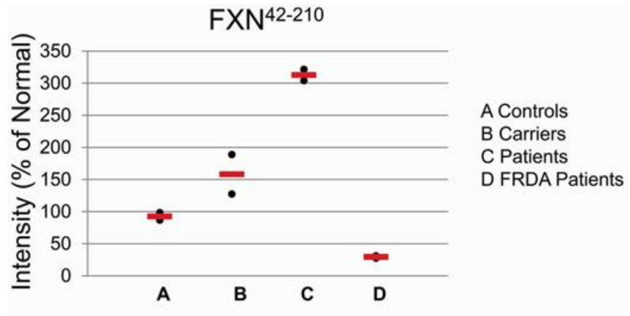
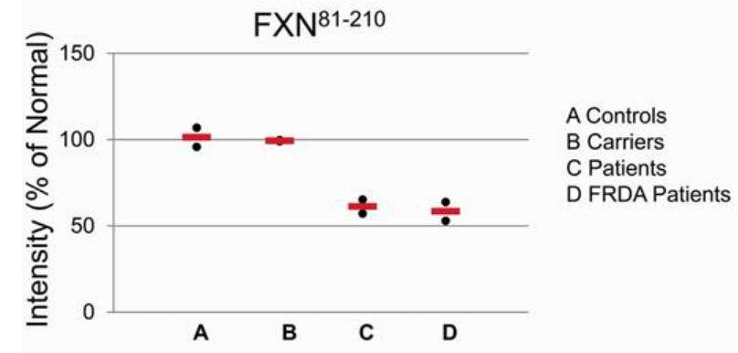
Variant 1: PVS1
PMPCA is a peptidase which matures mitochondrial proteins
A377T homozygote led to decreased PMPCA protein levels
Led to increased pre-processed FXN and decreased mature FXN, similar to levels seen in FRDA patients

Slide 30
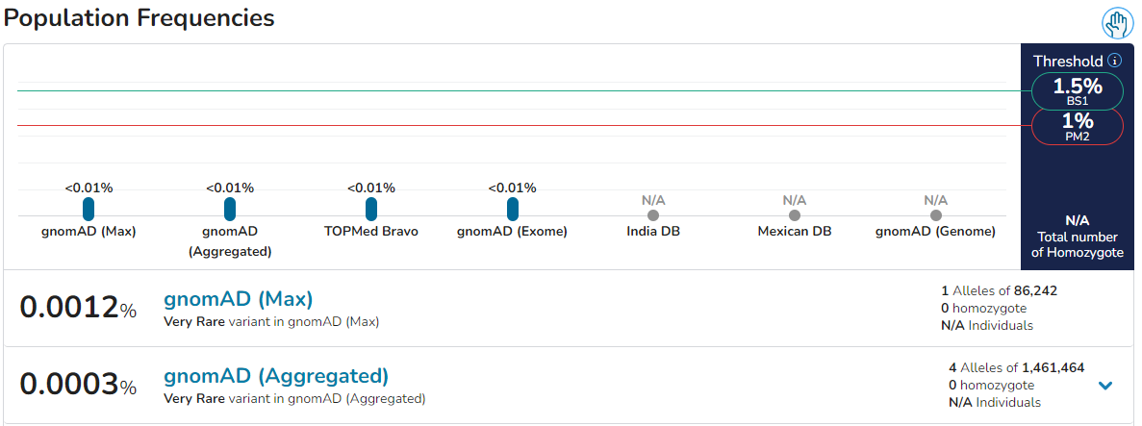
Variant 1: PM2

Slide 31
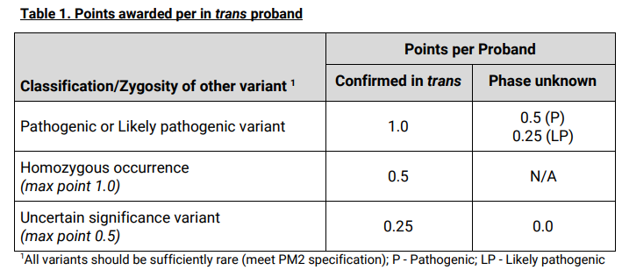
Variant 2: PM3
Patient had in trans variants: R223C and D285Ifs*16
Same missense variant in trans with a LOF variant
Patient history:
birth to 7 months: sitting & standing at 7 months
16 months: developmental regression
4 years: nystagmus, postural tremors, cogwheel rigidity, atrophy of the cerebellar vermis and T2 hyperintensities in the cerebellar cortex. PLA2G6 was suspected until WES revealed bilateral PMPCA variants.
Highly similar genotype leading to a highly similar phenotype.

Slide 32
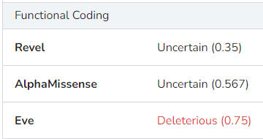
Variant 2: PP3

Slide 33
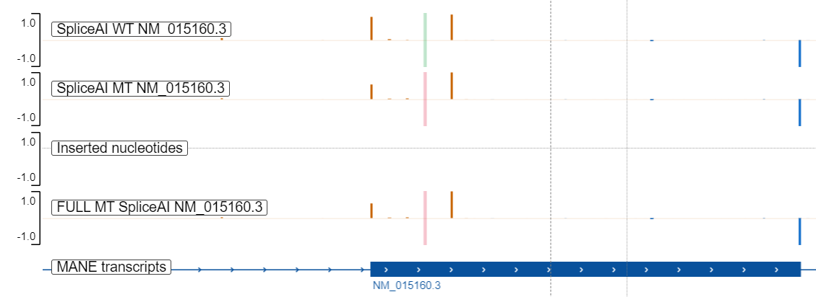
Variant 2: PP3
Weakened canonical acceptor
Strong cryptic acceptor
Splice-AI predicts weakening of canonical acceptor. If cryptic acceptor is used, the protein is thrown out of frame.

Slide 34
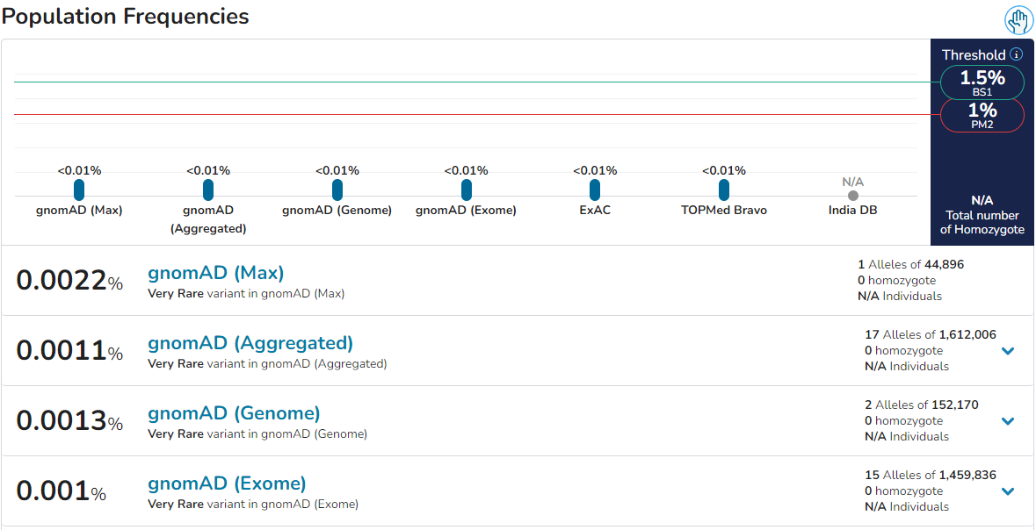
Variant 2: PM2

Slide 35
QUESTIONS & ANSWERS

