Slide 1
9th March 2022
SLAMBench: a performance, accuracy, and robustness evaluation framework for SLAM systems
Mihai Bujanca
Source Code
https://github.com/pamela-project/slambench

Slide 2
Outline
Motivation
How SLAMBench and ILLIRX fit together
Aims
Vision of SLAM -> Spatial AI. Increasing complexity
Why reproducibility is a challenge
What SLAMBench offers
SLAMBench timeline
SLAMBench 1.0: Performance and accuracy benchmarking
SLAMBench 2.0: Multi-objective, head-to-head benchmarking
SLAMBench 3.0: Beyond traditional SLAM
Robust SLAM systems: Are we there yet?
FullFusion: semantic 3D reconstruction in dynamic environments
Lessons from SLAMBench
Dependency management
Ablation studies
SLAMBench & ILLIXR
Acknowledgements

Slide 3
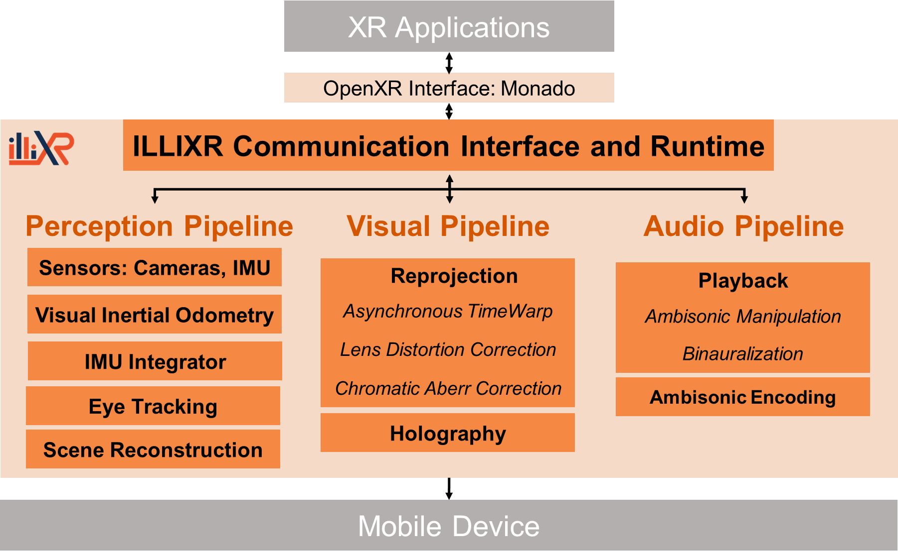

Slide 4
Aim
Automate reproducibility and evaluation of SLAM and Spatial AI systems.
ALGORITHM-AGNOSTIC:
DEFINE SLAM INPUTS AND OUTPUTS.
DATASET-AGNOSTIC:
SUPPORT EXISTING AND FUTURE SENSORS.
CONTEXT-AGNOSTIC:
EVALUATE PERFORMANCE FAIRLY

Slide 5
Currently supported algorithms
ORB-SLAM3 [Campos et al, ARXIV'20]: C++ as distributed by https://github.com/UZ-SLAMLab
ReFusion [Palazollo et al. IROS'19]: CUDA as distributed by https://github.com/PRBonn
OpenVINS [Geneva et al. IROS'19]: C++ as distributed by https://github.com/rpng/
Supereight [Vespa et al. RA-L'18]: C++, OpenMP as distributed by https://github.com/emanuelev
BundleFusion [Dai et al. ACM TOG'17]: CUDA as distributed by https://github.com/niessner
SemanticFusion [McCormac et al. ICRA'17]: CUDA as distributed by https://github.com/seaun163
ORB-SLAM2 [Mur-Artal et al, TOR'15 and TOR'17]: C++ as distributed by https://github.com/raulmur
DSO [Engel et al. Arxiv'16]: C++ as distributed by https://github.com/JakobEngel
ElasticFusion [Whelan et al, IJRR'16]: CUDA as distributed by https://github.com/mp3guy
InfiniTAMv2 [Kahler et al, ISMAR'15]: C++, OpenMP and CUDA versions as distributed by https://github.com/victorprad/
KinectFusion [Newcombe et al. ISMAR'11]: C++, OpenMP, OpenCL and CUDA inspired by https://github.com/GerhardR
LSDSLAM [Engel et al, ECCV'14]: C++, and threaded as distributed by https://github.com/tum-vision/ and modified by https://github.com/mp3guy
MonoSLAM [Davison et al, TPAMI'07]: Original version as distributed by https://github.com/hanmekim/
OKVIS [Leutenegger et al, IJRR'15]: Original version as distributed by https://github.com/ethz-asl
PTAM [Klein et al, ISMAR'07 and ECCV'08]: Original version as distributed by https://github.com/Oxford-PTAM/
SVO [Forster et al, ICRA'14]: Original version as distributed by https://github.com/uzh-rpg/rpg_svo/

Slide 6
Currently supported datasets
OpenLORIS [Shi et al, ICRA'20]: Lifelong SLAM dataset
Bonn Dynamic [Palazollo et al. IROS'19]: Dynamic scene dataset
UZH-FPV [Delmerico et al. ICRA'19]: Drone racing dataset
ETH Illumination [Park et al, ICRA'17]: Illumination changes dataset
VolumeDeform [Innmann et al, ECCV'16]: Non-rigid reconstruction
EuRoC MAV [Burri et al, IJRR'16]: Micro Aerial Vehicle dataset
ICL-NUIM [Handa et al, ICRA'14]: Synthetic dataset
TUM RGB-D [Sturm et al, IROS'12]: A standard SLAM benchmark

Slide 7
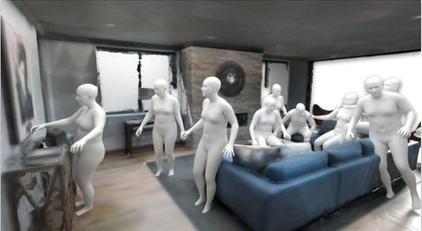
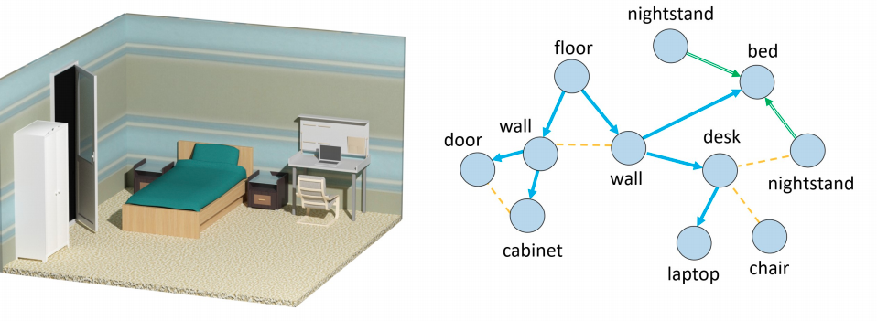
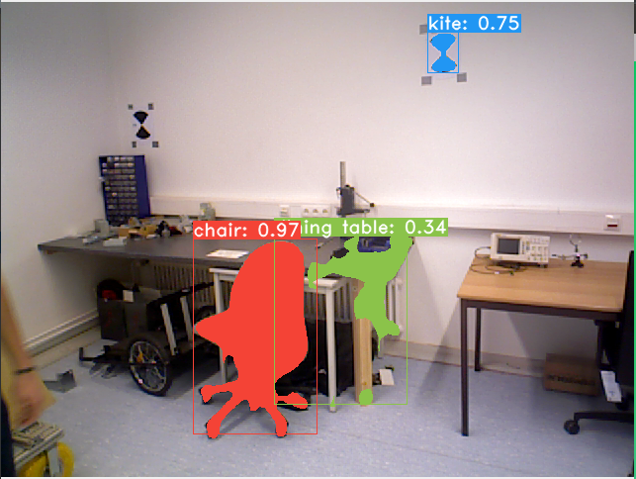
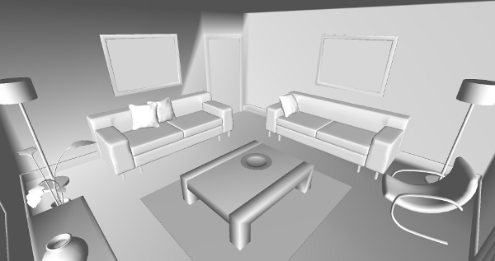
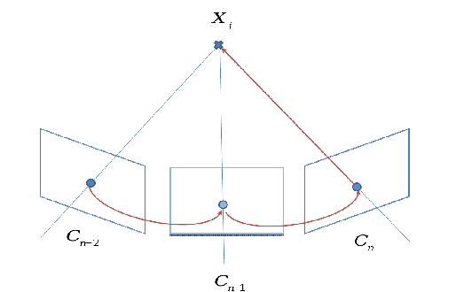
Background: from SLAM to Spatial AI
Level 4: Interaction understanding
Level 3: Scene understanding
Level 2: Reconstruction
Level 1: Camera localisation

Slide 8
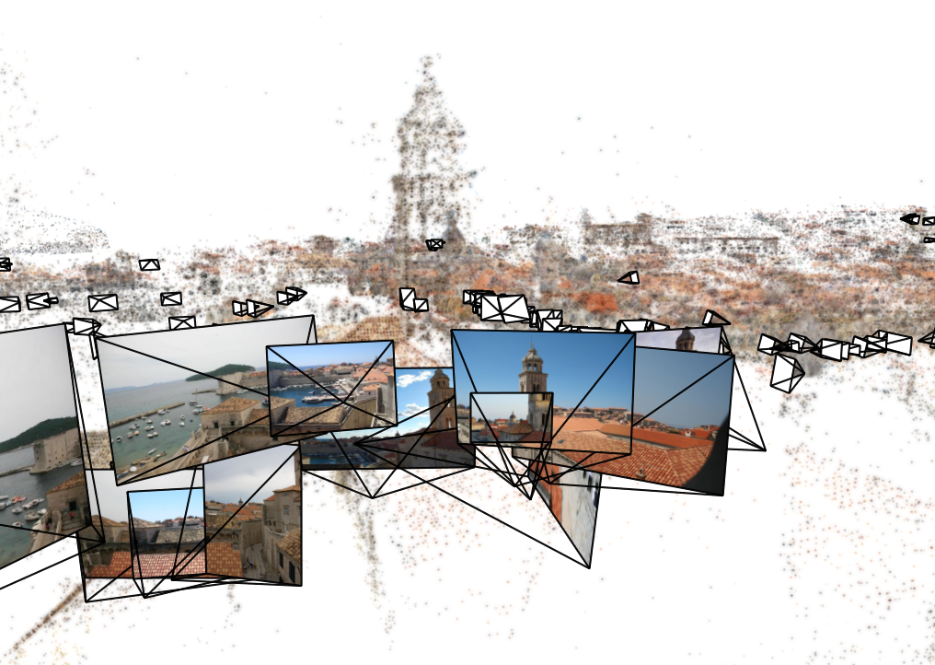
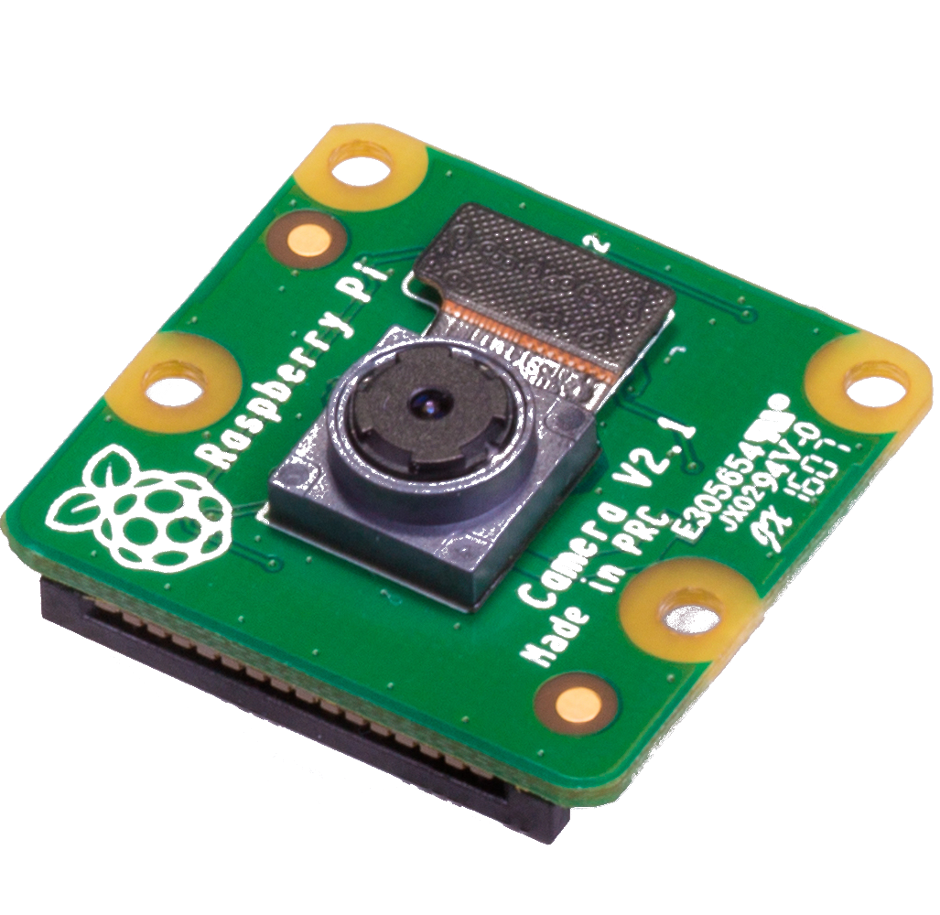
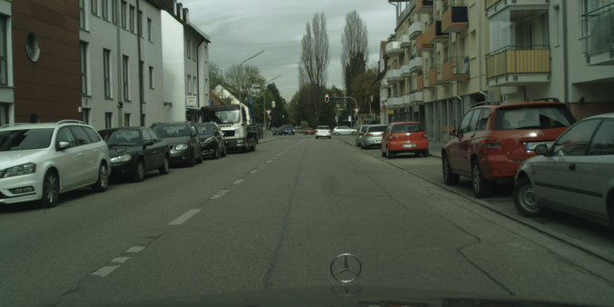
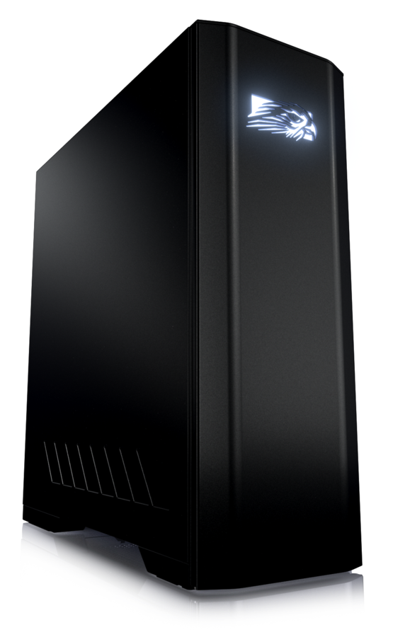
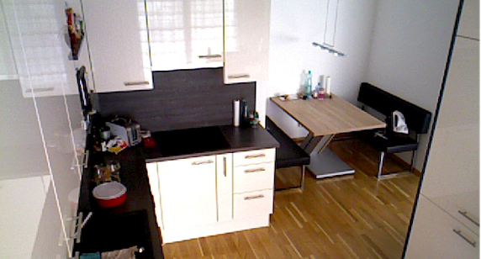
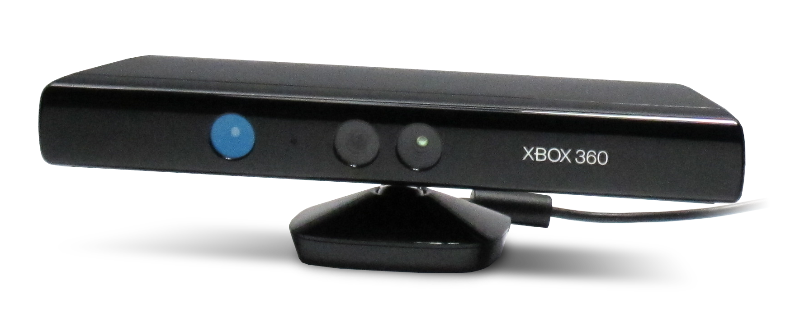
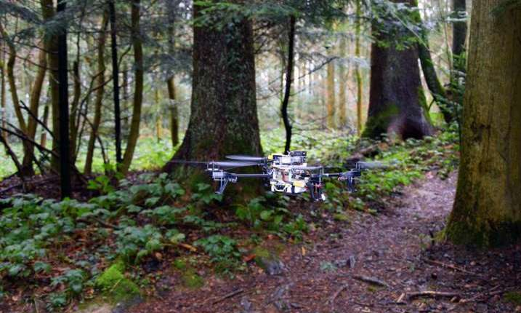
Motivation: SLAM systems are difficult to evaluate
Tasks
Sensors
Platforms
Environments
Visual Localization
Monocular
Cloud computing
City
3D Reconstruction
Stereo
Desktop
Indoor
Scene understanding
Depth
Mobile
Nature

Slide 9
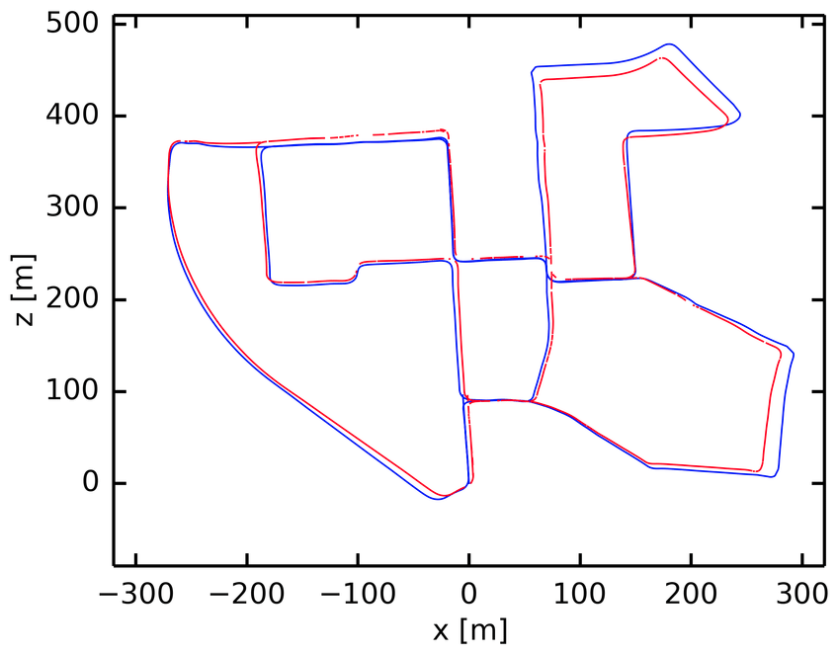
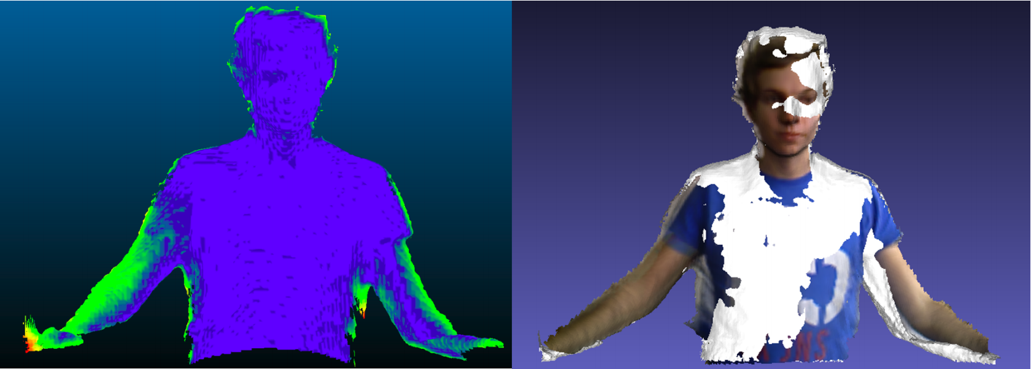
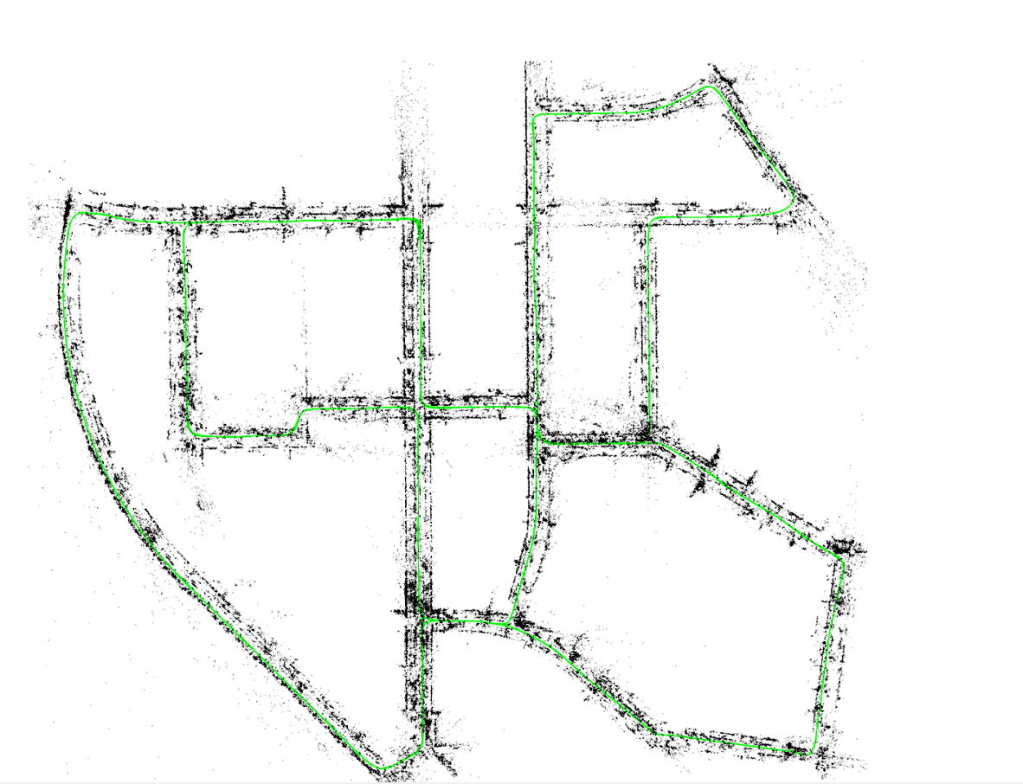
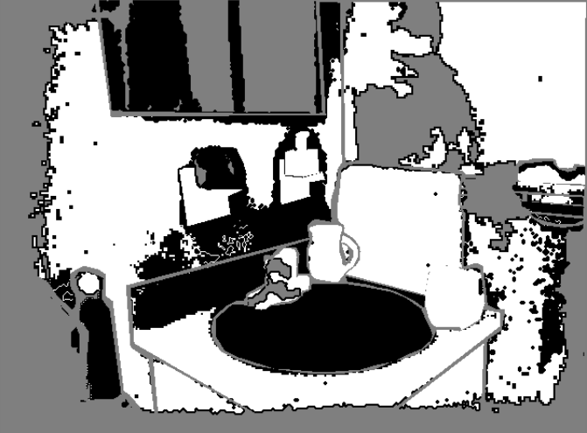
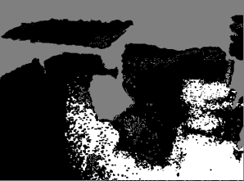
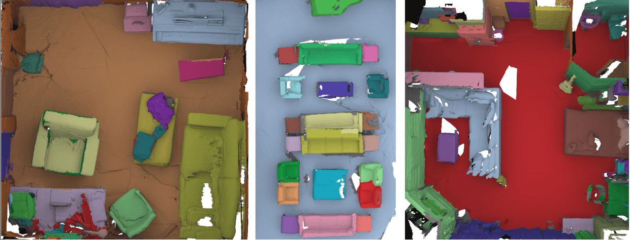
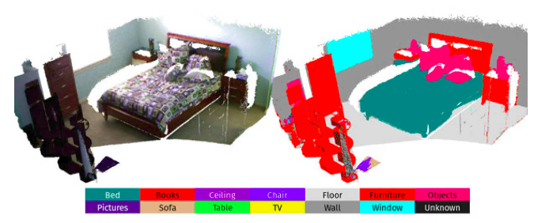
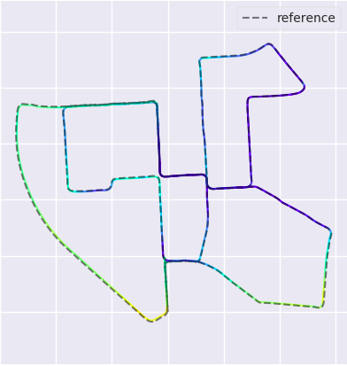
Algorithms
Datasets
Architectures
Metrics
RGB-D, Stereo
Reconstruction error
Traditional SLAM
Depth estimation
Semantic segmentation
Semantic understanding
2D / 3D semantics
Localization accuracy
Non-rigid reconstruction
Non-rigid
Speed
Power
Memory

Slide 10
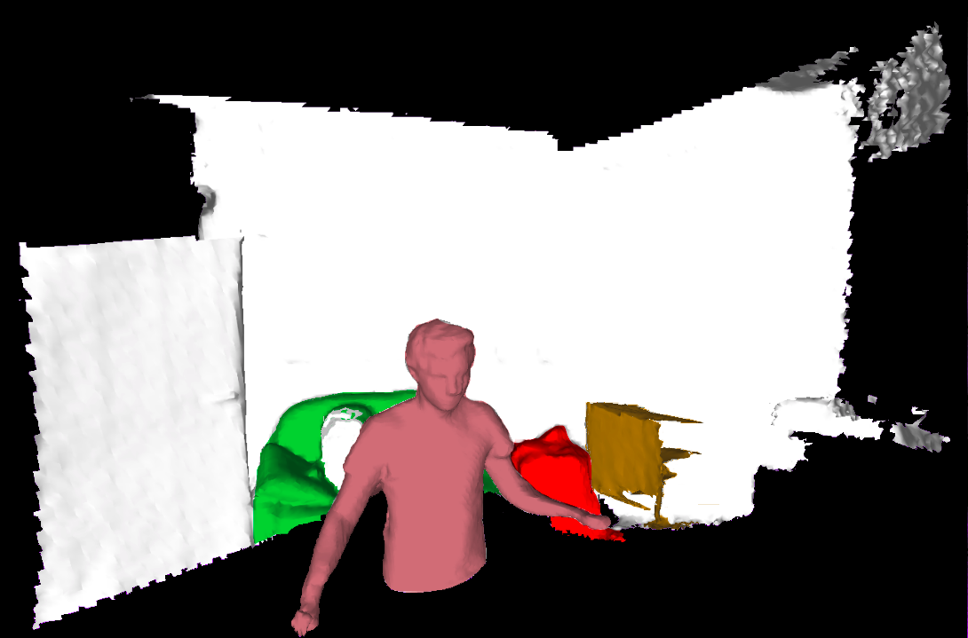
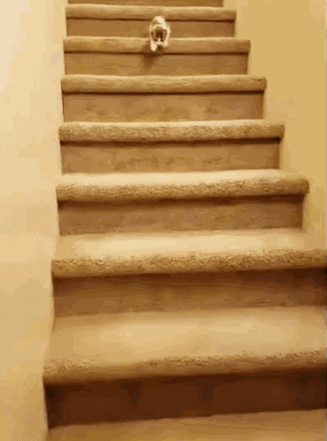
Characterizing SLAM systems:
Accuracy
Complex and rich representations
Efficiency
Robustness to perturbations

Slide 11
Level 4: Interaction understanding
Level 3: Scene understanding
Level 2: Reconstruction
Level 1: Camera localisation

Slide 12
SLAMBench 1.0
How can we understand SLAM systems?
Start by thoroughly evaluating one system, understand the details.
[ICRA’14] Introducing SLAMBench, a performance and accuracy benchmarking methodology for SLAM,
Luigi Nardi, Bruno Bodin, M Zeeshan Zia, John Mawer, Andy Nisbet, Paul HJ Kelly, Andrew J Davison, Mikel Luján, Michael FP O'Boyle, Graham Riley, Nigel Topham, Steve Furber

Slide 13
SLAMBench 1.0
Multiple implementations of KinectFusion (C++, OpenMP, OpenCL, CUDA)
Three metrics (Speed, Power, Accuracy)
Scripts to run the system, collect data, and analyse performance.
Tested on multiple O.S. (Android, Linux, Windows, MacOS)
[ICRA’14] Introducing SLAMBench, a performance and accuracy benchmarking methodology for SLAM,
Luigi Nardi, Bruno Bodin, M Zeeshan Zia, John Mawer, Andy Nisbet, Paul HJ Kelly, Andrew J Davison, Mikel Luján, Michael FP O'Boyle, Graham Riley, Nigel Topham, Steve Furber

Slide 14
Level 4: Interaction understanding
Level 3: Scene understanding
Level 2: Reconstruction
Level 1: Camera localisation
Notes:
Introduced by Andy Davison in FutureMapping: “the goal of a Spatial AI system is not abstract scene understanding, but continuously to capture the right information, and to build the right representations, to enable realtime interpretation and action”.
The basic idea is that SLAM has evolved beyond the original definition, so the term Spatial AI can be used to describe extensions of SLAM with more complex representations.
We think of Spatial AI in 4 levels, this isn’t part of the original definition but it’s how we think about it.
I hope you can already see the relevance of these levels to ILLIXR, I think what we call Level 4 is one of the end goals.

Slide 15
SLAMBench 2.0: multi-objective, head-to-head benchmarking
[ICRA’18] SLAMBench2: Multi-objective head-to-head benchmarking for visual SLAM
Bruno Bodin, Harry Wagstaff, Sajad Saeedi, Luigi Nardi, Emanuele Vespa, John Mawer, Andy Nisbet, Mikel Luján, Steve Furber, Andrew J Davison, Paul HJ Kelly, Michael O'Boyle

Slide 16
SLAMBench 2.0: multi-objective, head-to-head benchmarking

Slide 18
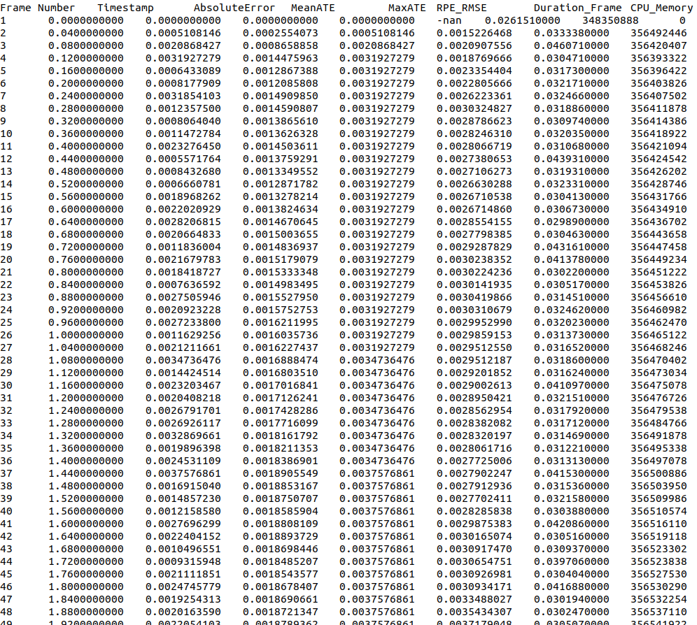
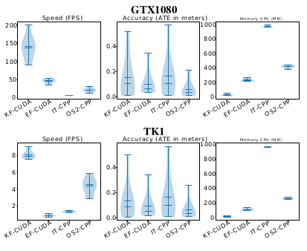
Notes:
Scripts for generating paper-ready plots from logs

Slide 19
Level 4: Interaction understanding
Level 3: Scene understanding
Level 2: Reconstruction
Level 1: Camera localisation

Slide 20
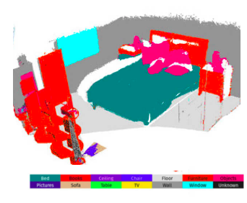
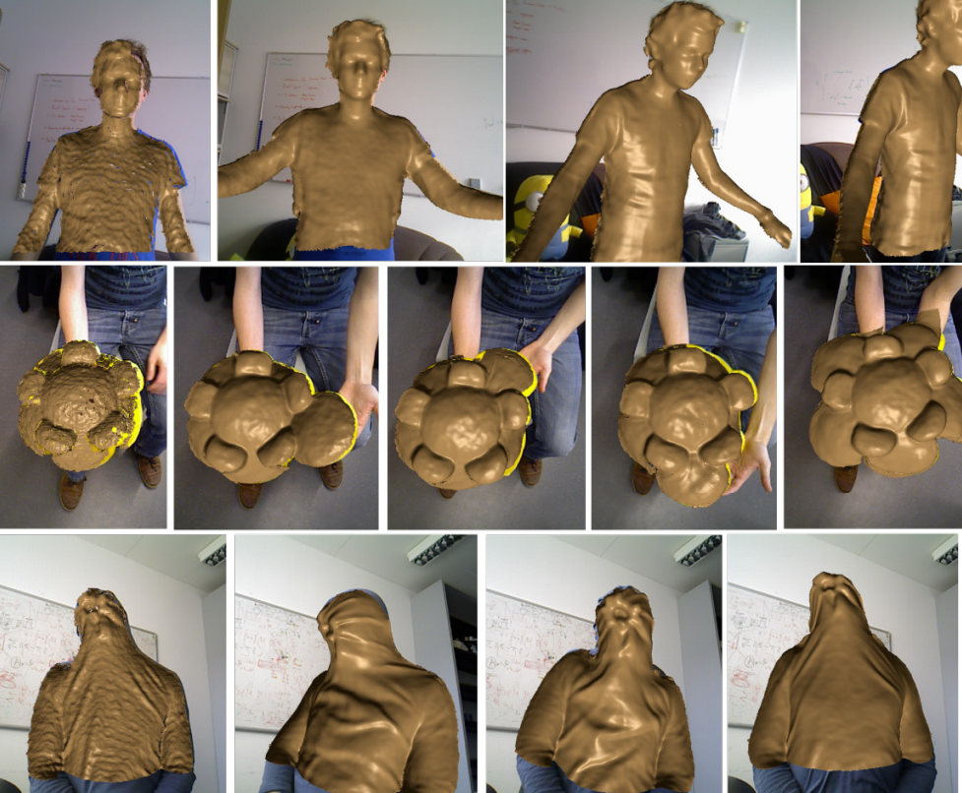
SLAMBench 3.0: Beyond traditional SLAM
Dynamic Reconstruction
Semantic Reconstruction
Depth Estimation
[IROS ‘19] Bujanca, M., Gafton, P., Saeedi, S., Nisbet, A., Bodin, B., O'Boyle, M. F., & Furber, S. (2019, May).
SLAMBench 3.0: Systematic automated reproducible evaluation of SLAM systems for robot vision challenges and scene understanding.

Slide 21
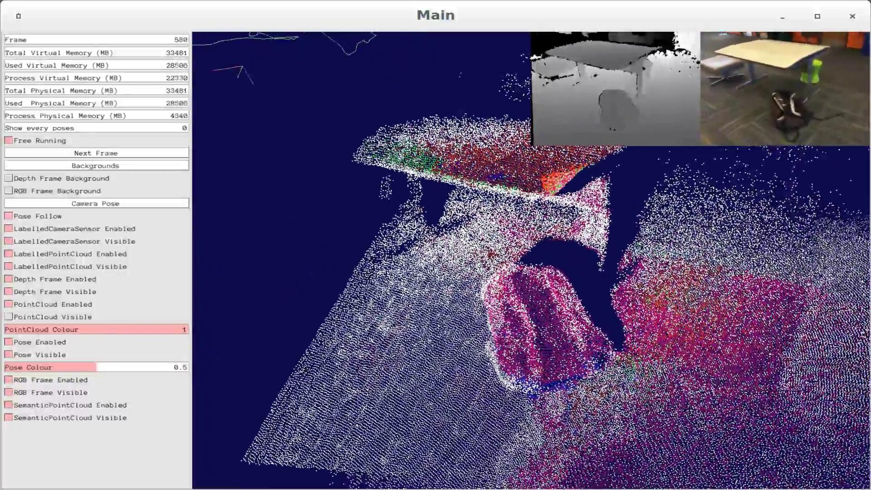

Slide 22
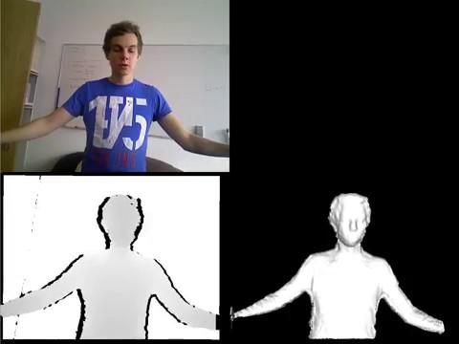

Slide 23
Characterizing SLAM systems:
Accuracy
Complex and rich representations
Efficiency
Robustness to perturbations

Slide 24
Robustness in Spatial AI
Robustness: the capacity of a system to perform correctly in the presence of perturbations
Perturbation: environmental factor that increases the likelihood of a system to fail
[IROS ‘21] Bujanca, M., Shi, X., Spear, M., Zhao, P., Lennox, B., & Luján, M. (2021, September).
Robust SLAM Systems: Are We There Yet?. In 2021 IEEE/RSJ International Conference on Intelligent Robots and Systems (IROS)

Slide 25
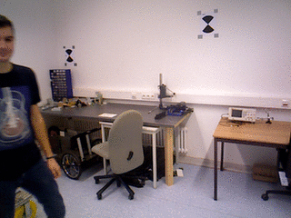
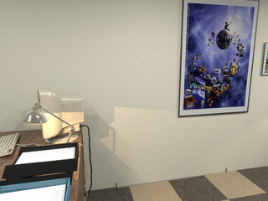
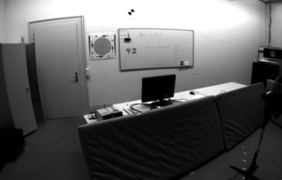
Robustness: study cases
Bonn Dynamic (Palazzolo et al.)
ETH Illumination (Park et al.)
EuRoC MAV (Burri et al.)
OpenLORIS (Shi et al.)
Notes:
Dynamic objects:throw off both the reconstruction and the pose estimation under the assumption of a static env
Illumination: affects a class of algorithms in particular - direct methods, which often work under the assumption of constant illumination
Fast motion: hard to detect features or lines under motion blur
Combination: OpenLORIS e.g cafe with exposure correction and dynamic object.

Slide 27
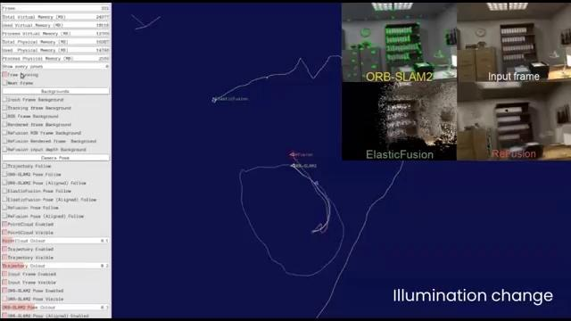

Slide 28
Robustness: Results
 | ElasticFusion | FullFusion | ReFusion | OpenVINS | ORB-SLAM2 | ORB-SLAM3
Baseline Accuracy | Very good | Good | Good | Very good | Very good | Very good
Illumination | Not robust | Excellent | Not robust | No data | Excellent | Excellent
Dynamic | Not robust | Good | Very good | No data | Not robust | Acceptable
Fast | No data | No data | No data | Very good | Acceptable | Very good
OpenLORIS (Combined) | Not robust | Acceptable | Acceptable | No data | Acceptable | Good
Overall qualitative results

Slide 29
FullFusion: a framework for semantic reconstruction of dynamic scenes
Integrating semantics, dynamic models and static background into one framework
Idea: semantic label integration is generally desirable, use labels to embed prior knowledge
[ICCVW’19] FullFusion: a framework for semantic reconstruction of dynamic scenes
Mihai Bujanca, Mikel Luján, Barry Lennox

Slide 30
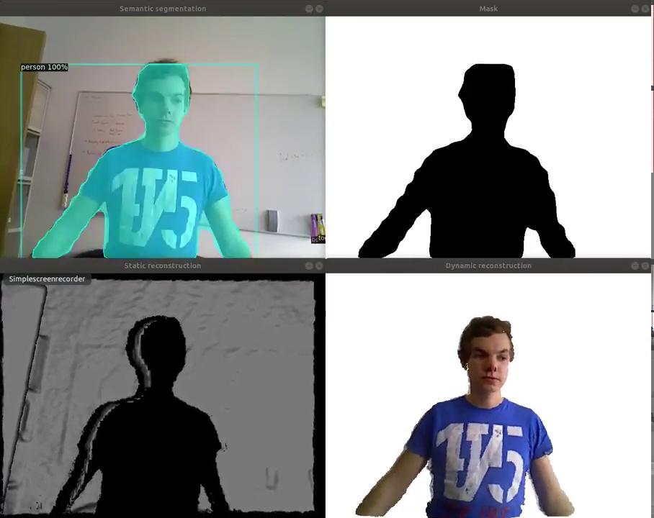

Slide 31
Adding a new SLAM system in SLAMBench

Slide 32
ILLIXR + SLAMBench

Slide 33
Lessons from SLAMBench
Dependency management. Two options:
Try to use the same dependencies across all systems.
Use separate containers with dependencies + system every time.
CMake often problematic.
Automate ablation studies ^{[6]}
Dataset format

Slide 34
Thanks to collaborators and contributors:
Andrew J Davison
Andy Nisbet
Armin Stepanjans
Barry Lennox
Bruno Bodin
Emanuele Vespa
Graham Riley
Harry Wagstaff
John H Mayer
John Mawer
Leonard Papenmeier
Luigi Nardi
Luis Plana
Matthew Spear
Michael O'Boyle
Mihai Bujanca
Mikel Luján
M. Zeeshan Zia
Nigel Topham
Paul Gafton
Paul H.J. Kelly
Pengpeng Zhao,
Sajad Saeedi,
Steve Furber
Xuesong Shi

Slide 35
Research on SLAMBench is supported by:
EPSRC, grant PAMELA EP/K008730/1 and RAIN Hub EP/R026084/1.
EPSRC, grant RAIN Hub EP/R026084/1.
Arm Royal Academy of Engineering Research Chair

Slide 36
References
Davison, A. J. (2018). FutureMapping: The computational structure of spatial AI systems. arXiv preprint arXiv:1803.11288.
Huzaifa, M., Desai, R., Grayson, S., Jiang, X., Jing, Y., Lee, J., ... & Adve, S. V. (2021, November). ILLIXR: Enabling End-to-End Extended Reality Research. In 2021 IEEE International Symposium on Workload Characterization (IISWC) (pp. 24-38). IEEE.
Nardi, L., Bodin, B., Zia, M. Z., Mawer, J., Nisbet, A., Kelly, P. H., ... & Furber, S. (2015, May). Introducing SLAMBench, a performance and accuracy benchmarking methodology for SLAM. In 2015 IEEE international conference on robotics and automation (ICRA) (pp. 5783-5790). IEEE.
Bodin, B., Wagstaff, H., Saeedi, S., Nardi, L., Vespa, E., Mawer, J., ... & O'Boyle, M. F. (2018, May). SLAMBench2: Multi-objective head-to-head benchmarking for visual SLAM. In 2018 IEEE International Conference on Robotics and Automation (ICRA) (pp. 3637-3644). IEEE.
Bujanca, M., Gafton, P., Saeedi, S., Nisbet, A., Bodin, B., O'Boyle, M. F., ... & Furber, S. (2019, May). SLAMBench 3.0: Systematic automated reproducible evaluation of SLAM systems for robot vision challenges and scene understanding. In 2019 International Conference on Robotics and Automation (ICRA) (pp. 6351-6358). IEEE.
Bista, S. R., Hall, D., Talbot, B., Zhang, H., Dayoub, F., & Sünderhauf, N. (2021, December). Evaluating the Impact of Semantic Segmentation and Pose Estimation on Dense Semantic SLAM. In 2021 IEEE/RSJ International Conference on Intelligent Robots and Systems (IROS) (pp. 5328-5335). IEEE.
Bujanca, M., Shi, X., Spear, M., Zhao, P., Lennox, B., & Luján, M. (2021, September). Robust SLAM Systems: Are We There Yet?. In 2021 IEEE/RSJ International Conference on Intelligent Robots and Systems (IROS) (pp. 5320-5327). IEEE.

Slide 37
Thank you!
Code: https://github.com/pamela-project/slambench
Contact: horia-mihai.bujanca@manchester.ac.uk

