Slide 1
From majoranas to manufacturing
Physics Career Seminar
10 November 2022
Dr. Jeff Damasco (he/him)
Process Engineer at Intel
University of Illinois at Urbana-Champaign, Physics Ph.D. 2019
UCLA, Physics B.S. 2011

Slide 2
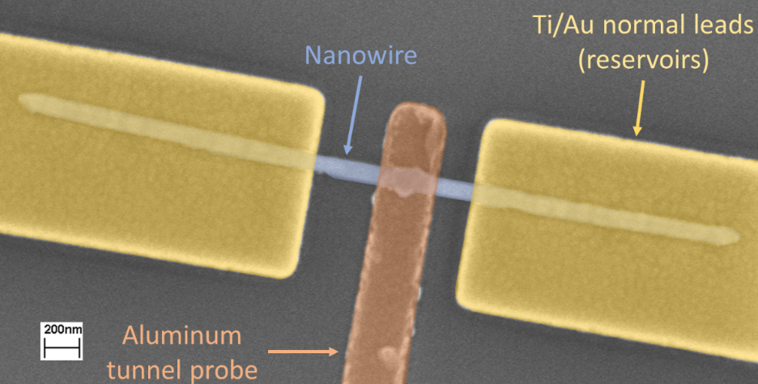
Seminar agenda
My time at grad school
What Intel does
Why I wanted to work at Intel
What Process Engineers at Intel do
Examples of engineering work
First months – what to expect
Day-to-day & on-call
Taken from thesis defense of J. Damasco
Taken from https://www.intel.com/content/www/us/en/silicon-innovations/6-pillars/process.html

Slide 3
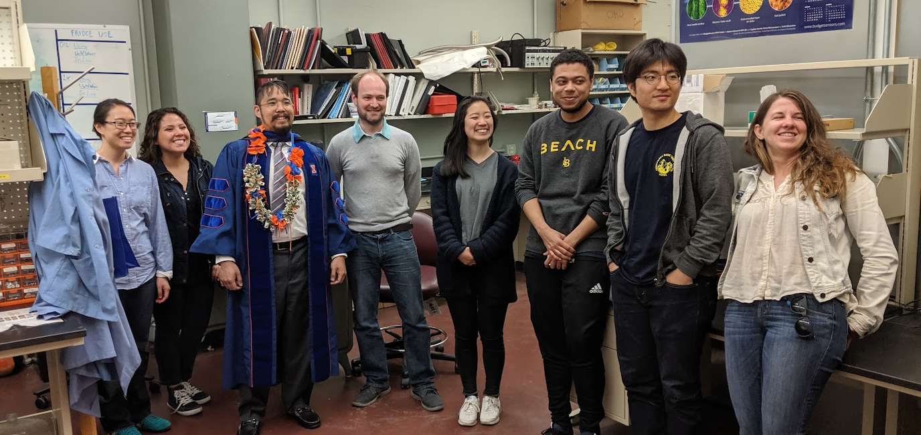
My Journey through grad school
Year | Milestones
2011 | Graduated from UCLA LANL computational physics workshop
2012 | Joined Prof. Mason’s group Graphene, LSMO, and LaO/STO
2014 | March Meeting - LSMO Preliminary exam
2015 | Started work on InSb nanowires
2018 | March Meeting - InSb Thesis defense
2019 | Science writing Started at Intel

Slide 4
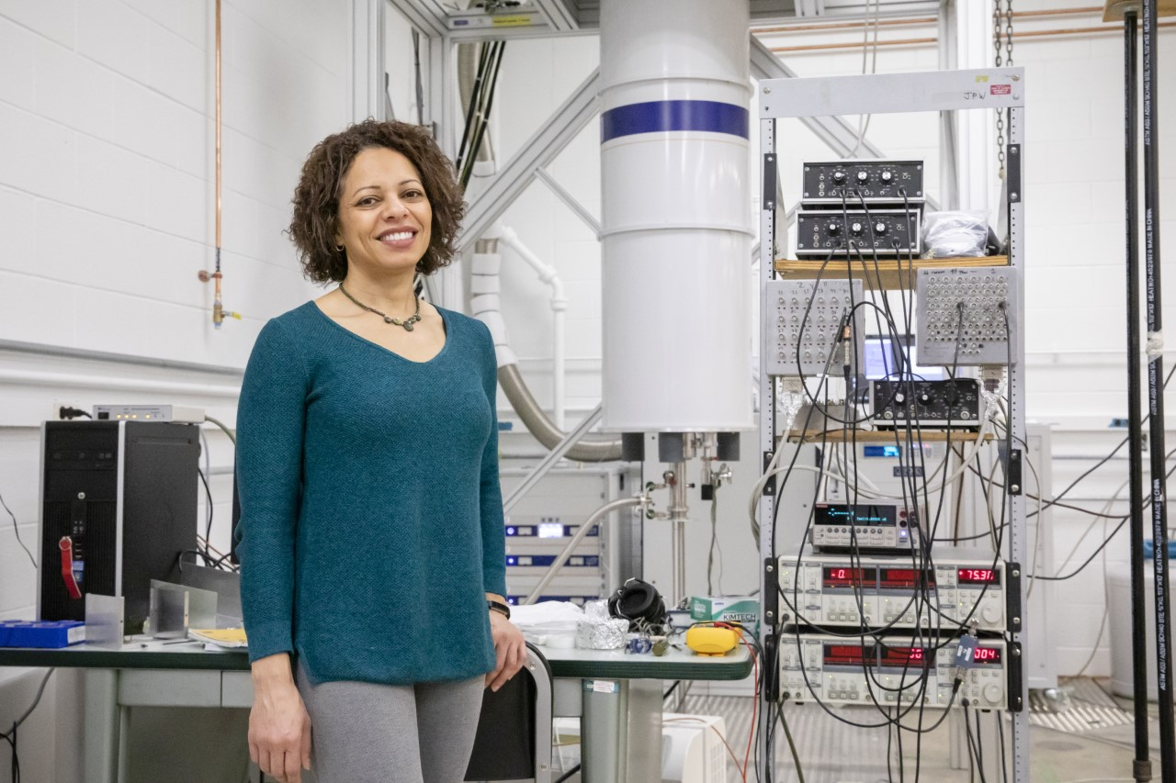
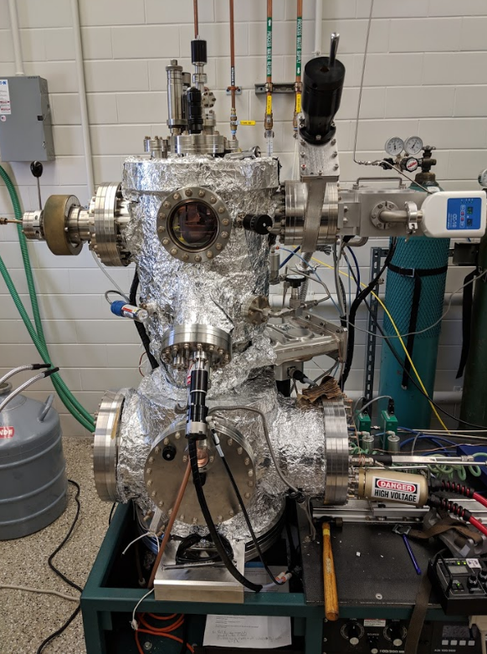
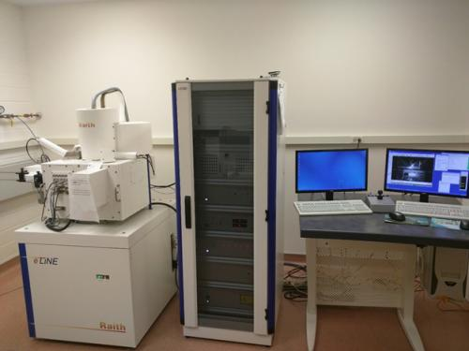
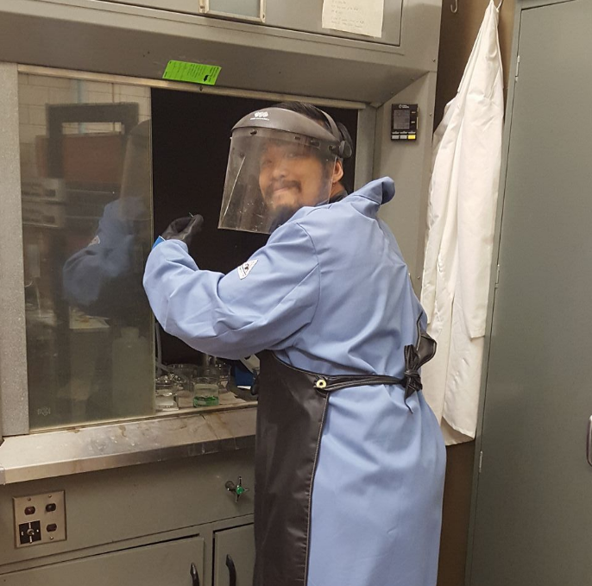
What I did in grad school
Electrical testing
Metal deposition
E-beam lithography
Wet etching
https://www.auburn.edu/cosam/cuwip/speakers.htm
HW/SW integration
https://mrl.illinois.edu/facilities/equipment/raith-eline-electron-beam-lithography-system
https://github.com/masonlab/labdrivers
Taken from thesis defense of J. Damasco
And more!

Slide 5
What I did in grad school
Defined process to build superconducting probe device
Patterning (optical + ebeam)
Metallization (thermal + ebeam)
Etching (wet + dry)
Characterized “goodness” of superconducting probe
Measured effective QPC length
Failure analysis of AlOx barrier
Collaborated with Delft, Pittsburg, and others to obtain InSb nanowires
Images from J. Damasco, et al., Appl. Phys. Lett. 115, 043503 (2019)

Slide 6
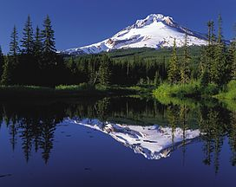
Personal motivations to work at intel
Satisfaction out of obtaining repeatable results
Love for automation/programming & integrating HW/SW
Domain expertise: semiconductor physics & metal deposition
Working on a diverse team
Data-driven decisions
More money than academia
The great outdoors
Food in Portland
https://www.fhwa.dot.gov/byways/photos/62736
https://www.travelportland.com/culture/food-cart-pods/

Slide 7
Disadvantages of industry
Problems are not necessarily new and exciting
Not guaranteed to travel to new places (e.g., for conferences)
Potentially way too many/useless meetings
Implied pressure to work more than typical 8-hour days
Subject to customer whims (internal & external)

Slide 8
What does intel do?

Slide 9
Intel makes chips for computers, servers, cars, etc.!
Transistors turned on via gate control
To build, need to:
Define n/p-type wells
Define the gate
Define S/D
Connect gates, sources, drains
Intel owns process from silicon start to packaging end
Semiconductor industry moving towards 3D structures

Slide 10
What process engineers do
Example/pretend part of flow
Define a pattern of parallel rectangles
Etch the pattern
Etch/”ash” remnants from the pattern
Deposit a hard mask
Wash the pattern definition away
Etch the exposed parts of chip
Etch the hard mask
Define another pattern
Etch the pattern
Etch/”ash” remnants from the pattern
Deposit a metal
Quick summary: engineers specialize in the equipment & process of one or several steps
Areas: Litho, Etch, Diffusion, Thin Films, Planar, Integration, Sort, FBE, TSV
Further subdivisions into sub-areas and groups
Groups work on one or several steps; total # steps = O(10³)
Engineers can own tools, layers, or initiatives
Collaborate with integration & other modules
Write & update spec to clearly dictate how modules function
Transfer processes to the Virtual Factory
Ultimate goal: define a process and make it manufacturable!

Slide 11
Example: Sending a recipe to a friend
Slide courtesy D. Bergstrom

Slide 12
skills to succeed at intel
Area | Skill/Value | What I did at grad school
Process | Materials Science | III-V semiconductors (InSb)
 | Process integration | Developed a process to create devices
 | Statistical Process Control | Take physics courses (stat mech!) Learn data science/statistics
 | Vendor selection | Obtained graphene samples from various vendors Used demo tools to compare to current equipment
Equipment | Safety | Created/maintained SOPs
 | Quality | Performed maintenance on equipment Limited sources used in evaporator to prevent contamination
 | Performance improvement | Built filtering for better thermalization Eliminated ground loops
 | Costs | Developed procedures to minimize liquid He loss
Automation | Programming | Programmed equipment to run on Python
 | Data processing | Set up automatic data collection & post-processing pipelines
Other | Presentations | Participated at March Meetings (2014 & 2018)
 | Teamwork | Worked in collaborations internally and externally
 | Training | Trained new grad students TA’ed physics classes

Slide 13
Factory values & goals
Values
Goals
Safety
Quality
Output
Hardware
Process
Automation
What are some examples of these values & goals?

Slide 14
Safety, quality, and output
Safety:
Secondary containment to avoid chemical spills
Eliminating the need to use certain chemicals
Quality:
Running equipment health monitors after maintenance
Improving within-wafer metrics to ensure performance uniformity
Eliminating human intervention via automation
Output:
Equipment improvements to ensure equipment are up as long as possible
Extending equipment lifetime with improved cleans or part robustness

Slide 15
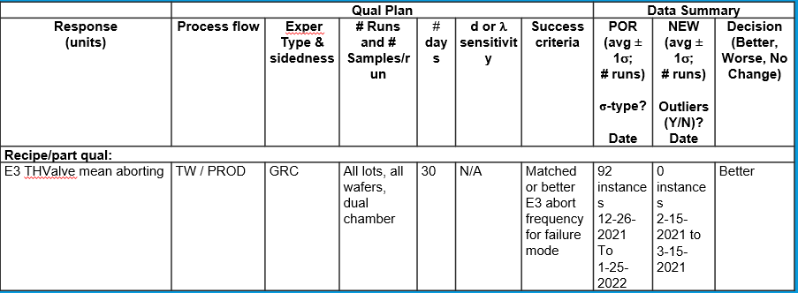
Example: pressure optimization to prevent premature part death
Before
After
Courtesy Z. Weinrich, A. Bunkofske

Slide 16
Example: improving WITHIN-WAFER PARAMETERS via RECIPE CHANGES
Thickness & VT reduction by adjusting recipe gas flow conditions
Thickness variation reduction by matching automated process control
Courtesy S. Yuan

Slide 17
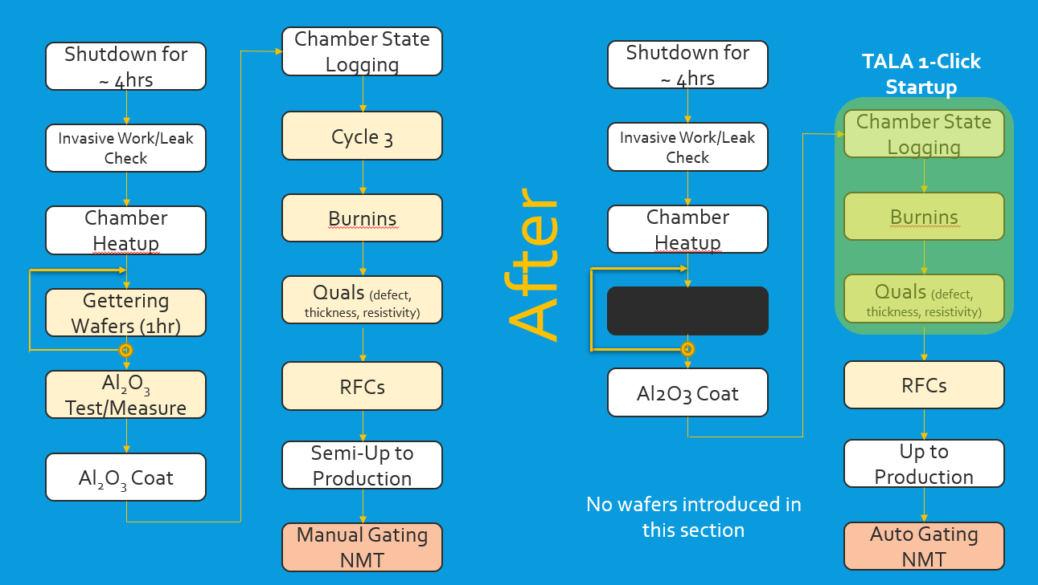
Example: automation of post-maintenance procedures
Before
Waferless Check (15m)
Courtesy Z. Jagoo, J. Damasco

Slide 18
First months at intel
Take WBTs and OJTs to learn various systems used
Focused on operations & equipment
Monitoring tool health
Introducing wafers to tool
Putting the tool together
Training on-shift with technicians
Engineers-in-training become FPOC
Image from https://www.wired.com/2010/10/inside-a-state-of-the-art-cleanroom/

Slide 19
Day-to-day
Typical day (for me): 0730 – 1630
Passdown from night to day shift
Reporting tool status
Chart review for tools
Plan maintenance
Afternoon planning meeting for OCE
Plans for the night
Experiments that are being run
Interacting with engineers/techs
Training
Collaborating/alignment
Meetings:
Focus teams for process development
Quality
Automation
Manufacturing Availability
Shared learning forums
Writing
Going on-site:
Inspect tool & surrounding area
Free coffee
“Work 2” occasionally in the evening

Slide 20
Tool owner – doctor, historian...and engineer, of course
Goal: Know your tool better than anyone else
Know the health of your tool
Proactively address issues that affect yield on prod wafers
Provide guidance on scheduled maintenance
Take detailed notes to allow OCE or backup TO to pick up if you are OOP
Suggest improvements given issues that your tool encounters

Slide 21
The dreaded on-call
Factory is 24/7
Engineers take turns being on-call
On-call done from home
Day off is given as compensation
Types of escalations:
Equipment
Automation
Tool health monitors
Shift engineers improved QoL for OCEs & expanded opportunities for non-PhD

Slide 22
Personal timeline at intel
Year | Main accomplishments
2019 | Joined at the end of 14nm Became a tool owner (& caused premature maintenance – hard lesson learned!) On-call certified
2020 | Eliminated failure mode from idle tools in 14nm Qualified a tool to run 10nm tech & owned escalations for its unique subfab Owned demolition of an old 14nm tool
2021 | Changed vendors for my tool’s subfab to make it CE! Automated post-maintenance procedures Created dashboards for easy access to data Represented group during external ISO audit (with zero findings!)
2022 | Improved automation of production wafers just after maintenance Convinced area to buy into new automation and led proliferation & troubleshooting Increased participation in greater OneMetals area Automation groups Represented group for 7nm and 22nm technologies Taking lead in ASTAR area Automation group Taking lead in Front End Metals SubFab group Started covering for GL (manager) as needed

Slide 23
Factory Roles at Intel
Role | Primary duties
Technician | Follow specifications for tools to operate & troubleshoot Monitor tools running Perform maintenance
Shift Engineer | First POC during day or night shift for equipment escalations Forms plans for operations or maintenance
Shift GL | Assigns techs to maintenance or operations Answers to manufacturing about tool status
Process Engineer | Second+ POC for equipment escalations Drives improvement projects for equipment, process, and automation
GL | Assigns projects to engineers Upskills engineers Steers module towards key deliverables to the factory
IC | Scope of work impacts more than just one module Projects can vary from person to person

Slide 24
Opportunities in the future...
Intel is currently slowing down hiring. Just be on the lookout for opportunities: https://jobs.intel.com/
Things to emphasize on your resume/CV:
Equipment troubleshooting
Attention to detail
Care for safety & quality
Engineers: have at least one publication! (but not necessary...)
Career paths:
Bachelor → Technician, Engineer
Master → Technician, Engineer
Doctorate → Engineer

