Slide 1
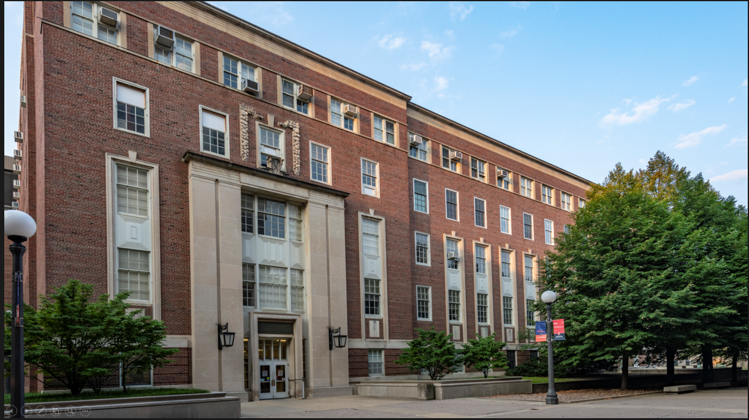
Chemical and Biomolecular Engineering

Slide 2
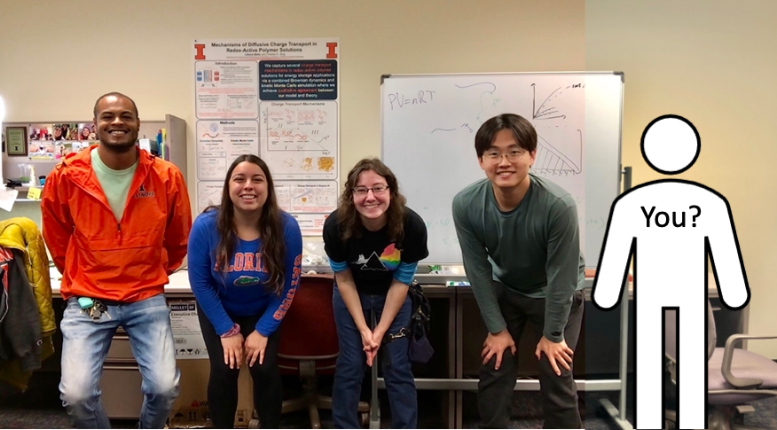
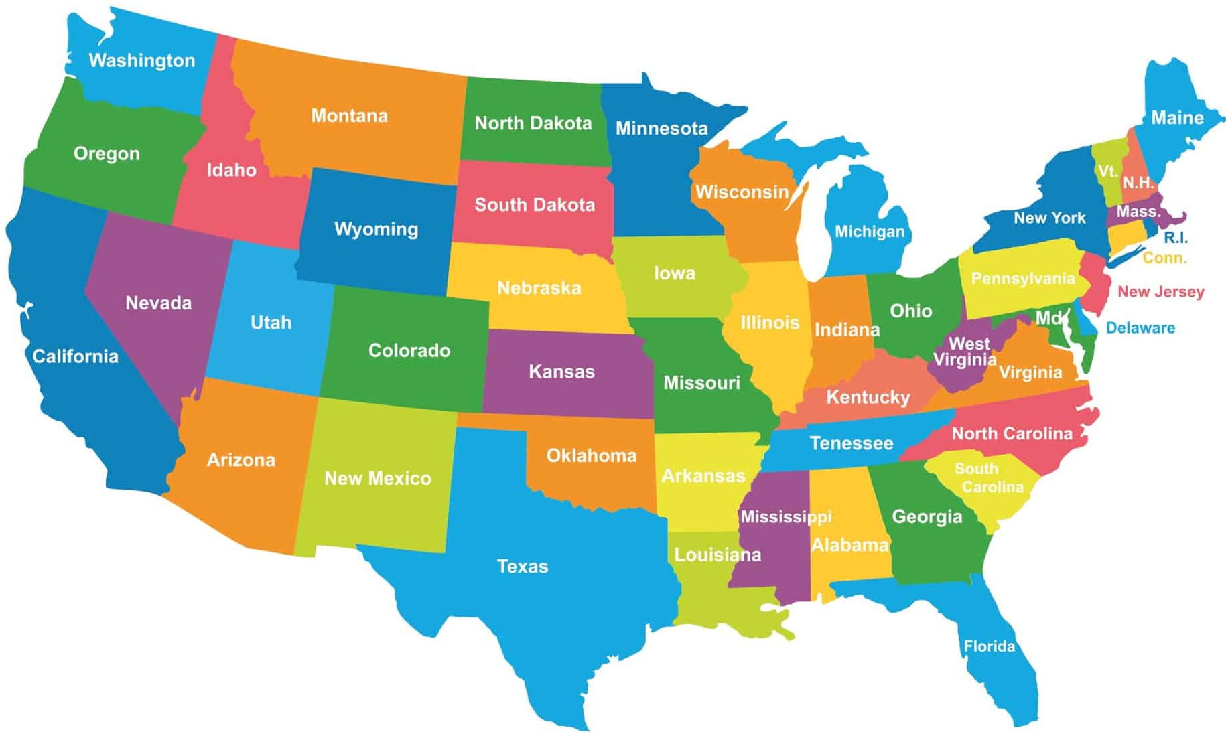
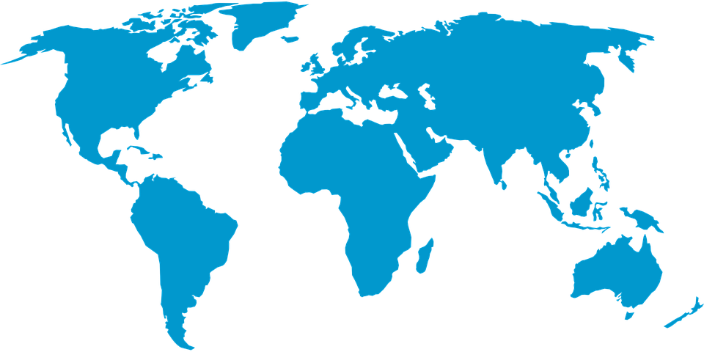
Who are we?
Professors: We studied for a long time (25+ years)! We teach and
do research at a university.
Graduate Students: We are studying to receive a doctoral degree.
Undergraduate Students: We are studying to receive a bachelor's degree.
This could be you one day!
Where we come from:

Slide 3
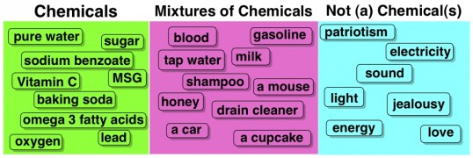
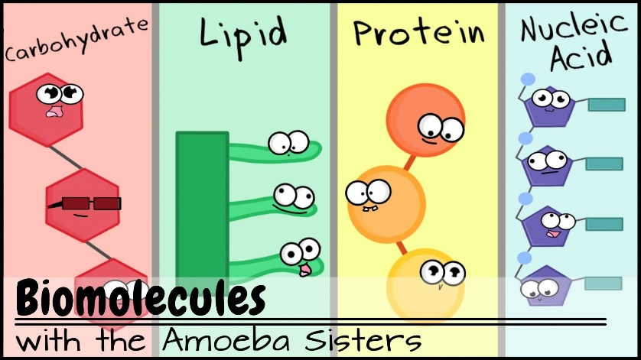
What is Chemical and Biomolecular Engineering?
What is a chemical?
Everything you can touch and more!
What is a biomolecule?
Everything nature makes!

Slide 4
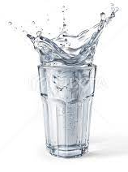
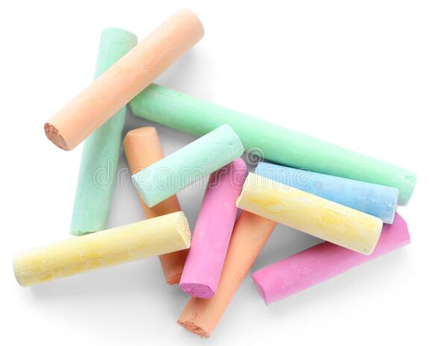
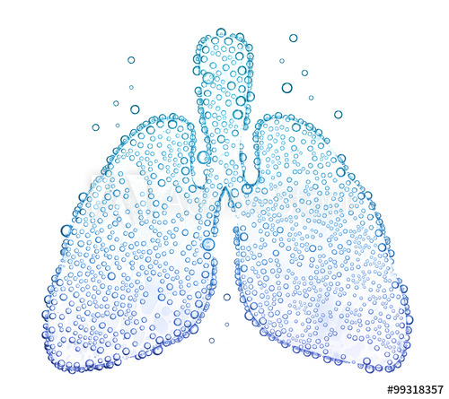
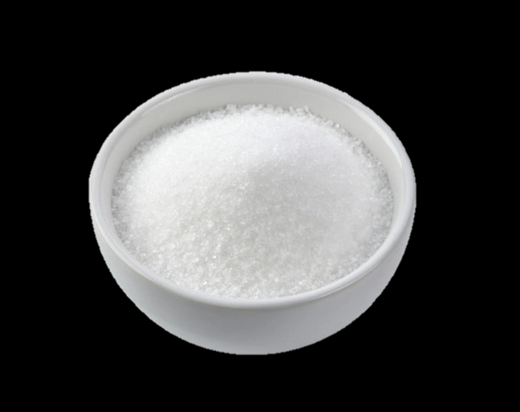
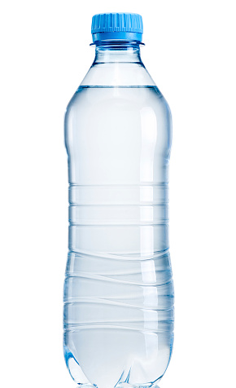
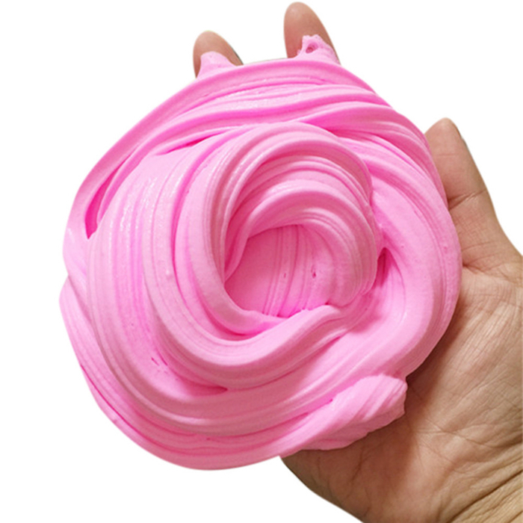
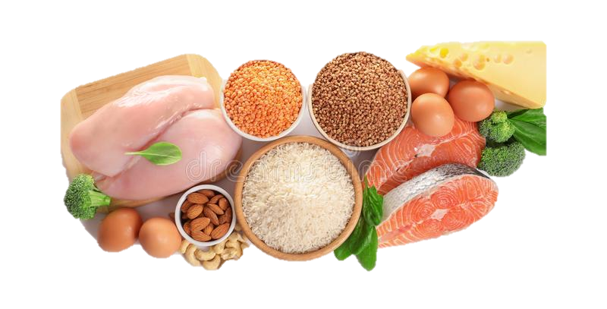
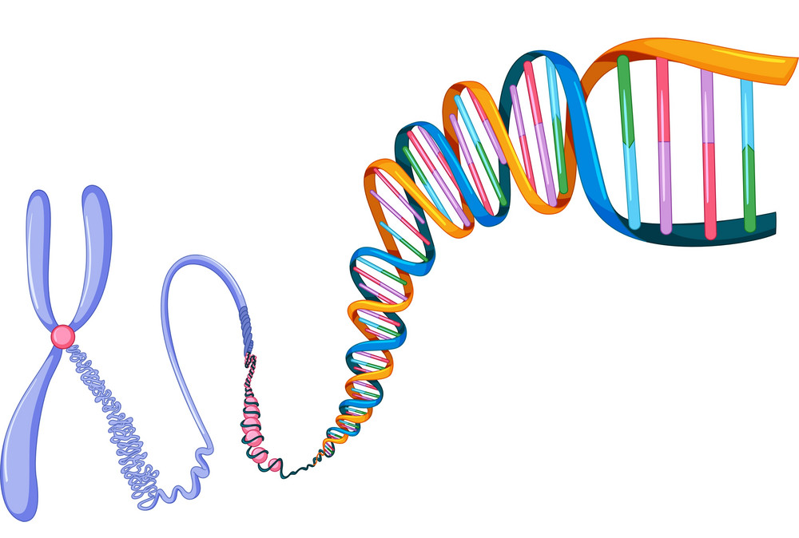
What is Chemical and Biomolecular Engineering?
What is a chemical?
Chemicals make up all the materials around us!
Water
Vinegar
Chalk
Lead
Oxygen
Sugar
Glue
Plastic
When chemicals mix together, they react to make something new!
All living things!
Slime
What is a biomolecule?
Protein
Chemicals made by living things (animals, plants, humans, and more)!
DNA

Slide 5
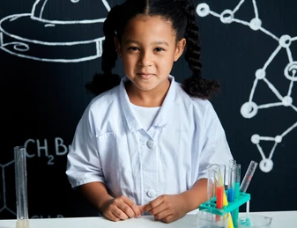
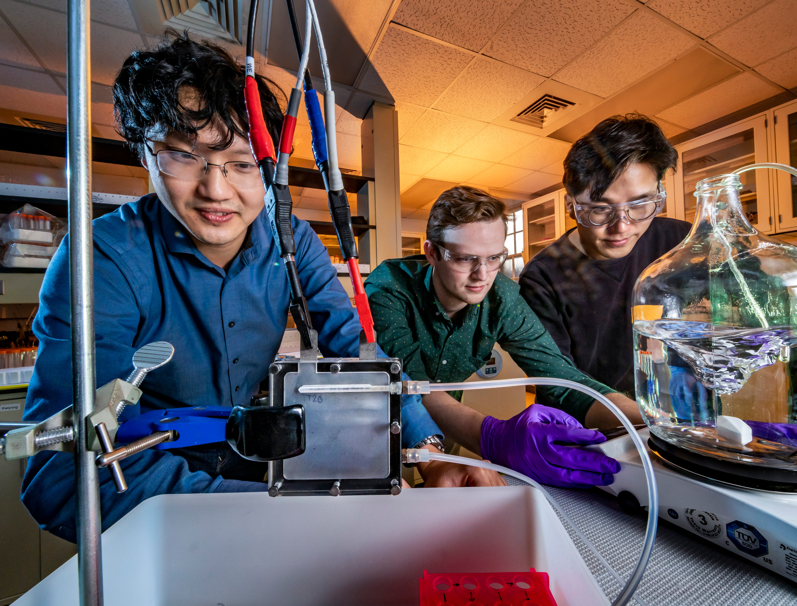
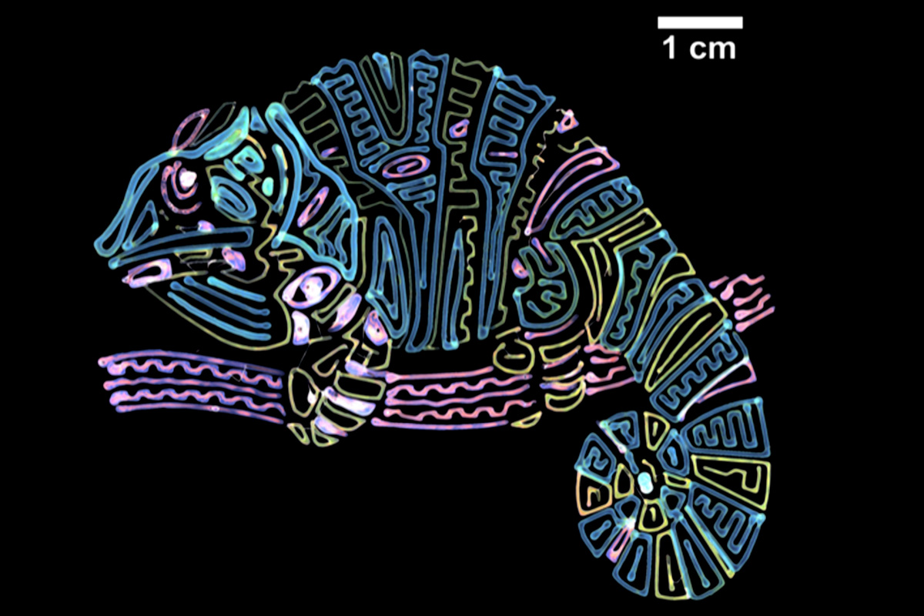
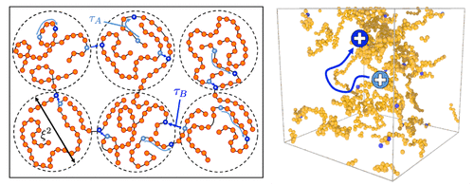
What is Chemical and Biomolecular Engineering?
What is an engineer?
Which of you likes……
helping people
science/cooking
being creative
computers
Conclusion: a chemical engineer is someone that knows a lot of about chemicals and solves fun and important problems!

Slide 6
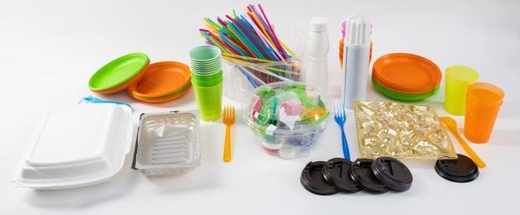
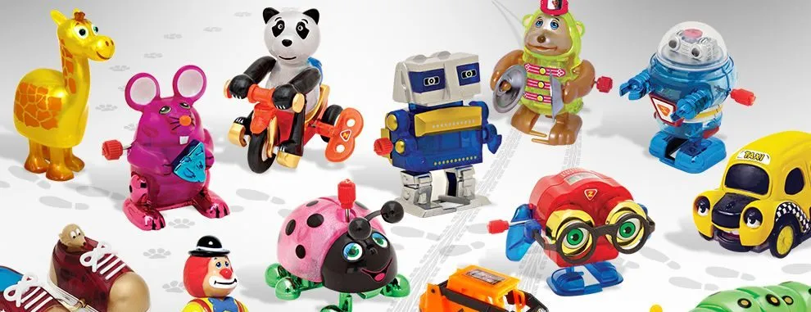
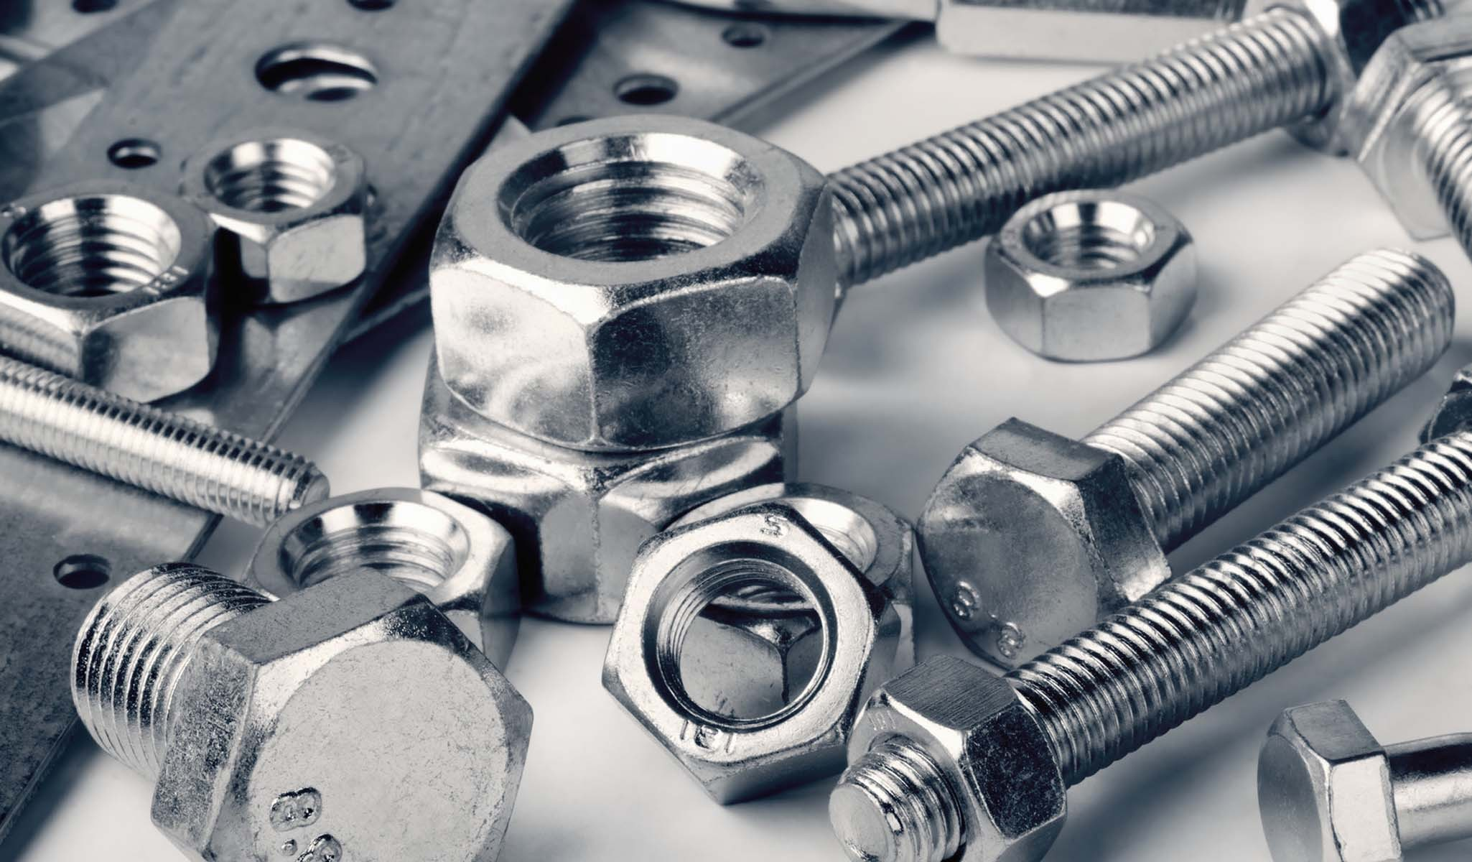
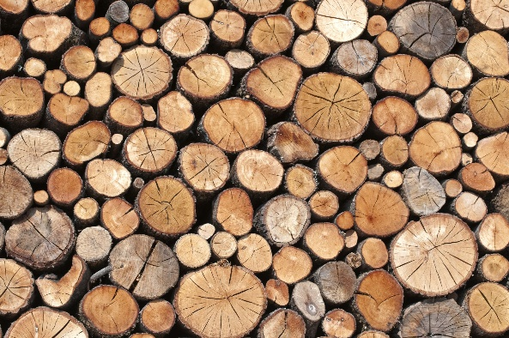
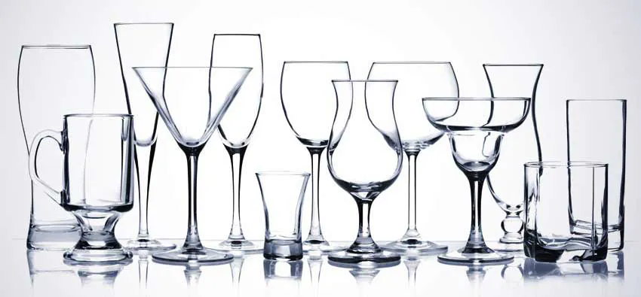
TOPIC of the day: Plastics
Can you show me something made of plastic?
Can you show me something that is not made of plastic?

Slide 7
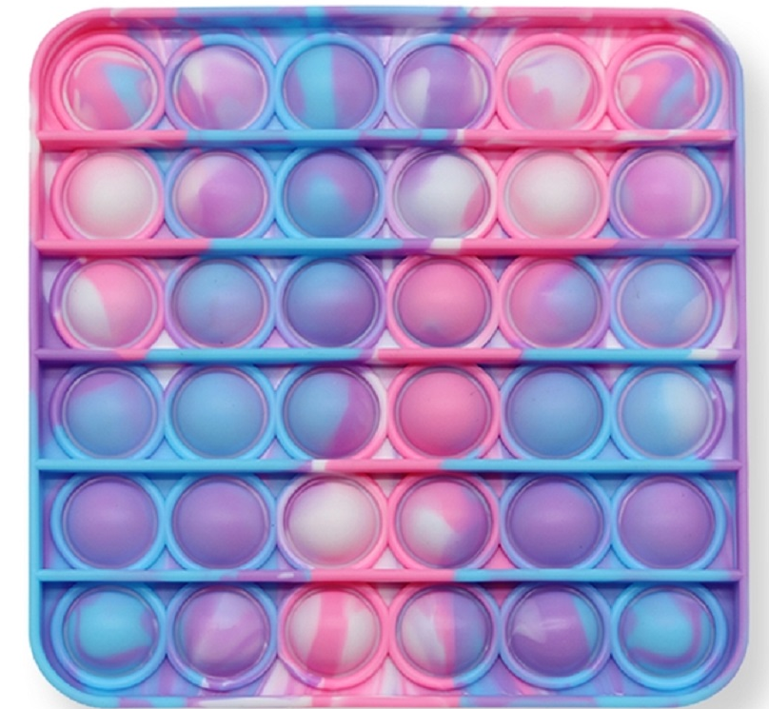
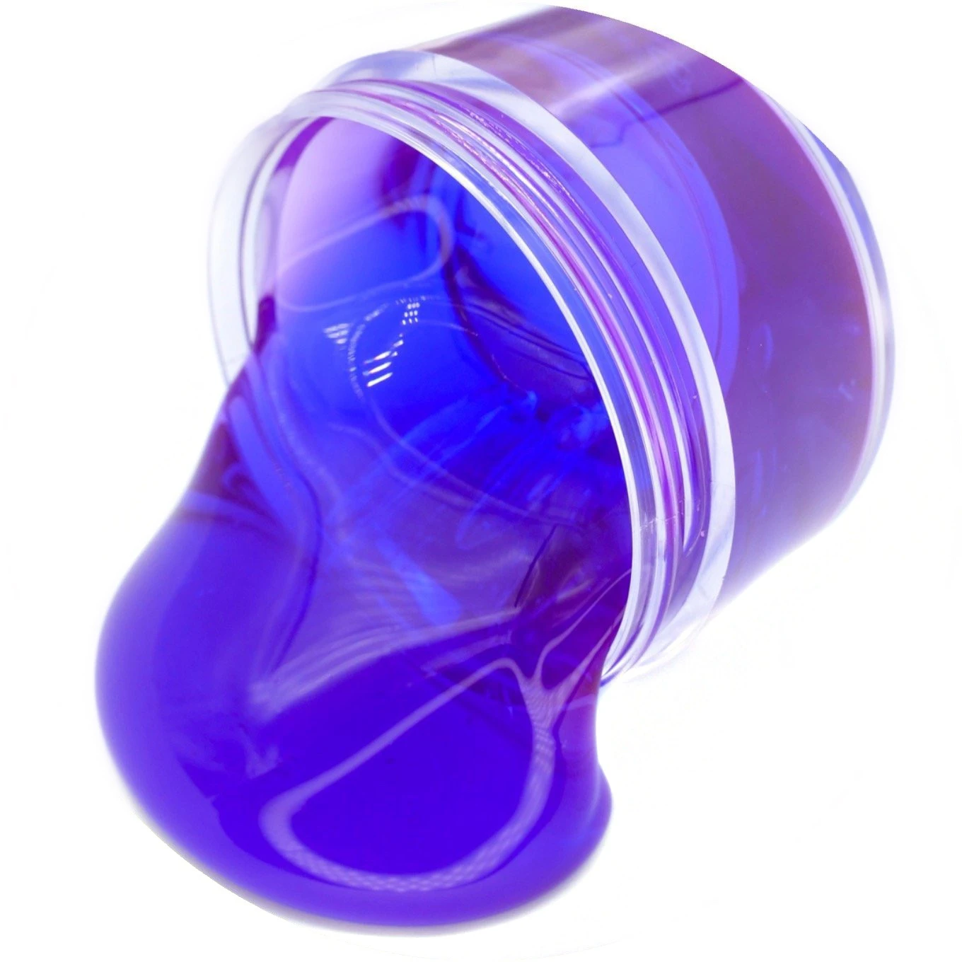
What is plastic made of?
Plastics are big molecules. We call them Polymers!
Slime
Pop-It Toys
zoom in!
zoom in!
Monomers:
building blocks
Long polymer chains
Not connected to one another
Feels liquid/slimy
Connected polymer chains
Feels solid/rubbery

Slide 8
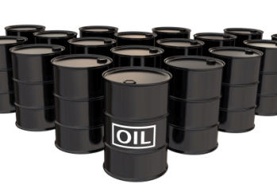
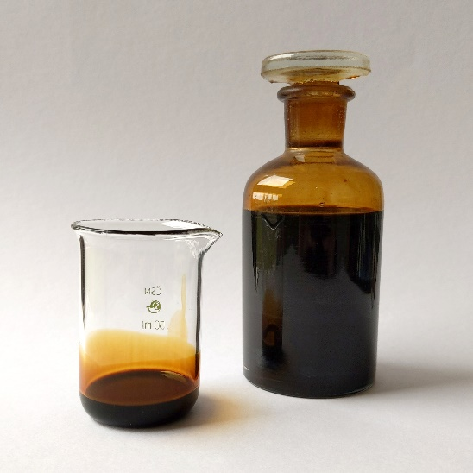
What is plastic made of?
Raw Materials are the things products are made of.
What are the raw materials for bread?
What is the raw material for plastics?
Answer: The raw materials for plastics is crude oil or petroleum

Slide 9
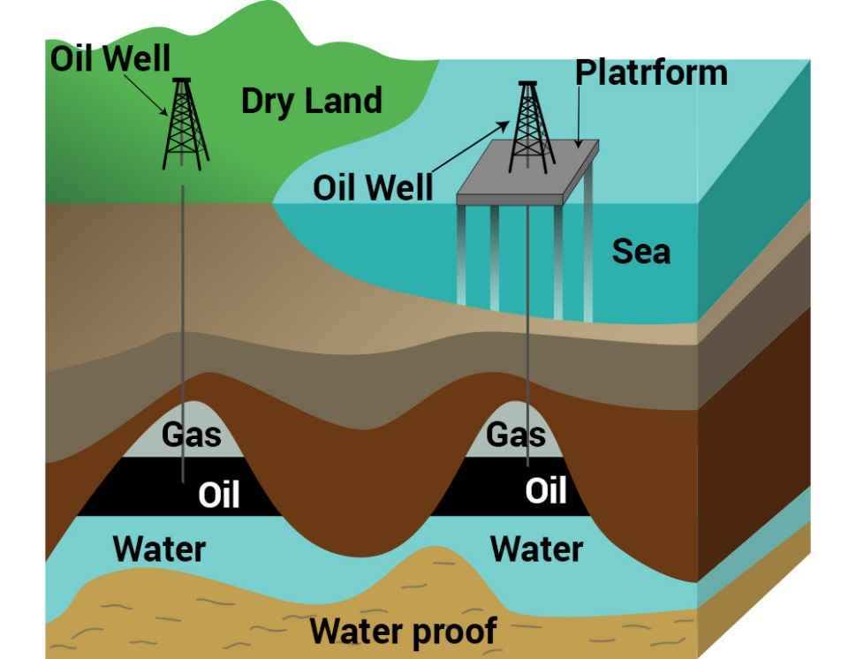
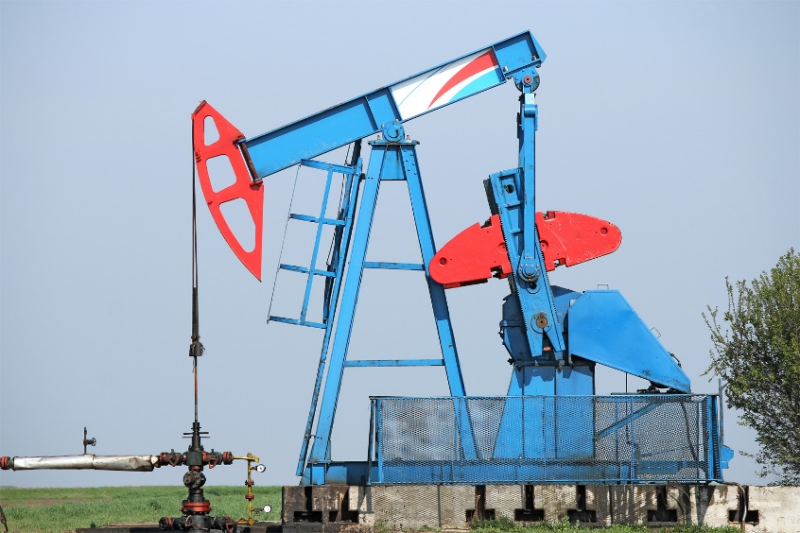
Where is oil found?
Where do you think we find oil?
Have you ever seen one of these?
Their nickname is grasshopper
They bring oil to the surface!
In the ground and at the bottom of the ocean!

Slide 10
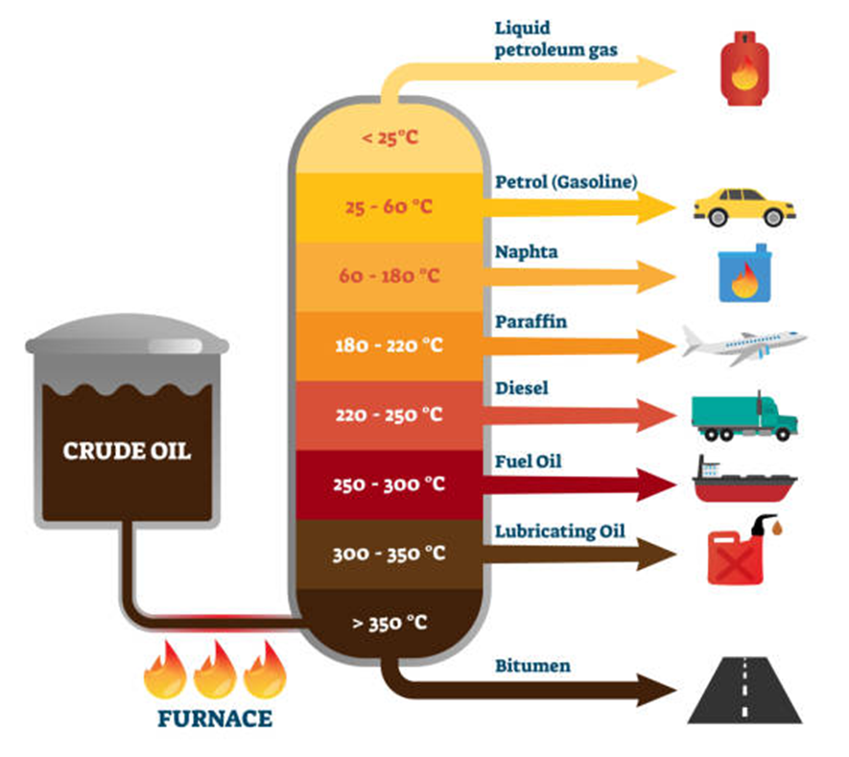
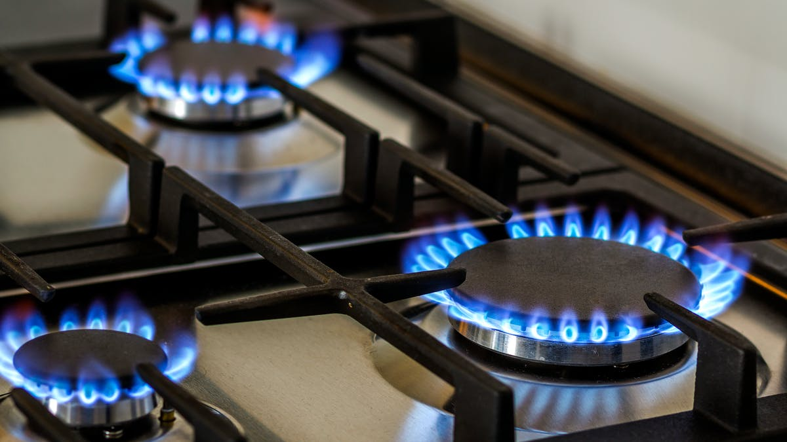
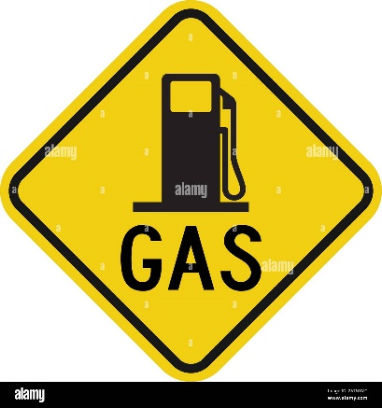
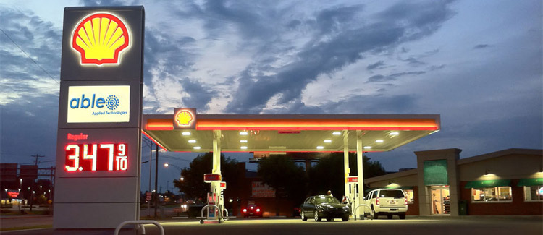
What can you do with oil?
This is where we get our different monomers:
building blocks
You need to separate the different molecules (distillation)

Slide 11
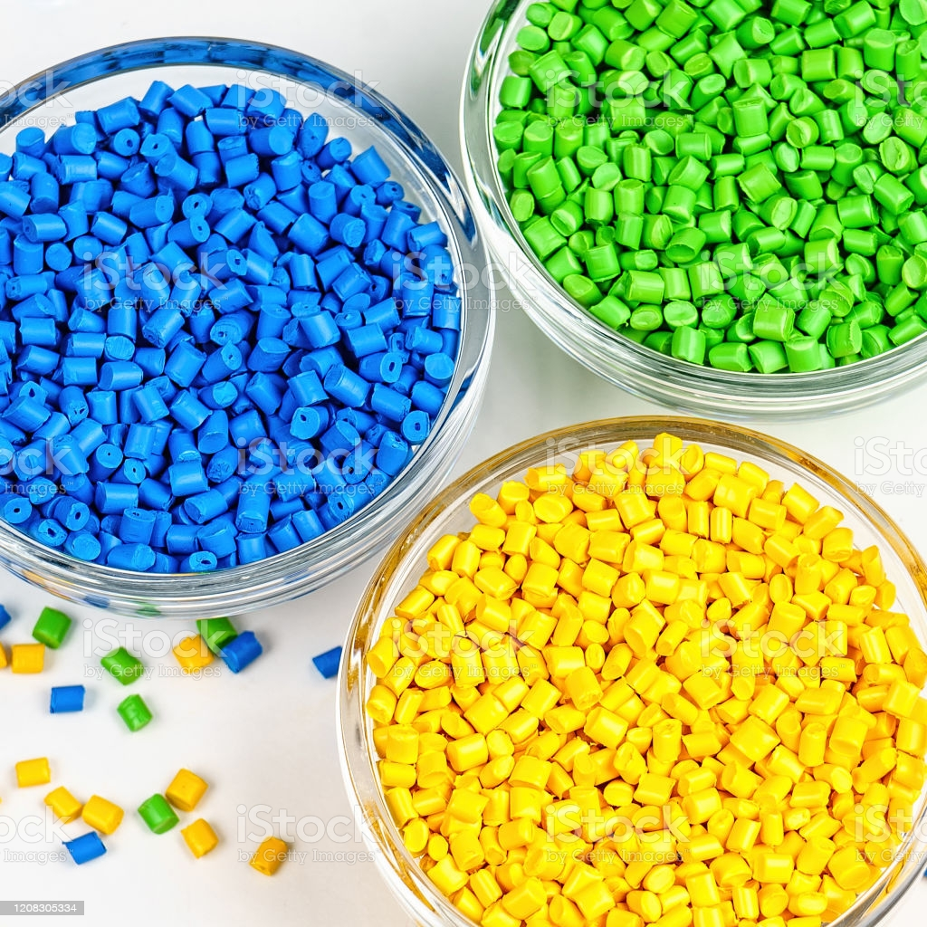
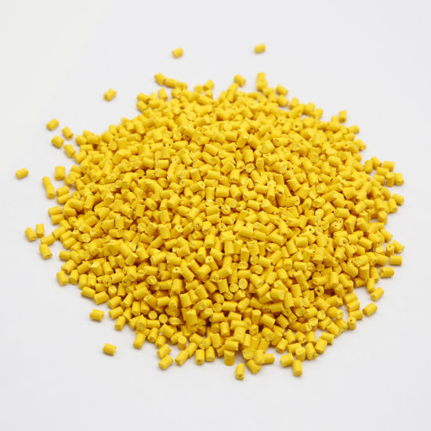
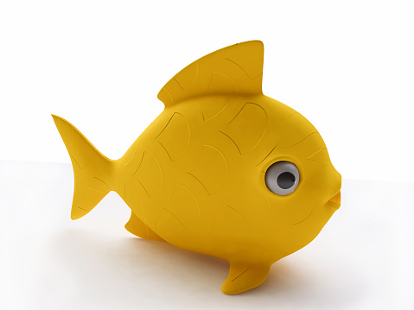
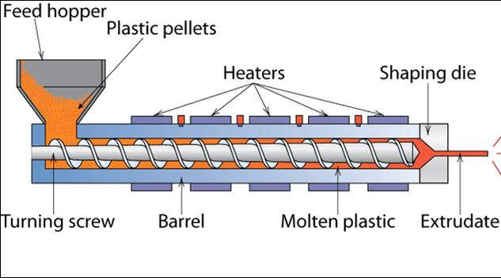
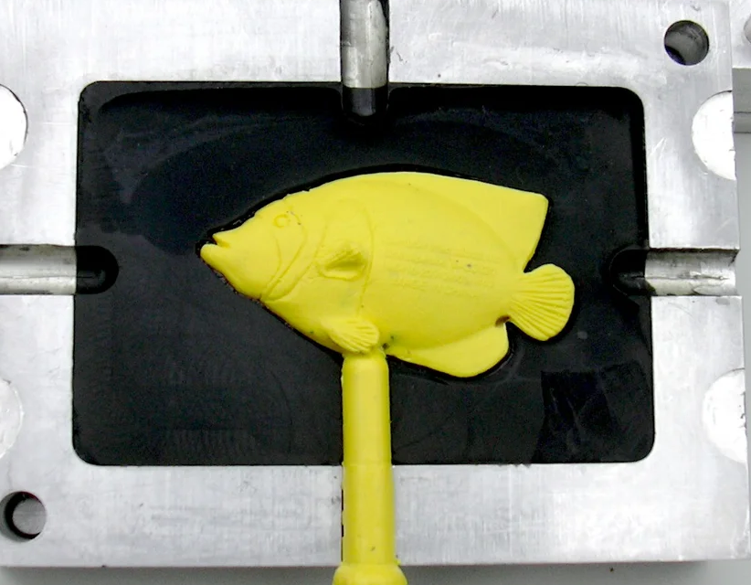
How do you turn a monomer into a plastic object?
Step 1: Polymerization- build long chains
MONOMER
building blocks
connect them
Polymer
long chains
Step 2: Process it
Extrusion
Molding

Slide 12
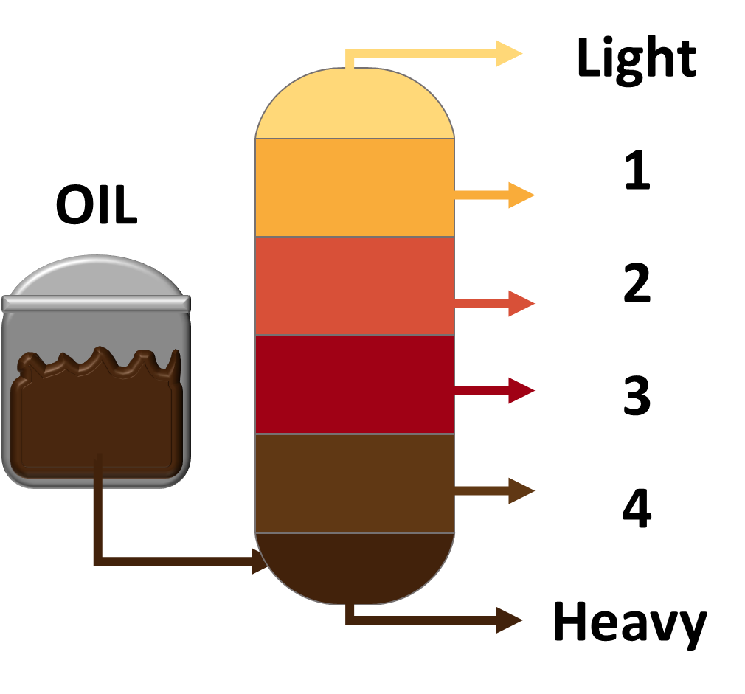
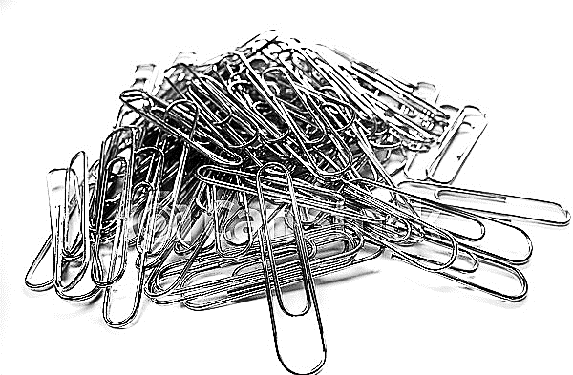
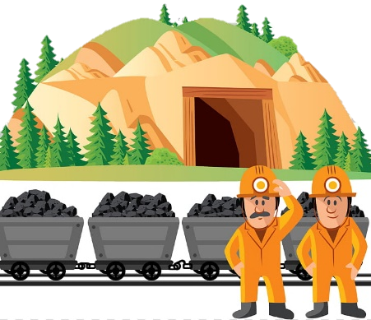
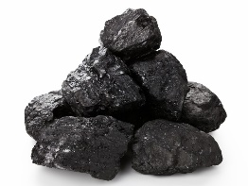
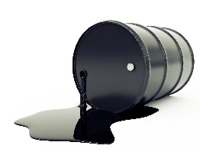
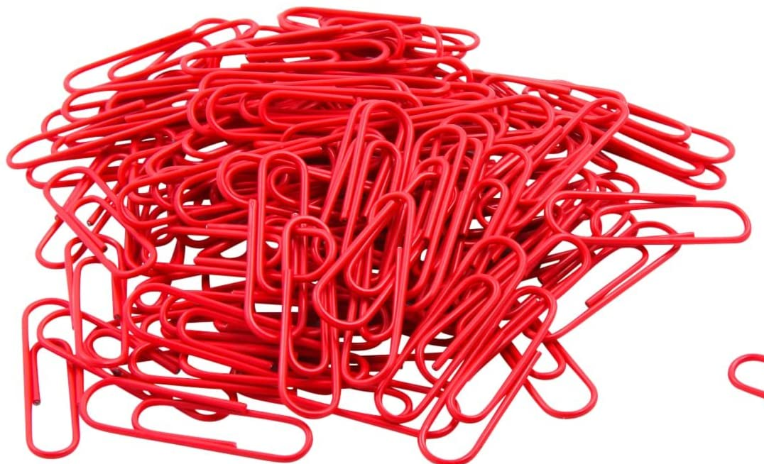
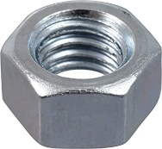
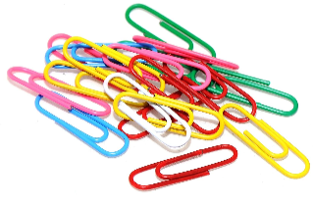
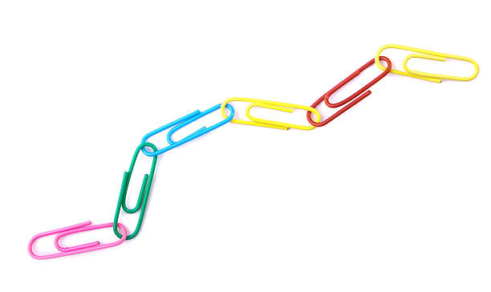
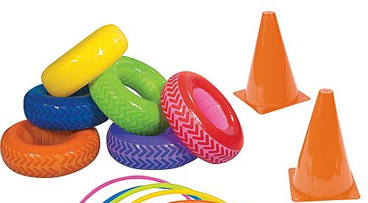
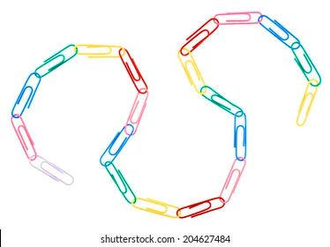
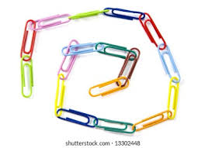
Activity for today:
Step 1: Mine your raw materials
Step 2: Separate your oil
COAL OIL
Step 3: Make your polymers
Step 4: Process into different shapes!

