Slide 1
Career Seminar
Department of Physics, UIUC
Rezvan Shahoei
April 2023

Slide 2
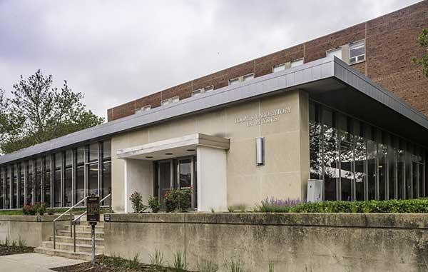
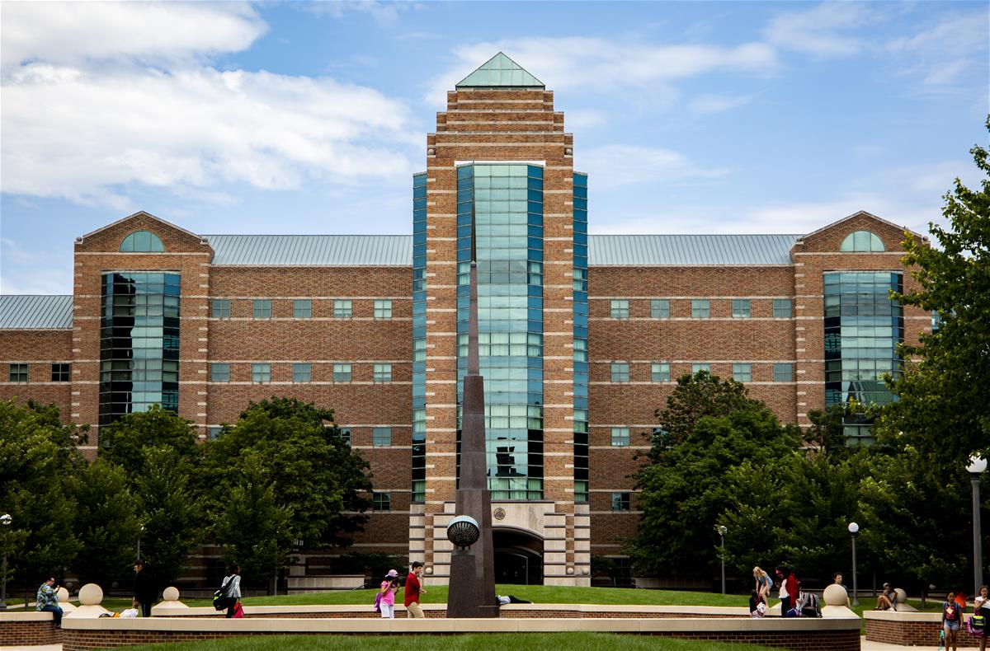
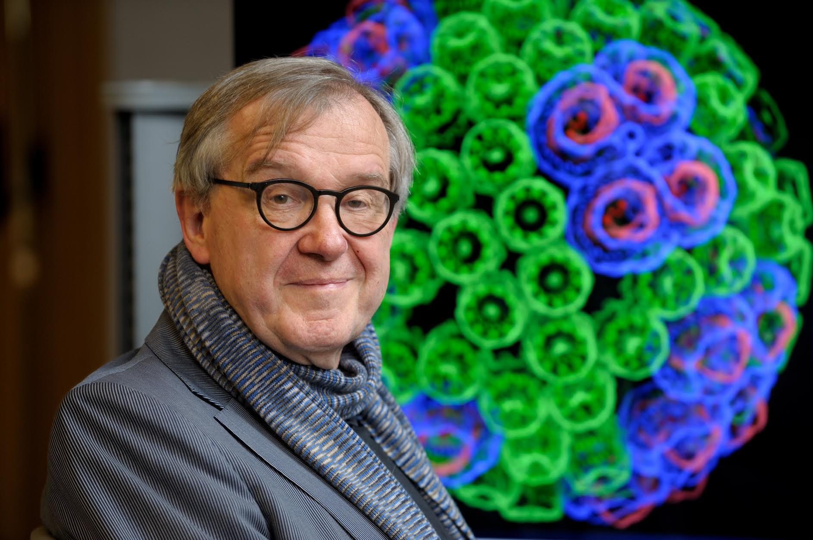
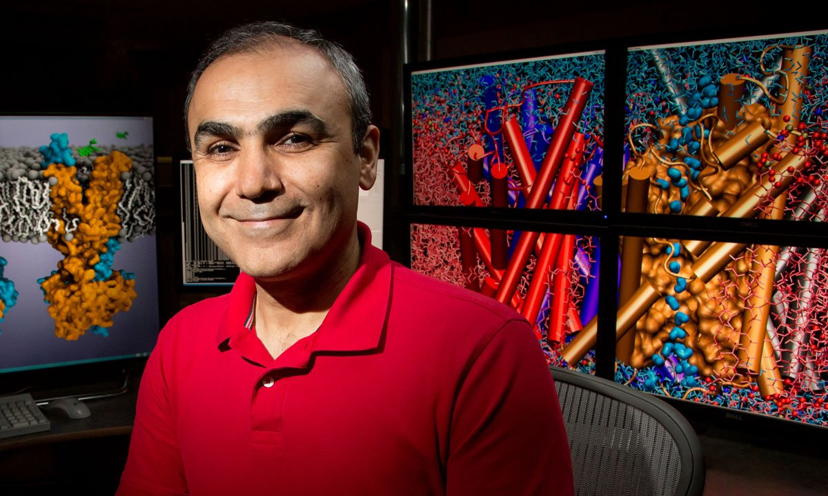
Department of Physics, UIUC
Theoretical & Computational Biophysics Group (TCBG) at The Beckman Institute for Advanced Science & Technology
Klaus Schulten (1947–2016)
Emad Tajkhorshid
Notes:
2010
2012
2019-2020
MD
VMD and NAMD.

Slide 3
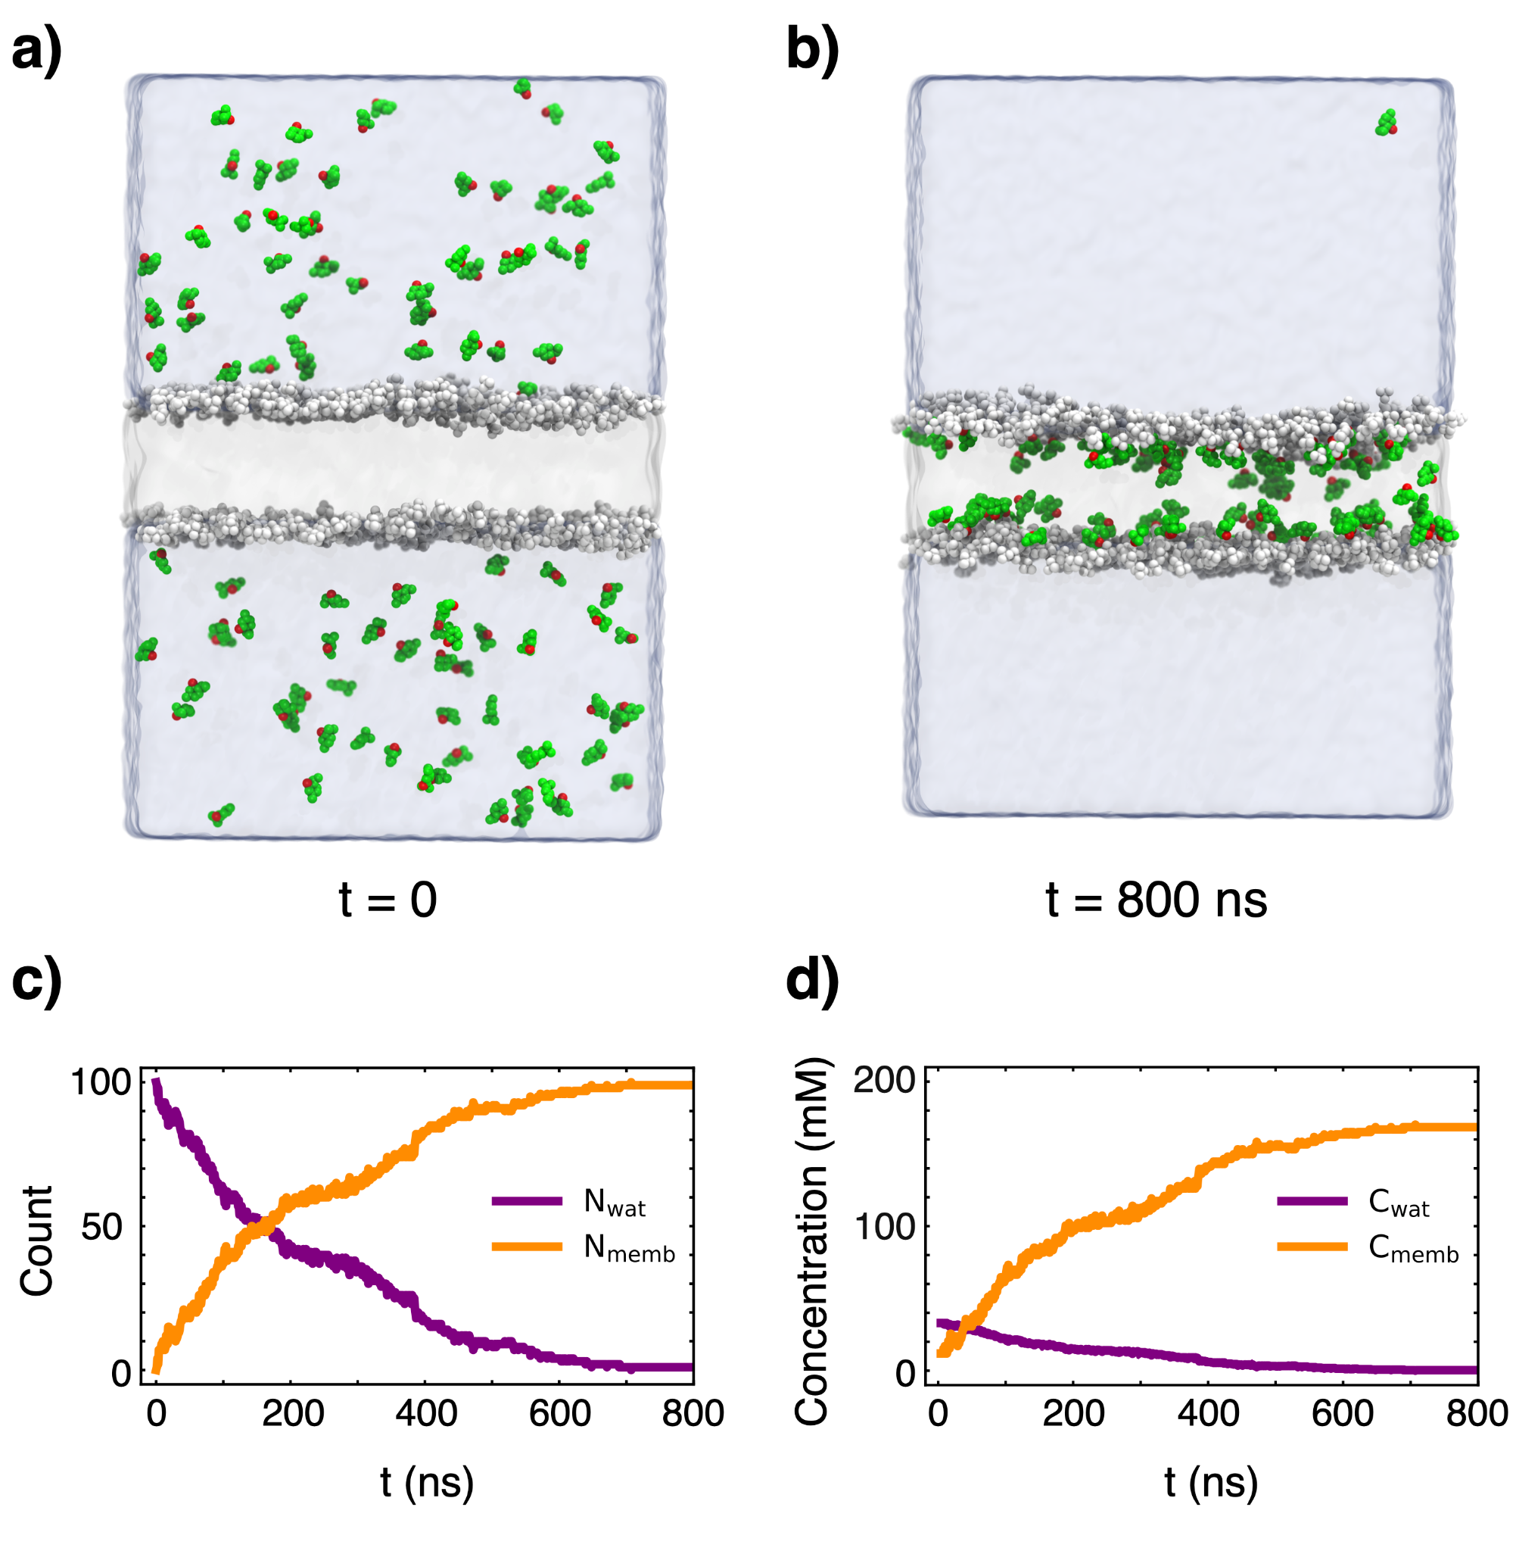
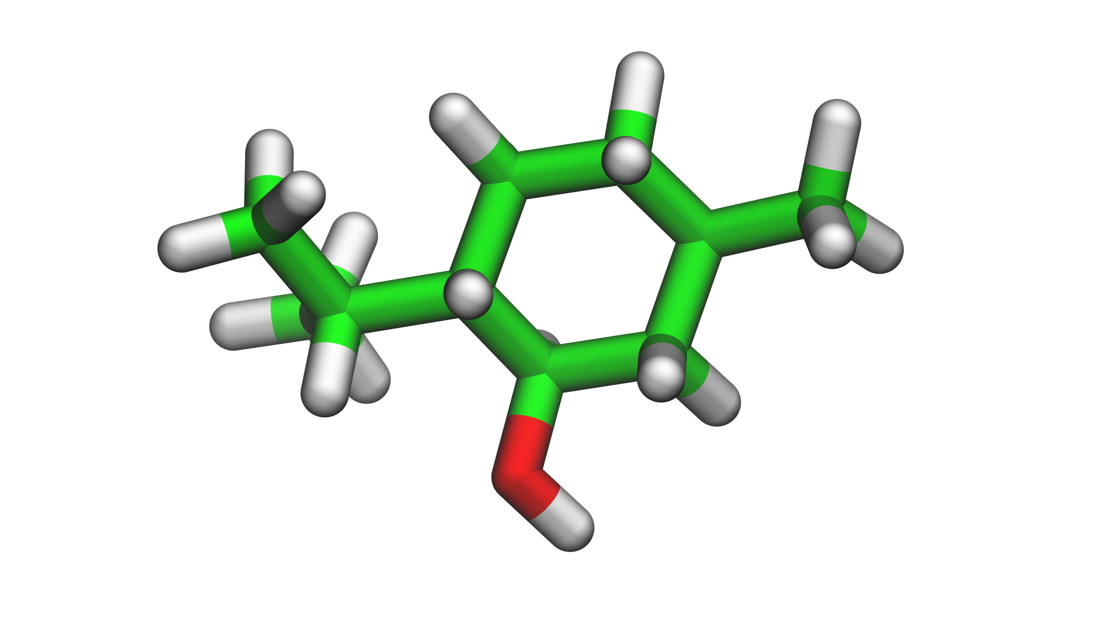
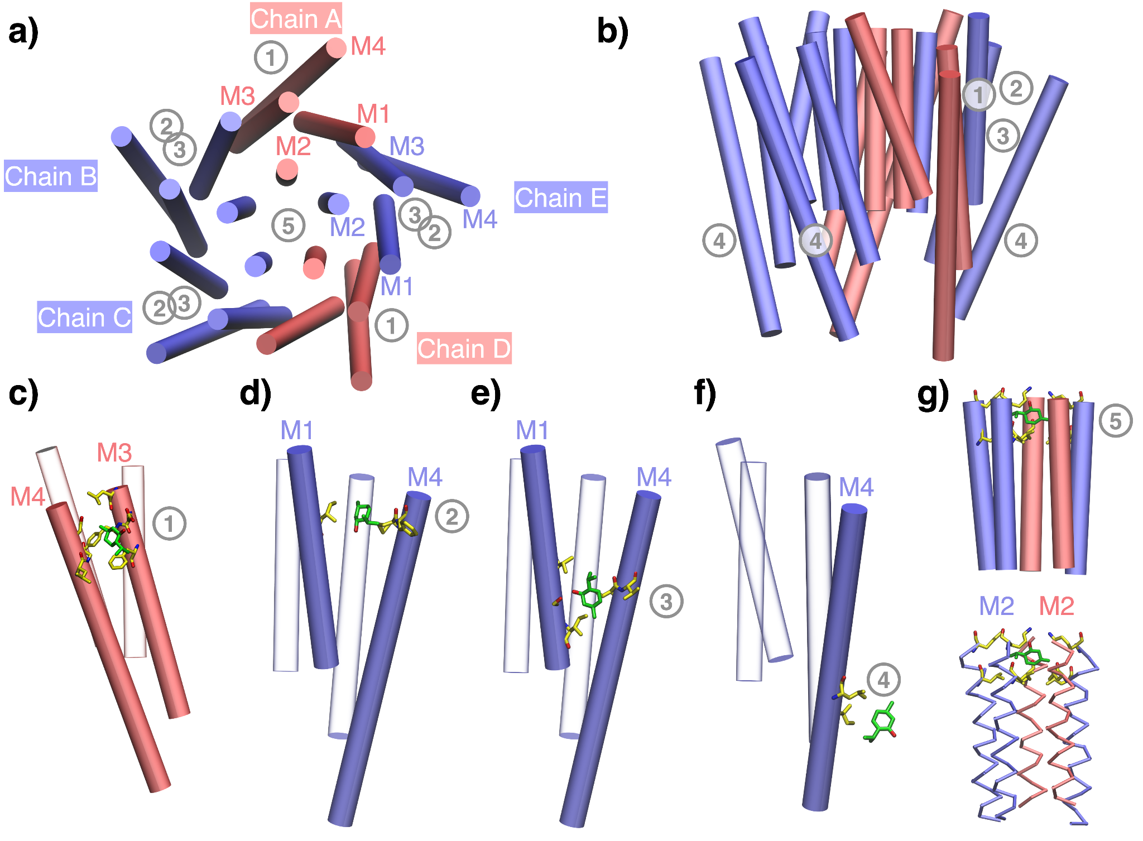
Menthol binds to the human α4β2 nicotinic acetylcholine receptor facilitated by its partitioning in the membrane.
Menthol
Α4β2 Nicotinic Acetylcholine Receptor
Shahoei & Tajkhorshid. J. Phys. Chem. B. 2020; 124(10): 1866–1880
Notes:
Idea was brought to our attention by our experimental collaborators.
Did a work with them but continued the work ourselves since it was an interesting question.
The question was whether menthol binds to the human nicotinic acetylcholine receptor and if it does, what is the binding mode.
Menthol - flavor additive that can be extracted from mint or peppermint.
Nicotinic acetylcholine receptor - membrane protein in the nervous system. The one we worked on was the most prevalent nicotinic receptor in the human brain, about 70%.
We looked at menthol and its interactions with the membrane first. We calculated its free energy of transfer from bulk solvent to a lipid bilayer. We then characterized the properties of the bilayer and whether menthol affects them.
Then introduced protein into the picture.
Binding sites on both the transmembrane and extracellular domain.

Slide 4
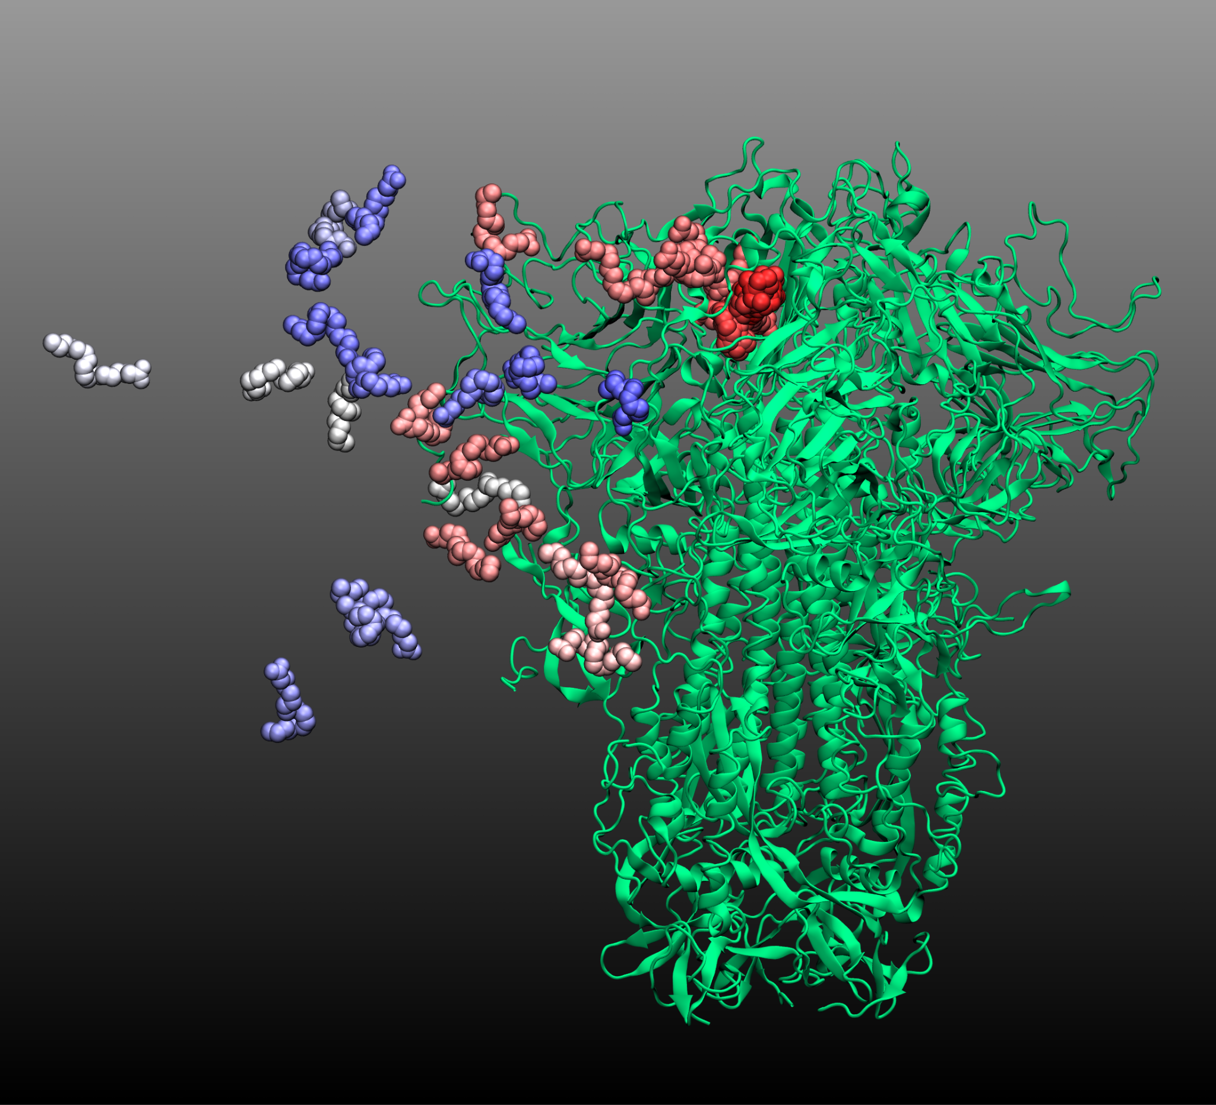
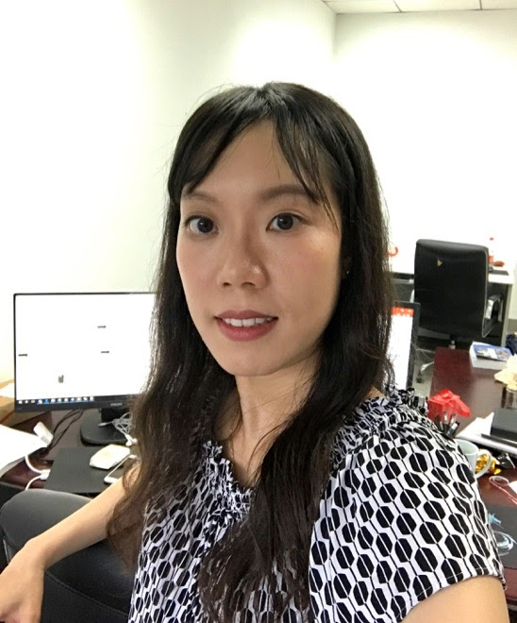
Identifying the unbinding pathway of linoleate from the spike glycoprotein of SARS-CoV-2
using Ligand Gaussian Accelerated Molecular dynamics simulations
Yu-ming Mindy Huang

Slide 5
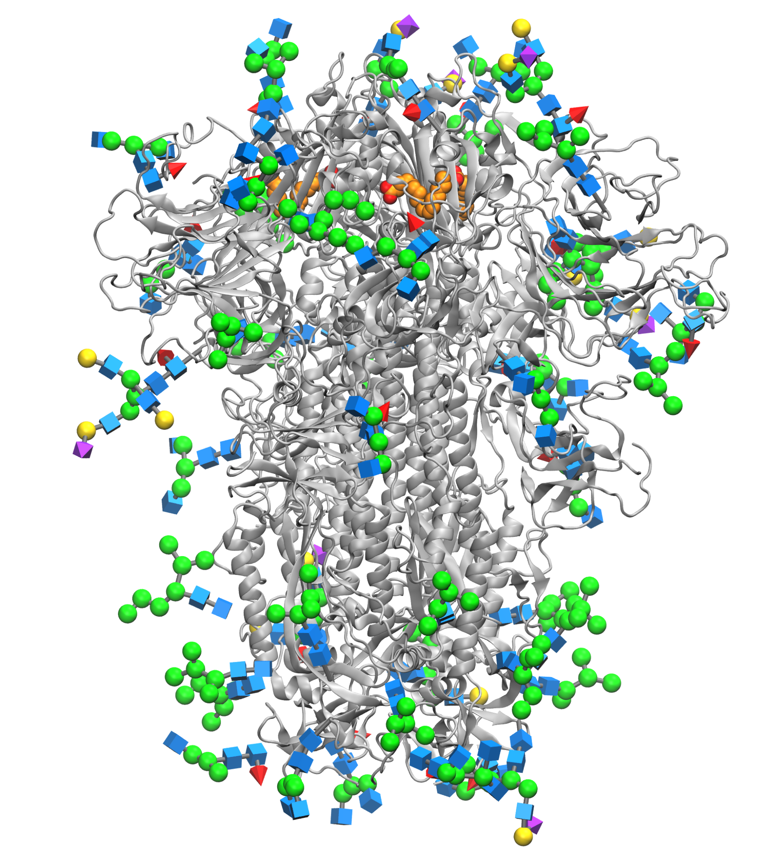
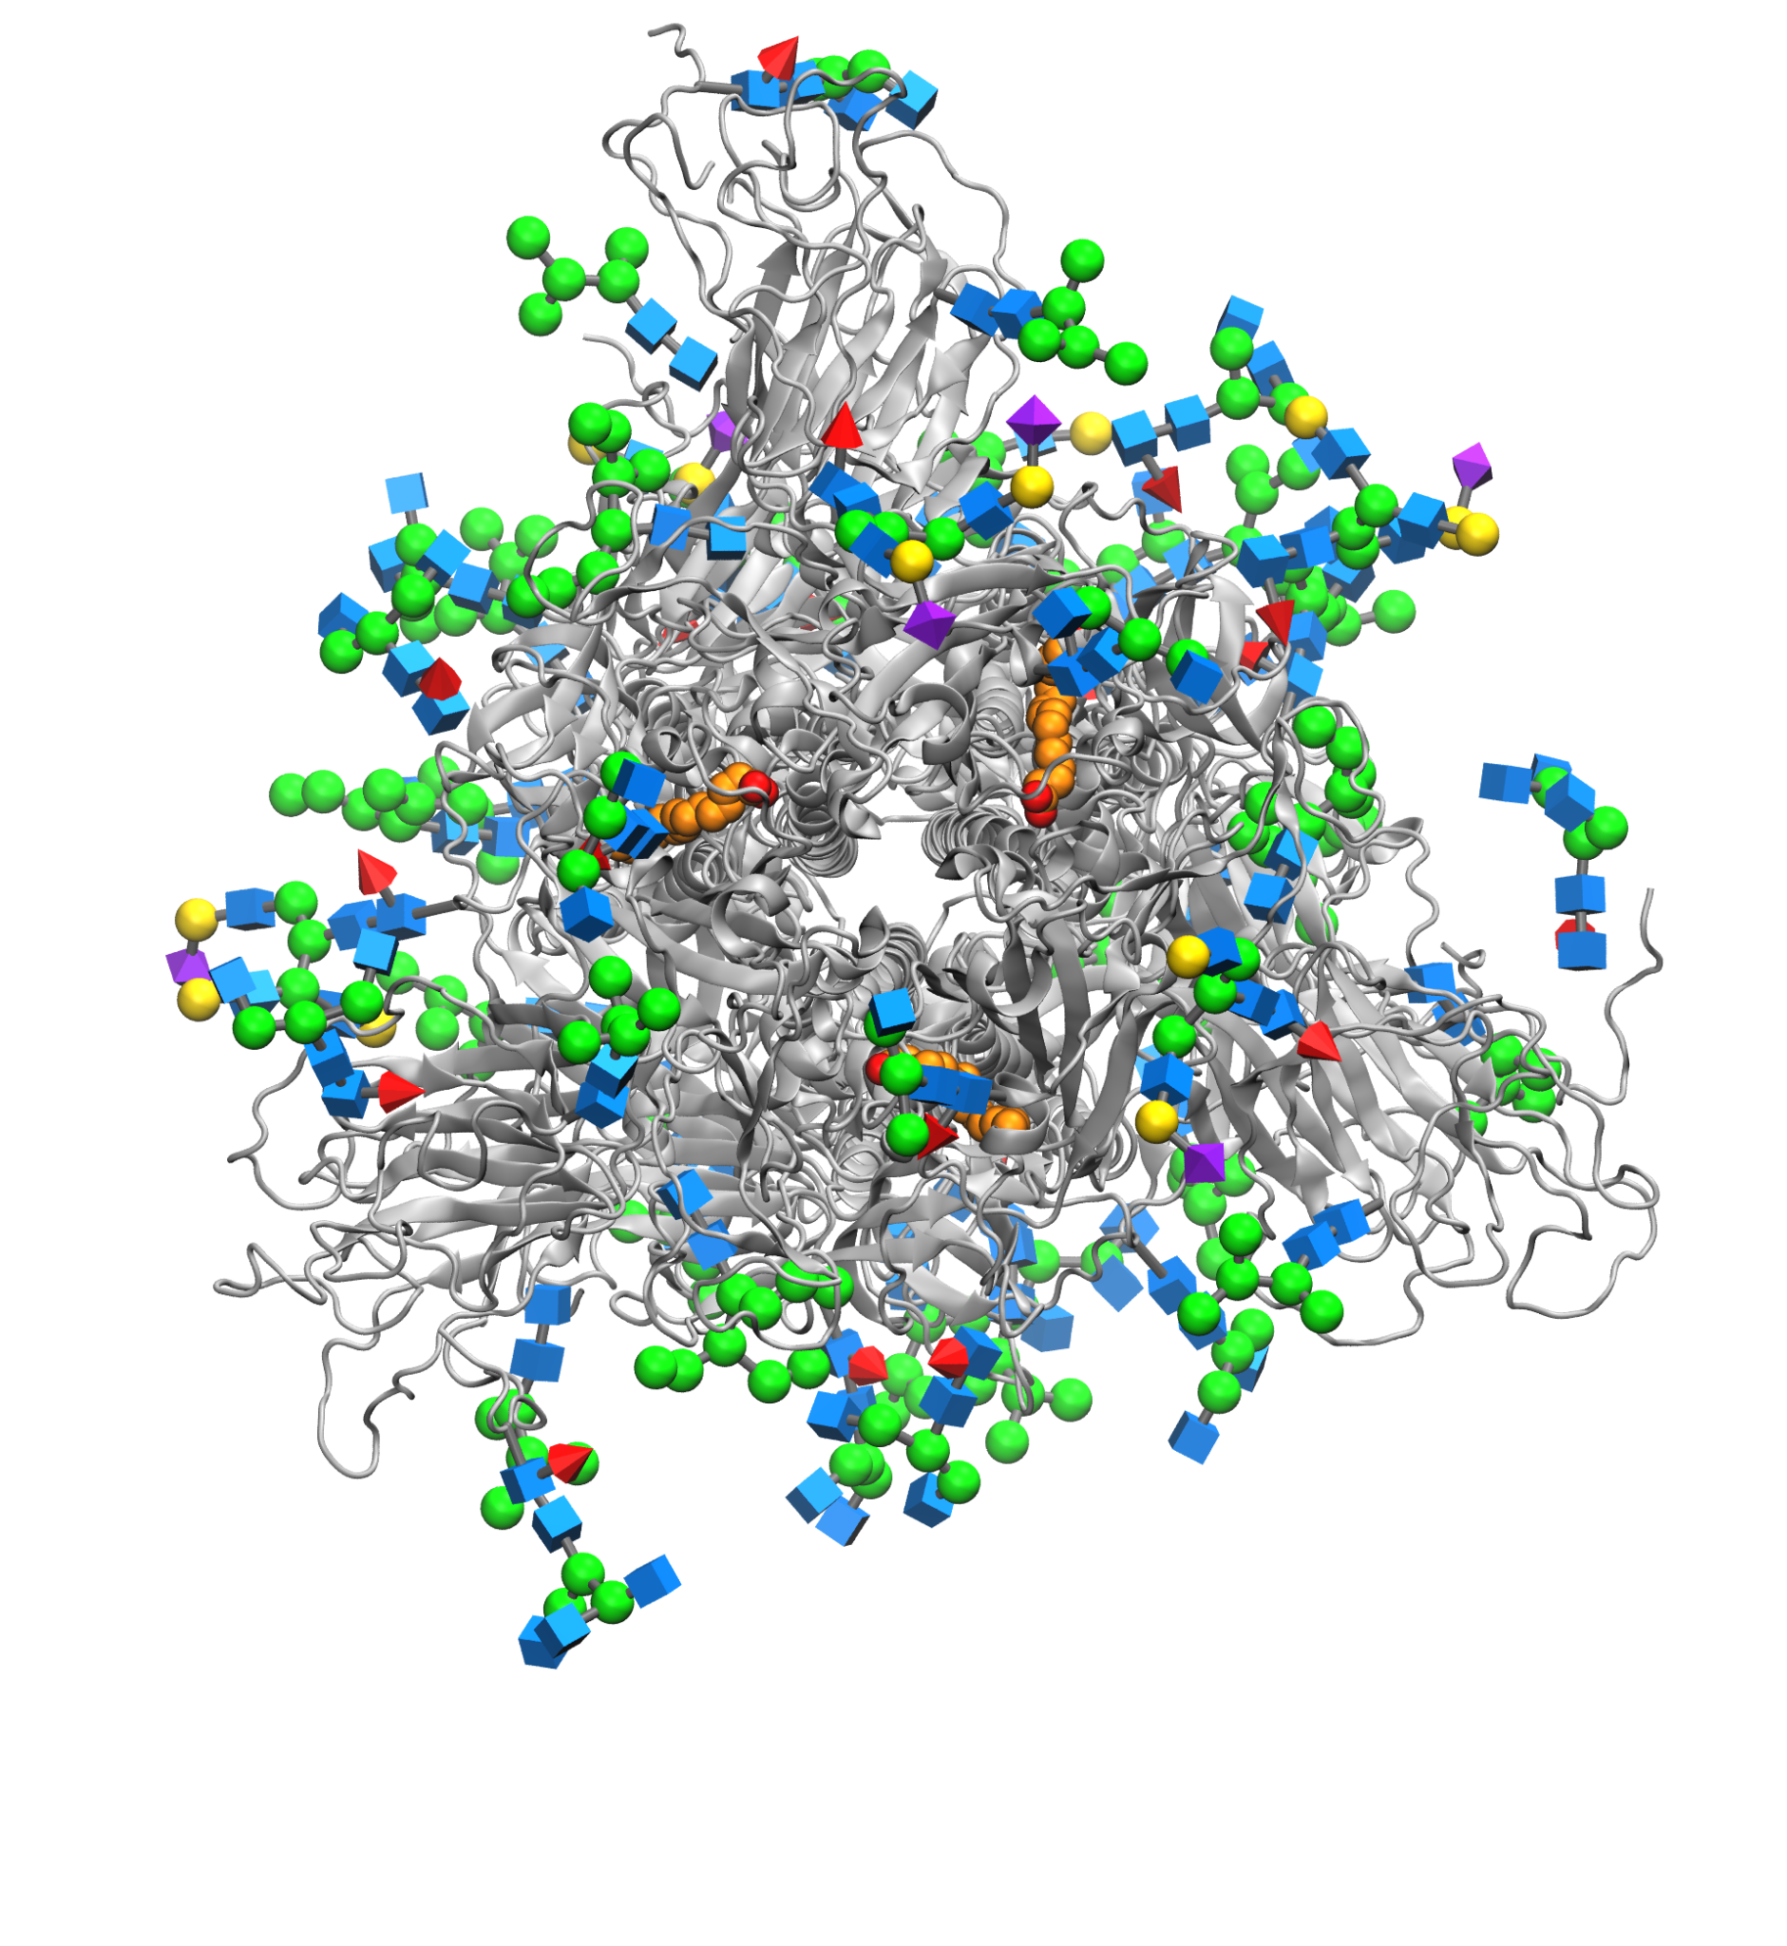
Identifying the unbinding pathway of linoleate from the spike glycoprotein of SARS-CoV-2
using Ligand Gaussian Accelerated Molecular dynamics simulations
Yu-ming Mindy Huang
Notes:
Glycans, sugars from the host cell.

Slide 6
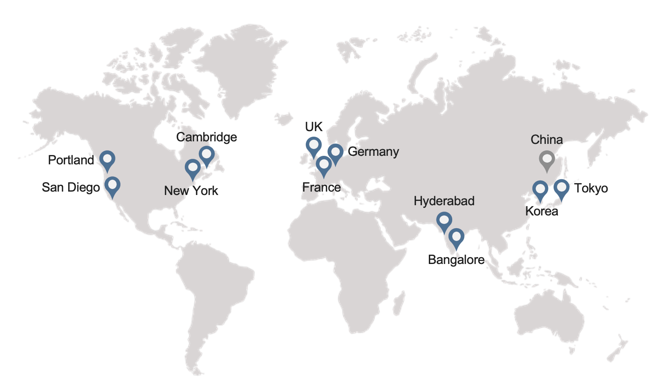
Schrödinger is a Global Company Dedicated to Scientific Innovation
Established in 1990
800+ employees worldwide
> 50% dedicated to R&D
> 40% PhD

Slide 7
Long Track Record of Scientific Innovation
1990
1994
1998
2002
Schrödinger Founded
Quantum Mechanics
Accurate calculation of small molecule solution structures
Molecular Mechanics
Fast calculation of small molecule solution structures
Protein Refinement
Accurate prediction of local protein structure
2012
2008
2004
Comprehensive Force Field
Most comprehensive Force Field for small molecules
WaterMap
1st rigorous treatment of protein desolvation
Docking
Glide - 2nd most cited paper in J.Med.Chem (>3,000 citations)
2016
2019
2022
Free Energy Calculations
1st reliable and broadly applicable implementation for predicting binding affinity
Active Learning
Reaching ultra-large scale by combining physics-based with ML methods
Next Gen Protein Refinement
Enablement of proteins without experimental structures
For complete list of publications go to: https://www.schrodinger.com/publications

Slide 8
Schrödinger Has a Unique Business Model, Fostering Real Impact
Increase success of programs and collaborations
Strict firewall but strong synergies:
Transfer of know-how

Slide 9
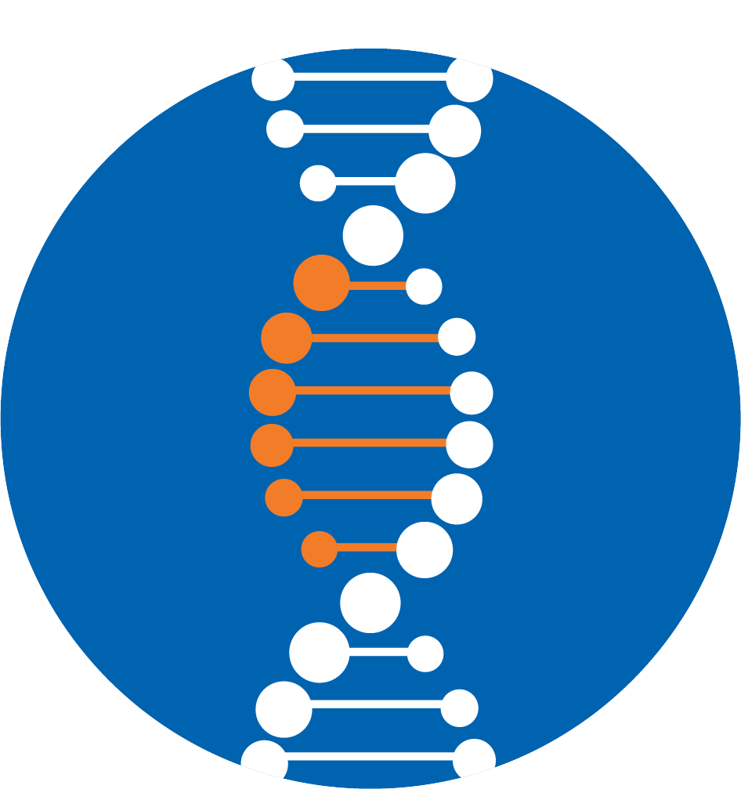
Schrödinger’s Software Suites
A comprehensive suite to accelerate hit discovery and lead optimization
All the tools that are important in modeling biologics, antibodies, and proteins
Integrated solutions for atomic-scale simulations of chemical systems
Data sharing and collaborative drug design across the entire discovery team in real time
Stunning high-performance molecular graphics for communicating structural results
Notes:
Our software has 5 suites: a small molecule suite dedicated to SM drug design, a biologics suite dedicated to biologics, you can think of antibodies and protein design, a material science suite for atomic-scale simulations of chemical systems, PyMOL for high quality visualization and movie creation and a Discovery Informatics suite for data sharing and collaborative design in real time.

Slide 10
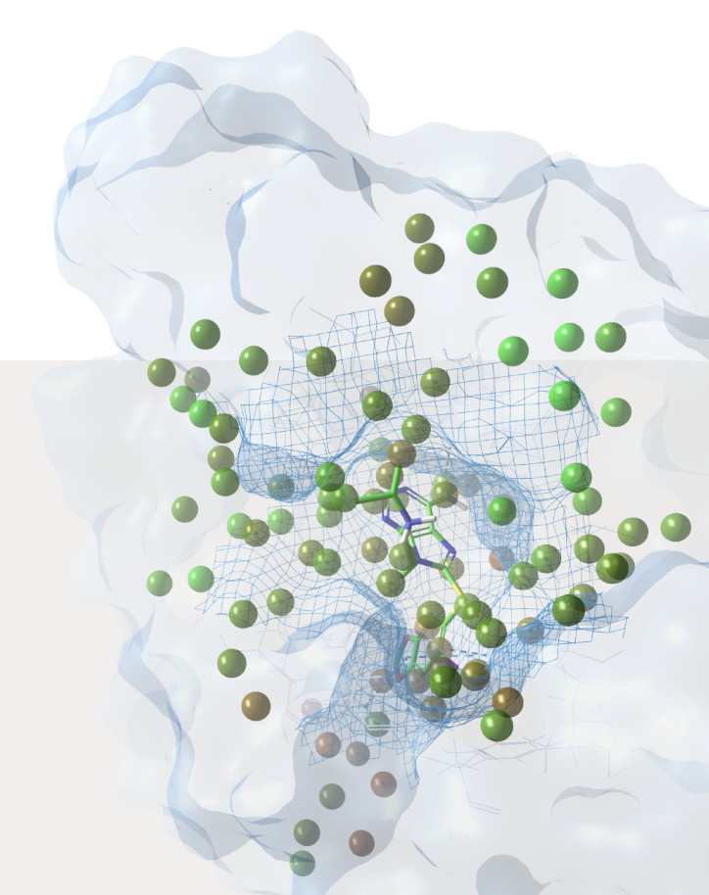
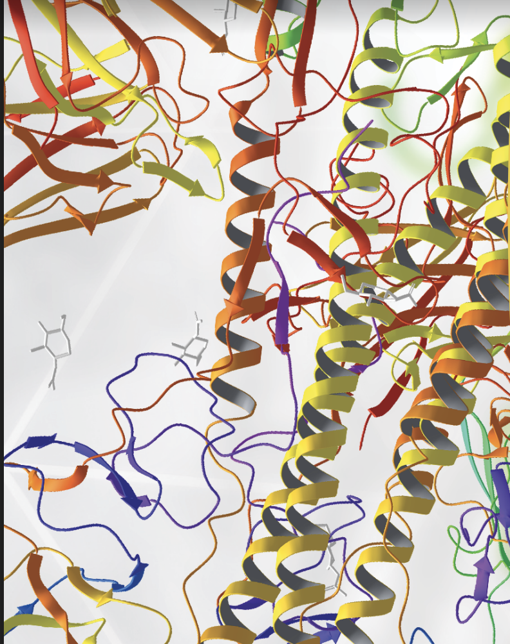
Applications across the full discovery pipeline & for diverse therapeutic modalities
Small Molecule Therapeutics
Biologics & Protein- Based Therapeutics
Target Validation
Protein Structure Prediction & Refinement
Hit Discovery
Hit-to-Lead and Lead Optimization
Drug Formulation
Protein & Antibody Structure Prediction
Antibody Humanization
Protein Engineering
Characterization and Liability Analysis
Drug Formulation
Notes:
Our SM suite can be used right at the beginning of a project for Target Validation and Protein Structure prediction and refinement and then throughout the project for Hit discovery, Hit-to-Lead optimization untl drug formulation.
Our biologics suite can also be used at the beginning of a project for protein and antibody structure prediction, and then for antibody humanization, protein engineering, characterization and liability analysis (such as solubility issues) and drug formulation

Slide 11
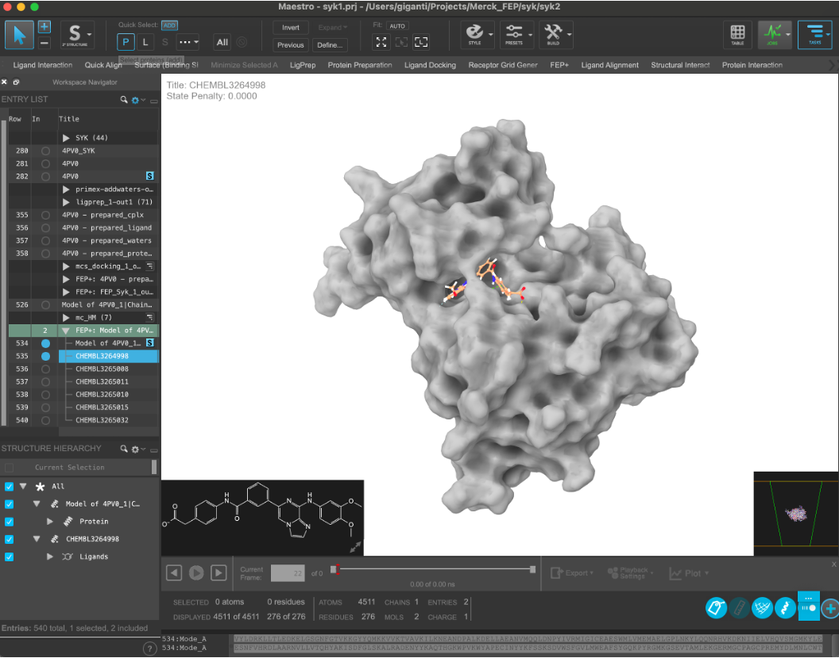
Maestro, a central graphical user interface for projects.

Slide 12
Current open positions for Applications Scientist at Schrödinger:
Applications Scientist (Cambridge, MA)
Applications Scientist, Biologics (San Francisco, CA)
For the full list of open positions go to: https://www.schrodinger.com/careers.

Slide 13
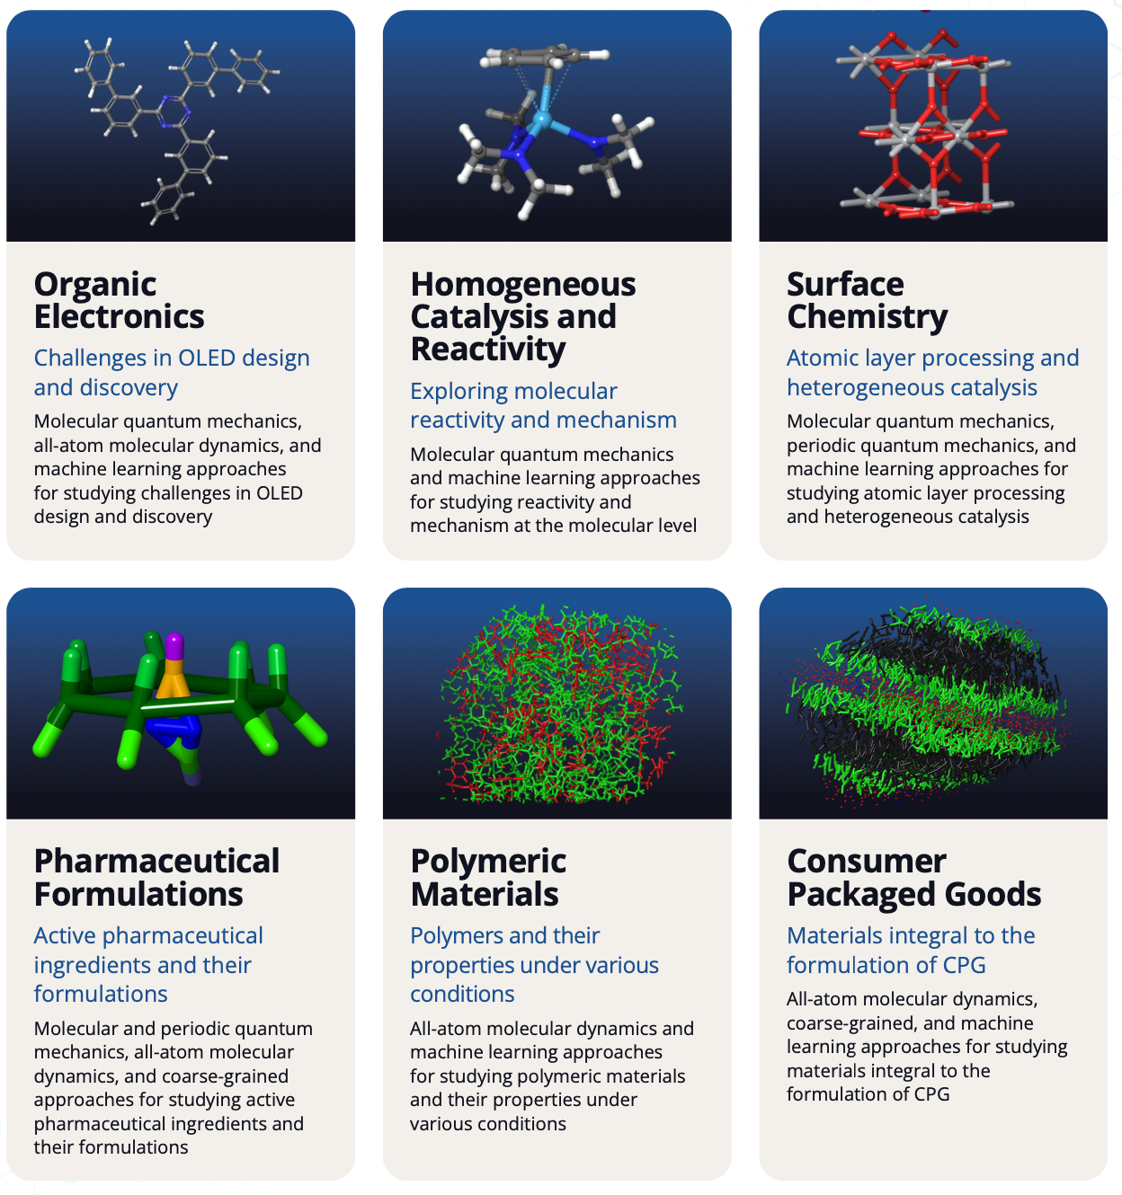
Schrödinger’s Online Courses

Slide 14
Thank you!

Slide 15
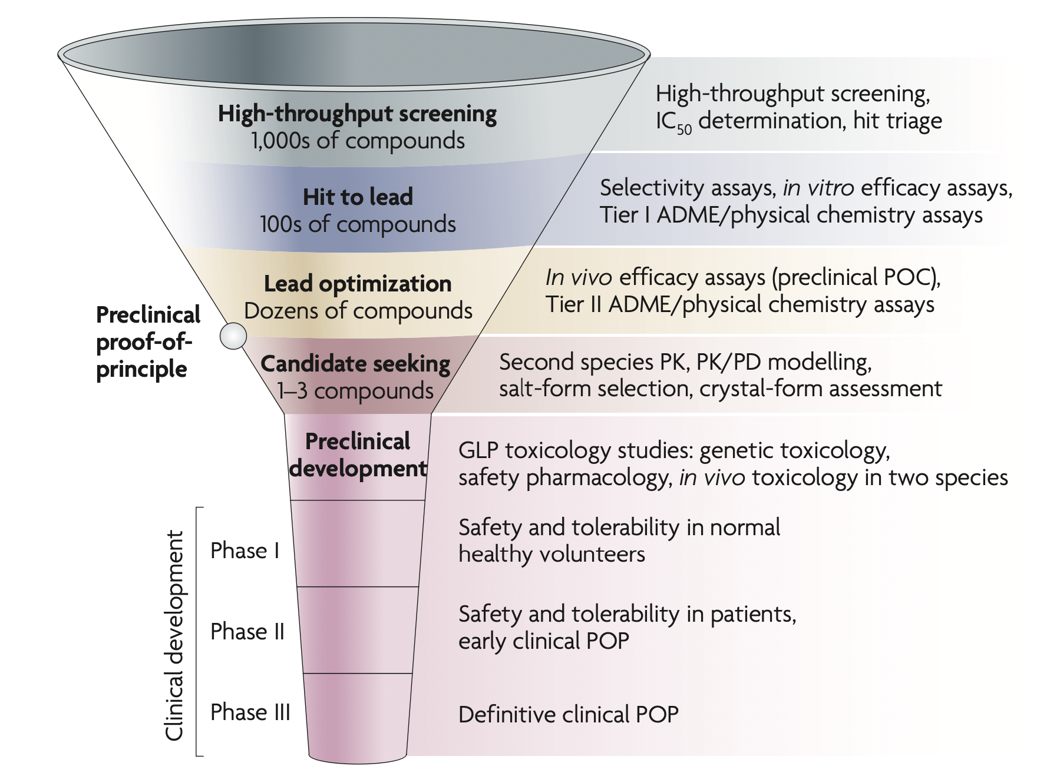
Drug Discovery and Development Funnel
Kramer et al., Nat Rev Drug Discov 6, 636–649 (2007), https://doi.org/10.1038/nrd2378

Slide 16
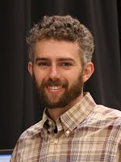
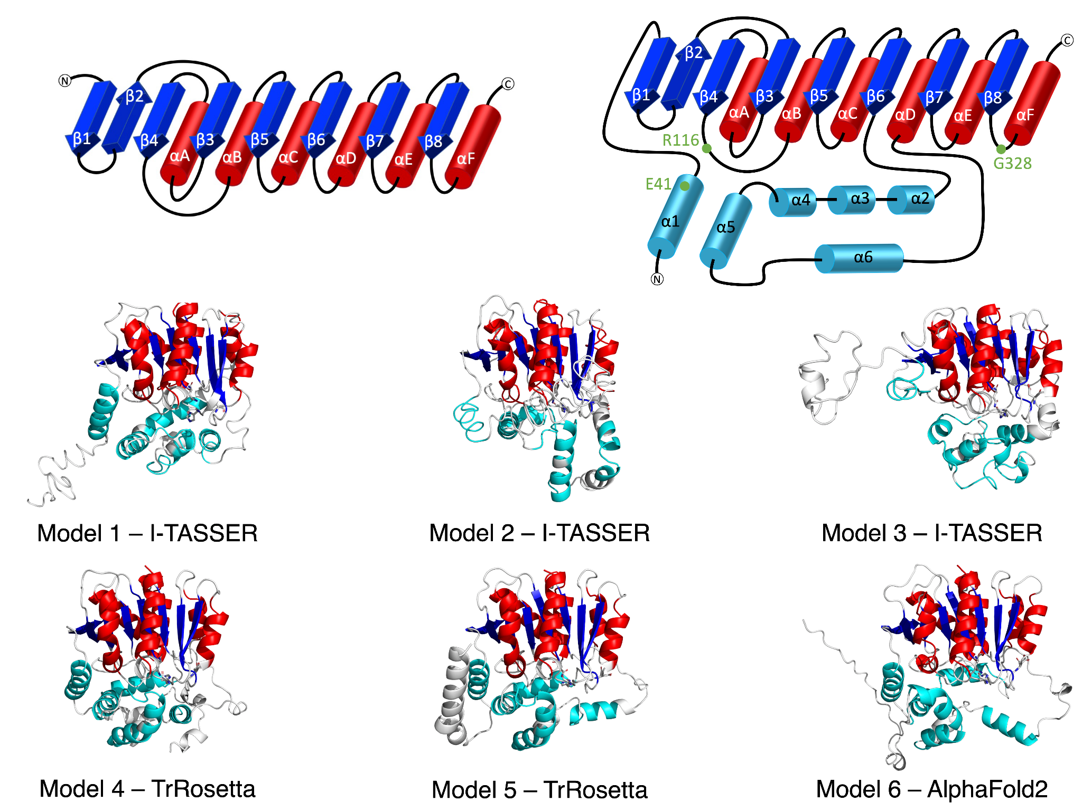
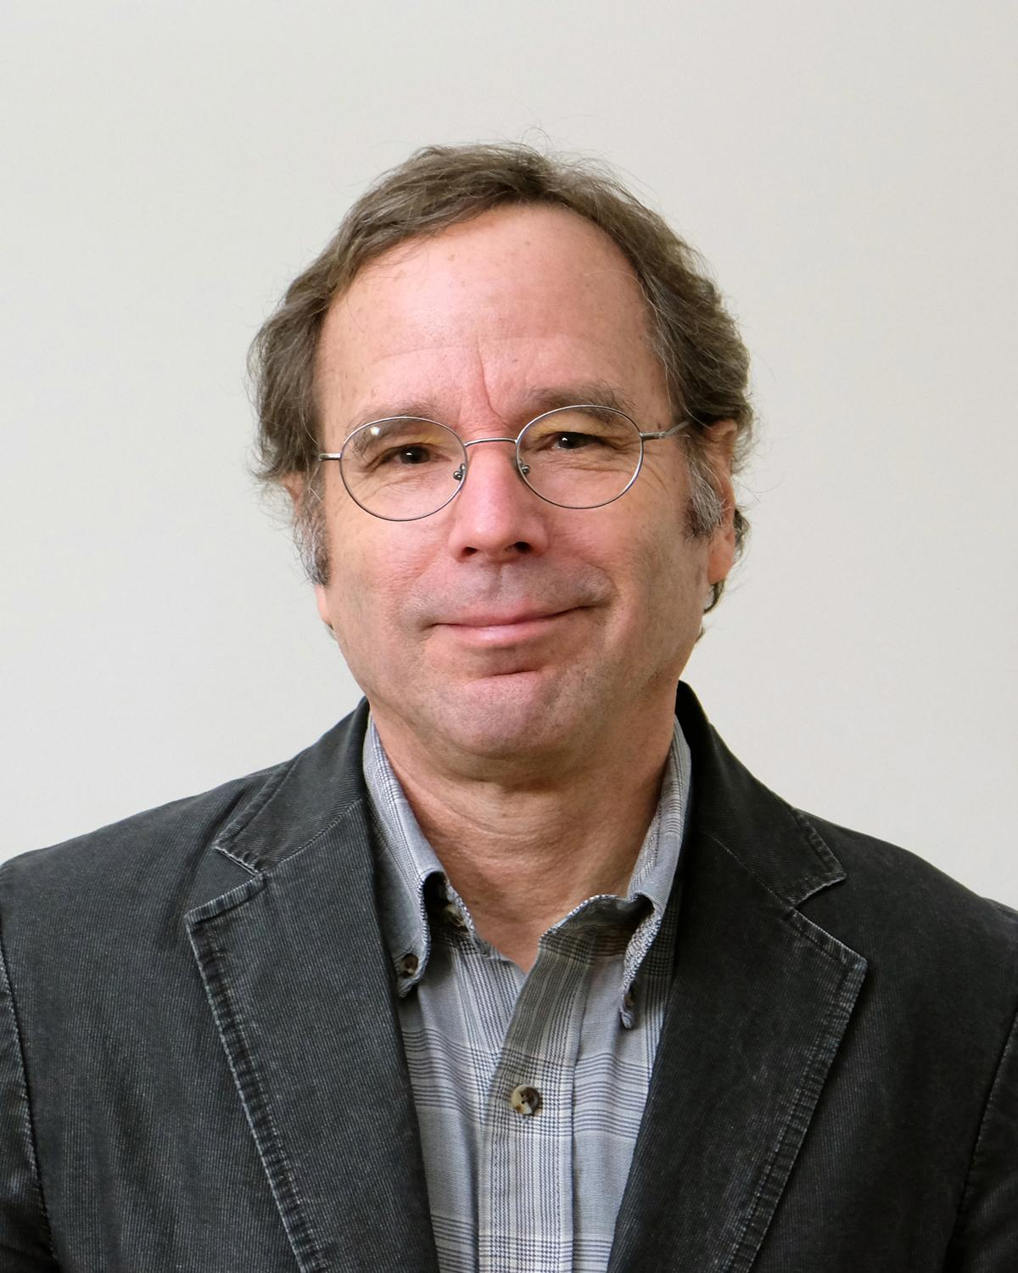
Molecular Modeling of alpha/beta hydrolase domain-containing 5 Structure and Ligand Recognition
Christopher V. Kelly
James G. Granneman
Shahoei et al., Front. Mol. Biosci. 2022; 9: 935375. DOI: 10.3389/fmolb.2022.935375
Yu-ming Mindy Huang
Notes:
Close collaboration with experimentalists.

