Slide 1
Long Read Sequencing
Jesse R. Walsh, Ph.D.
Jag Balan
UIUC – Comp Gen Course
June 25th, 2025

Slide 2
Outline
Why long reads? (“3rd” generation sequencing)
Long read platforms
Bioinformatics tools
Examples
Lab/Workshop

Slide 3
Sanger Sequencing: Principle, Steps, Applications, Diagram
Notes:
Image from Sanger Sequencing: Principle, Steps, Applications, Diagram - https://microbenotes.com/sanger-sequencing/

Slide 4
How we got to 3rd Gen Sequencing
1st Generation sequencing
Characterized by
Chain termination method
High accuracy
Low throughput
Example Sequencing Methods
Sanger
Sanger Sequencing
Sanger Sequencing: Principle, Steps, Applications, Diagram
Notes:
Images from Sanger Sequencing: Principle, Steps, Applications, Diagram - https://microbenotes.com/sanger-sequencing/

Slide 5
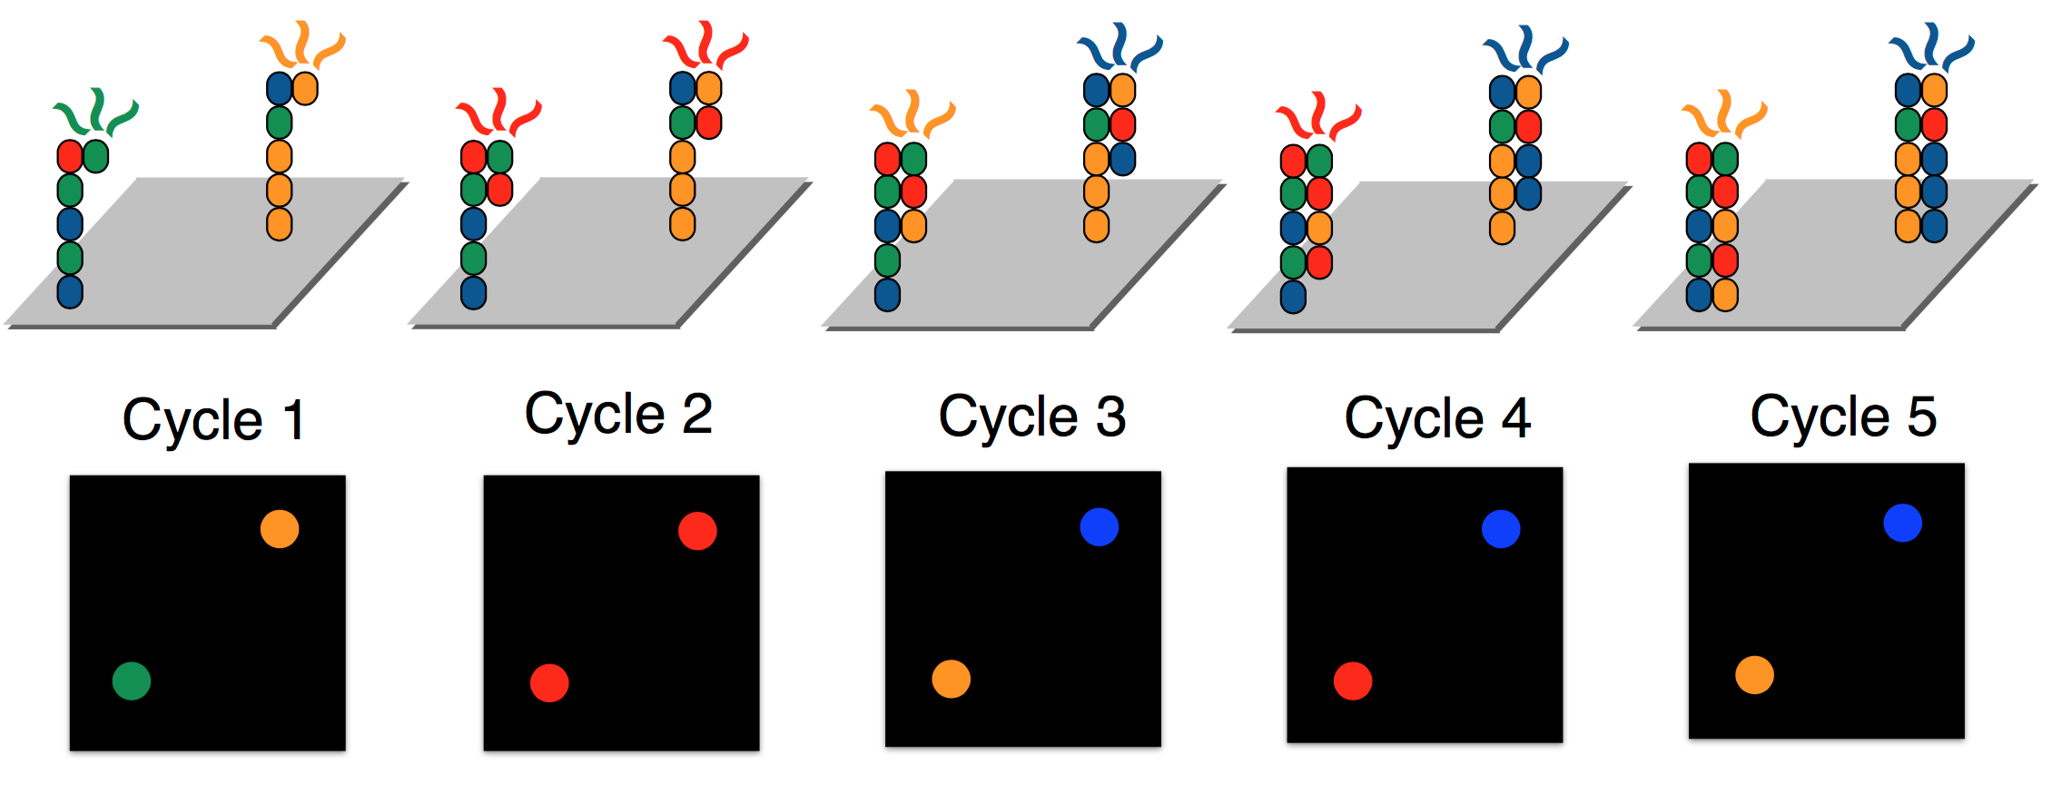
How we got to 3rd Gen Sequencing
2nd Generation sequencing (NGS)
Characterized by
High throughput
Short reads
Example Sequencing Methods
Roche/454
Illumina
SOLiD
Sequencing by Synthesis
Basics of DNA & Sequencing by Synthesis
Notes:
Image from Basics of DNA & Sequencing by Synthesis - https://data-science-sequencing.github.io/Win2018/lectures/lecture2/
Cost per base of sequencing - DNA Sequencing Costs: Data - https://www.genome.gov/about-genomics/fact-sheets/DNA-Sequencing-Costs-Data

Slide 6
Why Long reads?
Eventually, limitations of SRS led to the need to develop LRS
Short read methods
Are unable to span difficult to sequence regions of the genome
Haplotyping is a major challenge
Additional capabilities, such as methylation, require additional assays

Slide 7
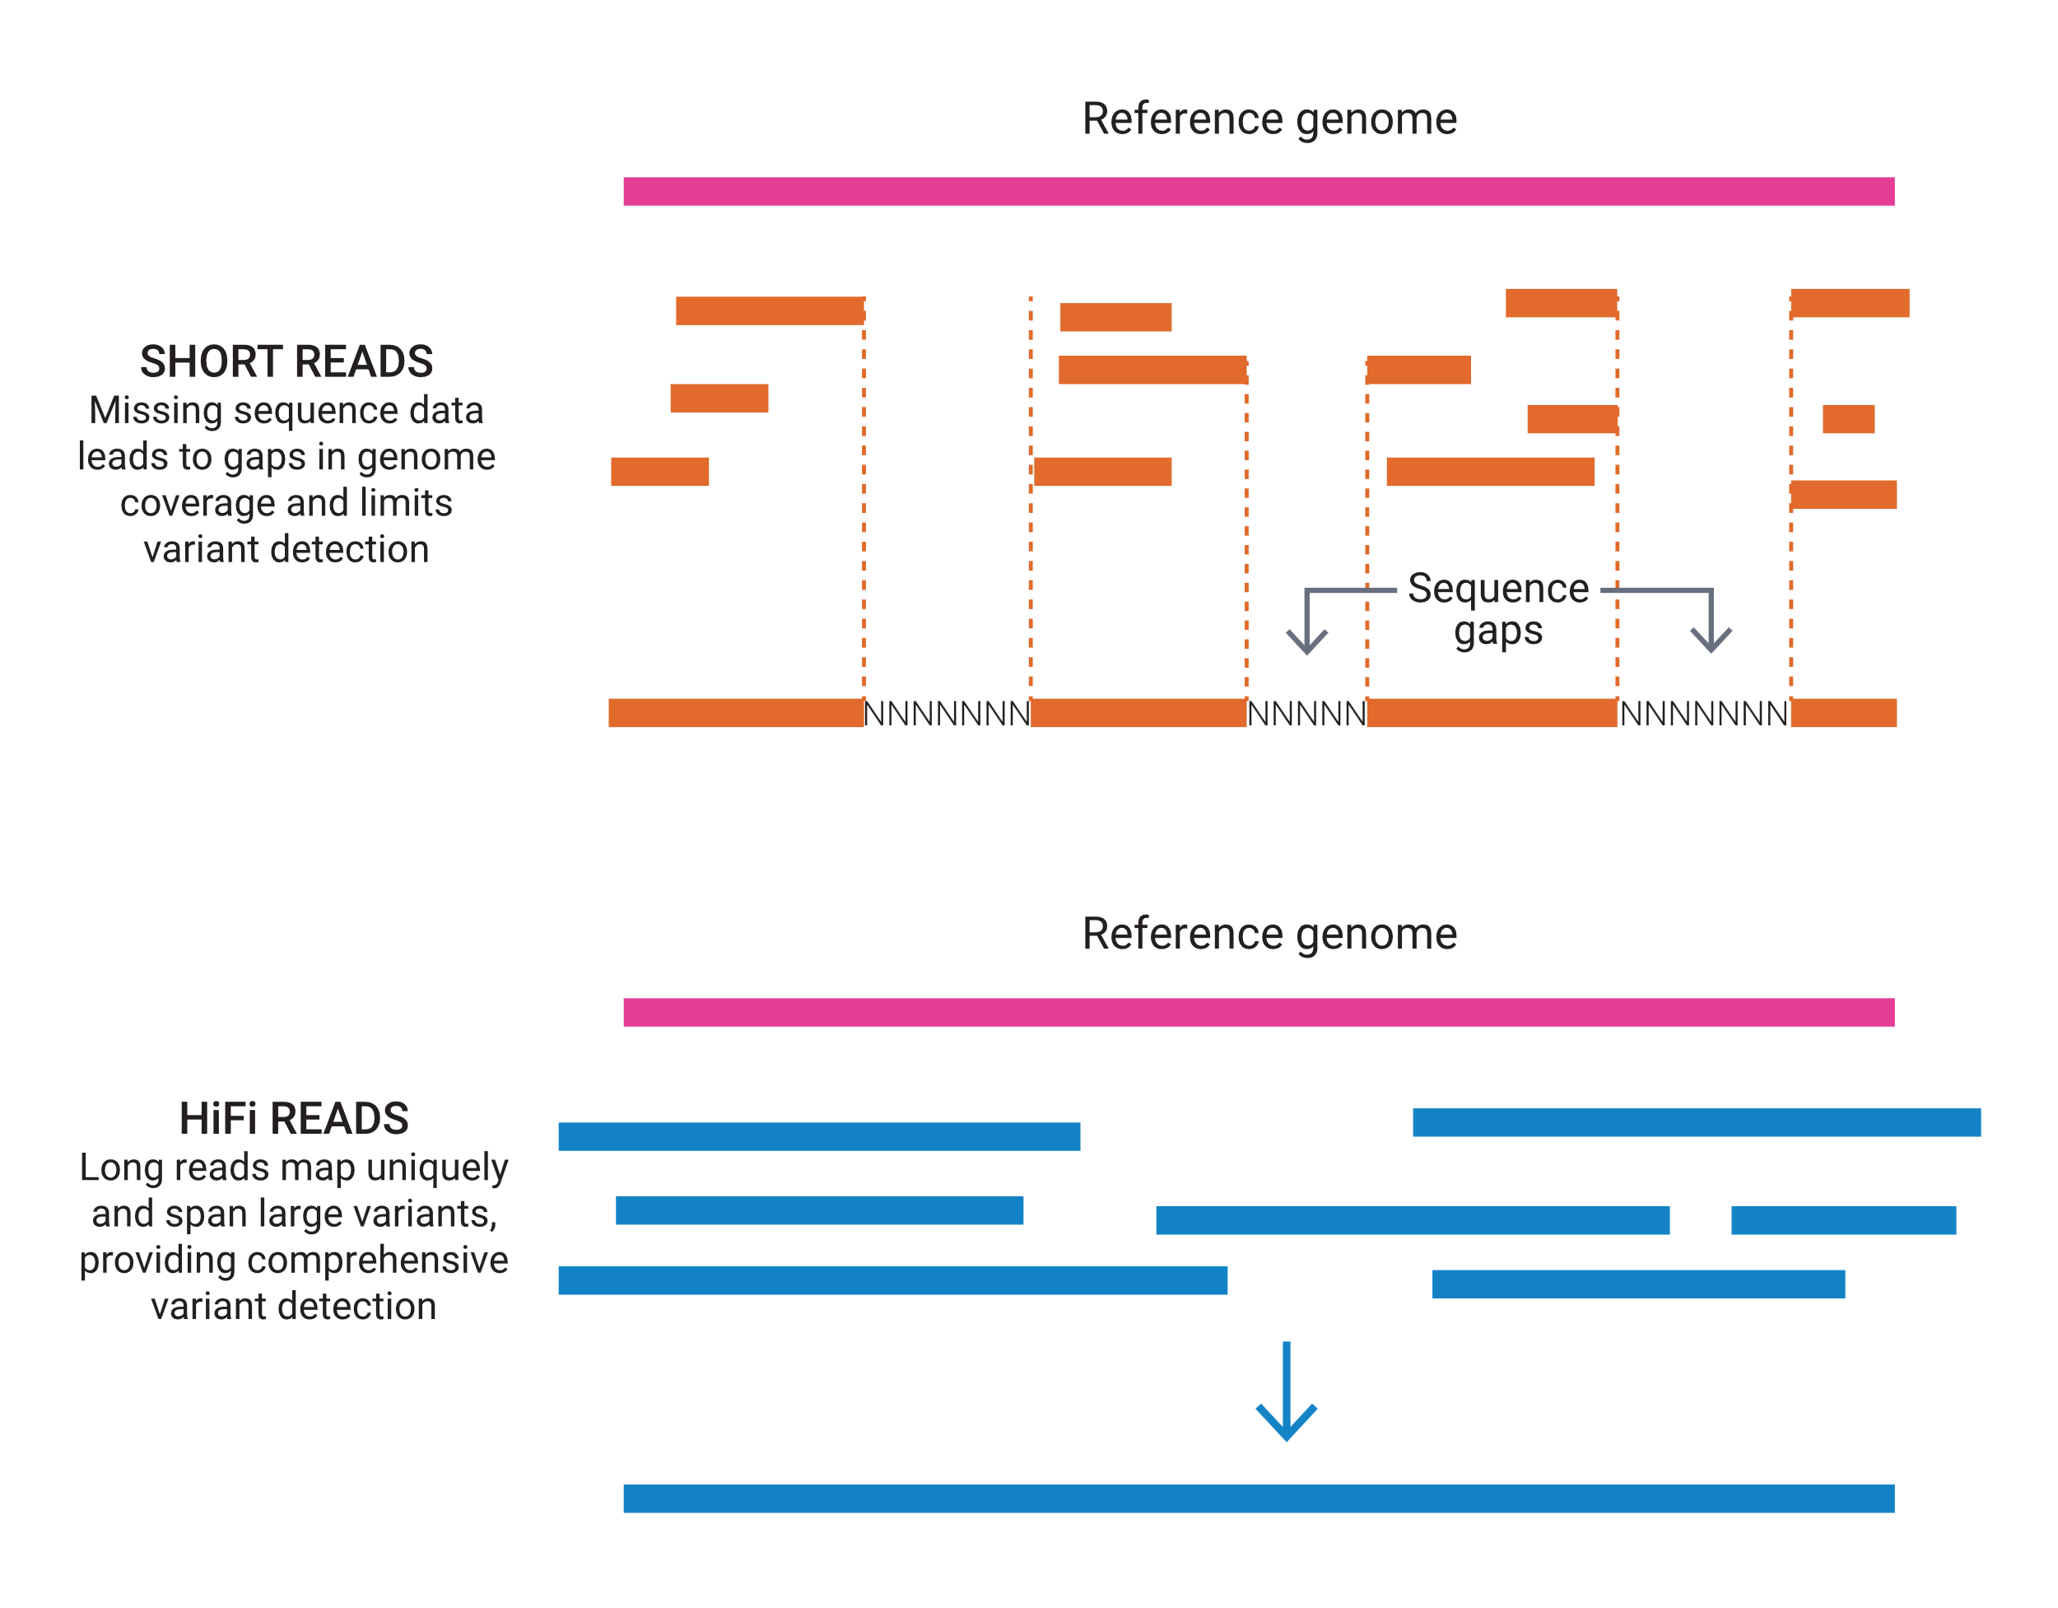
How we got to 3rd Gen Sequencing
3rd Generation sequencing
Characterized by
Longer reads
Single molecule
Real time
Example Sequencing Methods
PacBio SMRT
ONT Nanopore
Use Cases for Long Reads
Traditional Panels
Methylation
Dark Genome
Telomeres
BRCA
Fragile-X
SMN1/2
Telomere Length
Sequencing 101: Comparing long-read sequencing technologies - PacBio

Slide 8
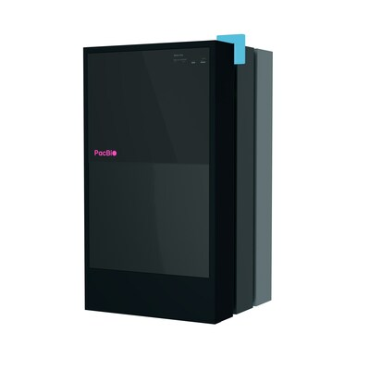
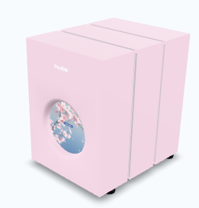
Pacbio LONG READ PLATFORMs
Revio
PacBio
Vega
1 SMRT cell
Revio
Up to 4 SMRT cells
Vega

Slide 9
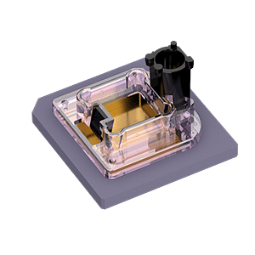
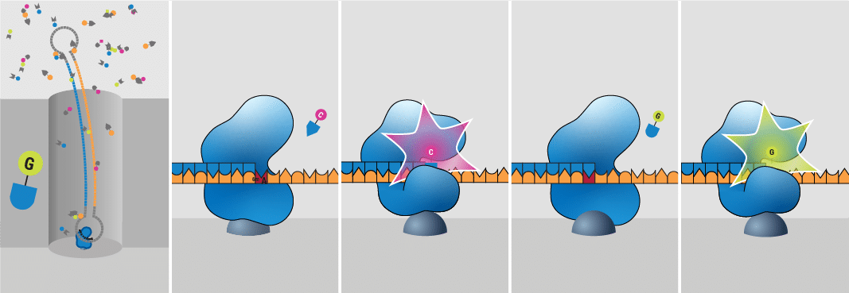
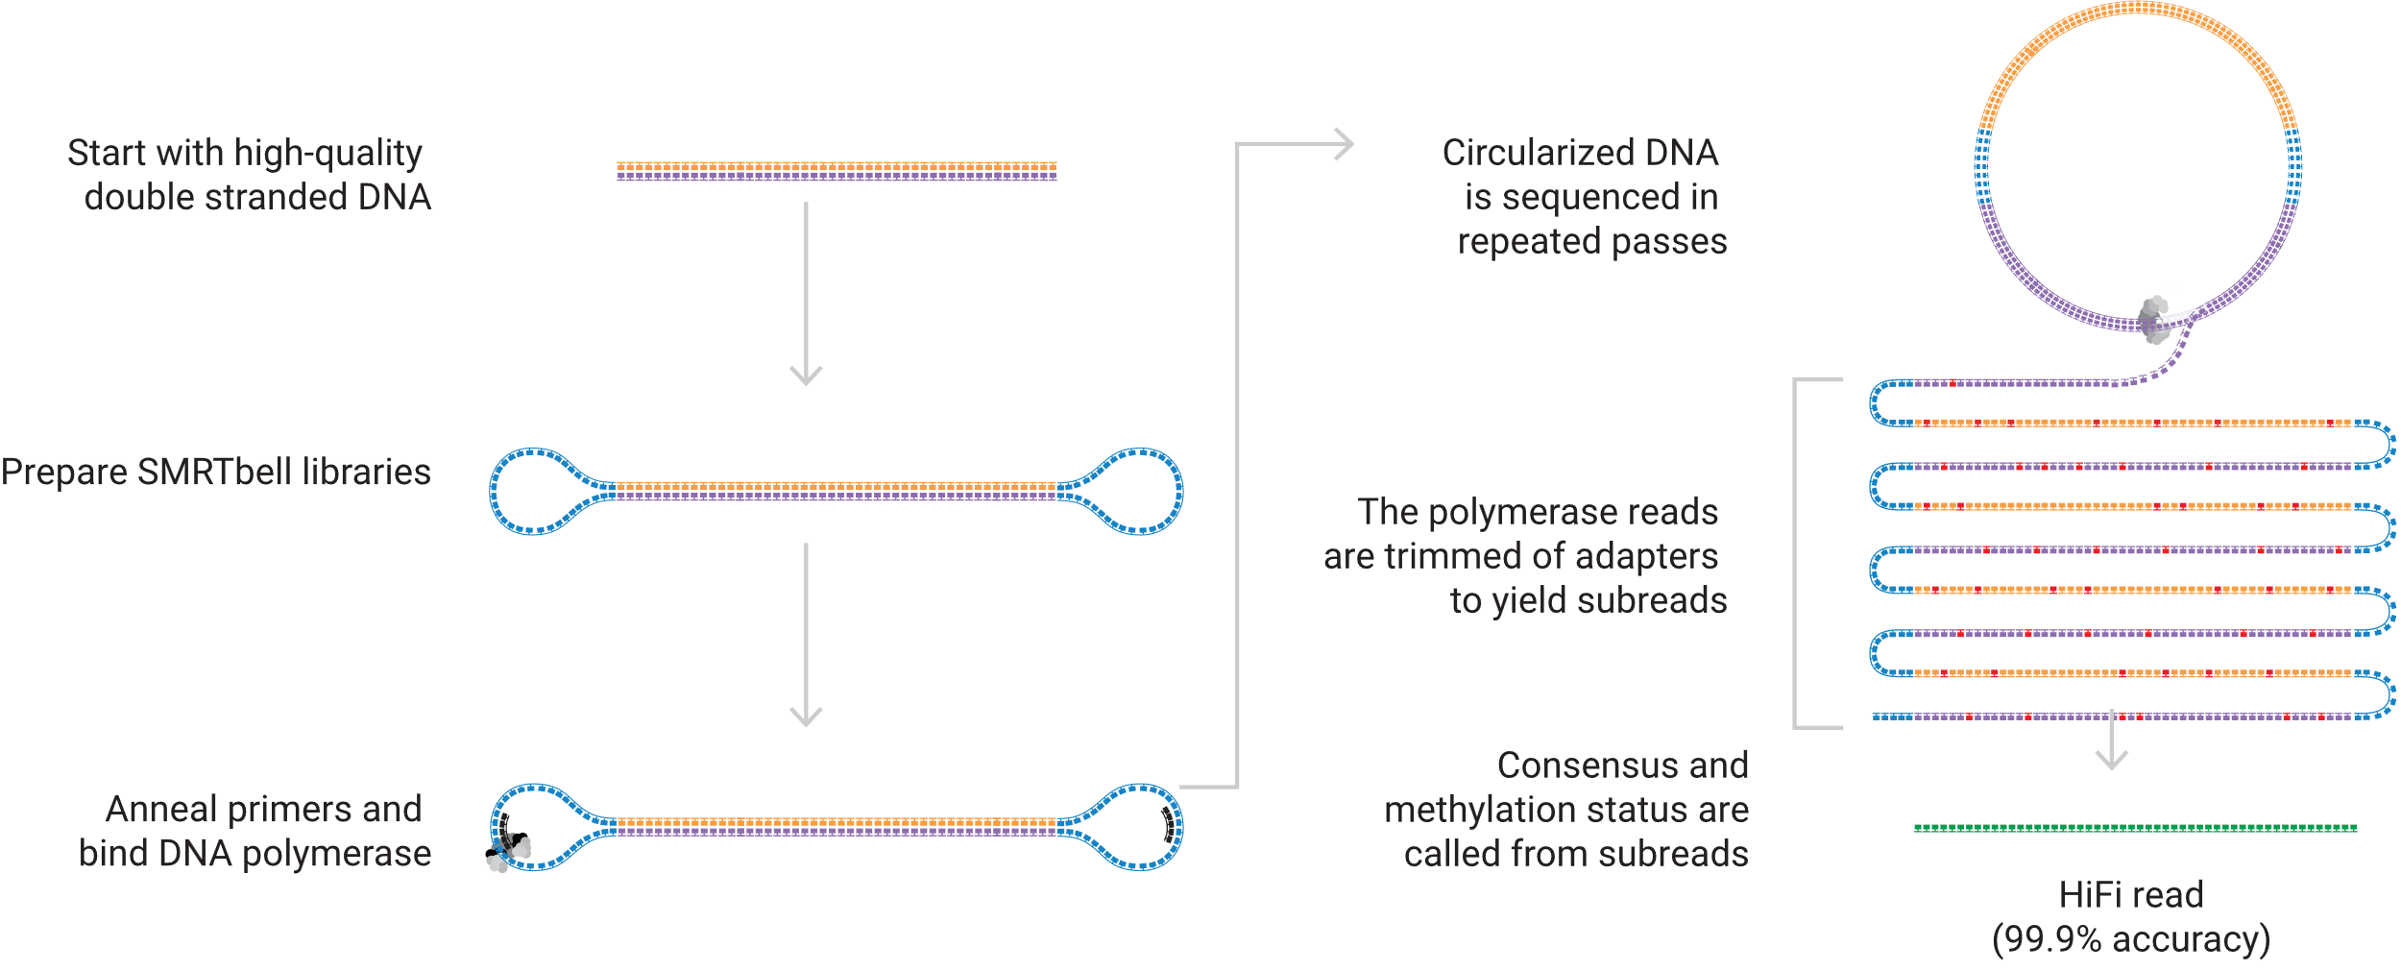
HIFI Sequencing
PacBio uses Hi-FI sequencing method
Each Single Molecule, Real-Time (SMRT) cell contains many zero mode waveguides (ZMWs)
Sequencing 101: Comparing long-read sequencing technologies - PacBio
Notes:
Image from
Sequencing 101: Comparing long-read sequencing technologies – PacBio - https://www.pacb.com/blog/sequencing-101-comparing-long-read-sequencing-technologies/
Sequencing 101: The SMRT Cell in PacBio long-read sequencing – PacBio - https://www.pacb.com/blog/smrt-cell/
How HiFi sequencing works – PacBio - https://www.pacb.com/technology/hifi-sequencing/how-it-works/

Slide 10
PacBio SMRT Sequencing
WGS on human genome
15-20kb library
30-40x per SMRT Cell (1 sample per)
Error rate in sequencing is advertised as 99.95% (Q33)
Methylation output available

Slide 11
How Accurate is Q33?
Q21.2 (99.25%) ONT “High-Accuracy”
Q26 (99.75%) ONT “Super High-Accuracy”
Q33 (99.95%) PacBio HiFi

Slide 12
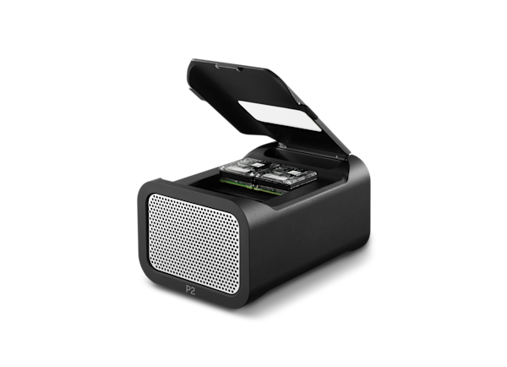
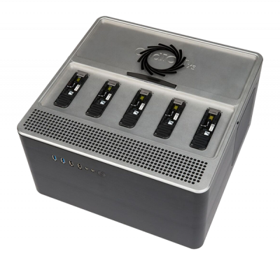
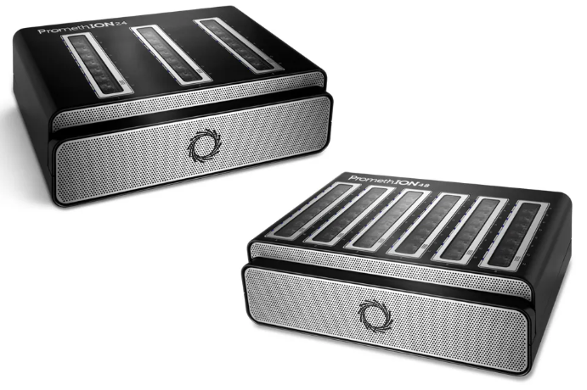
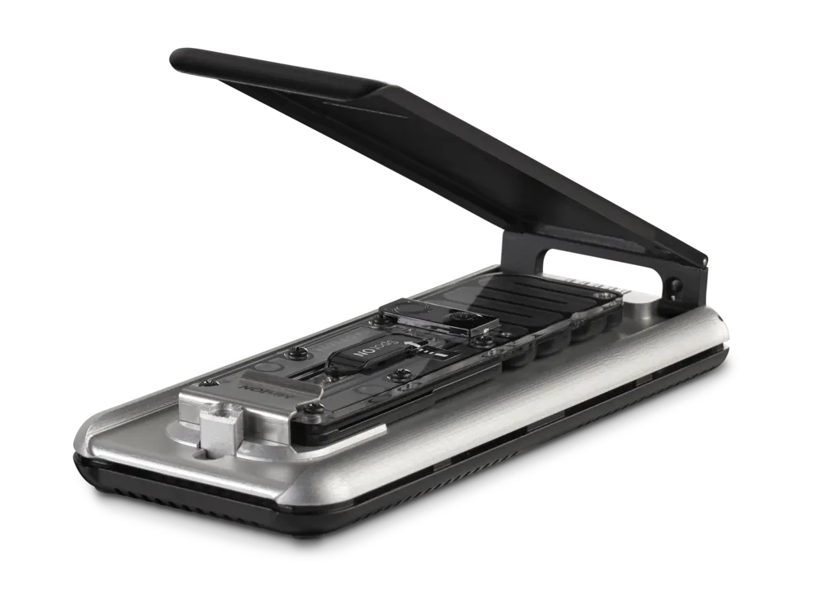
ONT Long Read PLATFORMs
P2 Solo
Oxford Nanopore Technology (ONT)
MinION
1 Flow cell
P2 Solo
2 Flow cells
GridION
5 Flow cells
PromethION 24
24 Flow cells
PromethION 48
48 Flow cells
GridION
PromethION 24
MinION
PromethION 48
Notes:
Images
PromethION 24/48 - https://nanoporetech.com/products/sequence/promethion-24-48
GridIon - https://enseqlopedia.com/2017/03/minion-gridion-core-lab/
MinIon - https://nanoporetech.com/products/sequence/minion
P2 Solo - https://store.nanoporetech.com/us/p2-solo.html

Slide 13
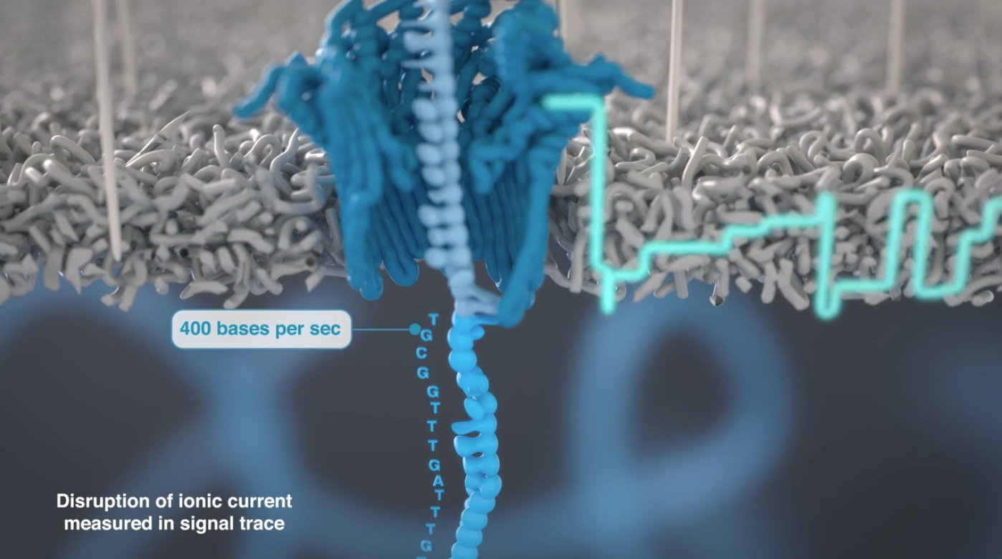
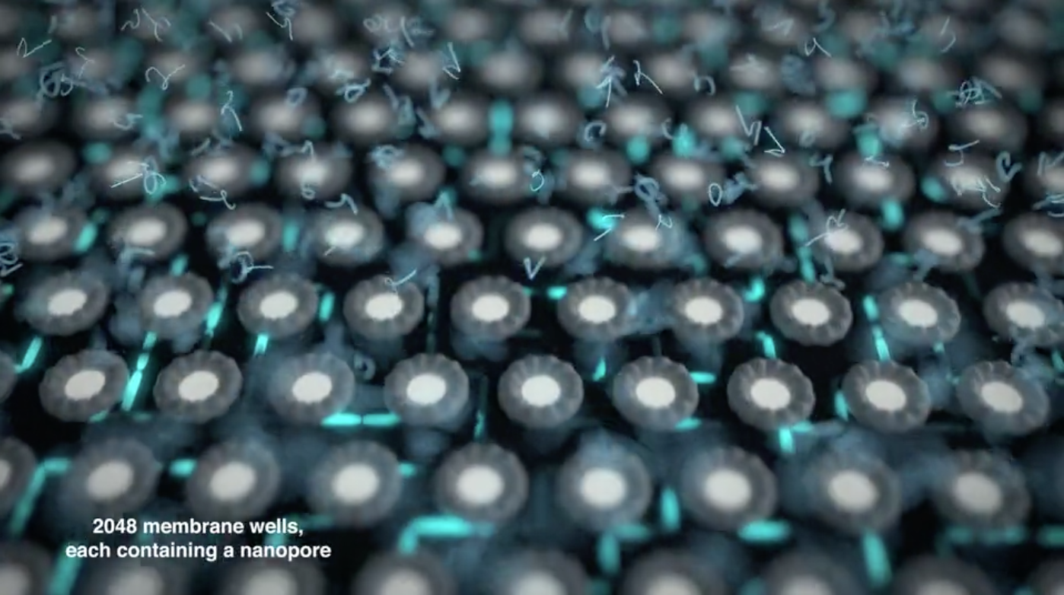
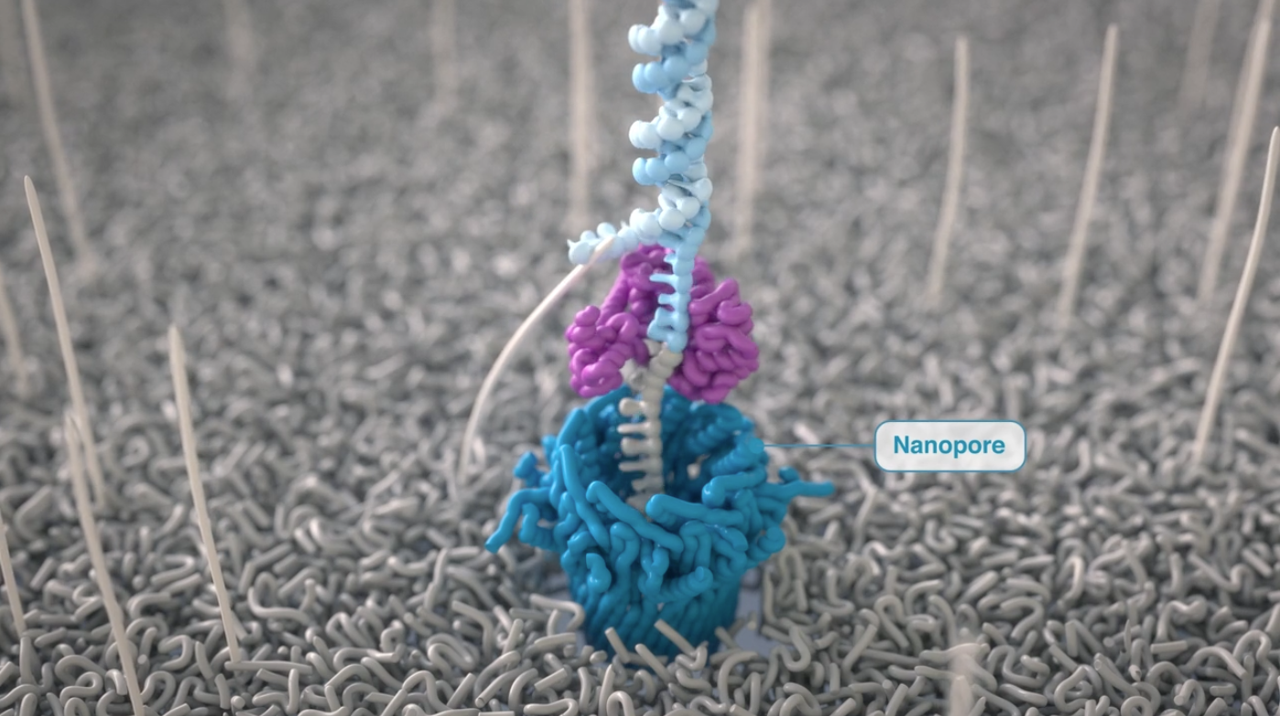
How Nanopore Sequencing Works
1)
4)
2)
3)
https://nanoporetech.com/
Notes:
https://nanoporetech.com/platform/technology/flow-cells-and-nanopores
https://nanoporetech.com/platform/technology/basecalling

Slide 14
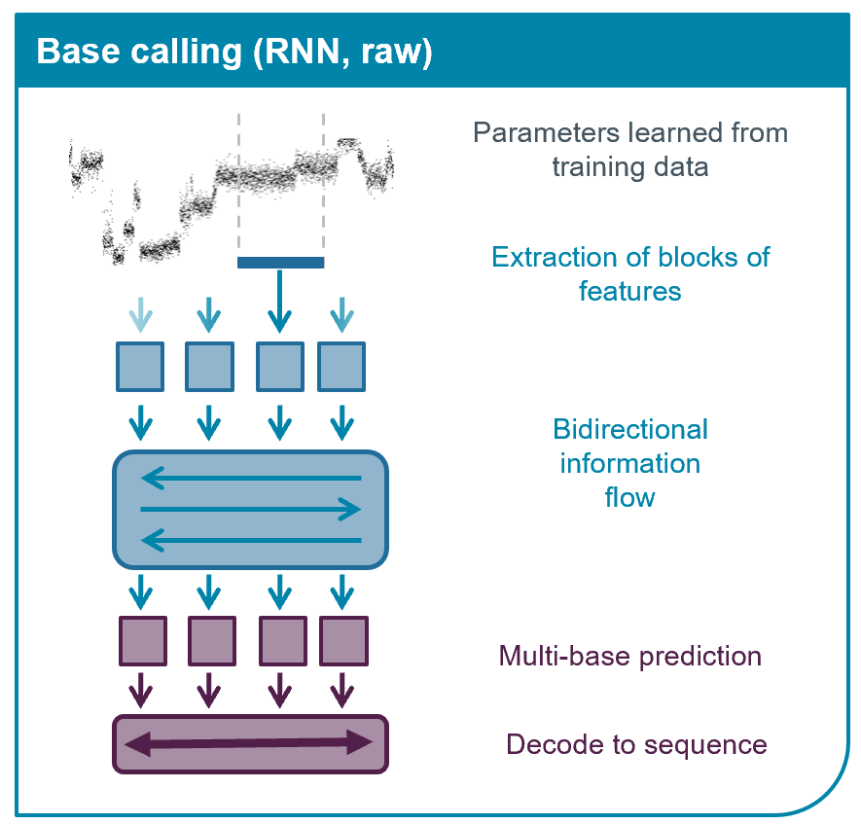
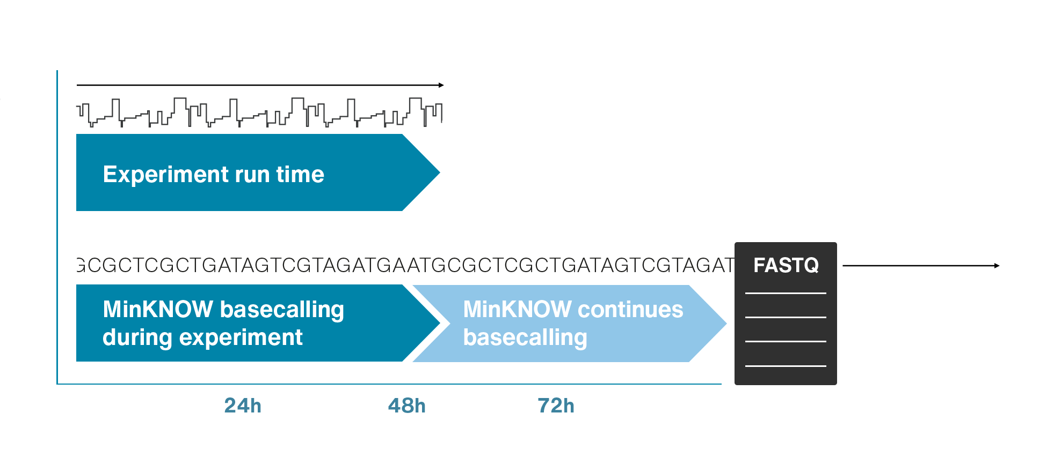
Base prediction from signal by pre-trained Neural Network models
Real time basecalling
Notes:
Images partly from:
https://nanoporetech.com/platform/technology/basecalling
https://nanoporetech.com/platform/accuracy

Slide 15
ONT Nanopore Sequencing
Large range in read lengths
Read length is dependent on prep and sample quality
Some tradeoff between length and coverage
Have seen experiments targeting 15kb and 30kb lengths
Have seen N50’s from ~500bp to 10,000bp
Shorter fragments get through nanopore faster, so they can bring down N50 average
Error rate in sequencing is advertised as 99.25% (Q21.2) - 99.75 (Q26) depending on model
Methylation output available

Slide 16
Base Calling
Basecalling Models | Compatible Modifications | Version
dna_r10.4.1_e8.2_400bps_fast@v5.0.0
dna_r10.4.1_e8.2_400bps_hac@v5.0.0 | 4mC_5mC 5mCG_5hmCG 5mC_5hmC 6mA | v3 v3 v3 v3
dna_r10.4.1_e8.2_400bps_sup@v5.0.0 | 4mC_5mC 5mCG_5hmCG 5mC_5hmC 6mA | v3 v3 v3 v3
Dorado
ONT provided basecaller
GPU accelerated
Uses pre-trained neural networks
Many models (and versions) available
Model choice matters
Accuracy
Fast (fast)
High (hac)
Super-high (sup)
Version
Modified bases (Methylation)
https://github.com/nanoporetech/dorado
Accuracy
Version
Modifications
sup@v4.2.0,5mCG_5hmCG
Notes:
Many models available: https://github.com/nanoporetech/dorado

Slide 17
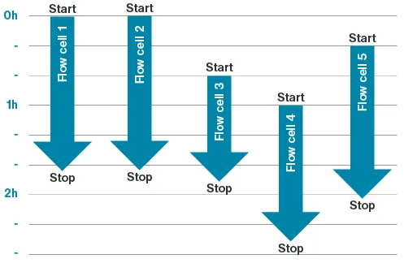
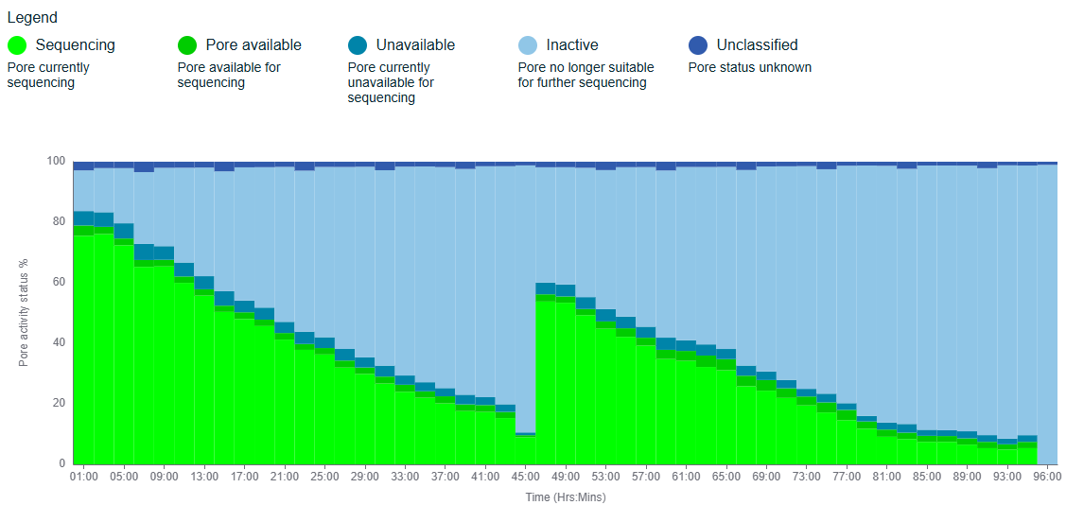
Flexible loading
Can start and stop individual FC’s
Add an additional sample while machine is already running
Restart a failed sample without impacting others
Improve a sample by reloading mid-run
e.g. Wash and reload at 48hr

Slide 18
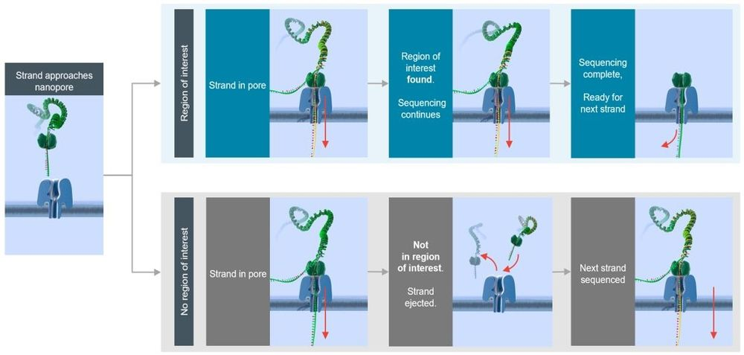
Adaptive sampling
Whole Genome Sequencing mode (~20-30x depth)
Adaptive sampling mode can get 3-5x boost
Notes:
https://nanoporetech.com/document/adaptive-sampling

Slide 19
Adaptive sampling Considerations
Need to provide a bed file to define the ROI
A well-designed bed file is
Total size of bed file should cover 1-5% of genome
Bigger on-target boost with smaller size
Diminishing returns between 1% and 3%
Padding size recommended at N90 of fragment library
Which is to say, the padding should be larger than most reads
Size of the ROI impacts the boost in depth
A 1% of the genome ROI might see a 5x boost
A 10% of the genome ROI might only see a 2x boost
Off-target reads are rejected after around 200-600bp. These reads can be useful as a low-pass short-read WGS.

Slide 20
Adaptive sampling example output
Target: 3-5x boost in ROI
Sample | WGS Depth | On-target Depth | Off-target Depth | % Genome | OnTarget/WGS
Sample 1 | 32.55 | N/A | N/A | 100% | 1.00x
Sample 2 | 27.88 | 41.61 | 26.12 | (Methyl) 10% | 1.49x
Sample 1 | 36.12 | 60.85 | 34.88 | (Methyl) 5% | 1.68x
Sample 1 | 37.54 | 70.47 | 36.62 | (Methyl) 3% | 1.88x
Sample 1 | 35.19 | 73.53 | 34.89 | (Methyl) 1% | 2.09x
Sample 1 | 32.09 | 65.49 | 30.27 | (CMRG) 1% | 2.04x
Sample 1, SRE, Not Sheared | 11.84 | 37.60 | 11.59 | (CMRG) 1% | 3.19x
Sample 1, SRE, Sheared | 24.04 | 84.54 | 23.46 | (CMRG) 1% | 3.52x
Sample 3, 20kb library | 20.41 | 157.37 | 19.60 | (CMRG) 1% | 7.71x

Slide 21
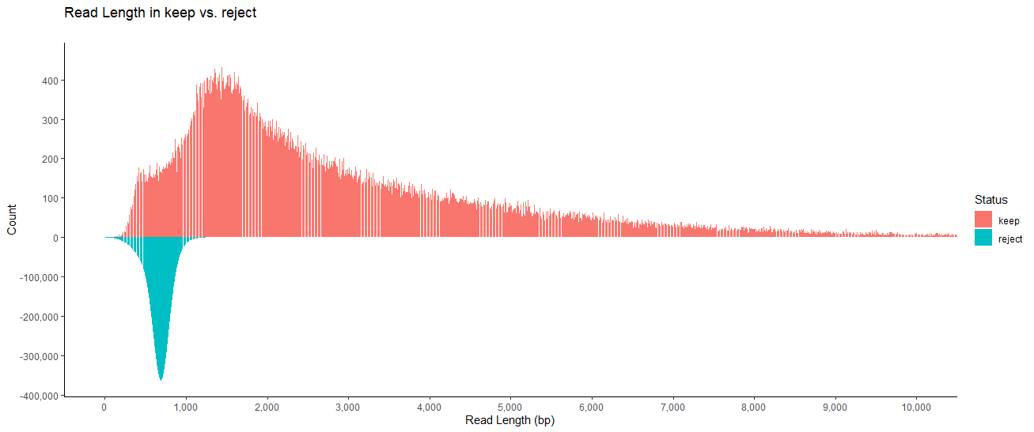
“Keep/Reject” Reads
Read Status | Mean Length | N10 | N50 | N90
Keep | 2,931.5 | 8,445 | 3,934 | 1,504
Reject | 672.9 | 867 | 707 | 542

Slide 22
“Keep/Reject” Reads
Read Status | Mean Length | N10 | N50 | N90
Keep | 6,157.2 | 41,087 | 16,922 | 2,446
Reject | 665.9 | 866 | 703 | 519

Slide 23
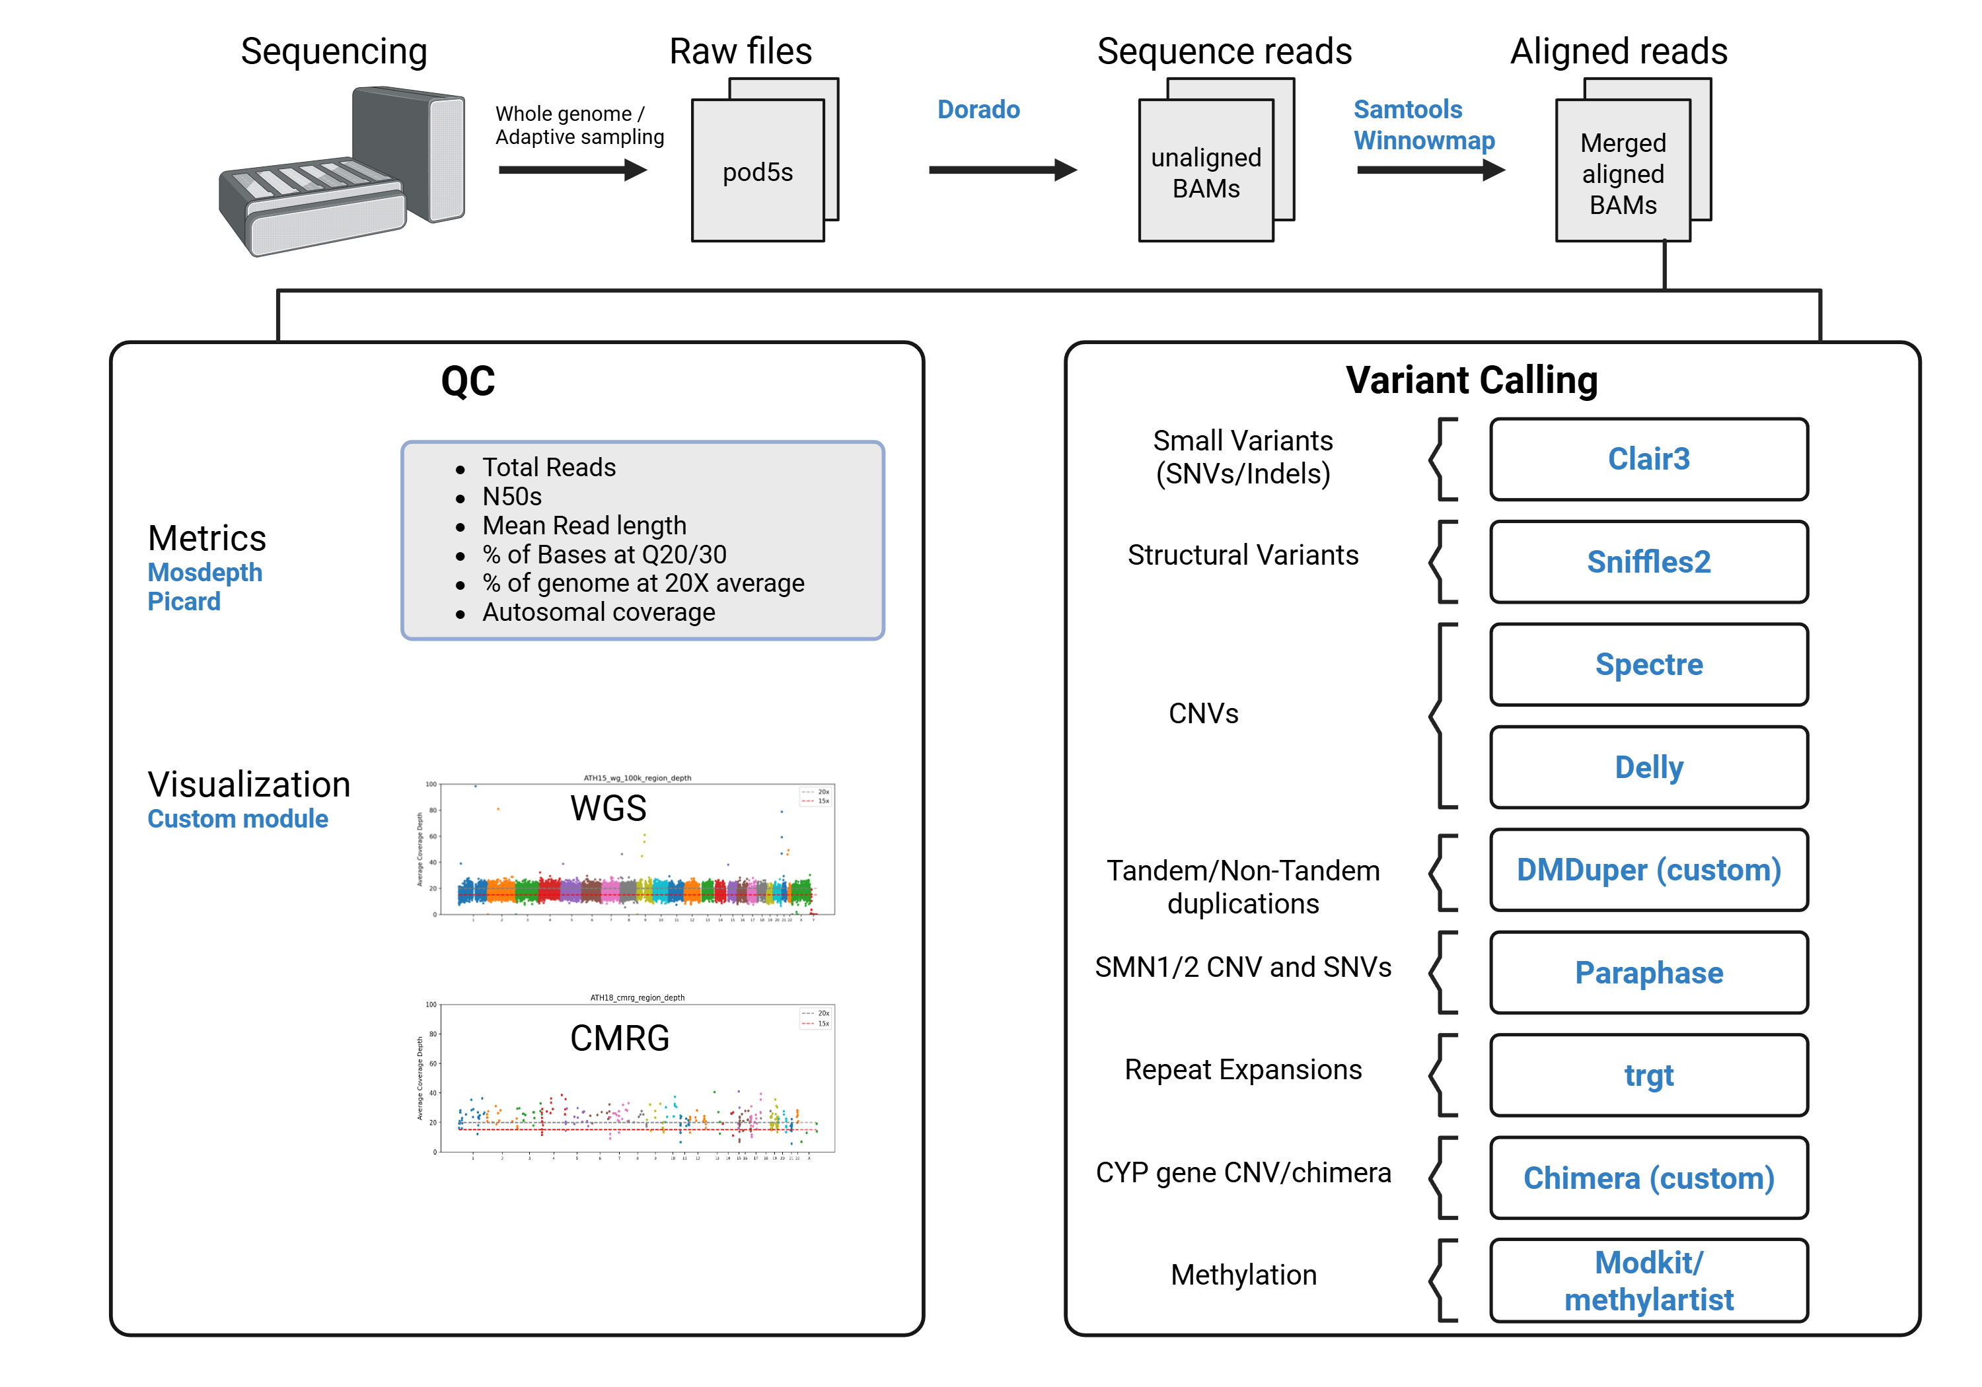
Pipeline for ONT Data
Internally developed using mostly published tools
Designed for DNA variant calling
Includes methylation
Several long-read specific tools doing familiar bioinformatics tasks
e.g. Alignment

Slide 24
ModKit
ONT developed tool for converting modBAM to bedMethyl format
If base calling was performed with an appropriate modification model, then the resulting bam has MM: and ML: tags representing methylation
The bedMethyl format is the base 3-column bed file with additional columns describing methylation
Count of reads at this position
Count of methylated reads at this position

Slide 25
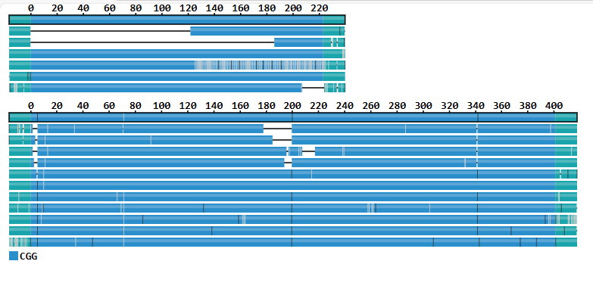
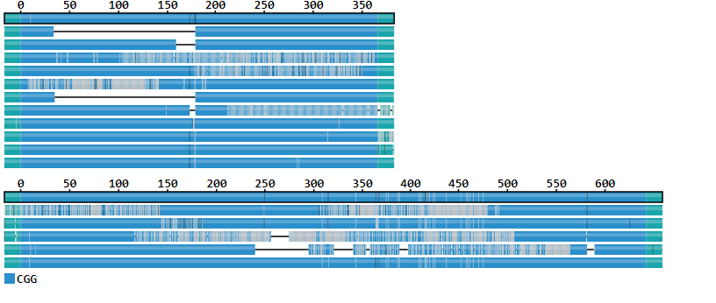
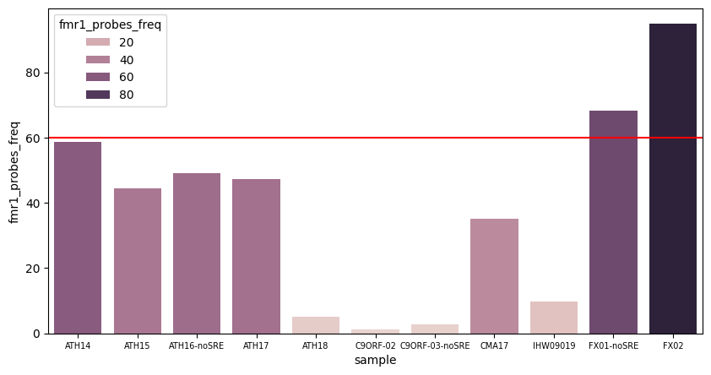
FRAGILE-X syndrome
Clinical result: FMR1 expansion (>200 and >200). Methylation abnormal
Clinical result: FMR1 expansion (>200 and 172). Methylation abnormal
Tool: trgt
Tool: trgt
Methylation result: Hypermethylation in FMR1 promoter region
Used average of methylation frequencies from modkit output in FMR1 promoter region

Slide 26
Improved dark genome
Genomic regions that cannot be adequately assembled or aligned using short reads.
Dark by “depth” – Lack of coverage for regions. ( <5x).
Dark by “ambiguous alignments” of sequence reads. (>90% of reads have low MQ, <10)
Notes:
Paper - Systematic analysis of dark and camouflaged genes reveals disease-relevant genes hiding in plain sight | Genome Biology | Full Text - https://genomebiology.biomedcentral.com/articles/10.1186/s13059-019-1707-2

Slide 27
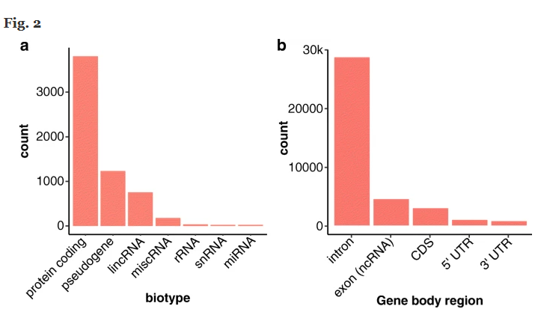
DARK GENOME and what it constitutes?
https://github.com/mebbert/DarkRegionFinder
36,794 dark regions characterized
Implicated in pathways important to human health, development, and reproduction.
76 dark genes with known mutations associated with 326 human diseases
Ebbert, M.T.W., Jensen, T.D., Jansen-West, K. et al. Systematic analysis of dark and camouflaged genes reveals disease-relevant genes hiding in plain sight. Genome Biol 20, 97 (2019). https://doi.org/10.1186/s13059-019-1707-2

Slide 28
Long read sequencing resolves dark regions
Authors showed good alignments in
Pseudogenes
Low complexity regions
Repeats
Resolves 77% of dark regions
Ebbert, M.T.W., Jensen, T.D., Jansen-West, K. et al. Systematic analysis of dark and camouflaged genes reveals disease-relevant genes hiding in plain sight. Genome Biol 20, 97 (2019). https://doi.org/10.1186/s13059-019-1707-2

Slide 29
Final Thoughts
Long read technology is much more mature than previous generations
Long reads can do basically anything that short reads can do in terms of
Long reads can do things short reads can’t
Challenging Medically Relevant Gene (CMRG) regions
Methylation
As cost and consistency improve, long reads open new possibilities in research and clinical practice

Slide 30
QUESTIONS & ANSWERS

