Slide 1
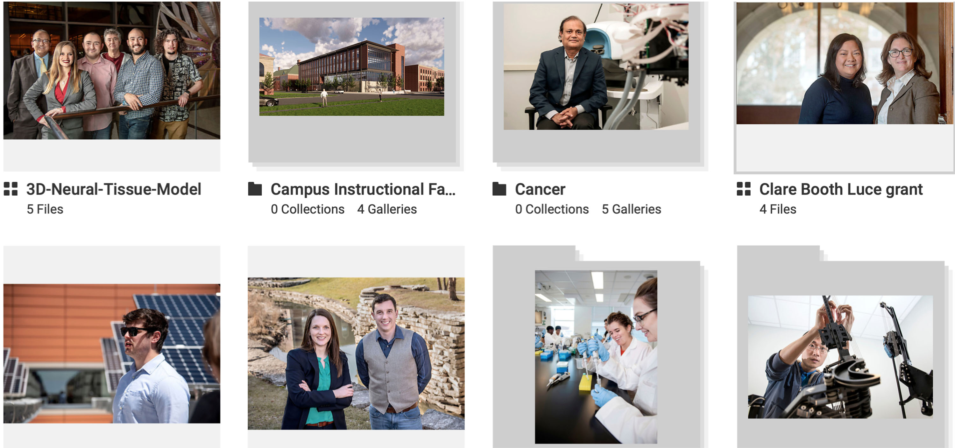
PhotoShelter: Store, Search, Share

Slide 2
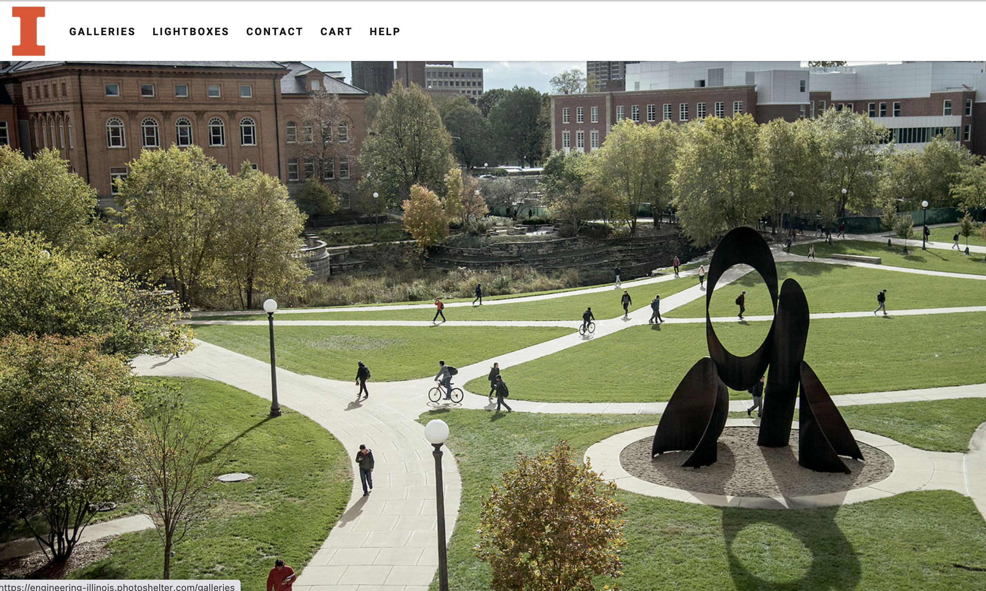
PhotoShelter Overview
PhotoShelter is cloud-based, digital management software. It is very useful as a searchable database and works much like Public Affairs’ PhotoShelter image database, except we focus on all things Grainger Engineering.
If you need the password to gain access, contact hcc@Illinois.edu
GRAINGER ENGINEERING

Slide 3
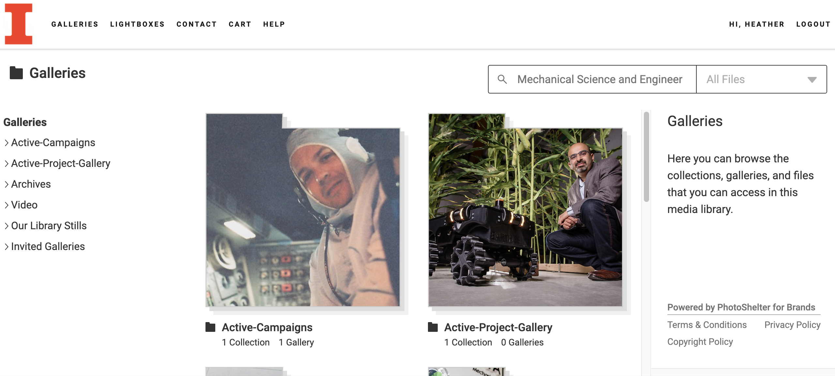
Search options
Begin your search by clicking on Galleries in the menu.
Next, type your chosen word(s), like Mechanical Science and Engineering, in the search bar. You can choose All Files for a broad search that includes all content accessible to you.
GRAINGER ENGINEERING

Slide 4
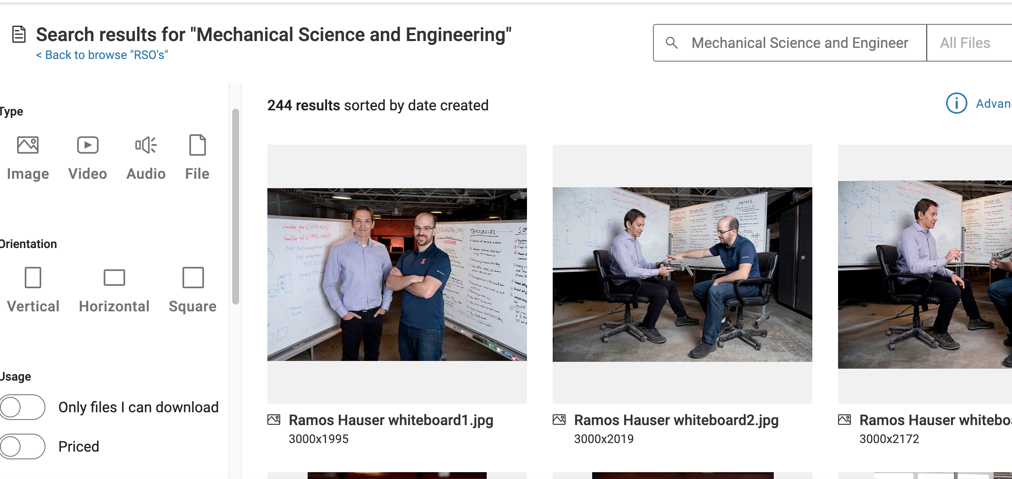
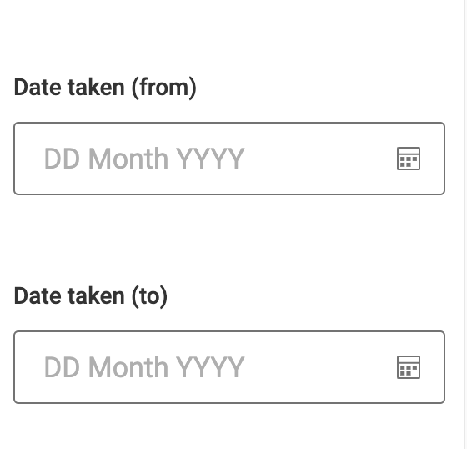
Search options
Here you can modify your search by choosing from Type, Orientation, and Dates in the left pane.
GRAINGER ENGINEERING

Slide 5
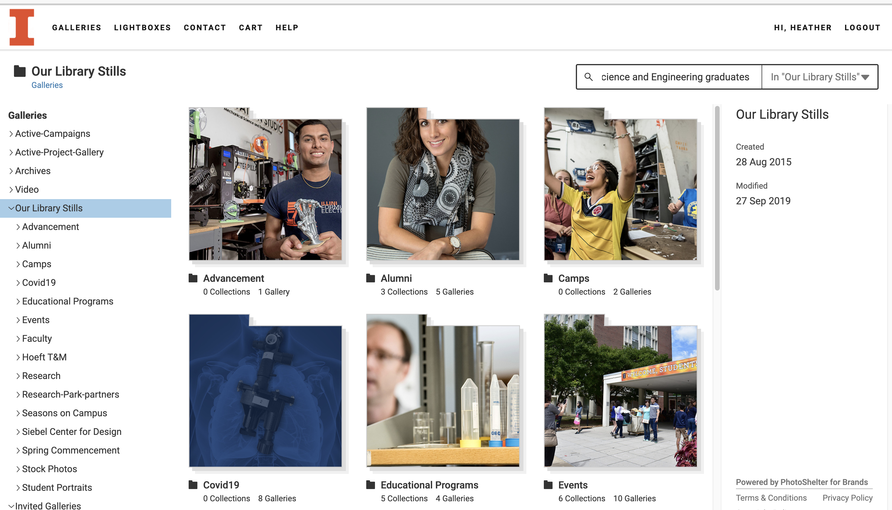
Search options
For narrower searches, return to the Galleries page and choose your type, like Video. In this example, we’ll choose Library Stills and add the word graduates to our original search. The more specific your keywords, the better the search.
GRAINGER ENGINEERING

Slide 6
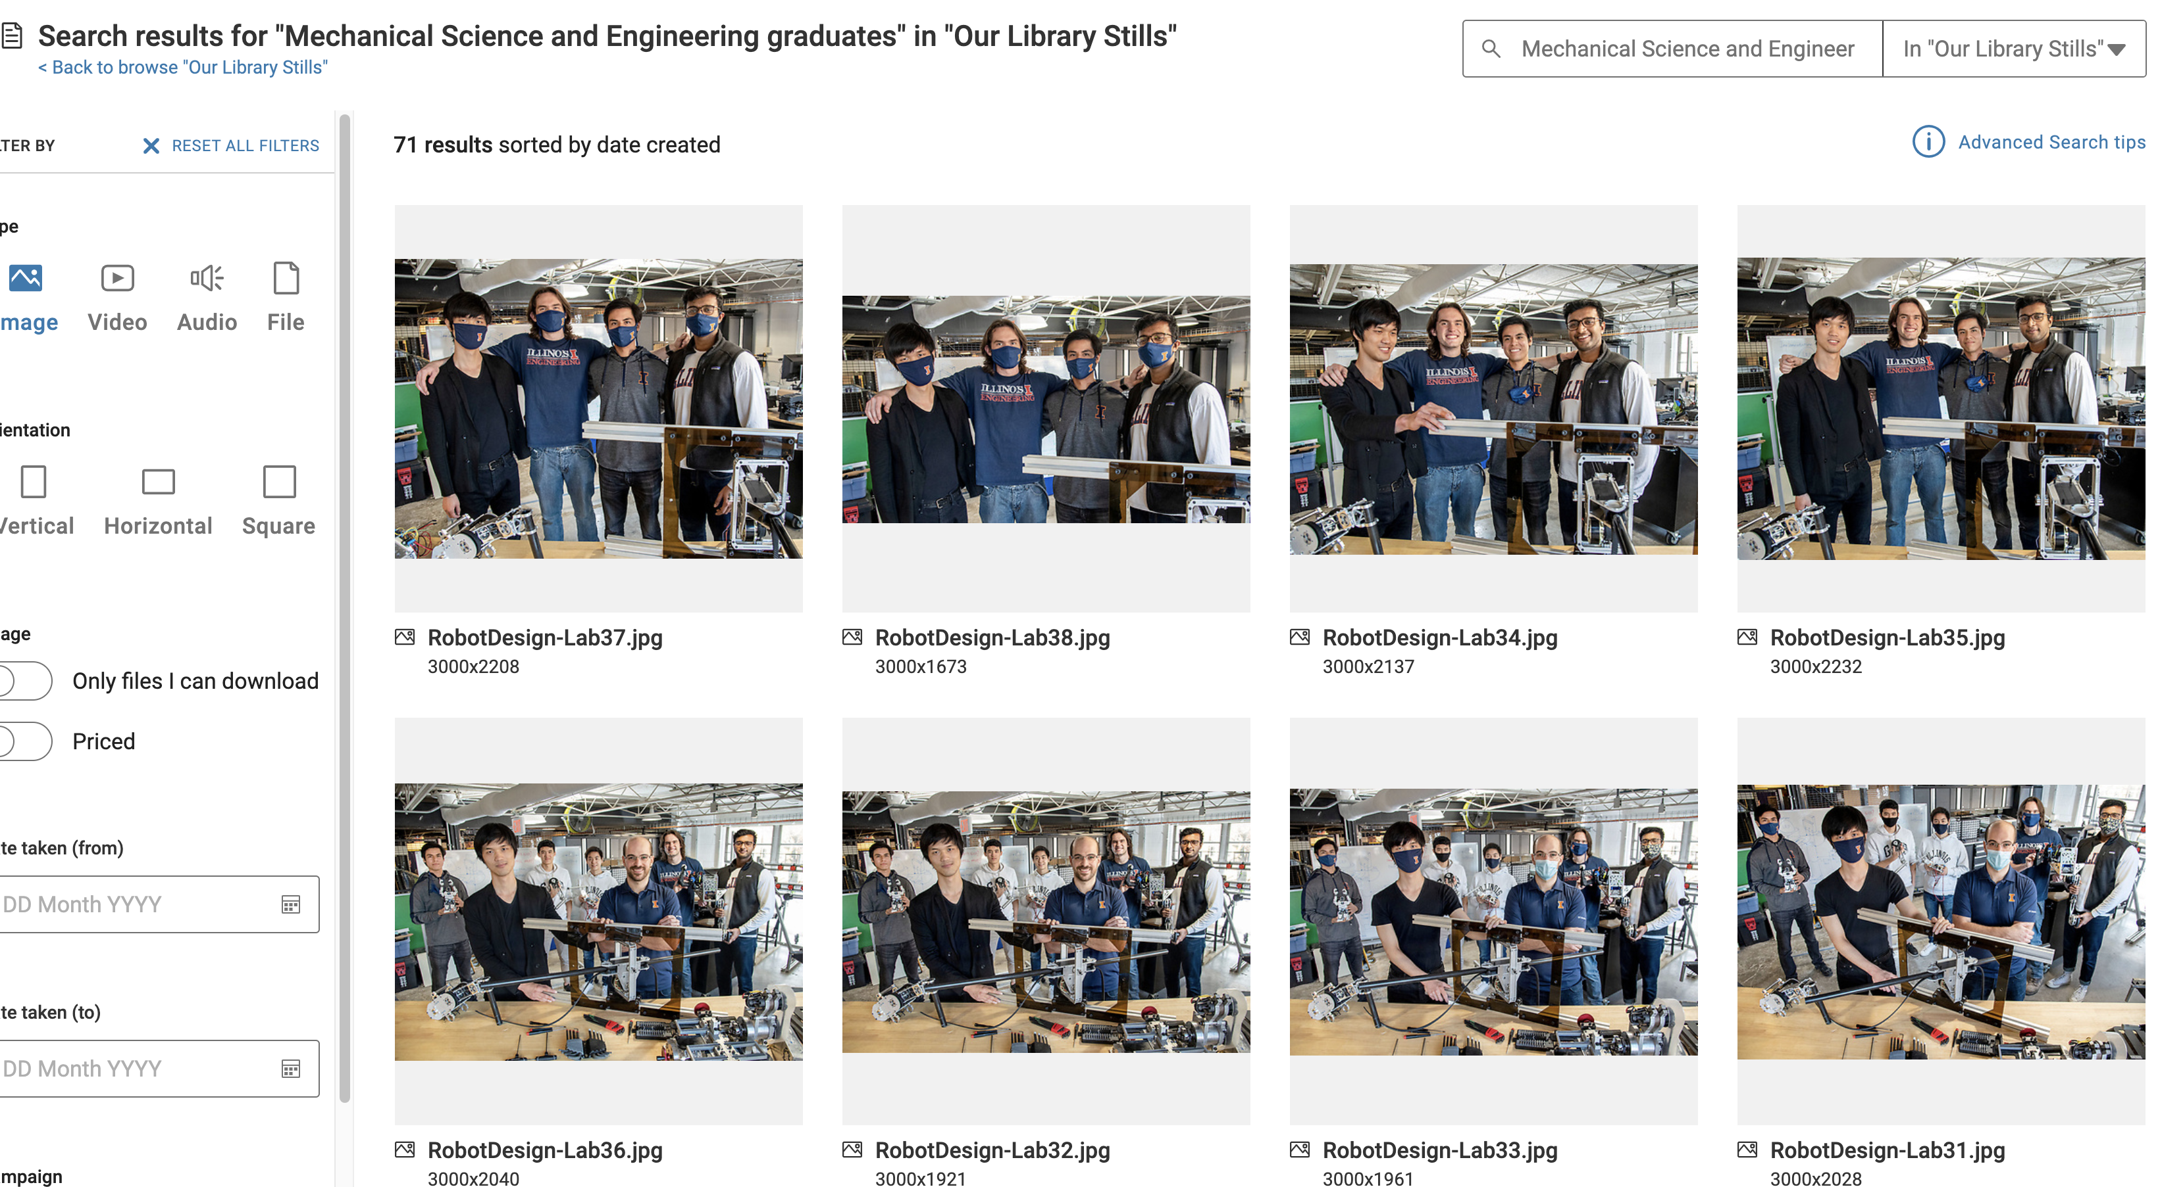
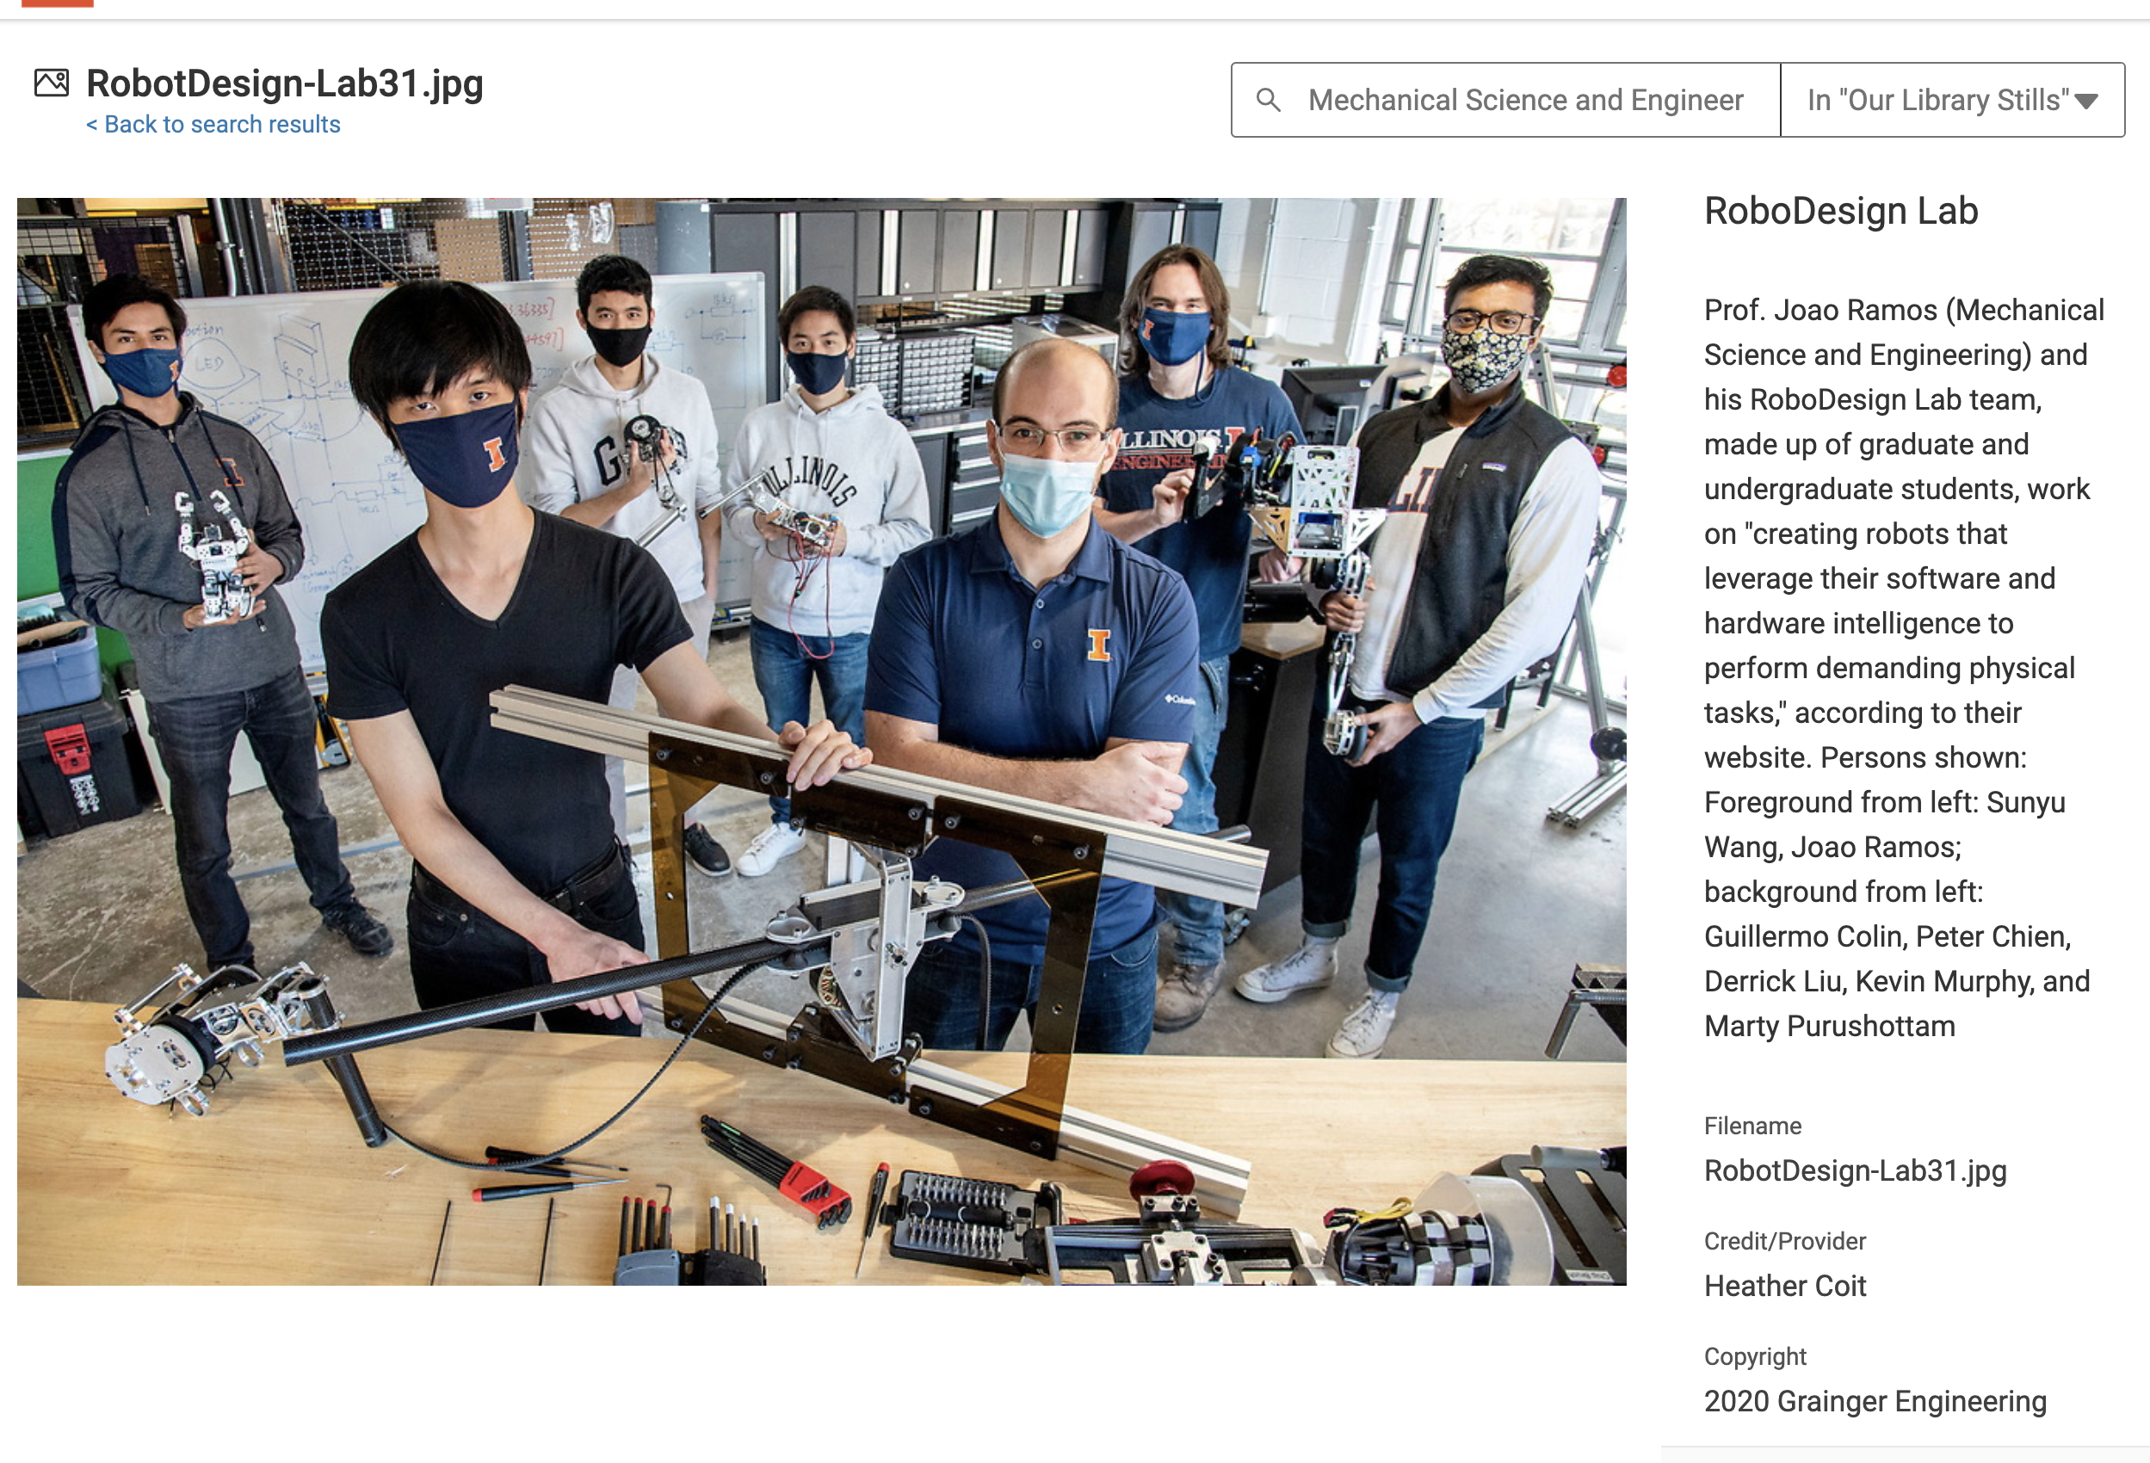
Search options
All images that contain the words Mechanical Science and Engineering and graduates in the database’s metadata will show up here.
Click on a particular image and searchable words, part of metadata, will accompany the image.
GRAINGER ENGINEERING

Slide 7
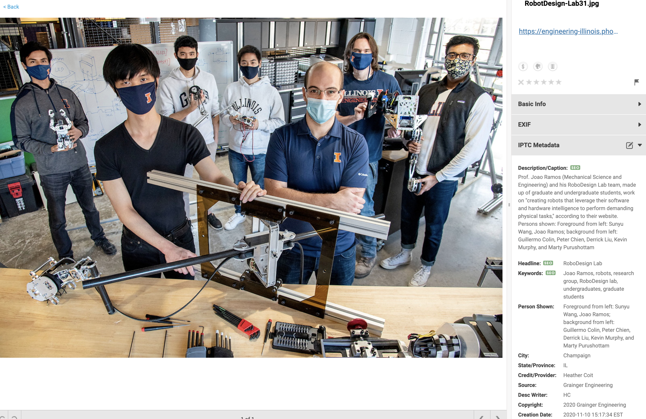
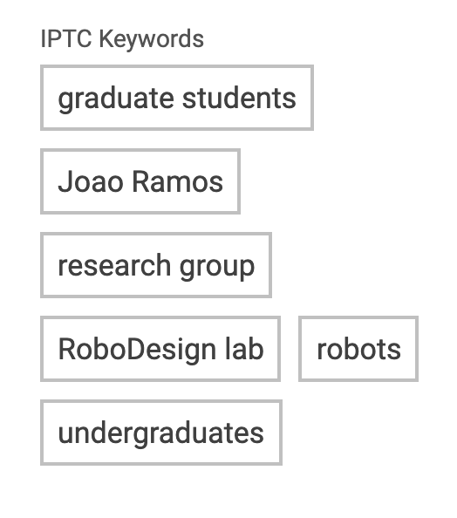
Metadata
Scroll to the bottom of the metadata associated with your photo, and you’ll find its related keywords.
Our metadata includes fields like Description/Caption, Headline, Keywords, City, State, Credit, Source, and Copyright. Any words found in these fields make content more searchable to you.
GRAINGER ENGINEERING

Slide 8
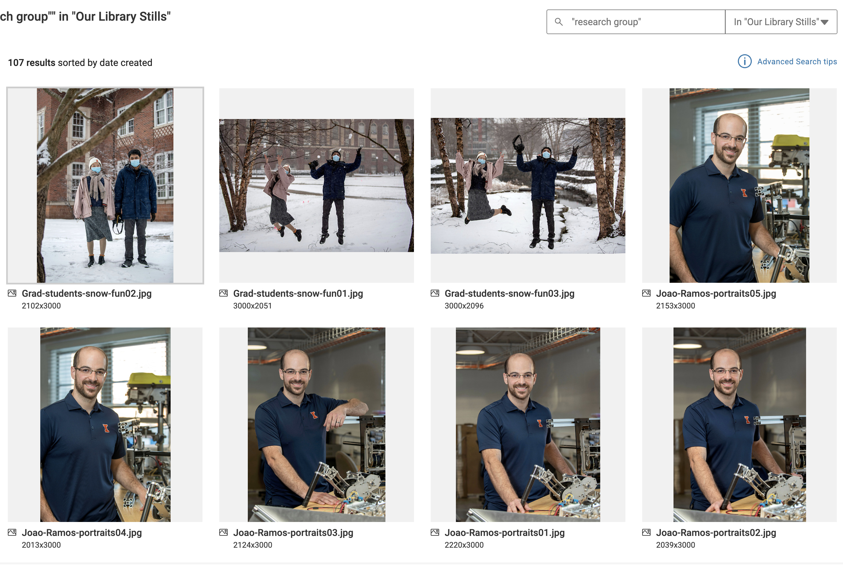
Keywords
You can click on a word, like research group, which leads you to all images that include that word. You can always modify the search so that the word is included in content, like Video.
GRAINGER ENGINEERING
IMAGE / GAPHIC
IMAGE / GRAPHIC

Slide 9
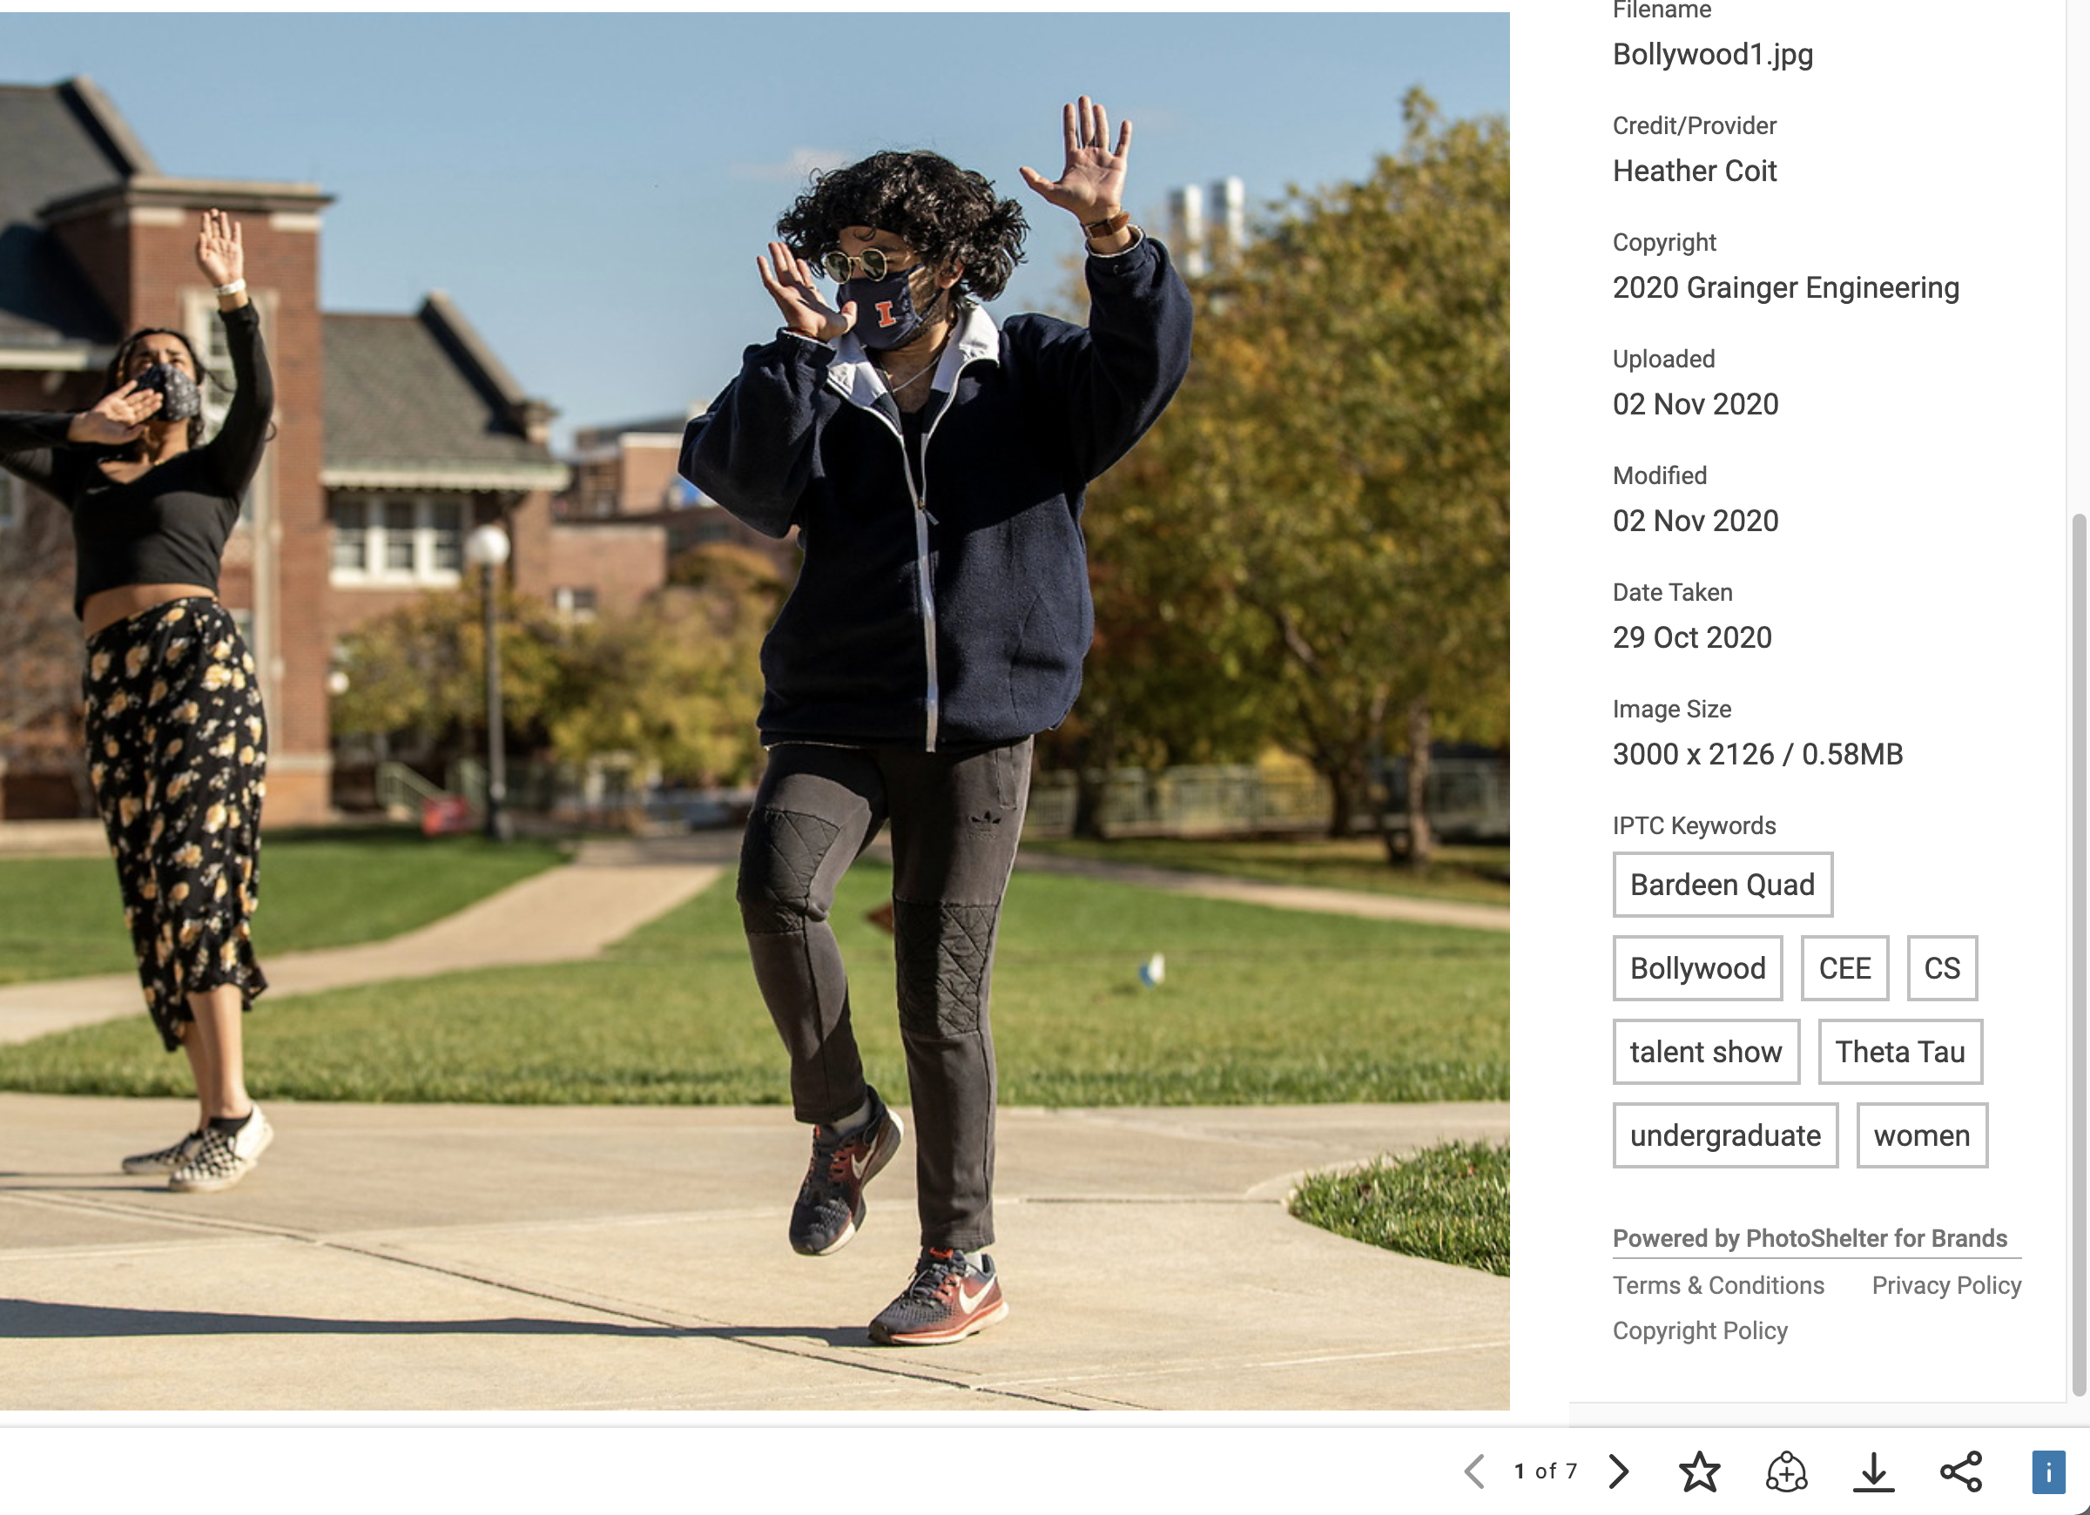
Chosen content
Those icons on the bottom right area
of the image have a function.
For lightbox, which we don’t use
To add image to Workspaces
To download the image
To share the link in an email
GRAINGER ENGINEERING

Slide 10
PhotoShelter’s Workspaces
Workspaces allows users to view, share, comment, and download photo or video content from direct user uploads; all in one place — without ever leaving PhotoShelter.
For Marcom Library Staff, this space allows for collaboration on projects, like Limitless Magazine.
For Invited Users, like Department Communicators, content is shared by uploading it to an assigned Workspaces folder. Communicators can add captions to the comments section. Anyone who has access to that folder can leave their own feedback in the comments section, as well.
To access Workspaces, log in to your PhotoShelter account.

Slide 11
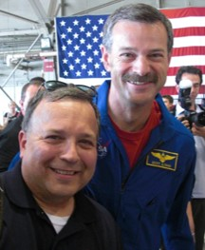
Content we’d love to see from you
Images suited for publication on our website or social posts - of your department’s faculty, students, and alumni, research groups, lab spaces, building renovations, events, timely subjects, etc.
Video content can include completed videos or b-roll clips with the above list in mind.
Be sure you have permission to share any content that you did not photograph or record yourselves.

Slide 12
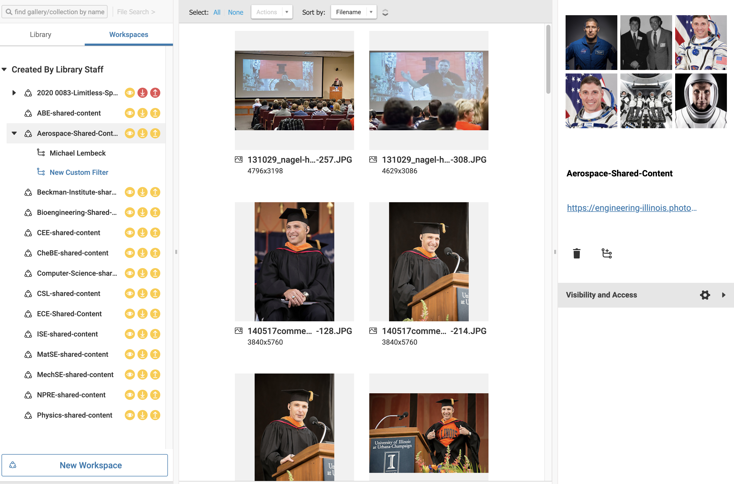
Workspaces as a collaborative tool
Communicators have their own assigned Workspaces folder. Contact hcc@Illinois.edu if you need an invite to your folder or need one added to this list.
GRAINGER ENGINEERING

Slide 13
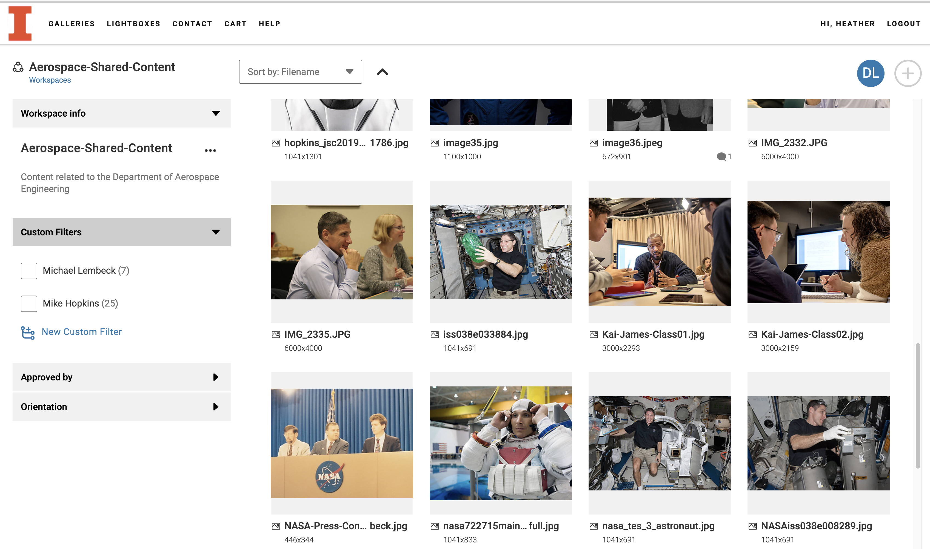
Workspaces
Here is an example of content Debra Larson uploaded to her Aerospace-Shared-Content Workspaces folder. Two Custom Filters, which act as subfolders, were created to better organize the volume of Mike Hopkins and Michael Lembeck photos.
GRAINGER ENGINEERING

Slide 14
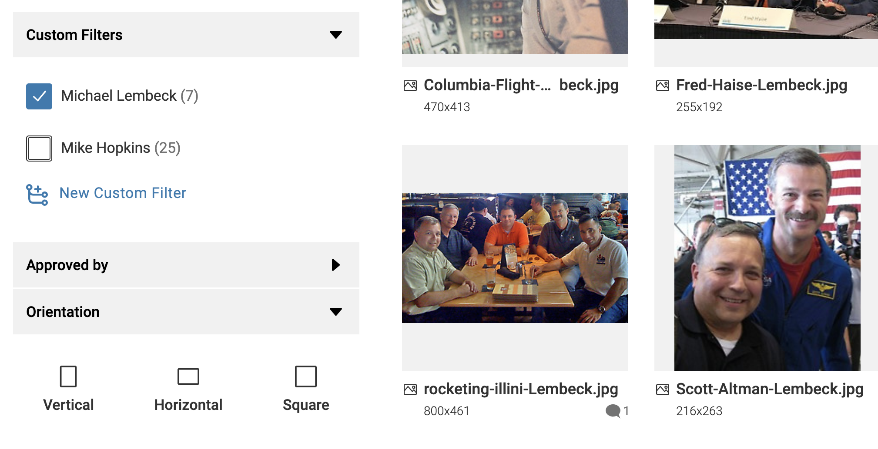
Workspaces
A helpful feature is File Info and Comments, which allows communicators to add image information. The comments bubble below the rocketing-illini-Lembeck image indicates a comment was entered.
GRAINGER ENGINEERING

Slide 15
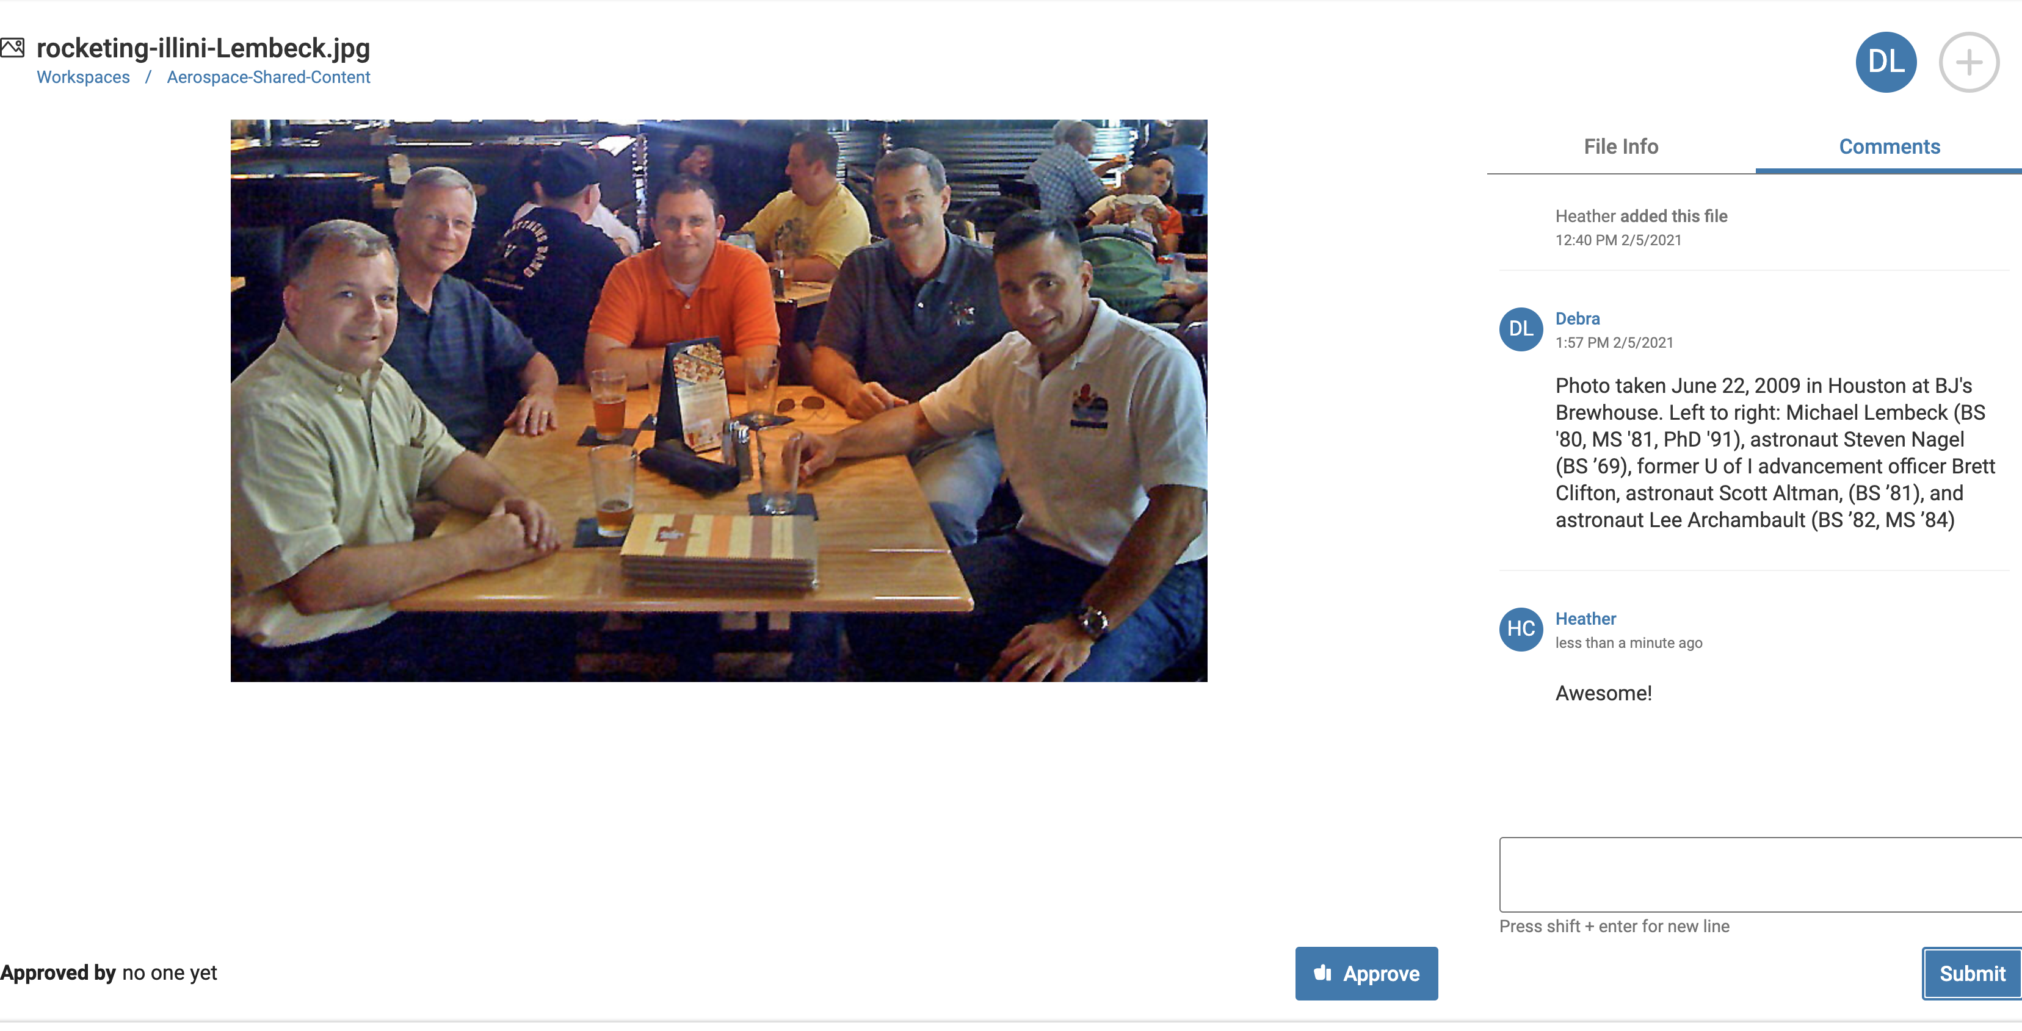
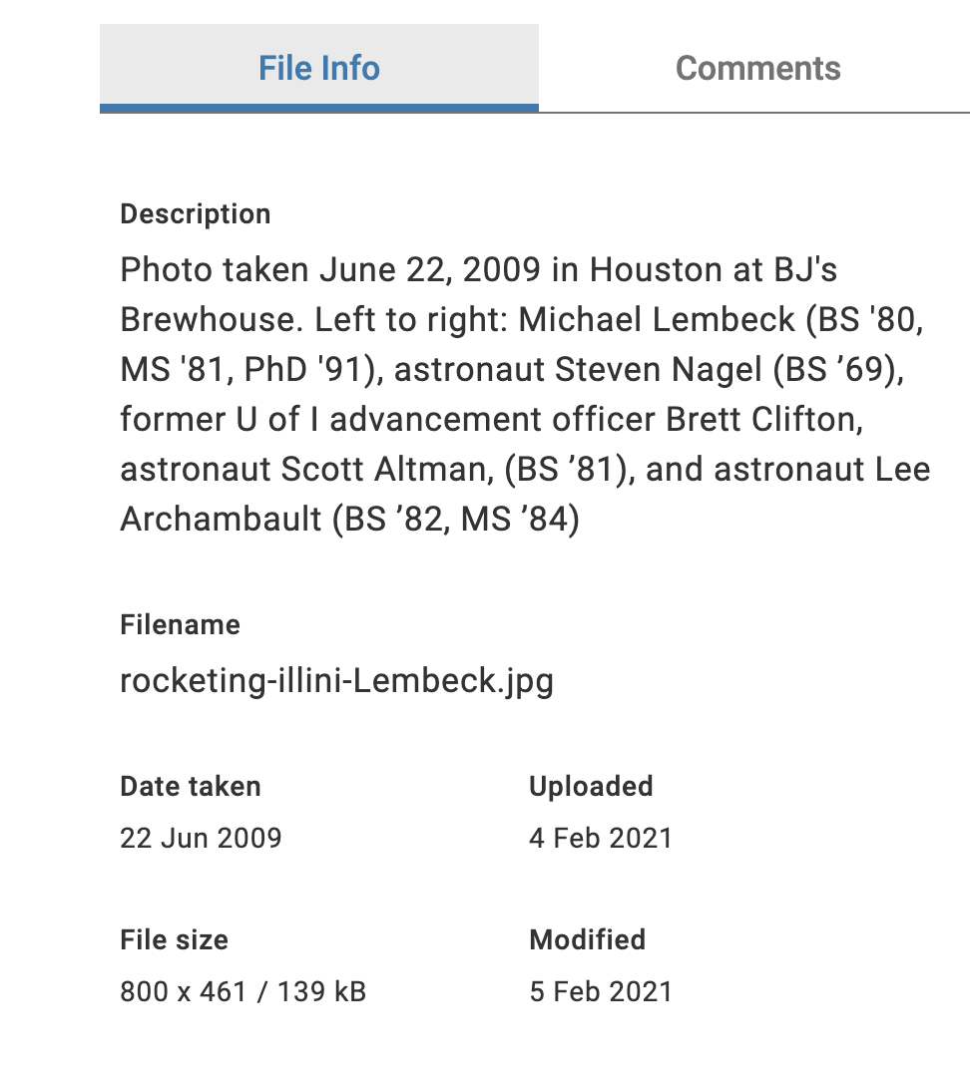
Workspaces
After clicking on the image, you can see Debra left caption information in Comments, to which I responded. This information will accompany the photo when it’s moved to Our Library Stills for storage - and for sharing with those who have access to the folder in which it’s housed.
GRAINGER ENGINEERING

Slide 16
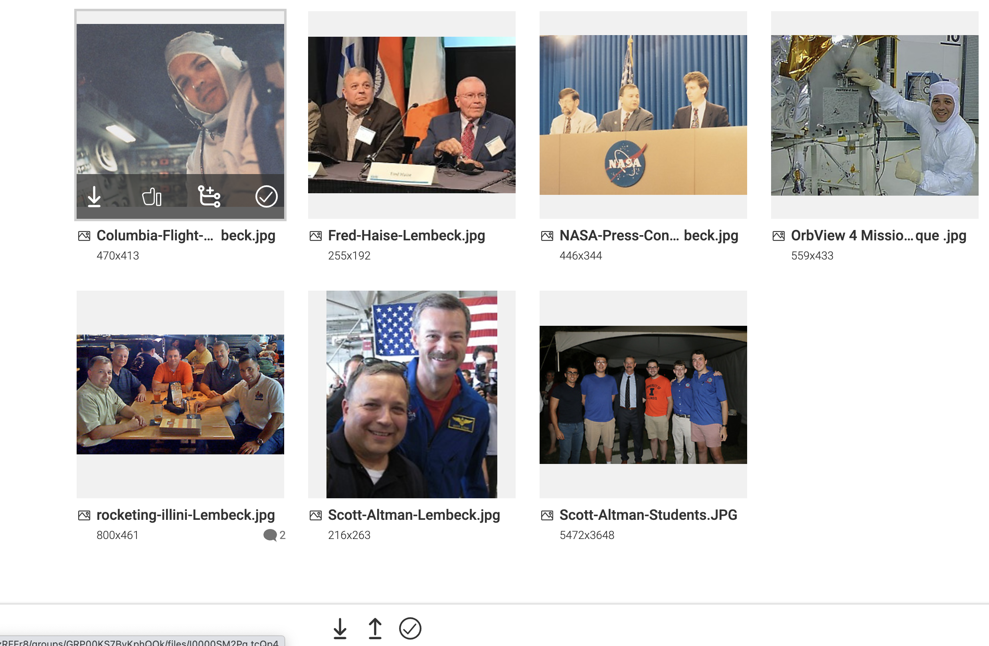
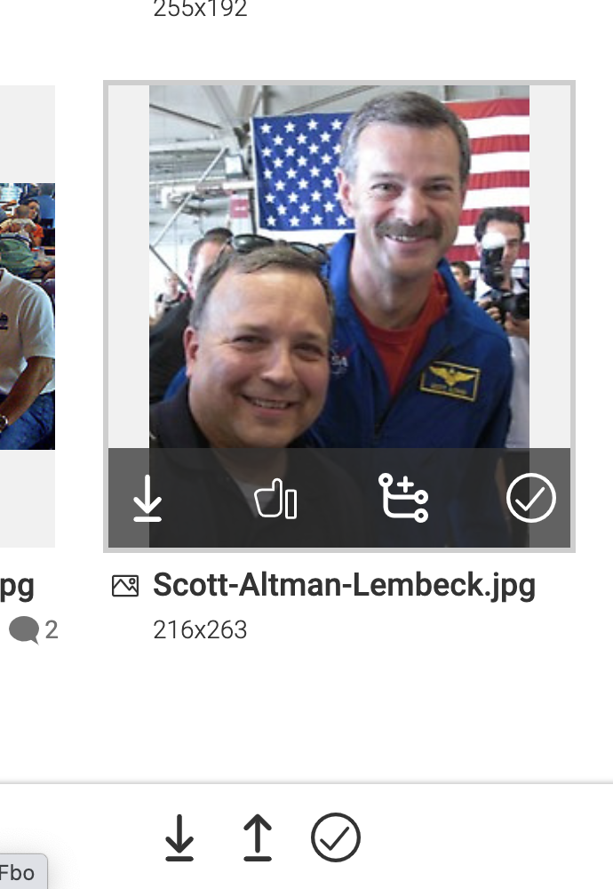
Upload/Download
Fairly self explanatory, but the up arrow at the bottom of the folder allows for uploads, down arrow for downloads, and the circled check mark, when clicked on, allows for batch selection of photos. You can delete images from here or give them a thumbs up for approval.
GRAINGER ENGINEERING

Slide 17
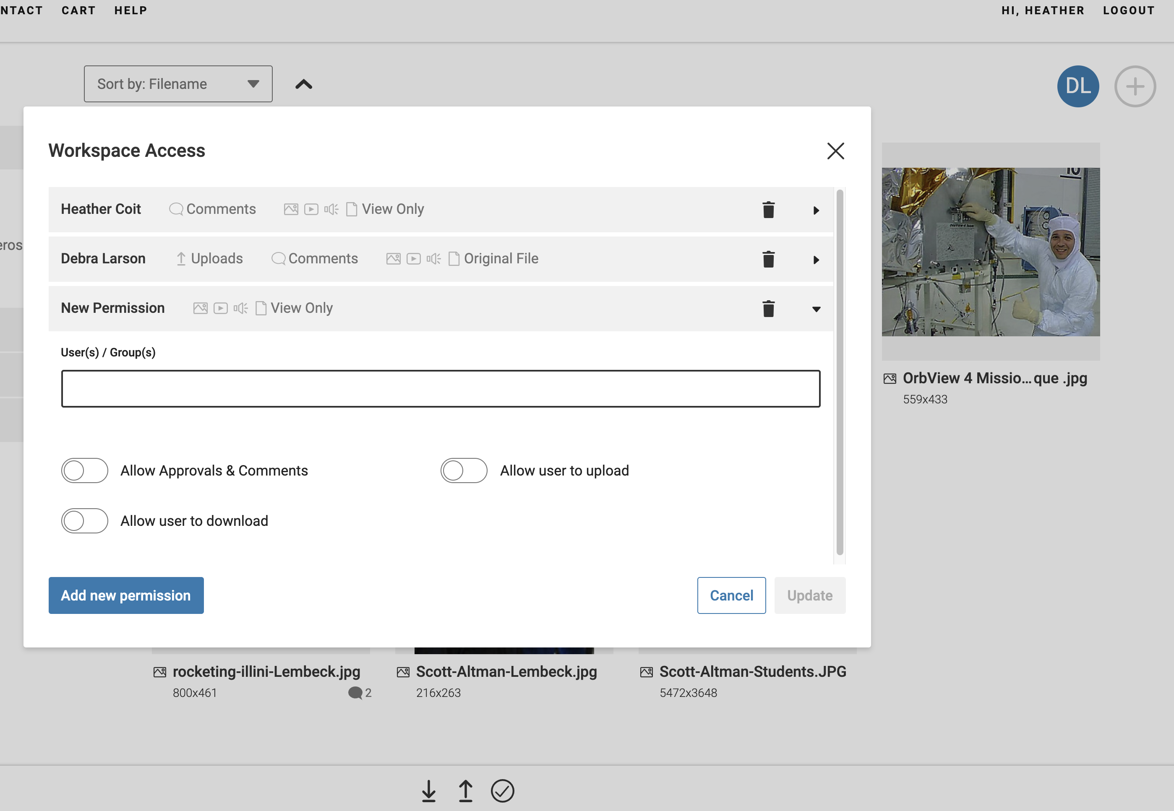
Workspace access permissions
If a communicator wants to invite someone from their department to the Workspaces folder, they may do so and set permissions here. Clicking on the plus icon, seen next to the communicator’s initials at upper right, opens the Workspace Access window.
GRAINGER ENGINEERING

Slide 18
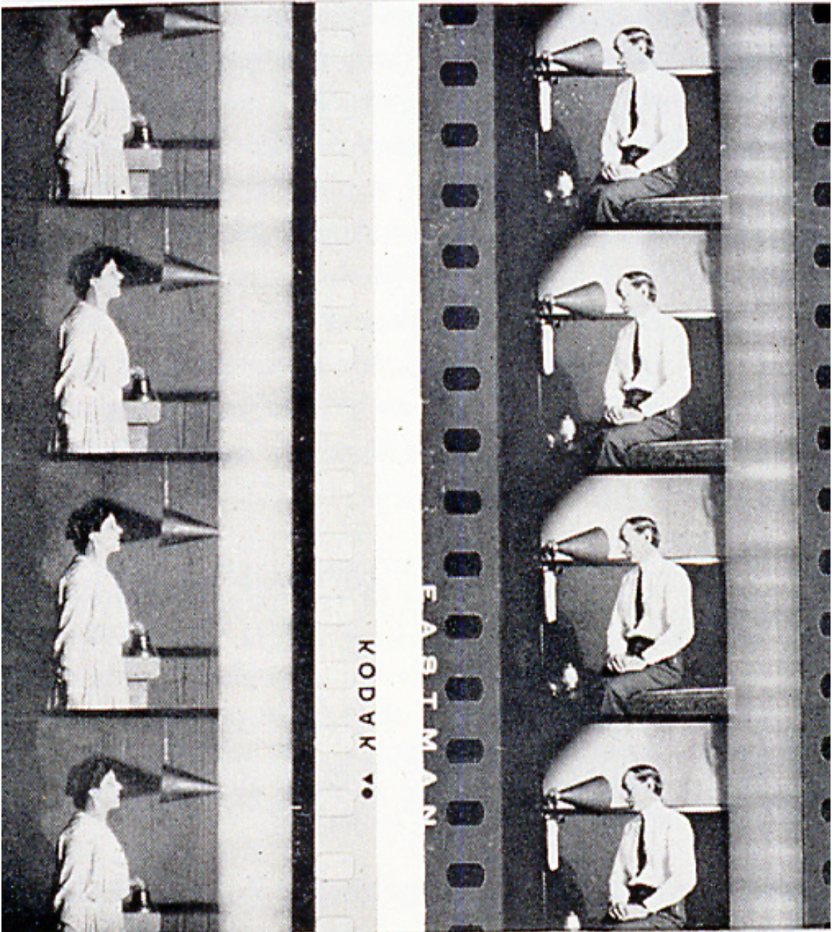
Archives
Inside PhotoShelter, we have a huge volume of engineering-related photos which span decades. We acquired these photos after an IT campus server was discontinued.
We would like your help in identifying any of these images that lack captions by using Workspaces. You might also know faculty or alumni, who would benefit from having these images – and you may share with them.

Slide 19
Help us caption these photos
These photos are yours to access, share, and store; many are also in need of captions, which is where you can help us. If you want to add a caption, simply click on the Workspaces add icon from the lower right.
You can add it to the Archives Workspaces folder and go into Comments to add info.
GRAINGER ENGINEERING

Slide 20
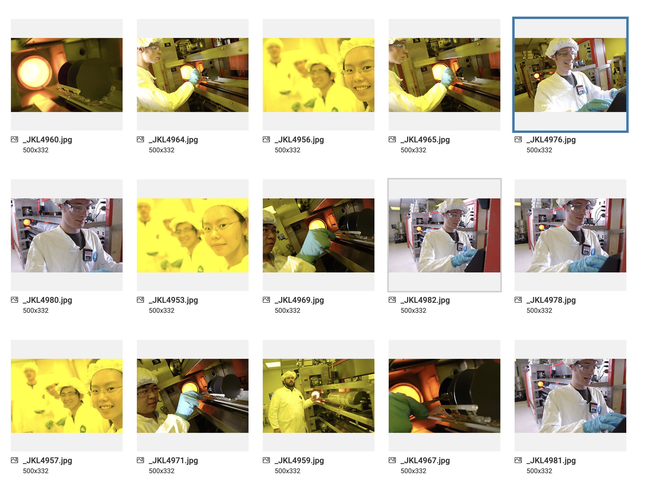
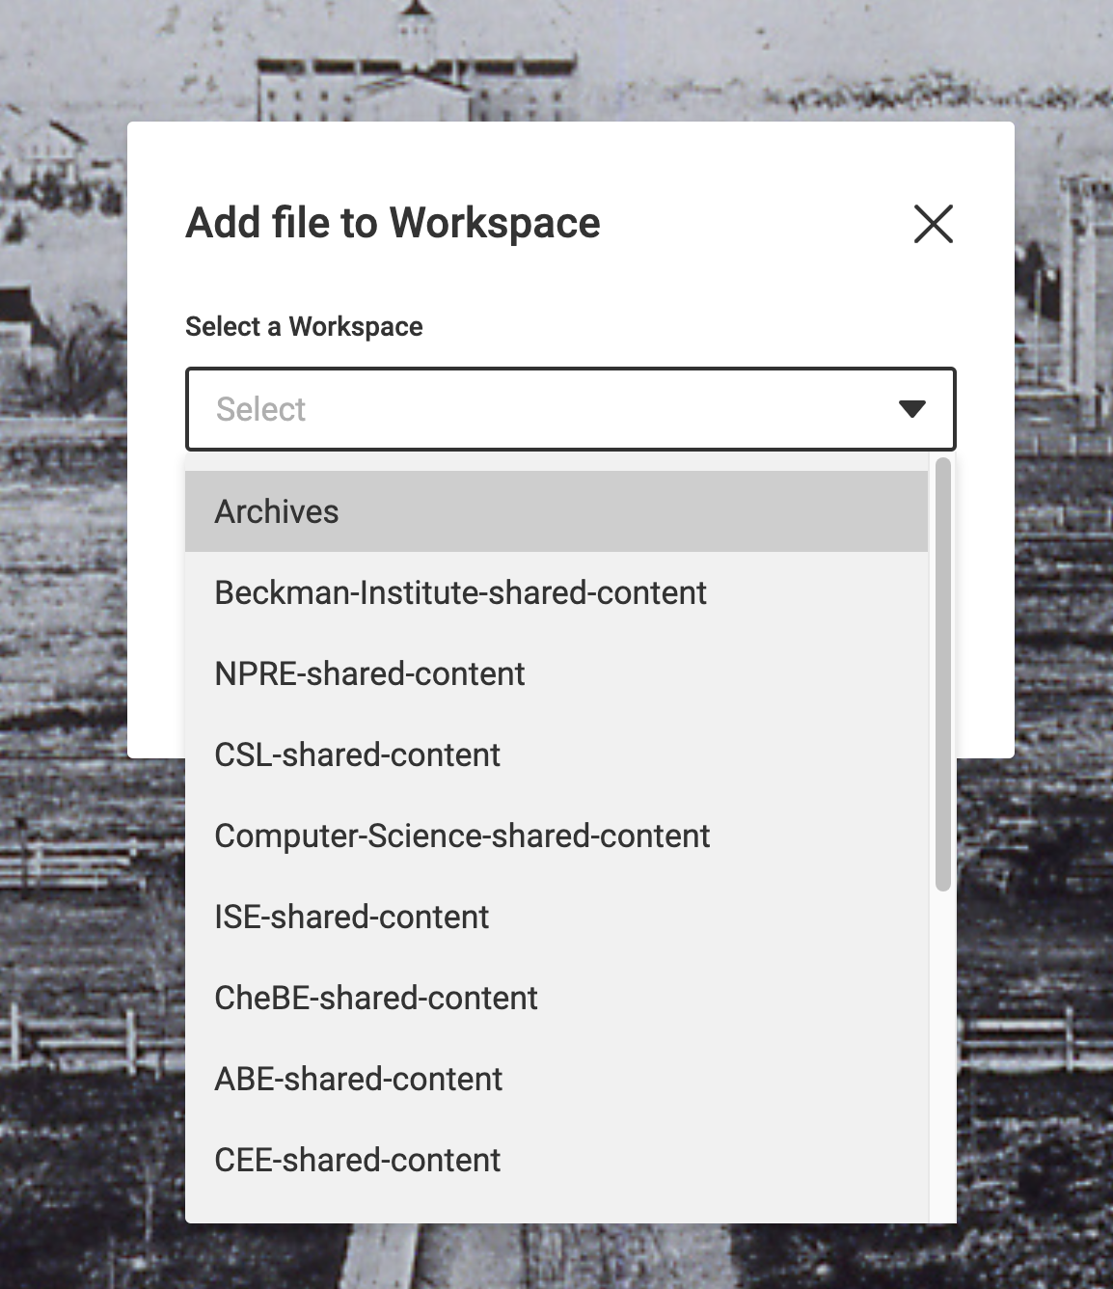
Archives
GRAINGER ENGINEERING

Slide 21
If you have any questions about PhotoShelter or any of its features, don’t hesitate to contact me: hcc@Illinois.edu
We look forward to sharing content with you!

