Slide 1
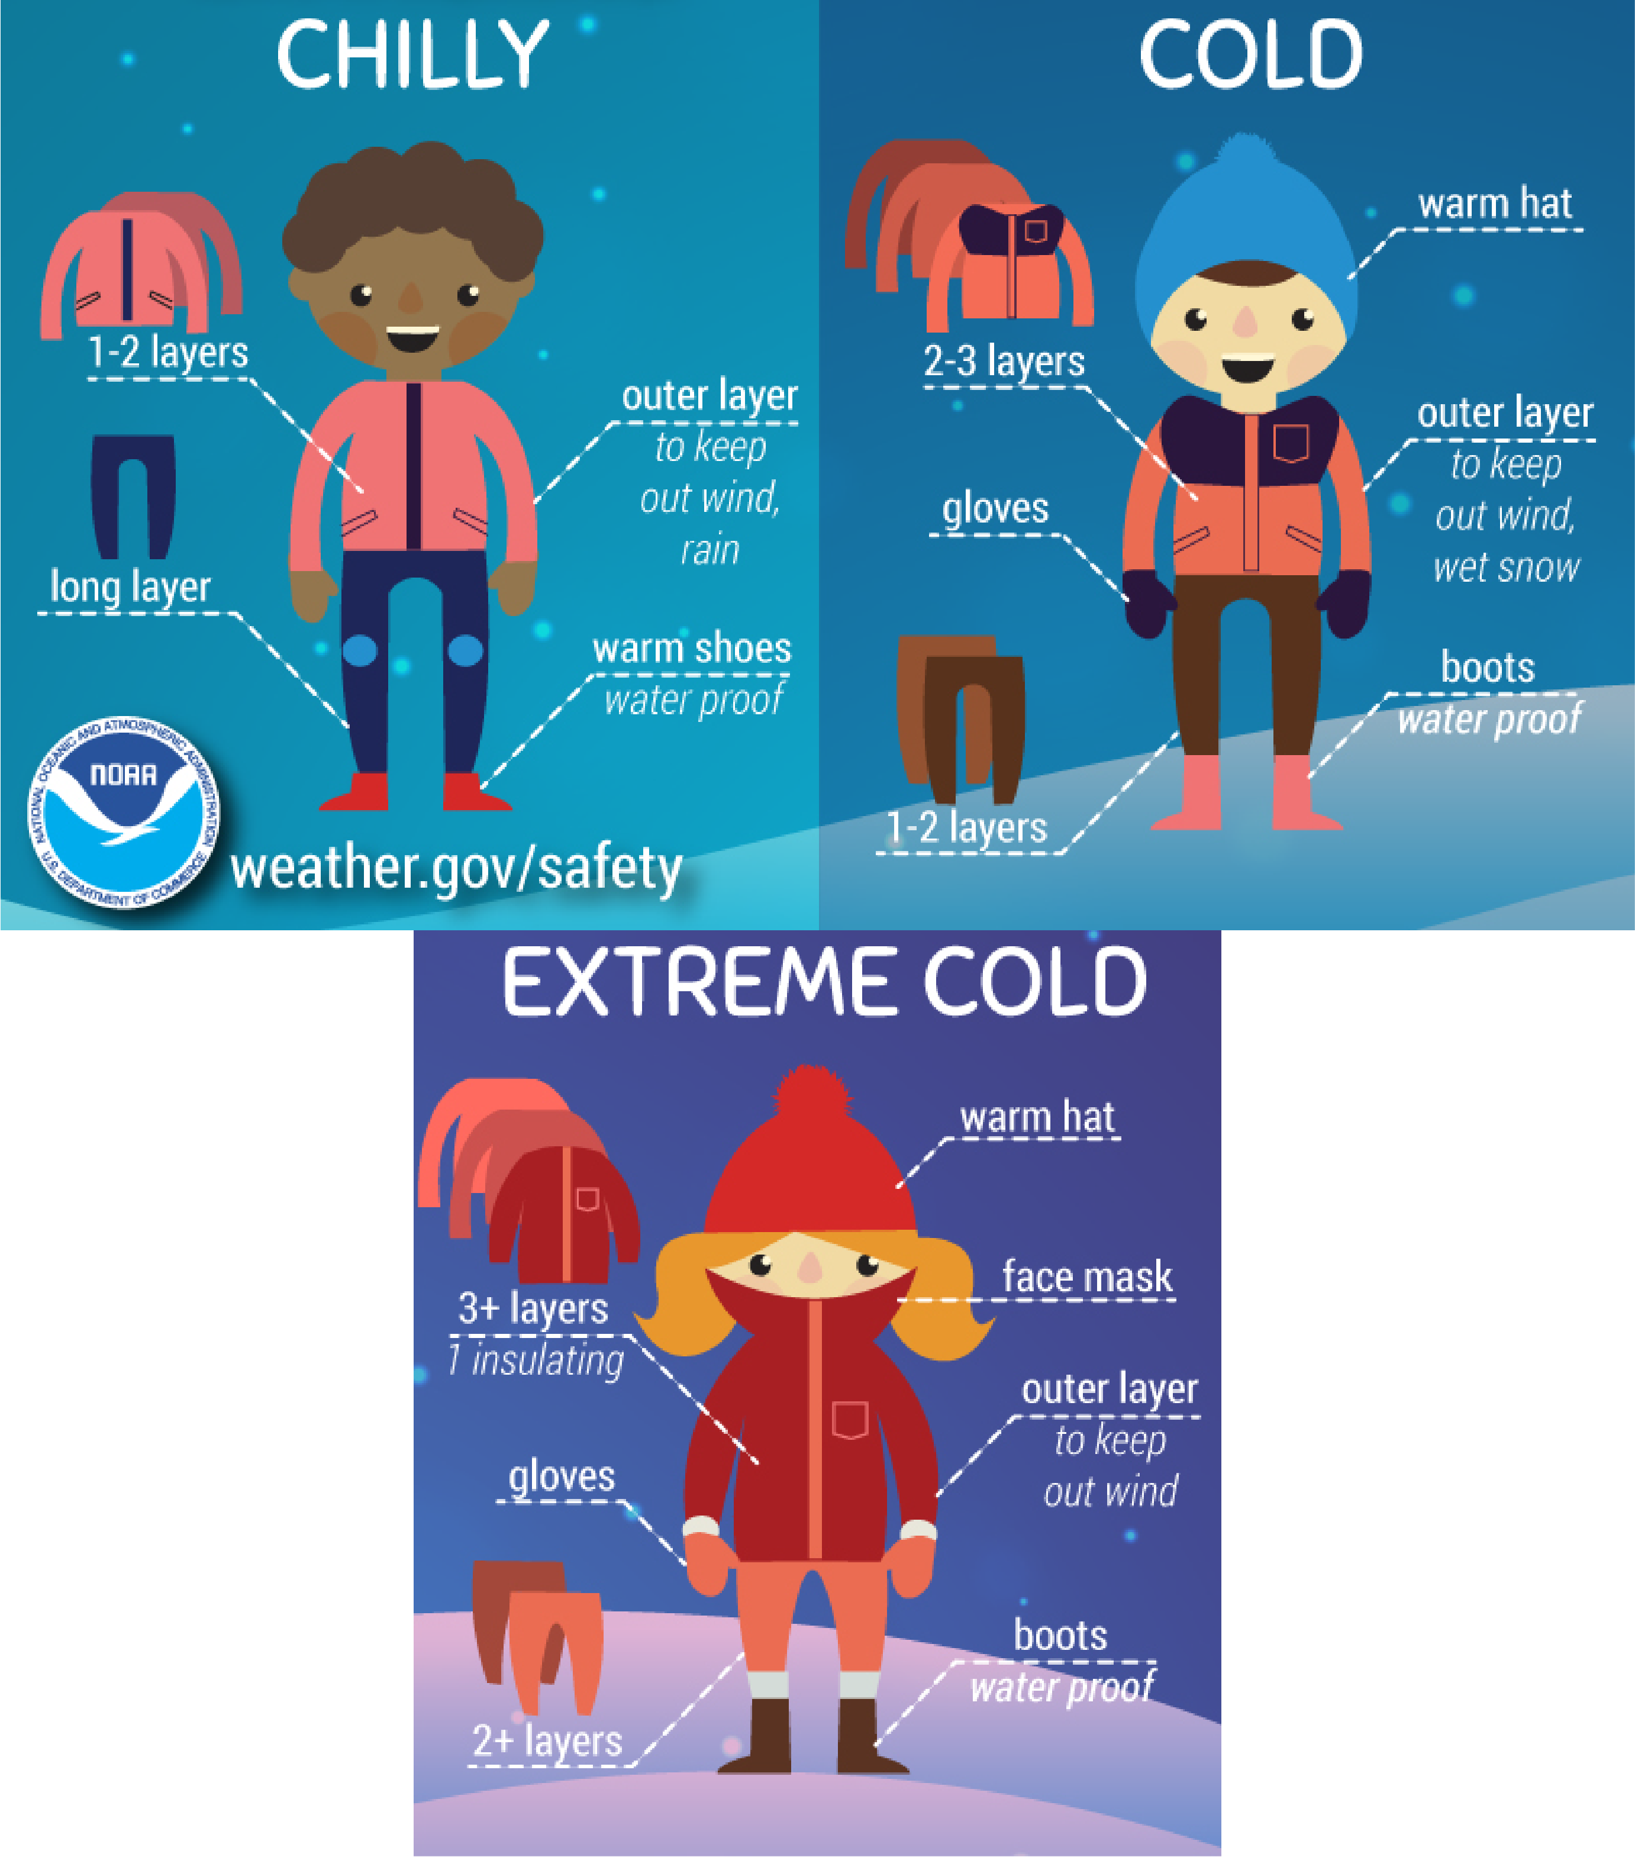
Minute for Safety -
Winter Weather
Preparing for Winter
On average, Illinois experiences five severe winter storms each year. (IEMA)
Be familiar with winter weather terms. (see IEMA guide)
Adding layers helps you keep warm
Winter Weather Risks
Winter weather risks include vehicle crashes, fires from improper use of heaters, overexertion, and exposure (cold stress).
Workers exposed to cold temperatures and wind chill are at risk of cold stress. Example health risks of cold stress are hypothermia and frostbite.
Winter driving conditions contribute to an average of nearly 29,000 vehicle crashes, more than 4,500 injuries and 80 fatalities in Illinois each year. (IEMA)
Additional resources:
Cold Stress – DRS Library
Winter Weather Preparedness Guide – Illinois Emergency Management Agency (IEMA)
Winter Dress Infographic – NOAA
ISE / OFFICE OF SAFETY
GRAINGER ENGINEERING
Notes:
Immediately report accident/incident to supervisor
Promptly seek medical care as needed
Thoroughly complete and sign the First Report of Injury/Illness

