Slide 1
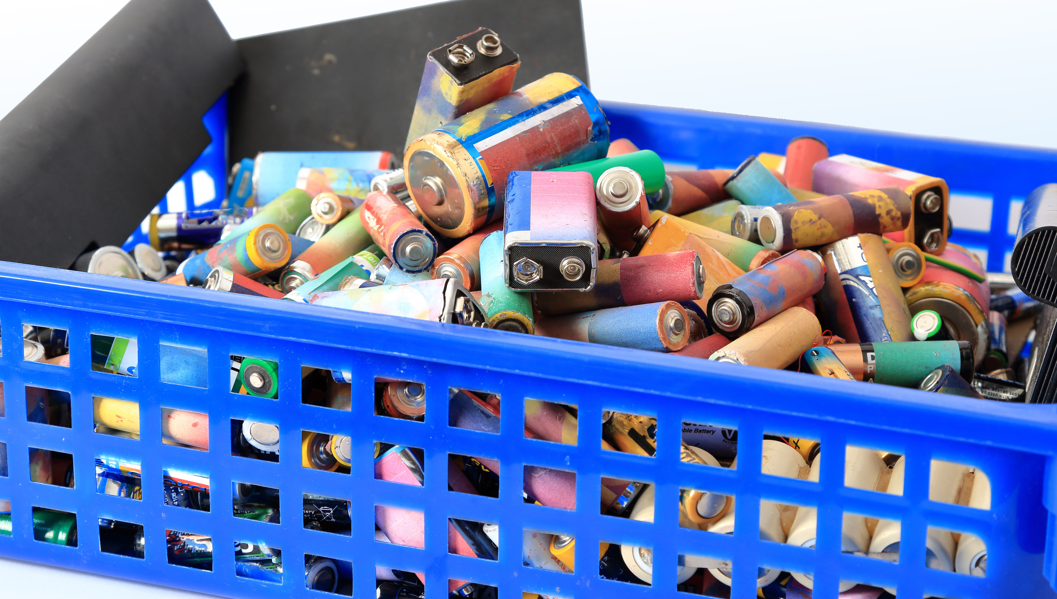
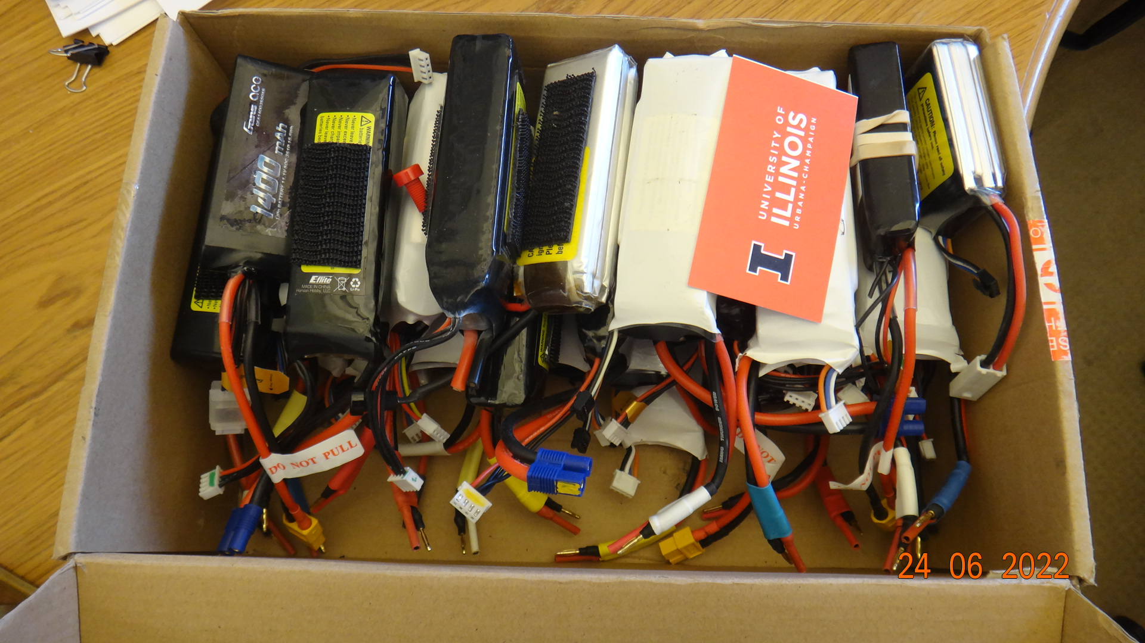
Minute for Safety –
Battery Disposal
Collecting Batteries
Only battery waste generated on campus should be collected.
Separate batteries by type (e.g., alkaline, lithium-ion (Li-Ion), lithium polymer (Li-Po))
Use tape to cover terminals of 9V and lithium metal batteries
Disposing Batteries
Use DRS Waste Management App to request pickup of unwanted batteries. DRS will recycle batteries whenever possible
Additional resources:
Battery Safety – DRS Library
Requesting a Waste Pick-up – DRS Library
ISE / OFFICE OF SAFETY
GRAINGER ENGINEERING
Notes:
Immediately report accident/incident to supervisor
Promptly seek medical care as needed
Thoroughly complete and sign the First Report of Injury/Illness

