Slide 1
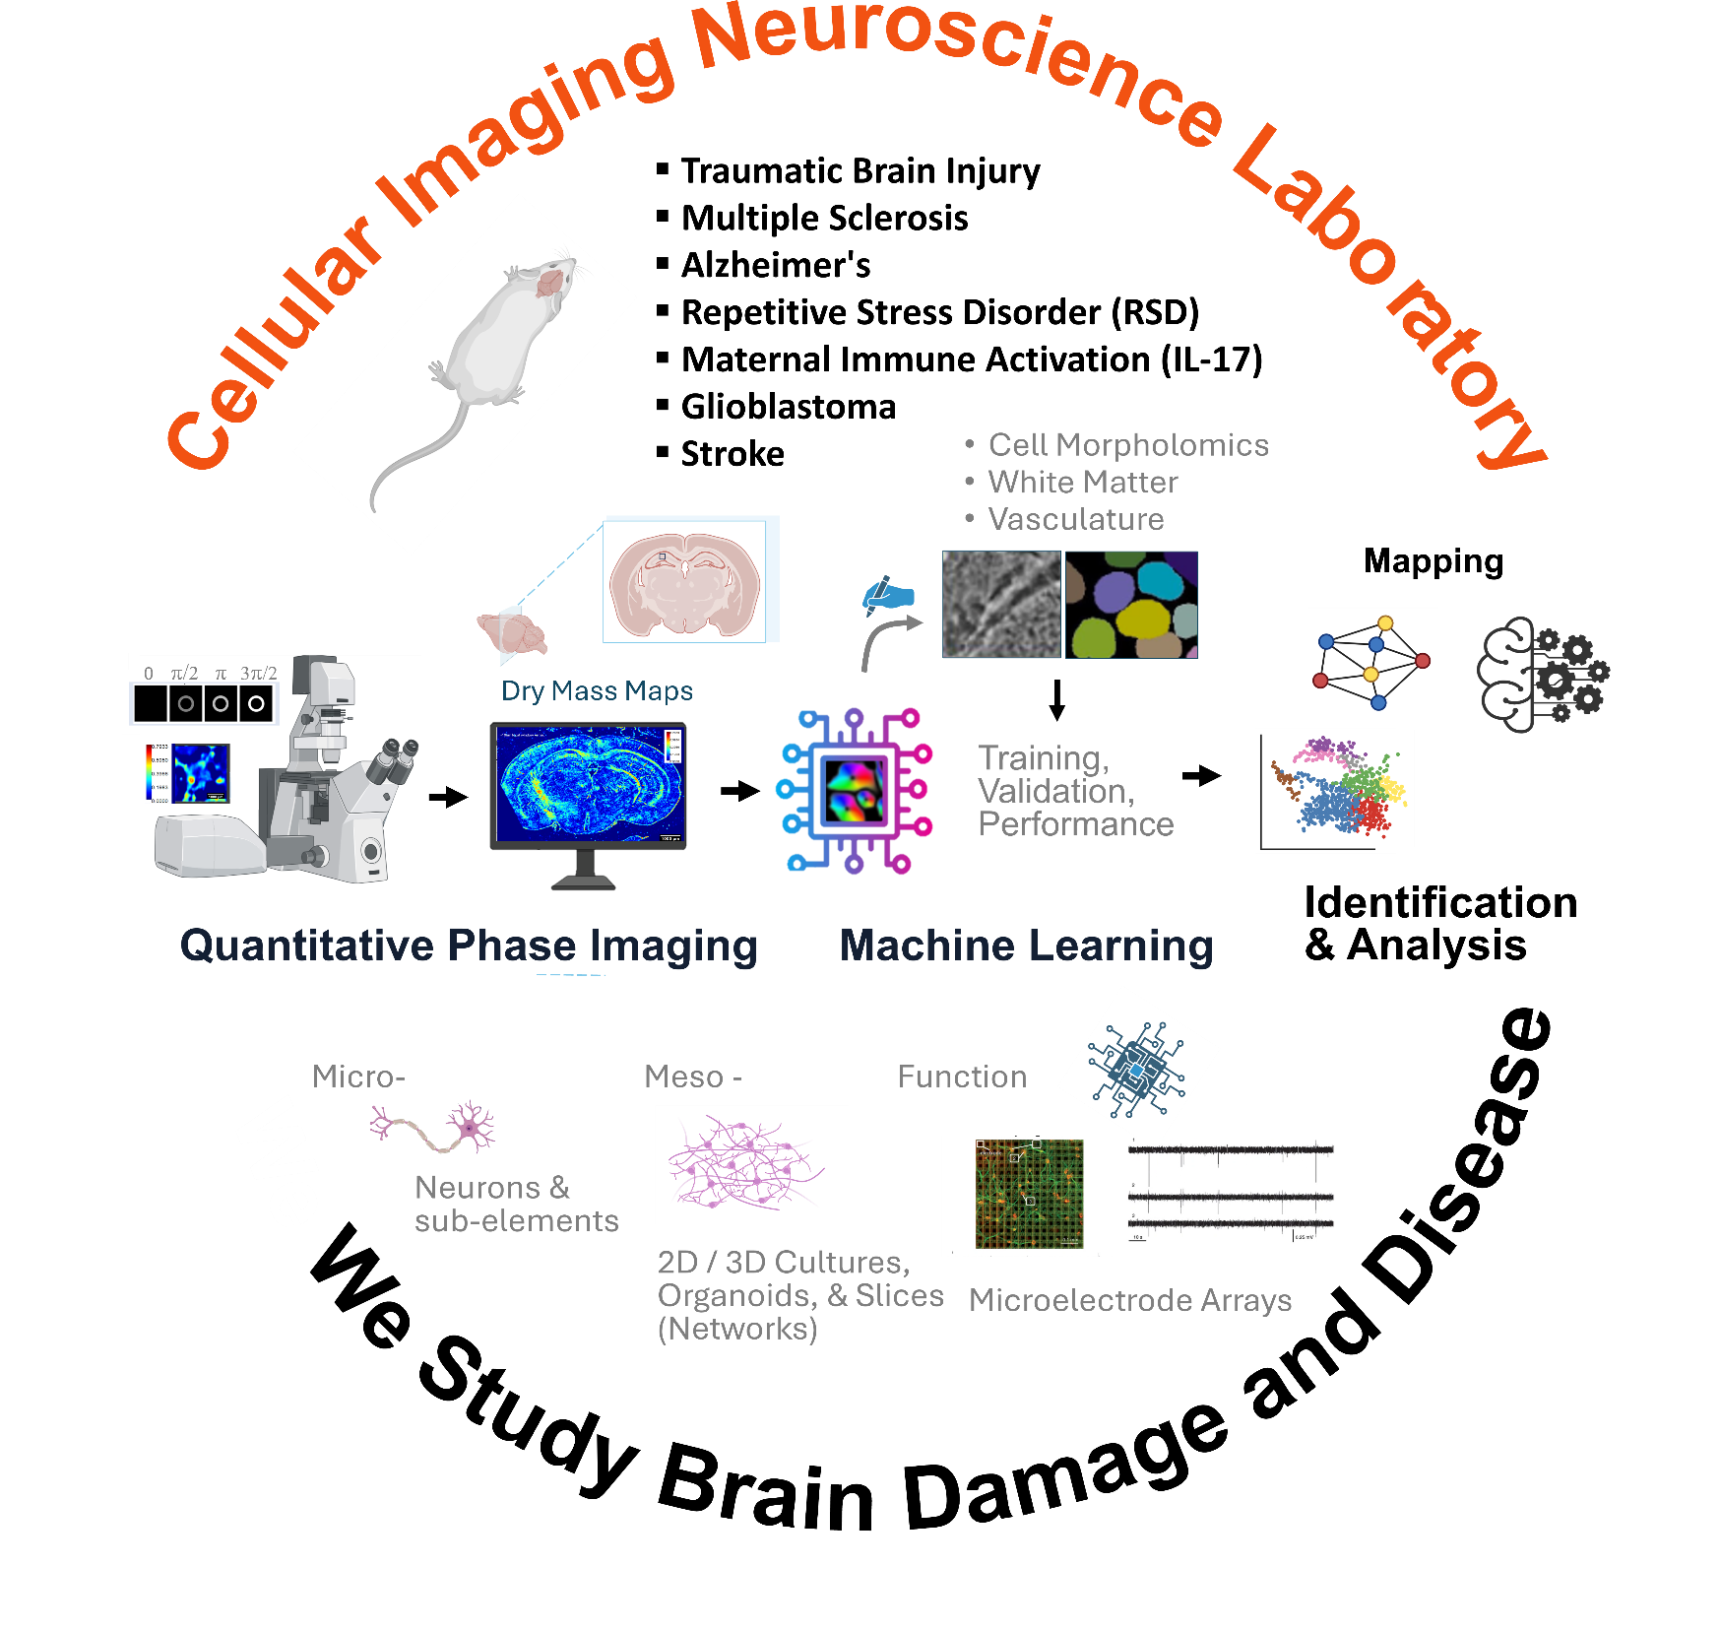
Current Projects
Quantitative Phase Imaging of Neurological Disorders and Trauma
Machine Learning Accelerated Brain Quantitative Phase Imaging Analysis
Keywords
Spatial Light Interference Microscopy (SLIM)
Glioblastoma, Traumatic Brain Injury, Multiple sclerosis, Alzheimer's Disease, Cerebral Palsy,
Neural Engineering
Catherine Best-Popescu
Assistant Research Professor
Bioengineering
Beckman Institute for Advanced Sciences
405 North Mathews Avenue, Room 2055
Urbana, IL 61801
Email: Cabest@illinois.edu

