Slide 1
Cancer Nanotechnology
Spring 2019
BIOE 479 / 598
Instructor: Prof. Shuming Nie
Cancer Biology and Clinical Oncology
With Special Thanks to Professor Andrew Smith
University of Illinois at Urbana-Champaign
Department of Bioengineering
Notes:
What are QDs and what are they used for
Nanocrystals composed of semiconductors
Fluorescent
2. Nie group first of 2
3. Used throughout biology in situations where dyes and proteins have been used
3. Major advantage for molecular scale imaging dynamic
Main benefit: single molecule imaging in cells
Top-down vs bottom up

Slide 2
Notes:
2
Cancer accounts for nearly one-quarter of deaths in the United States, exceeded only by heart diseases. In 2007, there were 562,875 cancer deaths in the US.

Slide 3
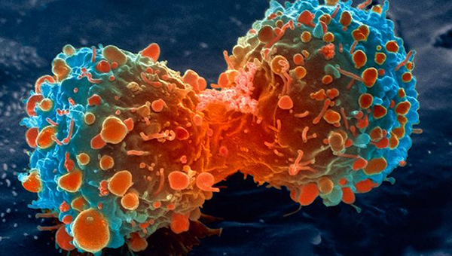
What is cancer?
Cancer is a group of diseases involving abnormal cell growth with the potential to invade or spread to other parts of the body. These contrast with benign tumors, which do not spread to other parts of the body

Slide 4
What does cancer look like?
Colorectal carcinoma
Lung squamous-cell
carcinoma
Ductal carcinoma (breast)

Slide 5
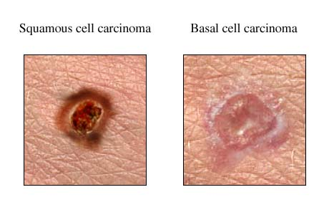
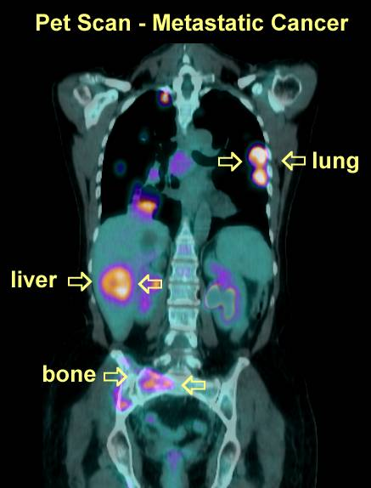
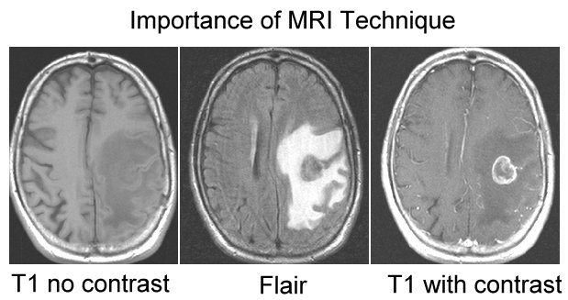
What does cancer look like?

Slide 6
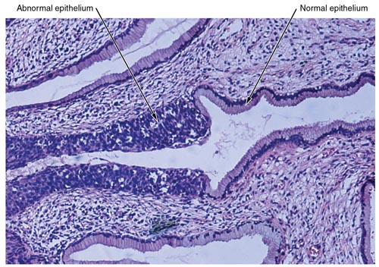
What does cancer look like?

Slide 7
Cancer Terminology
Neoplasia- “new” growth
Benign- Localized and non-invasive
Malignant- invasive with capacity to spread
Lymphatic and/or vascular
Primary tumor- original cancer
Metastases- tumor clones that have the capacity to spread and survive to distant foreign tissues

Slide 8
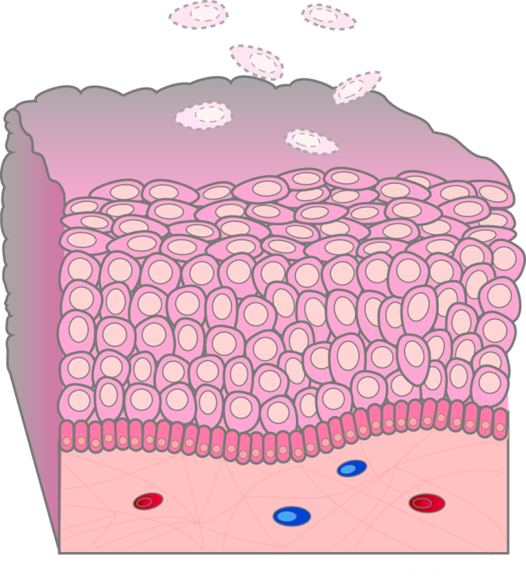
Example of Normal Growth
Dead cells shed from outer surface
Epidermis
Cell migration
Dividing cells in basal layer
Dermis
Notes:
National Cancer Institute
Understanding Cancer and Related Topics
Understanding Cancer
NCI Web site: http://cancer.gov/cancertopics/understandingcancer
8
To illustrate what is meant by normal growth control, consider the skin. The thin outermost layer of normal skin, called the epidermis, is roughly a dozen cells thick. Cells in the bottom row of this layer, called the basal layer, divide just fast enough to replenish cells that are continually being shed from the surface of the skin. Each time one of these basal cells divides, it produces two cells. One remains in the basal layer and retains the capacity to divide. The other migrates out of the basal layer and loses the capacity to divide. The number of dividing cells in the basal layer, therefore, stays the same.
In babies, 100% of bone turns over per year
In adults, 18% of bone turns over per year
Remodeling essential for bone strength and adaptation to changes in weight bearing
Turnover of GI epithelium in mouse one day in stomach & colon. Duodenum 2.5 days to migrate from crypts to villi tips.

Slide 9
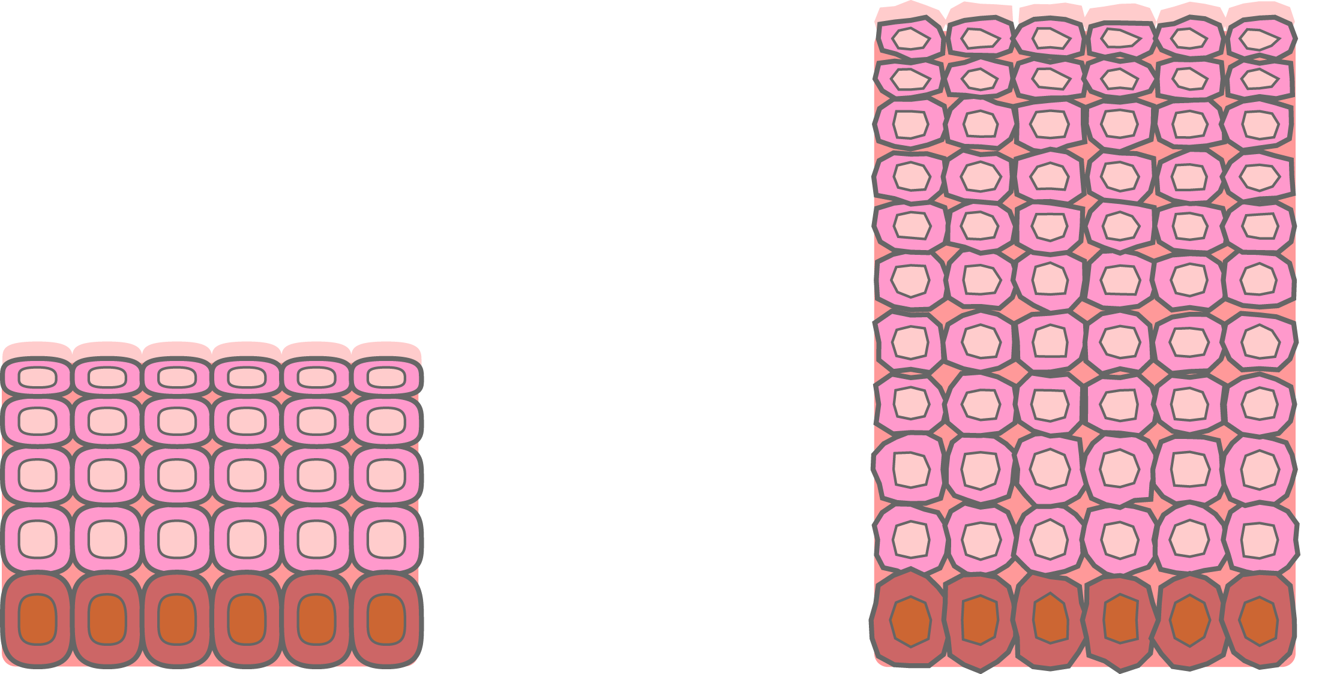
Hyperplasia
Normal
Hyperplasia
Notes:
National Cancer Institute
Understanding Cancer and Related Topics
Understanding Cancer
NCI Web site: http://cancer.gov/cancertopics/understandingcancer
9
Instead of finding a benign or malignant tumor, microscopic examination of a biopsy specimen will sometimes detect a condition called “hyperplasia.” Hyperplasia refers to tissue growth based on an excessive rate of cell division, leading to a larger than usual number of cells. Nonetheless, cell structure and the orderly arrangement of cells within the tissue remain normal, and the process of hyperplasia is potentially reversible. Hyperplasia can be a normal tissue response to an irritating stimulus. An example of hyperplasia is a callus that may form on your hand when you first learn to swing a tennis racket or a golf club.

Slide 10
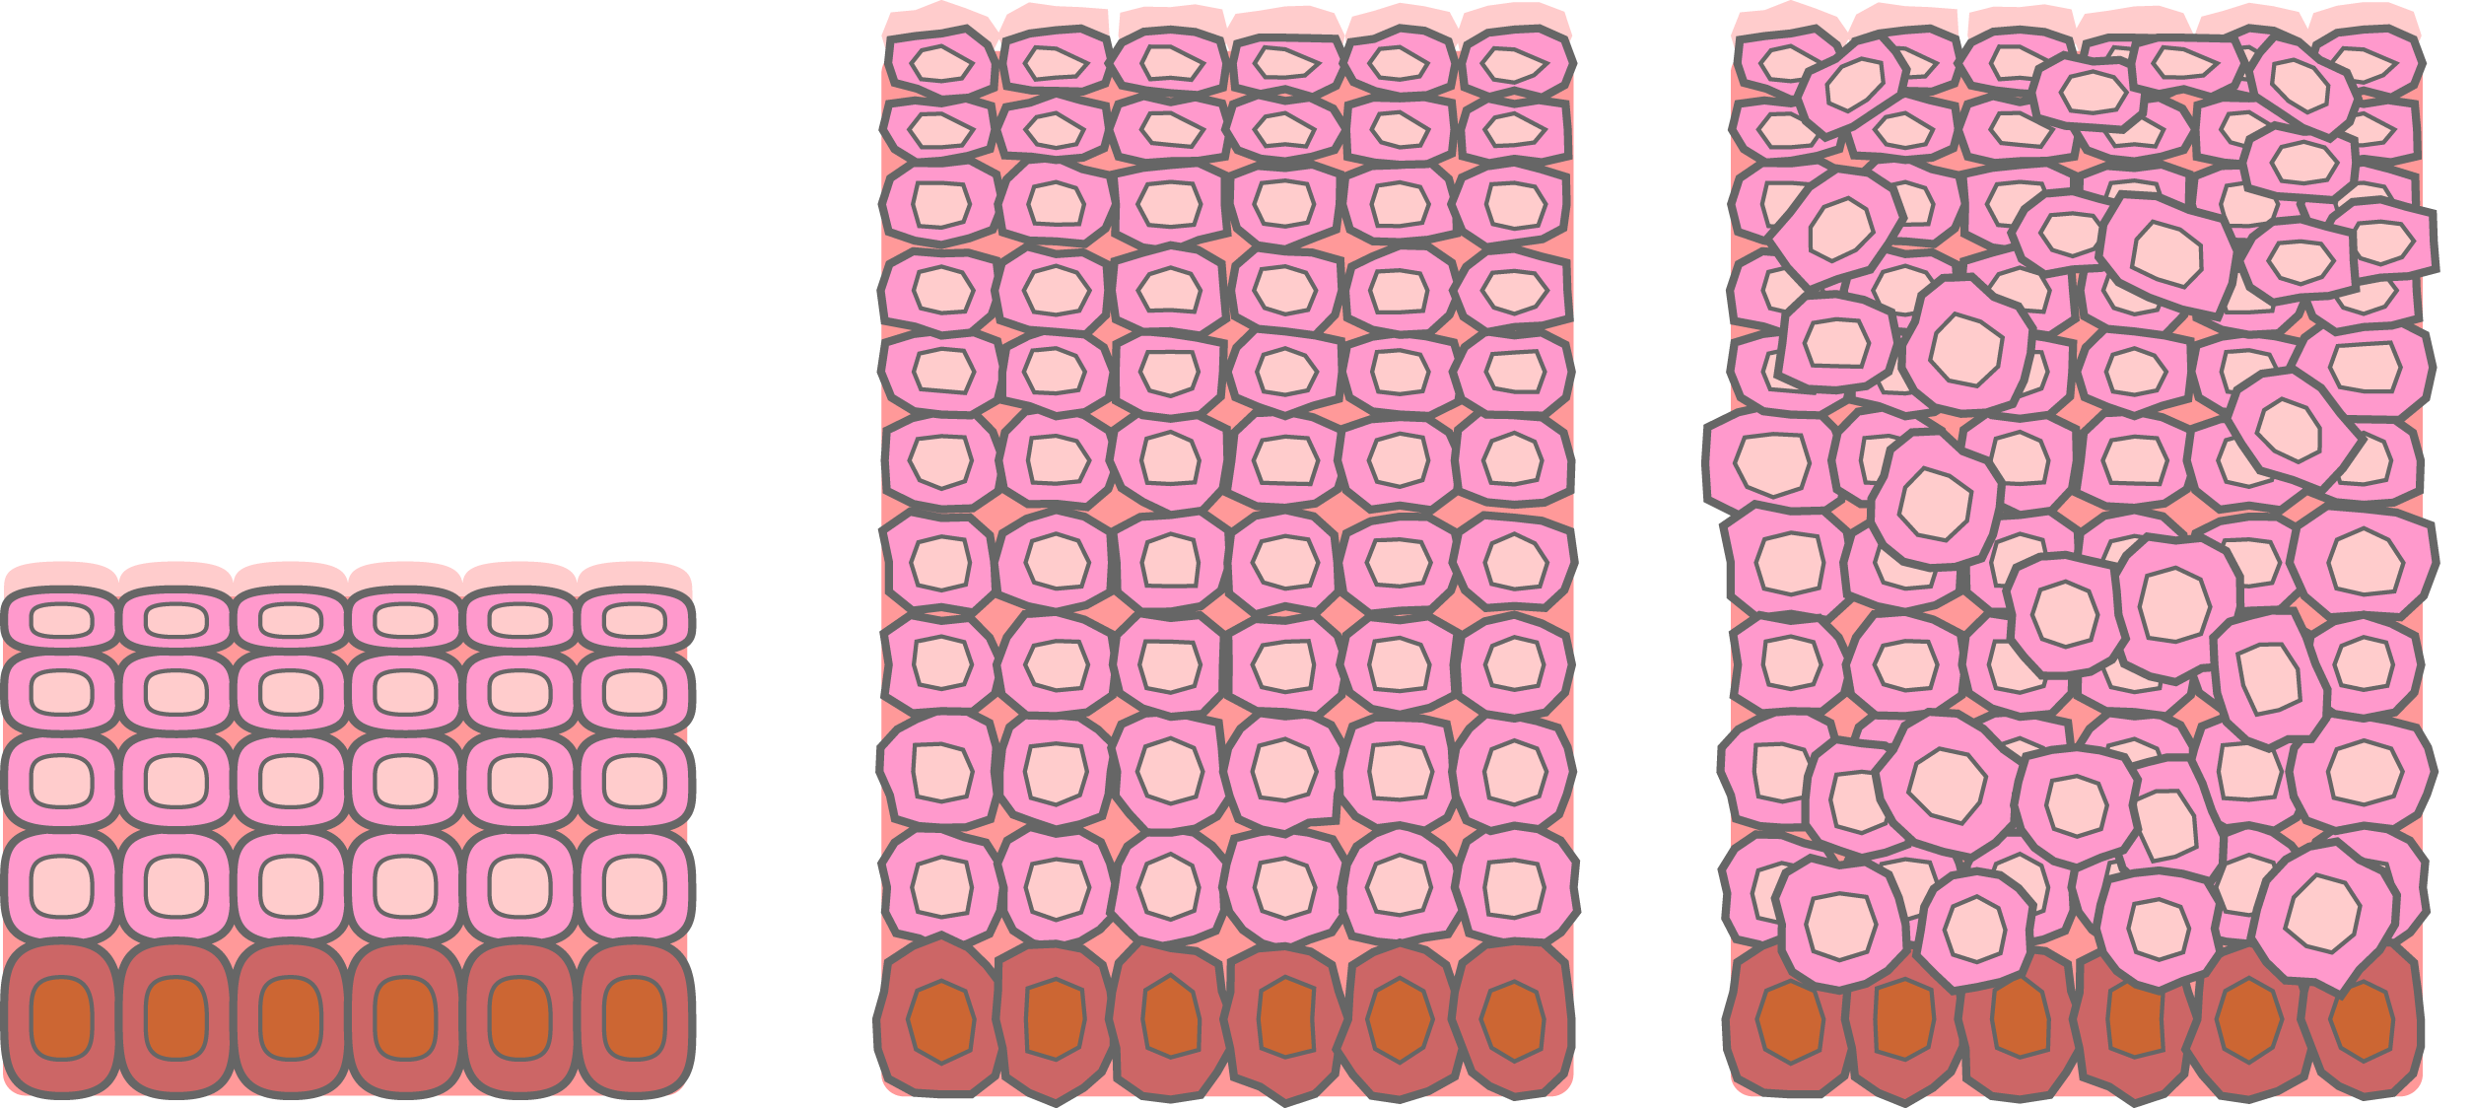
Dysplasia
Normal
Hyperplasia
Mild dysplasia
Notes:
National Cancer Institute
Understanding Cancer and Related Topics
Understanding Cancer
NCI Web site: http://cancer.gov/cancertopics/understandingcancer
10
In addition to hyperplasia, microscopic examination of a biopsy specimen can detect another type of noncancerous condition called “dysplasia.” Dysplasia is an abnormal type of excessive cell proliferation characterized by loss of normal tissue arrangement and cell structure. Often such cells revert back to normal behavior, but occasionally they gradually become malignant. Because of their potential for becoming malignant, areas of dysplasia should be closely monitored by a health professional. Sometimes they need treatment.

Slide 11
Oncogenesis & Tumor Progression
Normal
Hyperplasia
Mild dysplasia
Carcinoma in situ (severe dysplasia)
Cancer (invasive)
Notes:
National Cancer Institute
Understanding Cancer and Related Topics
Understanding Cancer
NCI Web site: http://cancer.gov/cancertopics/understandingcancer
11
The most severe cases of dysplasia are sometimes referred to as “carcinoma in situ.” In Latin, the term “in situ” means “in place,” so carcinoma in situ refers to an uncontrolled growth of cells that remains in the original location. However, carcinoma in situ may develop into an invasive, metastatic malignancy and, therefore, is usually removed surgically, if possible.

Slide 12
Multi-Step Development (Tumorigenesis)
Cancer develops progressively
Normal cell
Hyperplasia
Excessive numbers, but normal
Metaplasia
Normal cells, but co-mingling (stromal elements)
Dysplasia
Cytologically abnormal
Carcinoma in situ (pre-invasive) (e.g., ductal)
Abnormal, but non-invasive to basal membrane barrier
Invasive carcinoma

Slide 13
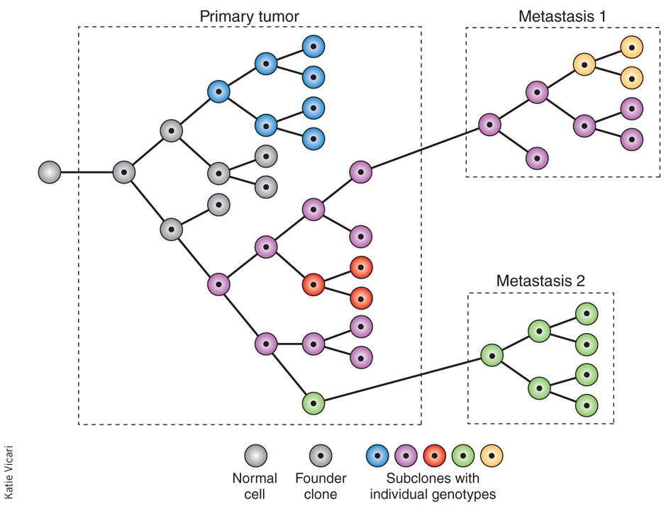
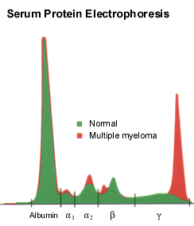
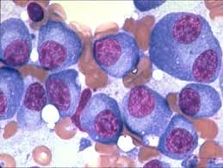
Single Cell Theory - Clonal Development
Initiated stem cell
Replication
Telomerase
Heterogeneity
Genetic
Clonality proof
Myeloma
Monoclonal Ab

Slide 14
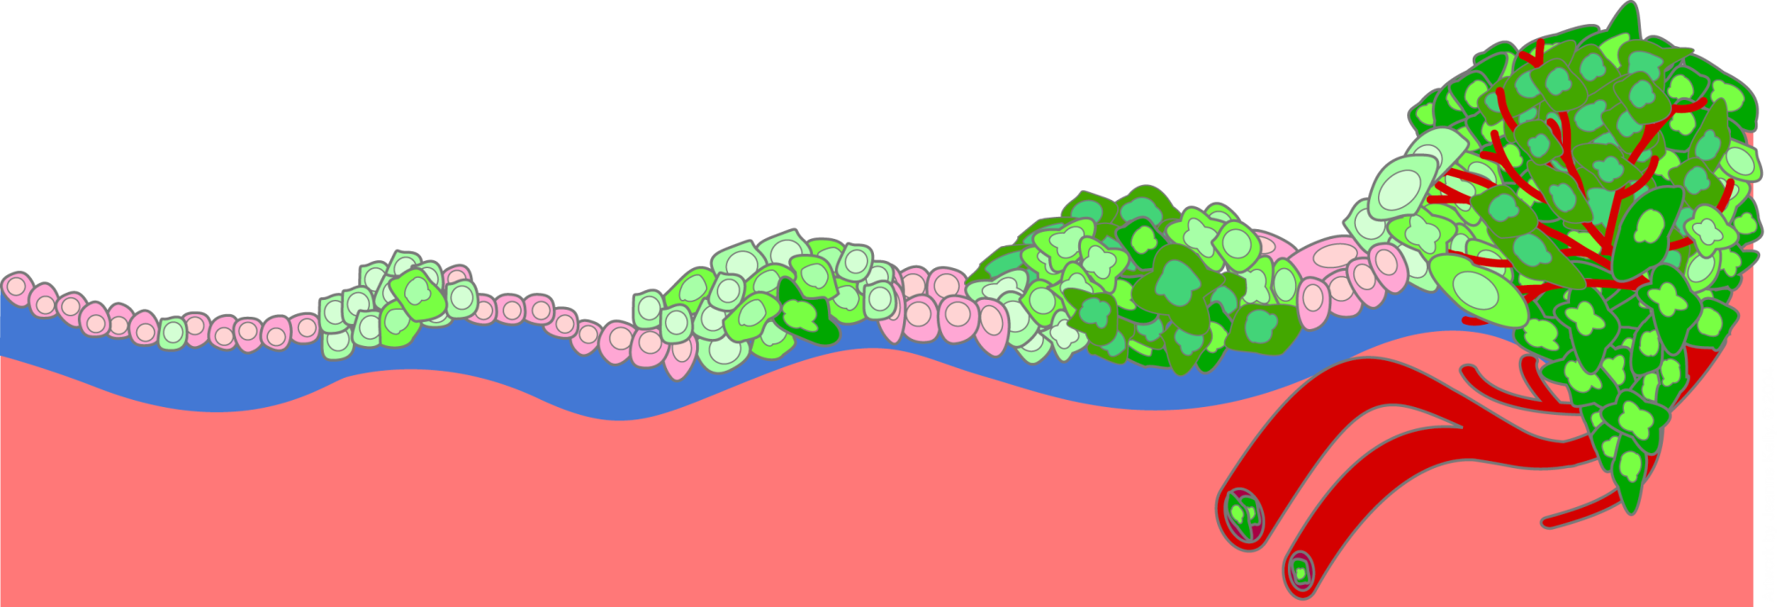
Malignant versus Benign Tumors
Benign tumor cells grow only locally and cannot spread by invasion or metastasis
Malignant (cancer) cells invade neighboring tissues, enter blood vessels, and metastasize to different sites
Time
Notes:
National Cancer Institute
Understanding Cancer and Related Topics
Understanding Cancer
NCI Web site: http://cancer.gov/cancertopics/understandingcancer
14
Depending on whether or not they can spread by invasion and metastasis, tumors are classified as being either benign or malignant. Benign tumors are tumors that cannot spread by invasion or metastasis; hence, they only grow locally. Malignant tumors are tumors that are capable of spreading by invasion and metastasis. By definition, the term “cancer” applies only to malignant tumors.

Slide 15
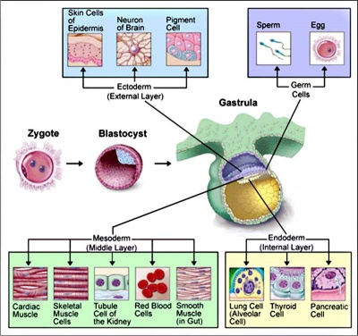
Tissues of Origin for Malignancies
Embryonic cell layers
Epithelial
Carcinoma
All 3 cell layers
Mesenchymal
Sarcoma
Mesoderm
Hematopoietic
Leukemia
Mesoderm
Neuroectodermal
CNS neoplasm
Ectoderm
Miscellaneous

Slide 16
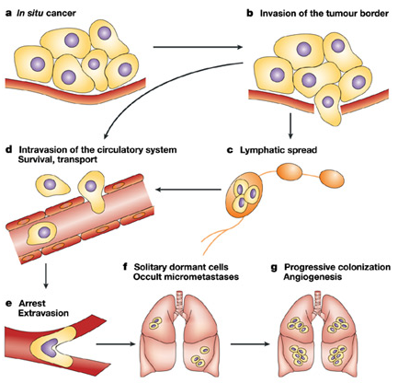
Cancer Progression, Invasion, and Spread (Metastasis)

Slide 17
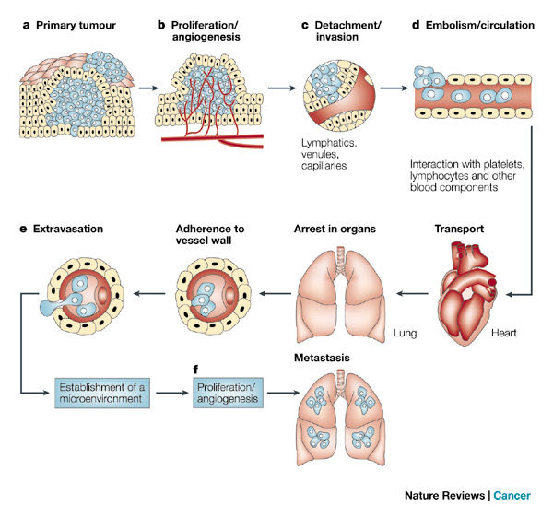
Major Steps in Tumor Metastasis
Notes:
National Cancer Institute
Understanding Cancer and Related Topics
Understanding Cancer
NCI Web site: http://cancer.gov/cancertopics/understandingcancer
17
A malignant tumor, a “cancer,” is a more serious health problem than a benign tumor because cancer cells can spread to distant parts of the body. For example, a melanoma (a cancer of pigmented cells) arising in the skin can have cells that enter the bloodstream and spread to distant organs such as the liver or brain. Cancer cells in the liver would be called metastatic melanoma, not liver cancer. Metastases share the name of the original (“primary”) tumor. Melanoma cells growing in the brain or liver can disrupt the functions of these vital organs and so are potentially life threatening.

Slide 18
The Seed and Soil Theory of Tumor Metastasis
Stephen Paget (1855–1926), English Surgeon
In 1889, Paget proposed that the processes of metastasis did not occur by chance but, rather, that certain favored tumor cells with metastasis activity (the ‘seed’) had a special affinity for the growth-enhancing milieu within specific organs (the ‘soil’, i.e., organs providing a growth advantage to the seeds). He concluded that metastases developed only when the seed and soil were compatible. In other words, the site of metastasis depended on the affinity of the tumor for the microenvironment.
Notes:
National Cancer Institute
Understanding Cancer and Related Topics
Understanding Cancer
NCI Web site: http://cancer.gov/cancertopics/understandingcancer
18
A malignant tumor, a “cancer,” is a more serious health problem than a benign tumor because cancer cells can spread to distant parts of the body. For example, a melanoma (a cancer of pigmented cells) arising in the skin can have cells that enter the bloodstream and spread to distant organs such as the liver or brain. Cancer cells in the liver would be called metastatic melanoma, not liver cancer. Metastases share the name of the original (“primary”) tumor. Melanoma cells growing in the brain or liver can disrupt the functions of these vital organs and so are potentially life threatening.

Slide 19
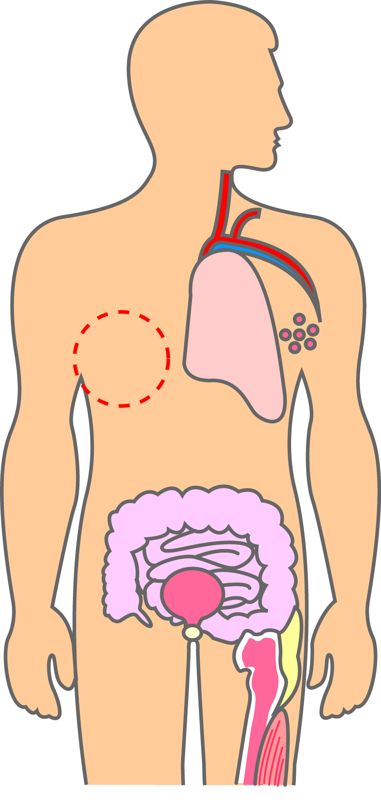
Tumor Types: Organ or Tissue Specific
Leukemias:
Bloodstream
Some common carcinomas:
Lung
Breast (women)
Colon
Bladder
Prostate (men)
Lymphomas:
Lymph nodes
Some common sarcomas:
Fat
Bone
Muscle
Notes:
National Cancer Institute
Understanding Cancer and Related Topics
Understanding Cancer
NCI Web site: http://cancer.gov/cancertopics/understandingcancer
19
Cancer can originate almost anywhere in the body.
Carcinomas, the most common types of cancer, arise from epithelial cells that cover external and internal body surfaces. Lung, breast, and colon are the most frequent cancers of this type in the United States.
Sarcomas are cancers arising from cells found in the supporting tissues of the body such as bone, cartilage, fat, connective tissue, and muscle.
Lymphomas are cancers that arise in the lymph nodes and tissues of the body’s immune system.
Leukemias are cancers of the immature blood cells that grow in the bone marrow and tend to accumulate in large numbers in the bloodstream.

Slide 20
Major Forms of Cancer Diagnosed Cases of Cancer in U.S. in 2010
20
Source: American Cancer Society, 2010.

Slide 21
Cancer Deaths in 2010
21
Source: American Cancer Society, 2010.

Slide 22
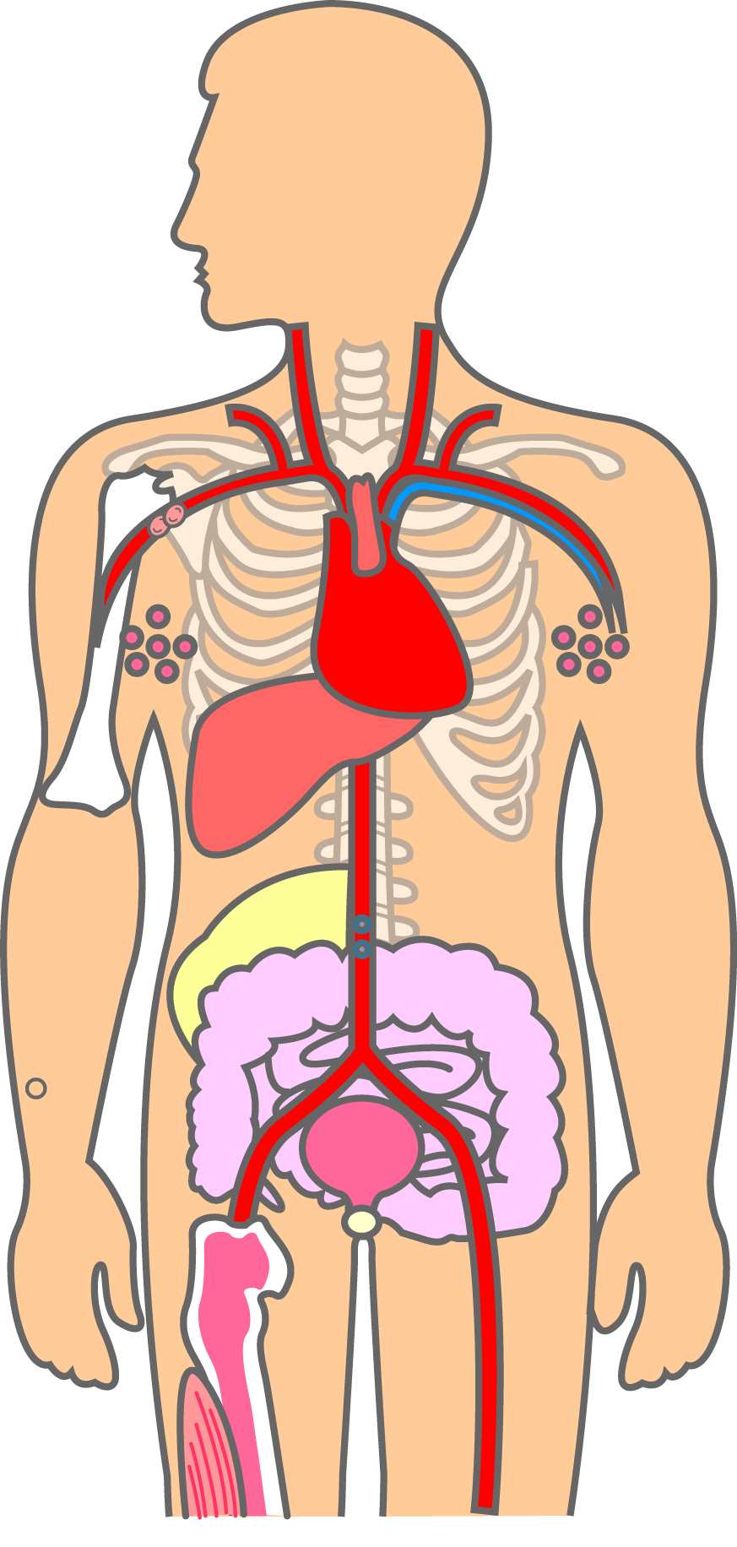
Naming Cancers
Cancer Prefixes Indicate Location
Prefix Meaning
adeno- gland
chondro- cartilage
erythro- red blood cell
hemangio- blood vessels
hepato- liver
lipo- fat
lympho- lymphocyte
melano- pigment cell
myelo- bone marrow
myo- muscle
osteo- bone
(adenocarcinoma)
(hepatocarcinoma)
(liposarcoma)
(osteosarcoma)
Notes:
National Cancer Institute
Understanding Cancer and Related Topics
Understanding Cancer
NCI Web site: http://cancer.gov/cancertopics/understandingcancer
22
Scientists use a variety of technical names to distinguish the many different types of carcinomas, sarcomas, lymphomas, and leukemias. In general, these names are created by using different Latin prefixes that stand for the location where the cancer began its unchecked growth. For example, the prefix “osteo” means bone, so a cancer arising in bone is called an osteosarcoma. Similarly, the prefix “adeno” means gland, so a cancer of gland cells is called adenocarcinoma--breast, prostate, lung, stomach, esophagus, pancreas.
Acute myelogenous leukemia (AML) is a fast-growing cancer of the blood and bone marrow. In AML, the bone marrow makes many unformed cells called blasts. Blasts normally develop into white blood cells that fight infection. However, the blasts are abnormal in AML. They do not develop and cannot fight infections. The bone marrow may also make abnormal red blood cells and platelets. The number of abnormal cells (or leukemia cells) grows quickly. They crowd out the normal red blood cells, white blood cells and platelets the body needs.

Slide 23
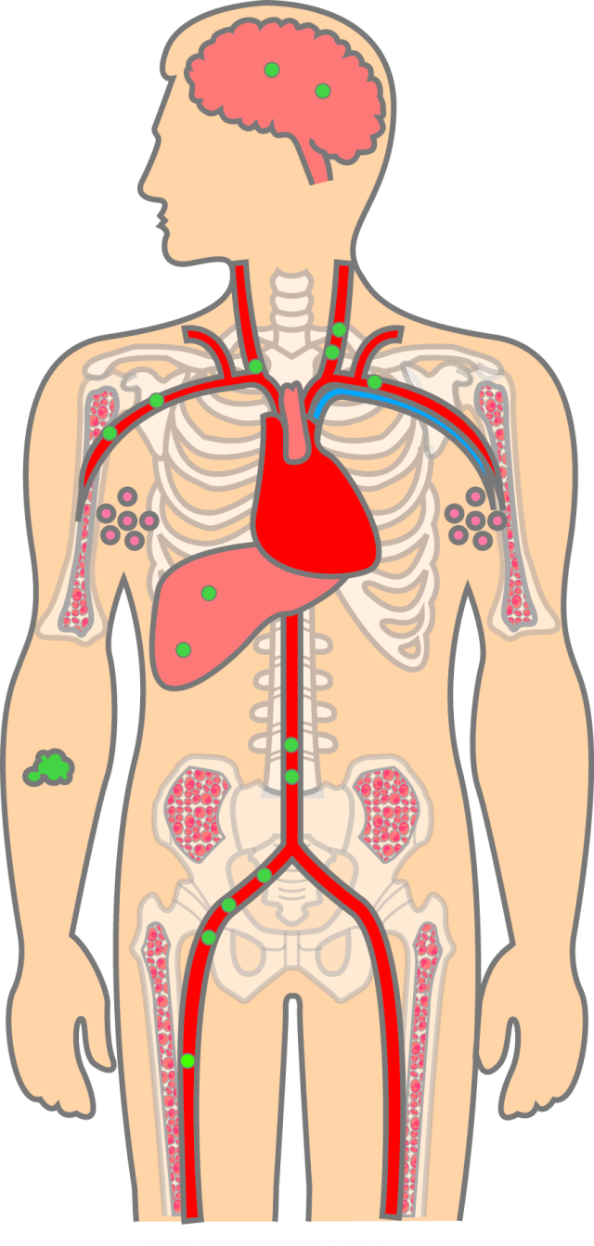
Why Cancer Is Potentially Dangerous - Metastasis to Vital Organs – Brain, Lung, Liver, and Bone
Brain
Melanoma cells travel through bloodstream
Liver
Metastatic melanoma
Melanoma (initial tumor)
Notes:
National Cancer Institute
Understanding Cancer and Related Topics
Understanding Cancer
NCI Web site: http://cancer.gov/cancertopics/understandingcancer
23
A malignant tumor, a “cancer,” is a more serious health problem than a benign tumor because cancer cells can spread to distant parts of the body. For example, a melanoma (a cancer of pigmented cells) arising in the skin can have cells that enter the bloodstream and spread to distant organs such as the liver or brain. Cancer cells in the liver would be called metastatic melanoma, not liver cancer. Metastases share the name of the original (“primary”) tumor. Melanoma cells growing in the brain or liver can disrupt the functions of these vital organs and so are potentially life threatening.

Slide 24
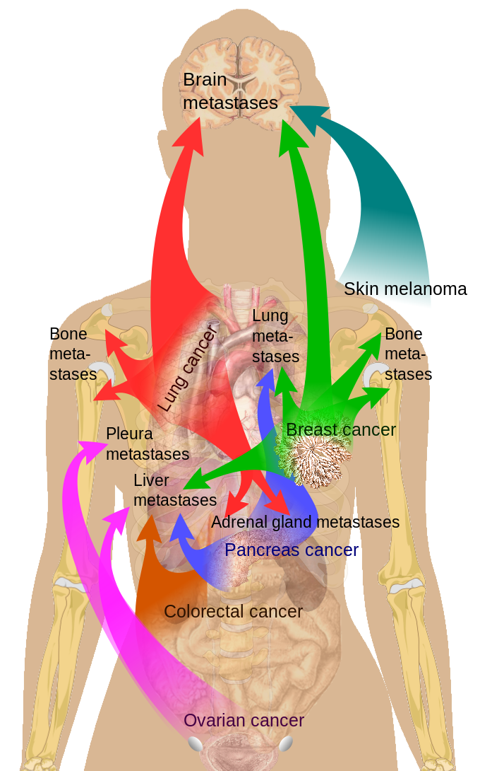
Why Cancer Is Potentially Dangerous - Metastasis to Vital Organs – Brain, Lung, Liver, and Bone
Notes:
National Cancer Institute
Understanding Cancer and Related Topics
Understanding Cancer
NCI Web site: http://cancer.gov/cancertopics/understandingcancer
24
A malignant tumor, a “cancer,” is a more serious health problem than a benign tumor because cancer cells can spread to distant parts of the body. For example, a melanoma (a cancer of pigmented cells) arising in the skin can have cells that enter the bloodstream and spread to distant organs such as the liver or brain. Cancer cells in the liver would be called metastatic melanoma, not liver cancer. Metastases share the name of the original (“primary”) tumor. Melanoma cells growing in the brain or liver can disrupt the functions of these vital organs and so are potentially life threatening.

Slide 25
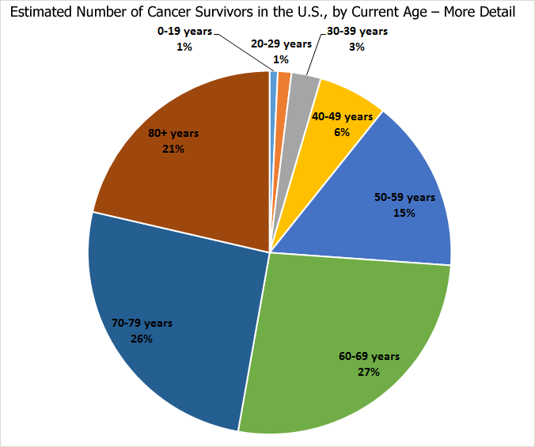
Clinical Oncology

Slide 26
Clinical Oncology - Treatment Options

Slide 27
Treatment Options for Breast Cancer

Slide 28
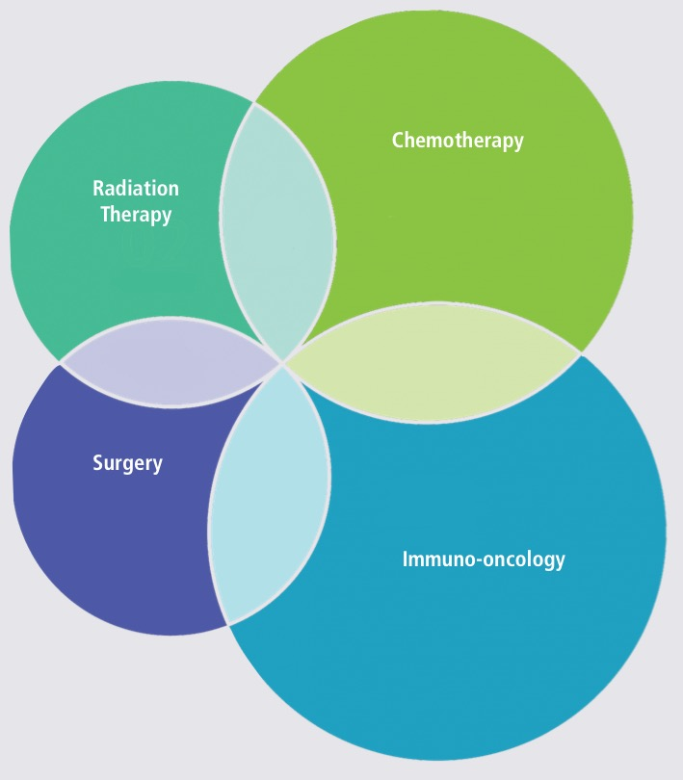
Recent Development of Immunotherapy

Slide 29
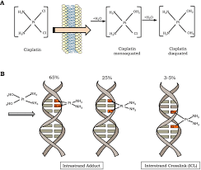
Traditional Chemotherapy - Cisplatin

Slide 30
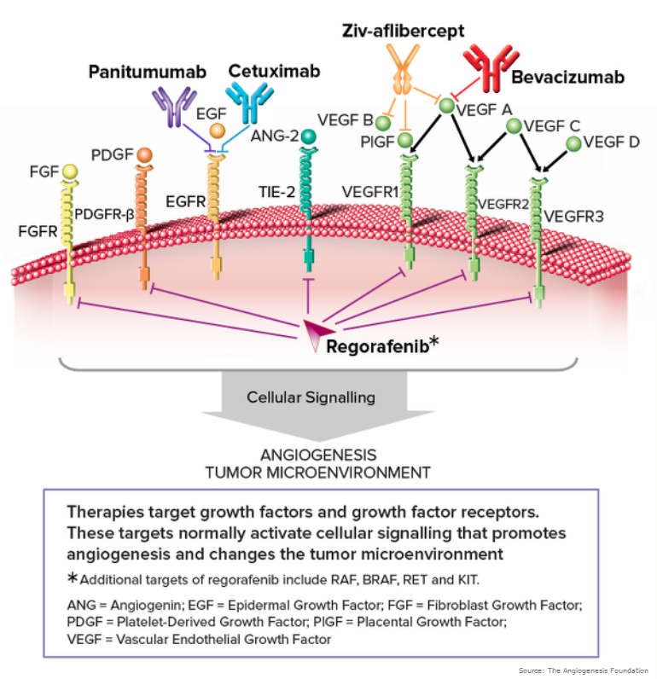
Targeted Cancer Therapy

Slide 31
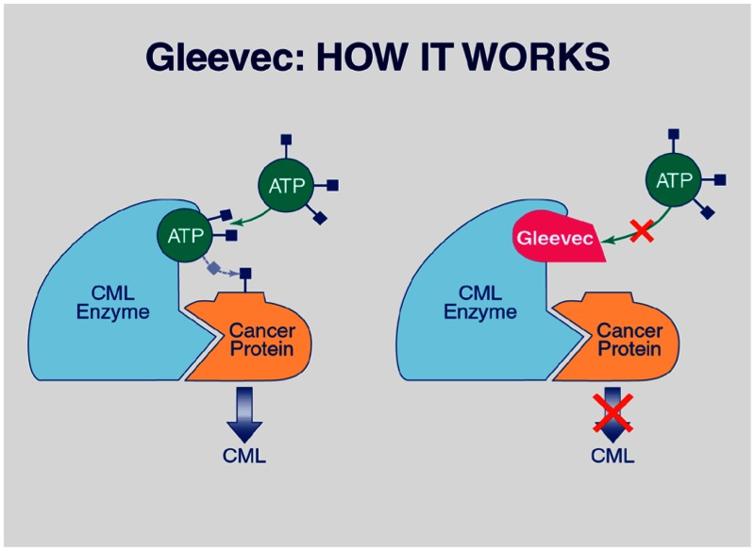
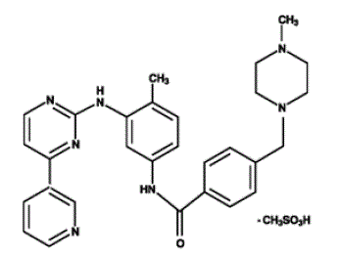
Targeted Cancer Therapy - Gleevec

Slide 32
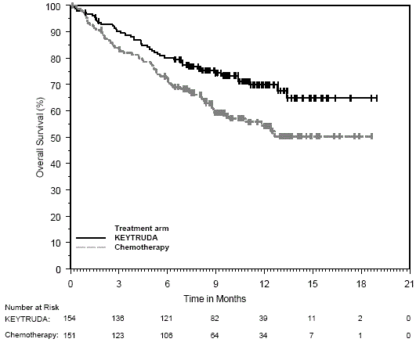
Cancer Immunotherapy

Slide 33
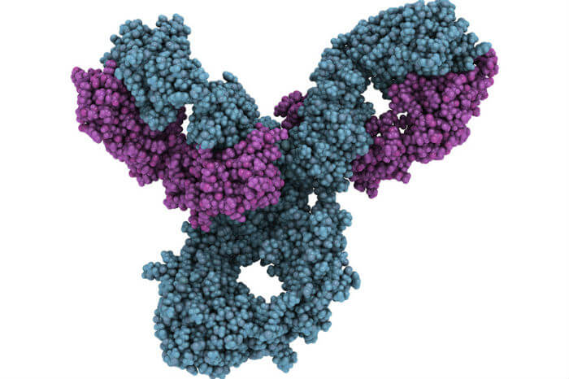
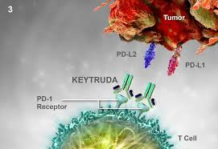
Immunotherapy – Keytruda (PD-1/PD-2)

Slide 34
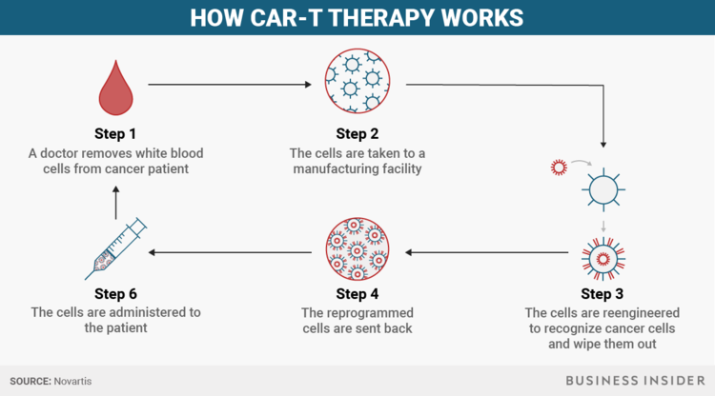
Immunotherapy – Chimeric Antigen Receptor T-Cell Therapy (CAR T)

Slide 35
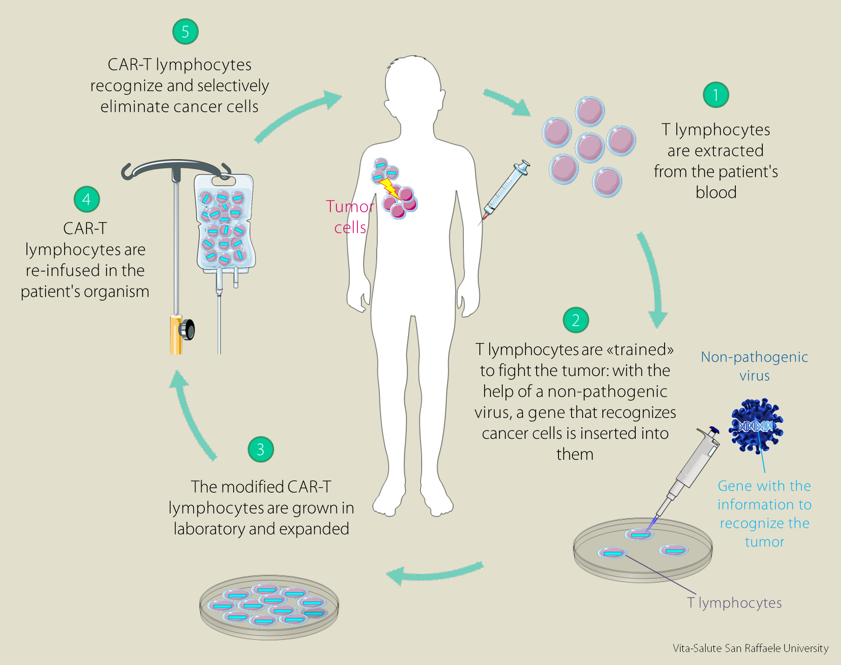
Chimeric Antigen Receptor T-Cell Therapy

Slide 36
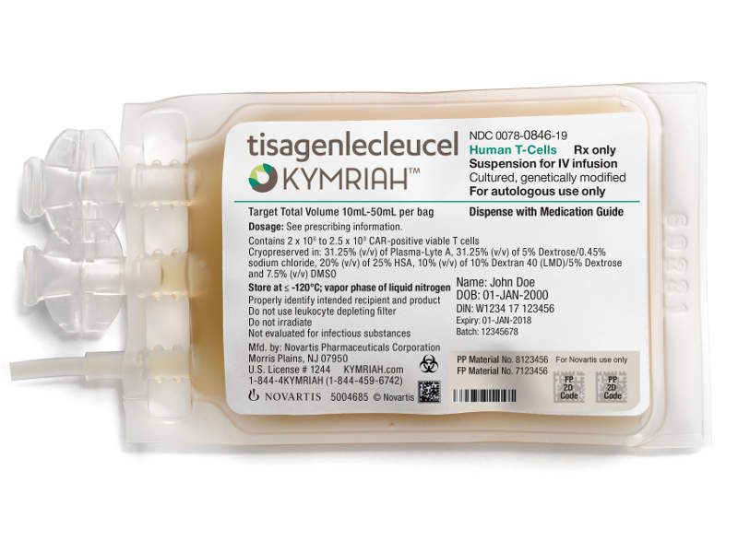
CAR-T Therapy - Kymriah

Slide 38
Clinical Oncology

Slide 40
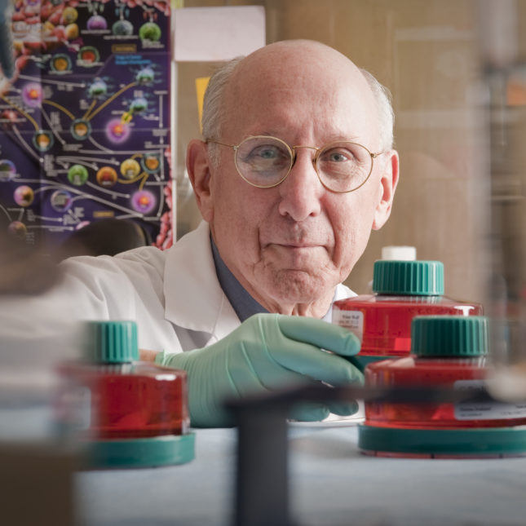
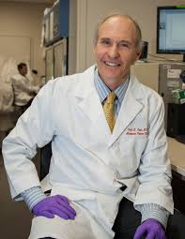
Immunotherapy – People Behind the Work
(Carle June of Upenn and Steven Rosenberg of NCI)

Slide 41
Personalized and Precision Medicine

Slide 42
Personalized Cancer Therapy

Slide 43
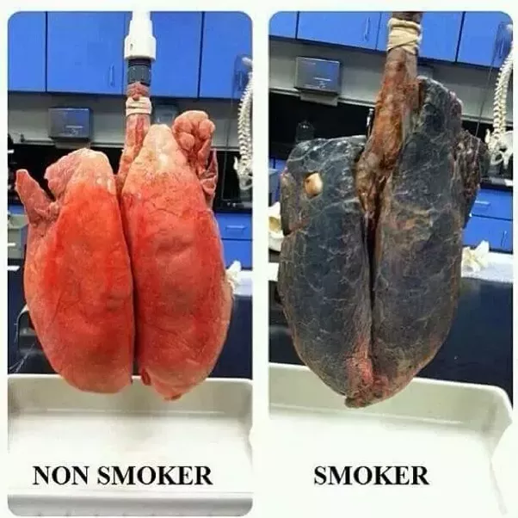
Smoker’s Lung and Cancer
Notes:
National Cancer Institute
Understanding Cancer and Related Topics
Understanding Cancer
NCI Web site: http://cancer.gov/cancertopics/understandingcancer
43
A malignant tumor, a “cancer,” is a more serious health problem than a benign tumor because cancer cells can spread to distant parts of the body. For example, a melanoma (a cancer of pigmented cells) arising in the skin can have cells that enter the bloodstream and spread to distant organs such as the liver or brain. Cancer cells in the liver would be called metastatic melanoma, not liver cancer. Metastases share the name of the original (“primary”) tumor. Melanoma cells growing in the brain or liver can disrupt the functions of these vital organs and so are potentially life threatening.

