Slide 1
GE298:Manufacturing Automation Week-1
Class – 1 : Introduction

Slide 2
Manufacturing
A series of SYSTEMATIC and INTERRELATED activities and operations involving
design
material selection
planning
production
quality assurance
management and marketing of discrete consumer and durable goods
that will CONVERT RAW MATERIALS INTO THEIR VALUE ADDED FORM

Slide 3
Name a few Processes?
Machining
Turning
Milling
Welding
Brazing
Soldering
Bulk deformation
Extrusion
Forging
Rapid Prototyping – additive
Casting
Molding
Powder Metallurgy
Sheet metal
Stamping
Blanking
coining
Rolling
Grinding

Slide 4
Manufacturing automation
Automation is the use of various control systems that include sensors, amplifiers, displays, recorders, control elements, valves and actuators in order to improve productivity and quality of manufacturing processes

Slide 5
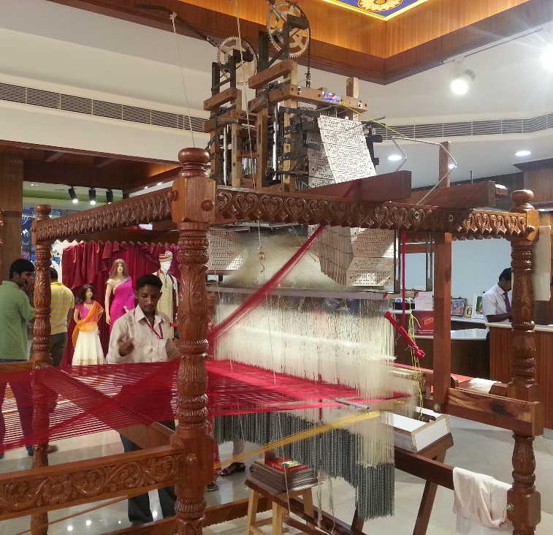
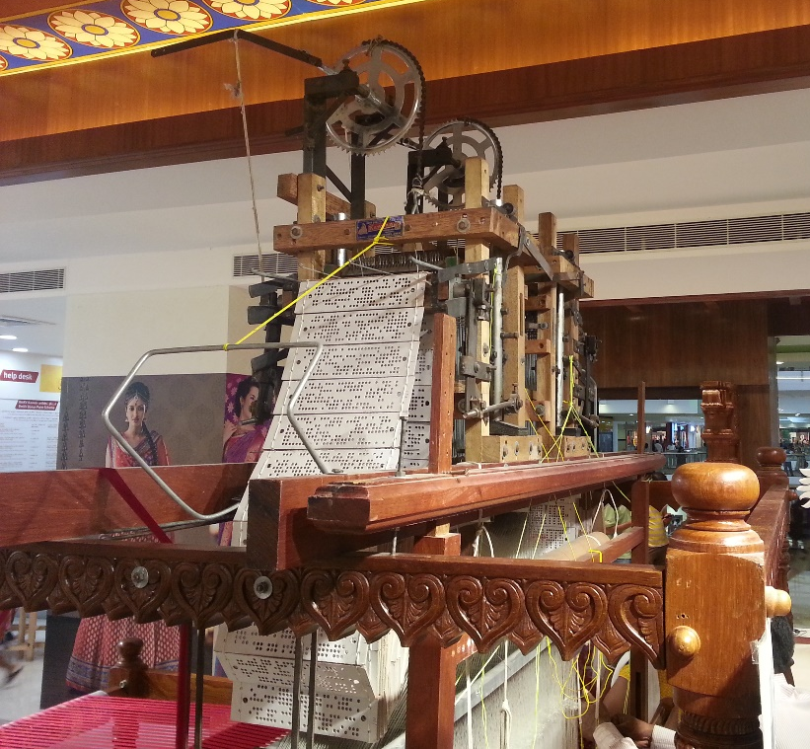
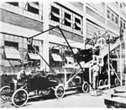
History of Manufacturing Automation
1800s – NC handloom (weaving machine)
https://www.youtube.com/watch?v=qBcnyB-BbQQ
1913 – moving assembly line for ford Model – T cars
https://commons.wikimedia.org/w/index.php?title=File%3AFord_Model_T_Assembly_Line(1919).webm
https://commons.wikimedia.org/wiki/File:Ford_assembly_line(1930).webm
Source: Wikipedia

Slide 6
History contd…
1930s – General motors and Japanese auto manufacturers
1950s – NC machines – punched cards
1960s – CNC machines
1970s – Distribute control systems - Programmable logic controllers (PLCs) - Honeywell
1980s – Computers and robots – computer integrated manufacturing (CIM)
1990s – CAD and CAM – Siemens, Fanuc, Autodesk etc.
2000s – Rapid prototyping – additive manufacturing – 3D printing

Slide 7
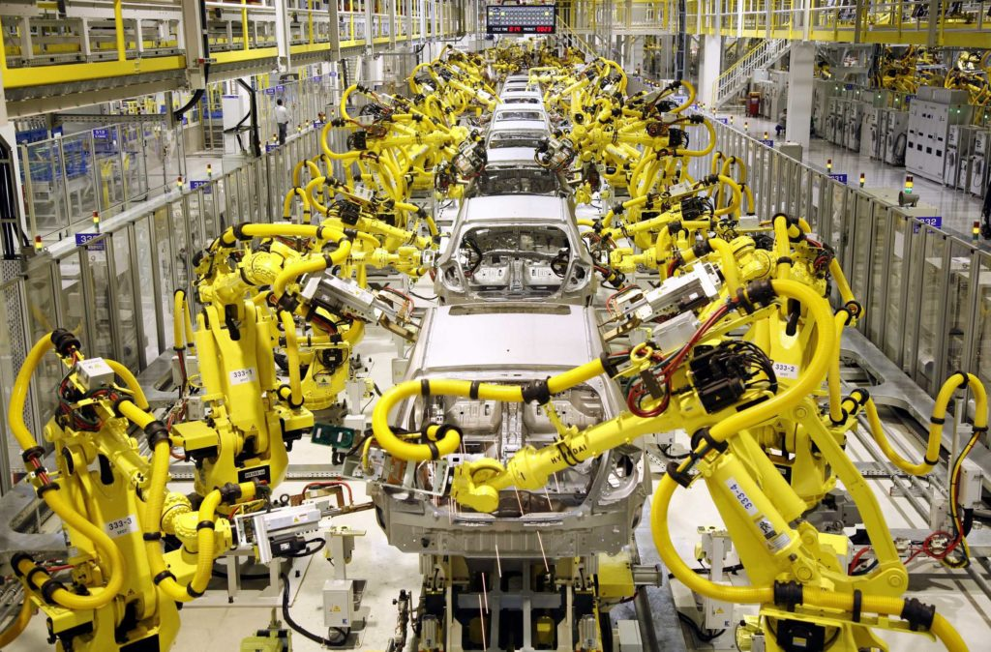
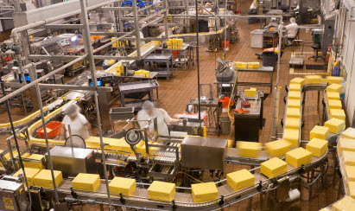
Applications
Auto
Mass production
Source: https://tallyfy.com
Drug
Packaging
Source: http://www.metronik.net

Slide 8
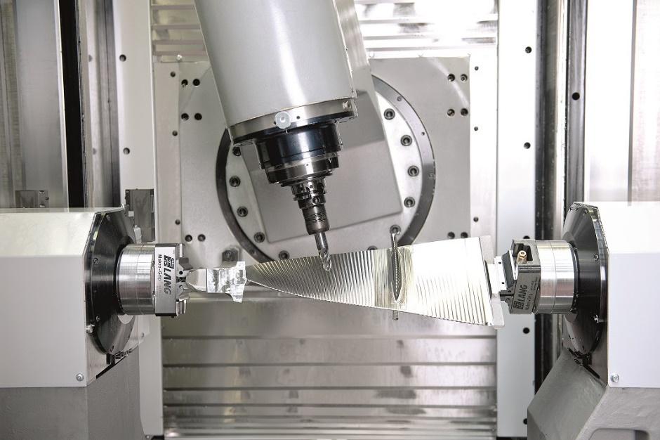
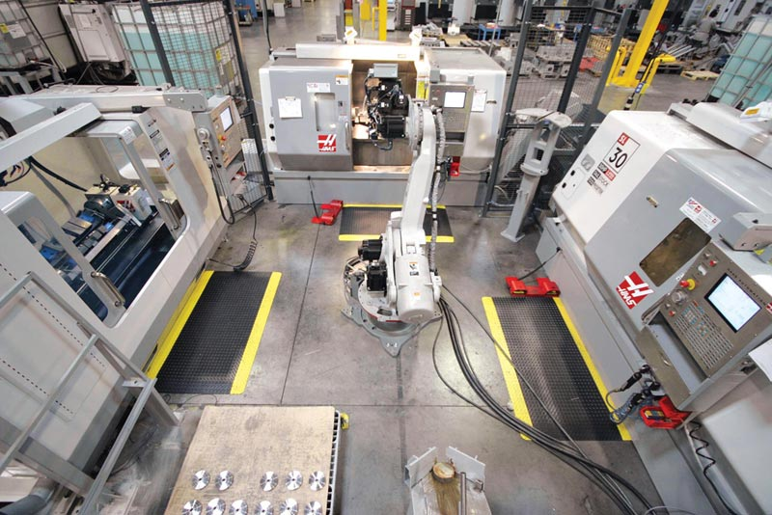
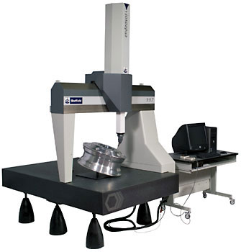
Applications contd…
Precision and improved quality
Source: http://www.multistation.com
Source: http://www.haascnc.com
Sourcehttp://www.padgettmachine.com/

Slide 9
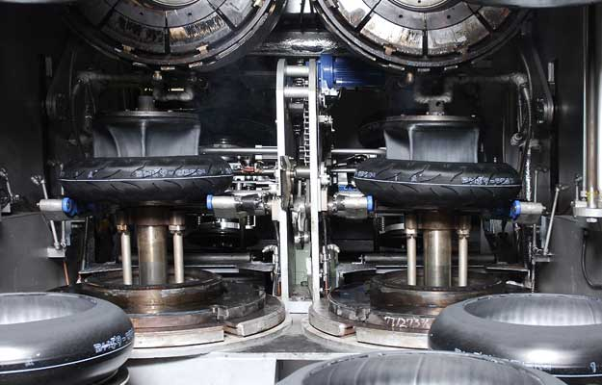
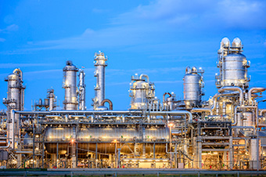
Applications contd…
Chemical industry – Hazardous environments
Tyre
Source:http://www.rotecautomation.lk
Chemical, oil and gas
Source: http://www.reditech.be

Slide 10
What is Manufacturing?
Manu Factus : Latin for ‘made by hand’
Definition:
A Well organized method of converting raw material to end product
End Product: Value and utility added to output.

Slide 11
Modern Manufacturing
- Began with the industrial revolution in 1750 AD
Product design and development
Marketing,Sales
Process
Planning
Support Services
Resources:
Materials, Capital, Energy,
People
Purchasing
Manufacturing
Shipping
Production
Control

Slide 12
Steps in Modern Manufacturing
Definition of product need, marketing information
Design analysis; codes/standards review; physical and analytical models
CAM and CAPP
Production
Conceptual design and
evaluation Feasibility study
Prototype production
testing and evaluation
Inspection and quality
assurance
CAD
Production drawings; Instruction manuals
Packaging; marketing and
sales literature
Material Specification; process
and equipment selection; safety review
Product
Pilot Production

Slide 13
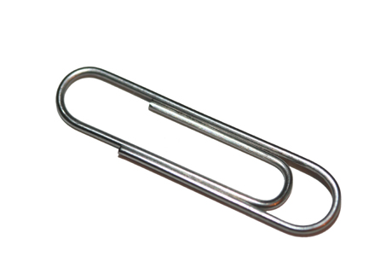
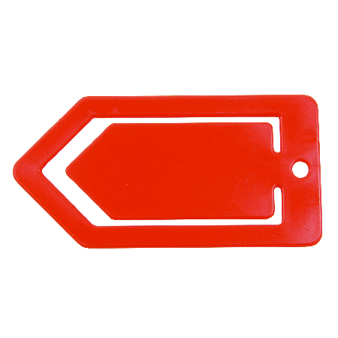
Manufacturing of a Paper Clip
What is the function
How long does it last
How critical is the part
Function based design Stress, Strain
Life of clip
Stiffness
Style Appearance, Color, Finish
Plating, painting
Material Metallic - what type
Non metallic – plastic
Dimension Diameter of clip
Shape of clip
Method of manufacturing Manual
Automated

Slide 14
Selection of the manufacturing process depends on
Dimensional and surface finish requirements
Operational Cost
Design and strength requirements
Consequences of various methods

Slide 15
Videos to be watched on SME website
Casting
Turning, milling, grinding
Computer numerical control
Electrical Discharge Machining, Thermal and Abrasive Waterjet Cutting
Micomachining, Nanotechnology Manufacturing, Direct Metal Manufacturing

